Slide 1


Git & GitHub
getting started
for beginners, by a beginner

Slide 2

What is Git & GitHub
Git is an example of version control
Why Version Control?

Slide 3









Why Version Control?
Project X

Slide 4

Why Version Control?
Version control:
is all about managing multiple versions of your source code or text data
is essential for effective teamwork and collaboration
acts like a time machine – you can go back and forth between different versions
you can see who modified what, when, and why
helps you track your project's progress over time
allows for safe experimentation using branches
protects your work by enabling backup and recovery
What is Git & GitHub

Slide 5
What is Git & GitHub
Git is an example of version control
is a command line tool
is a cloud-based platform where you can store, share, and work together
provides a web-based graphical interface that works on top of Git
provides access control and several collaboration features, wikis, task management tools
Is like a “social platform” to share knowledge and projects
GitHub

Slide 6
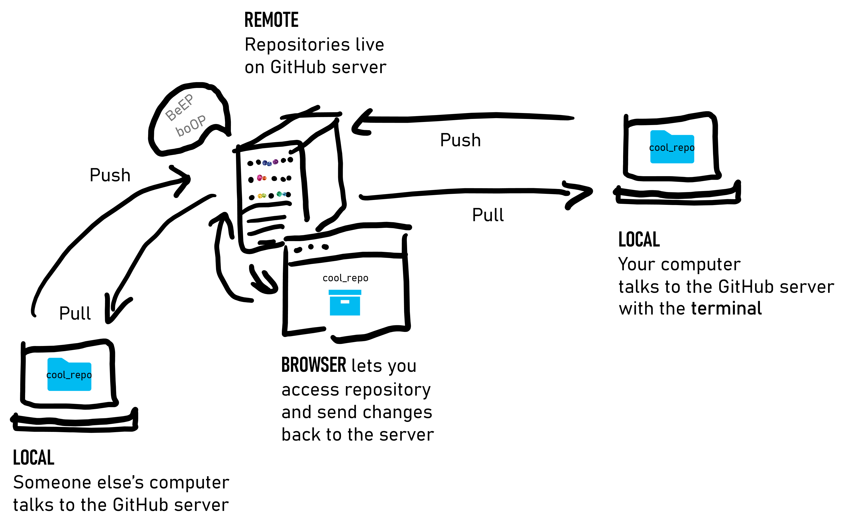
Concept of GitHub
https://www.freecodecamp.org/espanol/news/guia-para-principiantes-de-git-y-github/

Slide 7



usefull vocabulary for a GitHub workflow
Term | Definition
git repository | Local folder where Git tracks your project's version history
remote repository | A copy of your repo stored online (e.g. on GitHub)
commit | A saved snapshot of your work with a message describing the change
push | Upload local commits to the remote repository on GitHub
pull | Download changes from the remote repository to your local copy
clone | Copy a remote repository from GitHub to your local computer, you can make a pull request
pull request | A request to merge your changes into someone else's repository (via GitHub)
branch | A parallel version of your code for experimenting or developing new features
merge | Combine changes from one branch into another
fork | Copy someone else's GitHub repo to your own account to work independently

Slide 8
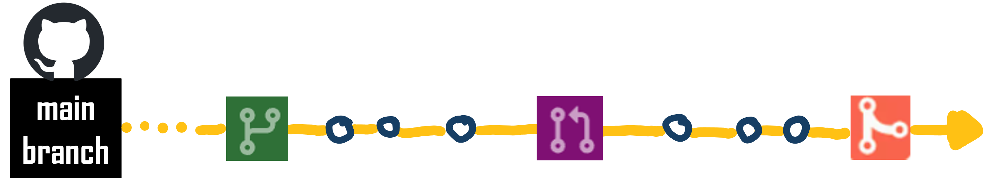
GitHub workflow working in a team
Clone remote repository
main
branch
Add commits
Discuss & Review
main
branch
Create a
new branch
You can safely experiment here
Open a
Pull request
You can get feedback or review your changes
Merge
Merge your changes in your main branch
commit
Comment on
pull request
Close pull request
compare
sync or push to branch
Add issues / resolve issues

Slide 9
Getting started
1. install Git → https://git-scm.com/downloads
2. create GitHub account → https://github.com/
helpful link: https://docs.github.com/en/get-started/onboarding/getting-started-with-your-github-account
Notes:
Enter token

Slide 10

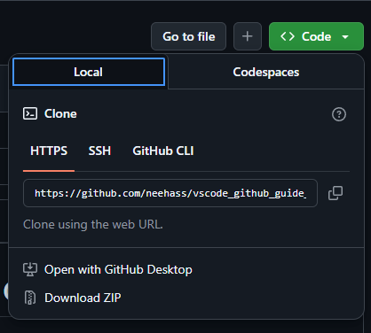

GitHub & vs-code workflow example
download guide
https://github.com/neehass/vscode_github_intro
extract & save in local folder
2. open vs-code
open folder
click on source control & publish on GitHub
log-in if necessary
go to GitHub → your first repository
follow the instruction in vscode_github_guide.txt
for further steps

Slide 11
GitHub & vs-code clone
1. clone repository
go to https://github.com/neehass/vscode_github_guide_A and copy link
open vs-code
in Command Palette type > Git: Clone & enter link → create local folder
2. sign in to GitHub
follow authentication process
open cloned repository
3. open existing vscode_github_guide.txt → follow the instructions

Slide 12
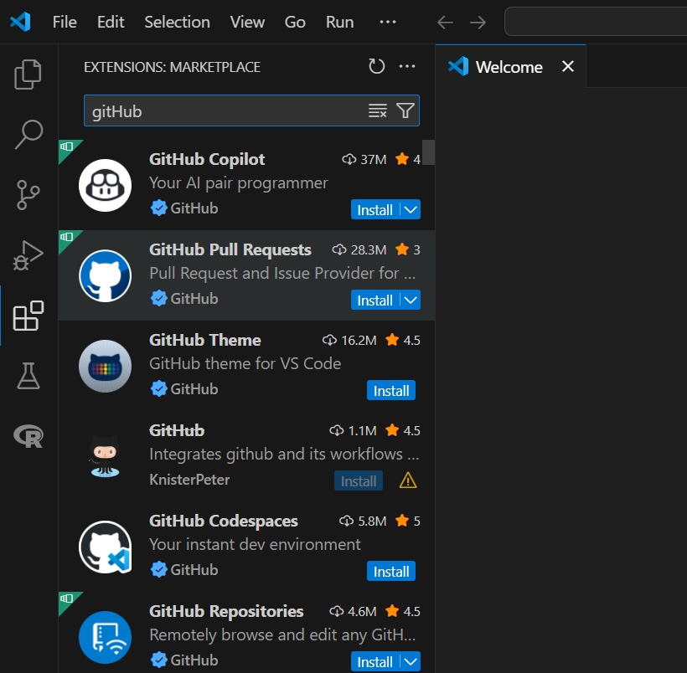
GitHub & vs-code pull request
install needed extensions in vs-code

Slide 13





basic Git commands terminal
Command | Description
git init | Initializes a new Git repository in the current directory
git clone <url> | Clones a remote repository to your local machine
git status | Shows the status of changes (staged, unstaged, untracked)
git add <file> | Stages a specific file for commit
git add . | Stages all changes in the current directory
git commit -m "message" | Commits staged changes with a message
git log | Shows the commit history
git diff | Shows changes between working directory and staged changes
git branch | Lists all branches
git branch <branch-name> | Creates a new branch
git checkout <branch-name> | Switches to a specific branch
git checkout -b <branch-name> | Creates and switches to a new branch
git merge <branch-name> | Merges a branch into the current branch
git pull | Fetches and merges changes from the remote repository
git push | Pushes committed changes to the remote repository
git remote -v | Lists the remote connections
git reset <file> | Unstages a file from staging area
git rm <file> | Deletes a file and stages the removal
git stash | Temporarily shelves (stashes) changes
git stash pop | Applies the stashed changes back onto the working directory
“username“
“user@name“
Push to the remote repository
…
Basics:
https://www.youtube.com/watch?v=rE2zRhZdjFU
https://education.github.com/git-cheat-sheet-education.pdf

Slide 14
sources
https://git-scm.com/
https://docs.github.com/en/get-started
https://docs.github.com/en/get-started/using-github/github-flow
Git commands: https://www.youtube.com/watch?v=rE2zRhZdjFU
https://code.visualstudio.com/
GitHub in VS Code:
https://code.visualstudio.com/docs/sourcecontrol/intro-to-git
https://code.visualstudio.com/docs/introvideos/basics

