Slide 1

Prepaded by: Nikko Murro

Slide 2
Introduction

Slide 3
What are Google Maps?
Google Maps is a free web mapping service by Google that provides various types of geographical information. Using Google Maps, one can.
Search for places or get directions from one place to another.
View and navigate through horizontal and vertical panoramic street level images of various cities around the world.
Get specific information like traffic at a particular point.
Google Maps provides an API using which you can customize the maps and the information displayed on them. This chapter explains how to load a simple Goolge Map on your web page using HTML and JavaScript.

Slide 4
Audience
This tutorial is meant for all those readers who would like to learn about Google Maps API. After completing this tutorial, you would be able to integrate Google Maps JavaScript API on your webpage, add a map with a marker, learn all map types, and localize your google map.
Prerequisites
Before proceeding with this tutorial, you should be familiar with at least basic HTML, CSS, JavaScript and the concepts of object-oriented programming. You should also be familiar with Google Maps from a user's point of view.

Slide 5
Simple Map

Slide 6
Simple Map
The easiest way to start learning about the Google Maps JavaScript API is to see a simple example. The following web page displays a map centered on Cebu City, Cebu, Philippines.

Slide 7
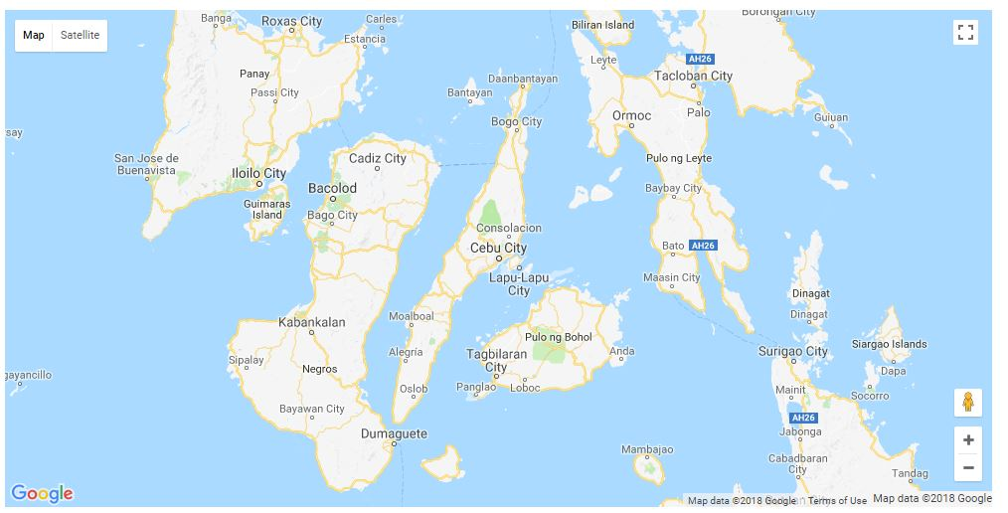
The Map
The Map

Slide 8
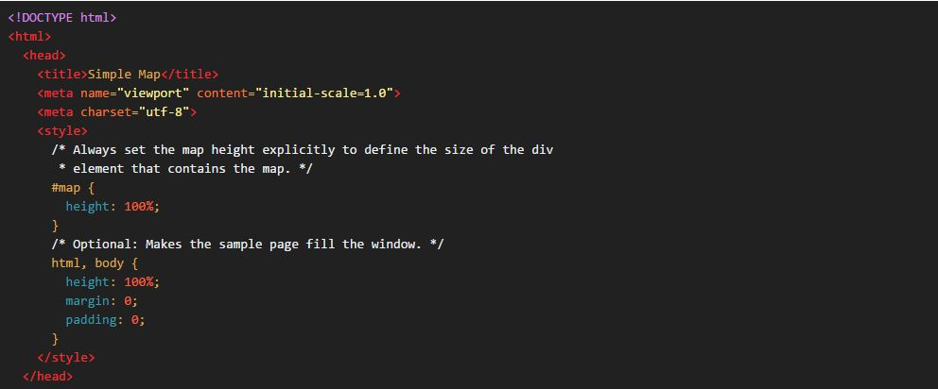

Slide 9
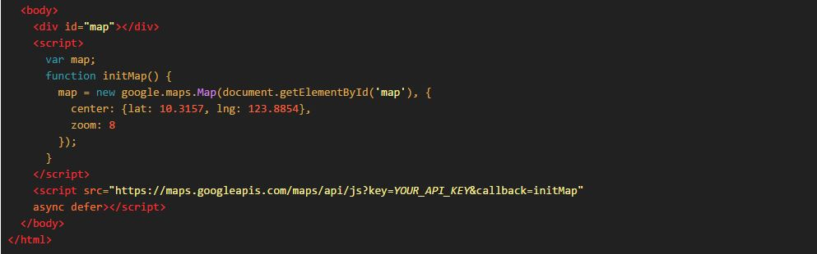

Slide 10
How To
There are few things to note in this code example:
We declare the application as HTML5 using the <!DOCTYPE html> declaration.
We create a div element named "map" to hold the map.
We define a JavaScript function that creates a map in the div.
We load the Maps JavaScript API using a script tag.
Code and steps are explained below.
Declaring your application as HTML5
It is recommended that you declare a true <!DOCTYPE html> within your web application.
Within the example here, HTML 5 has been declared our application using the simple HTML 5 <!DOCTYPE html> as shown below:

Slide 11
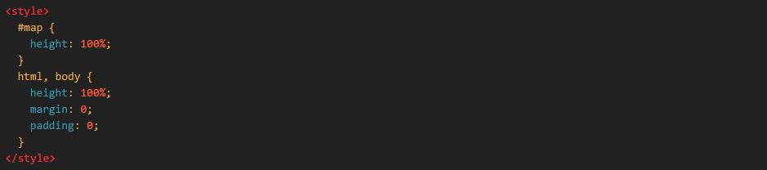
Most current browsers will render content that is declared with this DOCTYPE in "standards mode" which means that your application should be more cross-browser compliant.
CSS Style Declaration
This CSS declaration indicates that the map container <div> (with id map) should take up 100% of the height of the HTML body. Note that we must specifically declare those percentages for <body> and <html> as well.

Slide 12

Loading the Google Maps JavaScript API
To load the Google Maps JavaScript API, use a script tag like the one in the following example:
The URL contained in the script tag is the location of a JavaScript file that loads all of the symbols and definitions you need for using the Maps JavaScript API. This script tag is required.
The async attribute lets the browser render the rest of your website while the Maps JavaScript API loads. When the API is ready, it will call the function specified using the callback parameter.
The key parameter contains your application's API key. See Get a Key for more information.

Slide 13
Create the Map Container
To hold the map, we have to create a container element. In this case, we created a div element with id name map.
Note that the div id name map is the indicator that serves as the reference to be called for CSS and JavaScript.

Slide 14

Map Options
Set values for map initialization variables.There are two required options for every map: center and zoom.
center - Under this property, we have to specify the location where we want to centre the map.
latitude - This property is under center. Coordinate that specifies the north–south position of a point on the Earth's surface.
longitude - This property is under center. Coordinate that specifies the east-west position of a point on the Earth's surface.
zoom - Under this property, we have to specify the zoom level of the map.

Slide 15
Zoom Levels
The initial resolution at which to display the map is set by the zoom property, where zoom 0 corresponds to a map of the Earth fully zoomed out, and larger zoom levels zoom in at a higher resolution. Specify zoom level as an integer.

Slide 16
Map images within Google Maps and the Maps JavaScript API are broken up into map "tiles" and "zoom levels." At low zoom levels, a small set of map tiles covers a wide area; at higher zoom levels, the tiles are of higher resolution and cover a smaller area. The following list shows the approximate level of detail you can expect to see at each zoom level:
1: World
5: Landmass/continent
10: City
15: Streets
20: Buildings
Map Object
You can create a map by instantiating or calling the JavaScript class that represents a map called Map class. While instantiating this class, you have to pass an HTML container to hold the map and the map options for the required map. We create a new instance of this class using the JavaScript new operator.

Slide 17
Markers

Slide 18
This tutorial shows you how to add a simple Google map with a marker to a web page. To mark a single location on the map, Google Maps provides markers. These markers use a standard symbol and these symbols can be customized. The following web page displays a map that marks the city of Cebu.

Slide 19
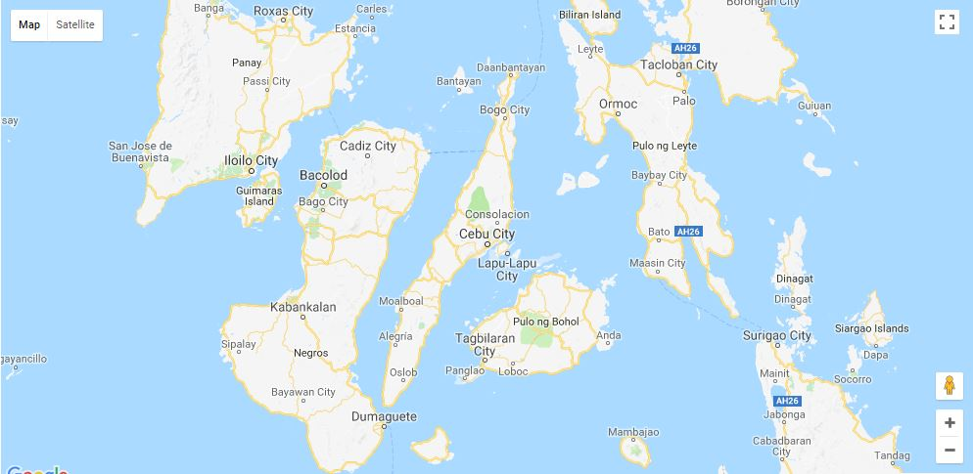

Slide 20
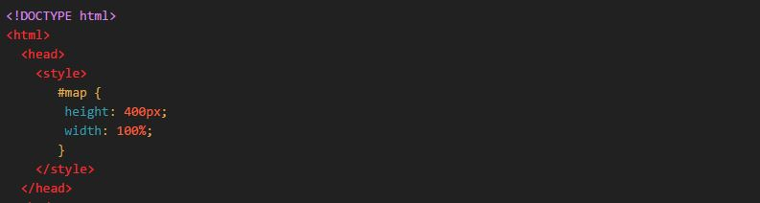

Slide 21
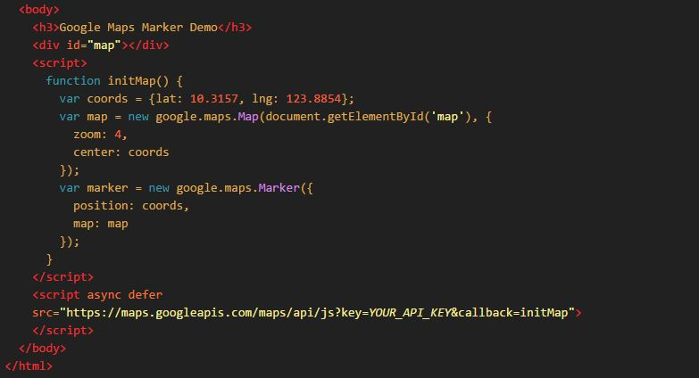

Slide 22
How To
There are three steps to creating a Google map with a marker on your web page.
Create an HTML page
Add a map with a marker
Get an API key

Slide 23
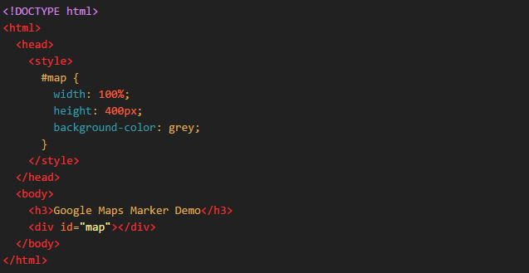
Create an HTML page
Here's the code for a basic HTML web page:

Slide 24
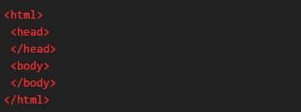

Understanding the code
The code below creates an HTML page consisting of a head and a body.
You can add a heading level three above the map using the code below.
The code below creates the container of your Google Map.

Slide 25
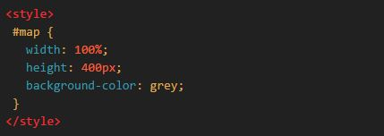
The code below defines the CSS that sets the size and color of the div.

Slide 26
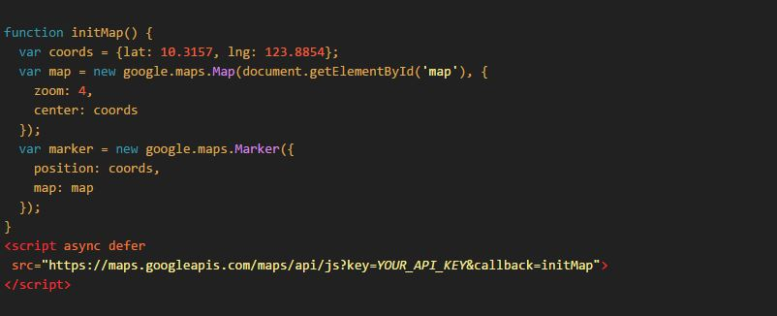
Add a Map with a Marker
This section shows you how to load the Google Maps JavaScript API into your web page, and how to write your own JavaScript that uses the API to add a map with a marker on it.

Slide 27

Understanding the Code
In the code below, the script loads the API from the specified URL
In the above code, the callback parameter executes the initMap function after the API loads. The async attribute allows the browser to continue rendering the rest of your page while the API loads. The key parameter contains your API key.
The code below contains the initMap function that initializes and adds the map when the web page loads. Use a script tag to include your own JavaScript which contains the initMap function.
Add the getElementById() function to find the map div on the web page.

Slide 28
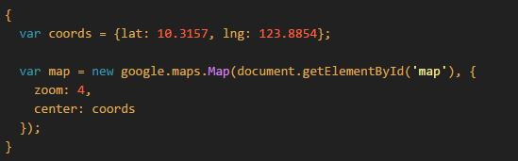
The code below constructs a new Google maps object, and adds properties to the map including the center and zoom level
In the above code, new google.maps.Map() creates a new Google maps object. The center property tells the API where to center the map. The map coordinates are set in the order: latitude, longitude.
The zoom property specifies the zoom level for the map. Zoom: 0 is the lowest zoom, and displays the entire earth. Set the zoom value higher to zoom in to the earth at higher resolutions.

Slide 29

The code below puts a marker on the map. The position property sets the position of the marker.

Slide 30
Get an API key
This section explains how to authenticate your app to the Google Maps JavaScript API using your own API key.
Follow these steps to get an API key:
Go to the Google API Console.
Create or select a project.
Click Continue to enable the API and any related services.
On the Credentials page, get an API key (and set the API key restrictions). Note: If you have an existing unrestricted API key, or a key with browser restrictions, you may use that key.
To prevent quota theft, secure your API key following these best practices.
(Optional) Enable billing. See Usage Limits for more information.

Slide 31
7. Copy the entire code of this tutorial from this page, to your text editor. If you don't already have a text editor, here are some recommendations: You can use: Notepad++ (for Windows); TextEdit (for macOS); gedit, KWrite, among others (for Linux machines).
8. Replace the value of the key parameter in the URL with your own API key (that's the API key that you've just obtained).
9. Save this file with a name that ends with .html, like google-maps.html.
10. Load the HTML file in a web browser by dragging it from your desktop onto your browser. Alternatively, double-clicking the file works on most operating systems.

Slide 32
Map Types

Slide 33
There are four types of maps available within the Google Maps JavaScript API.
The following map types are available in the Maps JavaScript API:
roadmap displays the default road map view. This is the default map type.
satellite displays Google Earth satellite images
hybrid displays a mixture of normal and satellite views
terrain displays a physical map based on terrain information.
You modify the map type in use by the Map by setting its mapTypeId property, either within the constructor via setting its Map optionsobject, or by calling the map's setMapTypeId() method. The mapTypeID property defaults to roadmap.

Slide 34
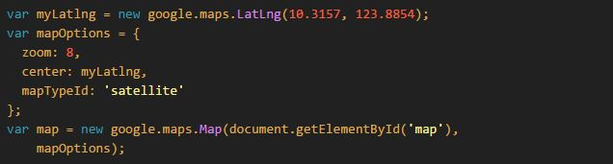
Setting the mapTypeId upon construction:

Slide 35
Localizing the Maps

Slide 36
You can customize your map for a specific country or region in the following ways:
Change the default language settings.
Specify a region code, which alters the map's behavior based on a given country or territory.
By default, the Google Maps JavaScript API uses the user's preferred language setting as specified in the browser, when displaying textual information such as the names for controls, copyright notices, driving directions and labels on maps. In most cases, it's preferable to respect the browser setting. However, if you want the Maps JavaScript API to ignore the browser's language setting, you can force it to display information in a particular language by adding a language parameter to the <script> tag when loading the Maps JavaScript API code.

Slide 37
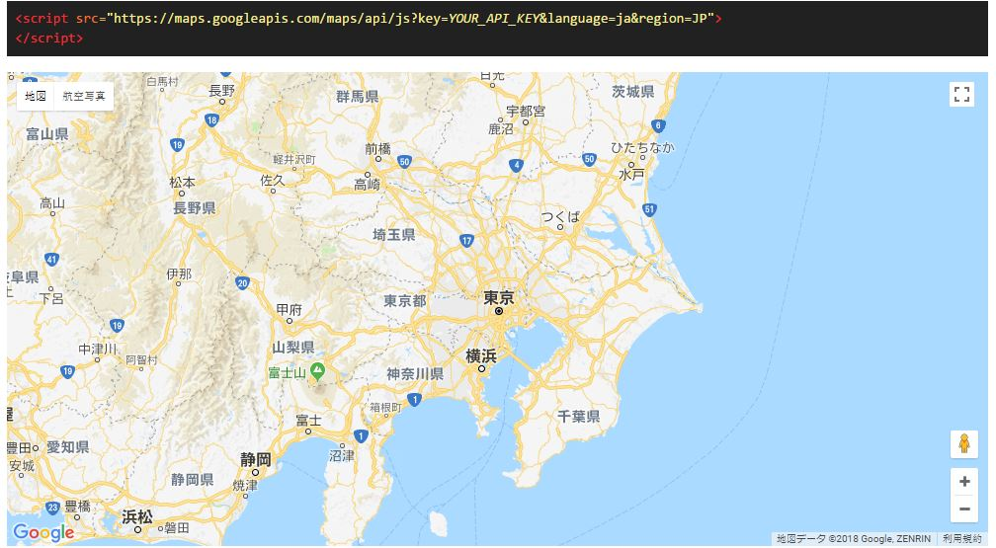
The following example displays a map in Japanese and sets the region to Japan:

Slide 38
That’s all folks!

Slide 39
You've learned now the basics of Google Maps API using JavaScript. You can now try integrate it on your own webpage or web application.
What you've learned
How to create a simple Google Map and display it in a webpage.
How to generate an API key from Google API Console.
How to add a map with marker.
Identify all map types available that can be used.
How to localize your own google map according to what specific language or region.
Keep learning. There's more!
Google Maps API Documentation and Tutorials
developers.google.com/maps/
tutorialspoint.com/google_maps
w3schools.com/graphics/google_maps_intro.asp

Slide 40
Check this tutorial on my website
https://neekodev.github.io/tuts-google-maps/

