Slide 1
N. Saadat
Weighted Least Squares Estimation of 3D Body Part Trajectories

Slide 2

Weighted Least Squares Estimation 3D Body Part Trajectories
FORMULAS

Slide 3

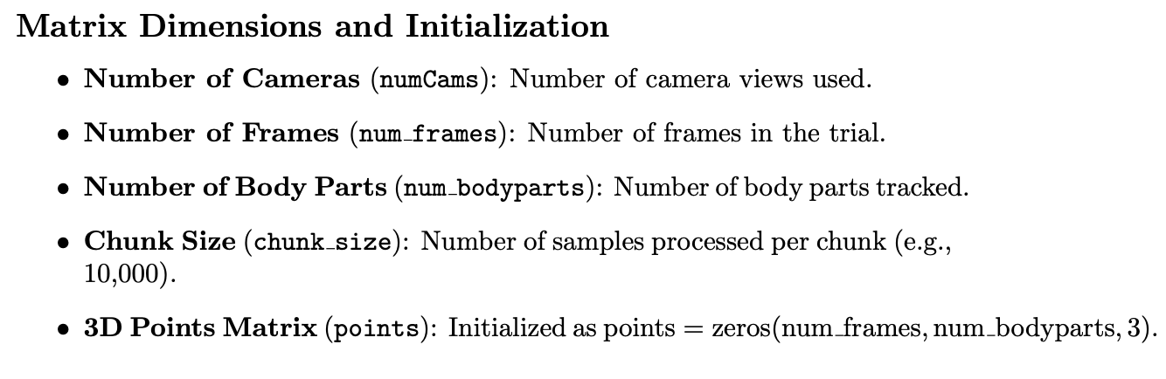
Weighted Least Squares Estimation 3D Body Part Trajectories

Slide 4
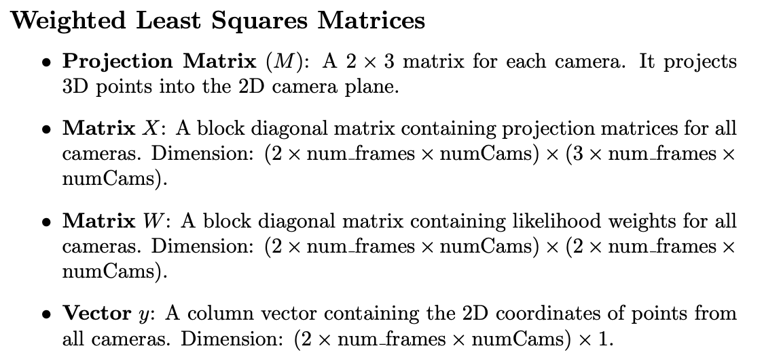
Weighted Least Squares Estimation 3D Body Part Trajectories

Slide 5
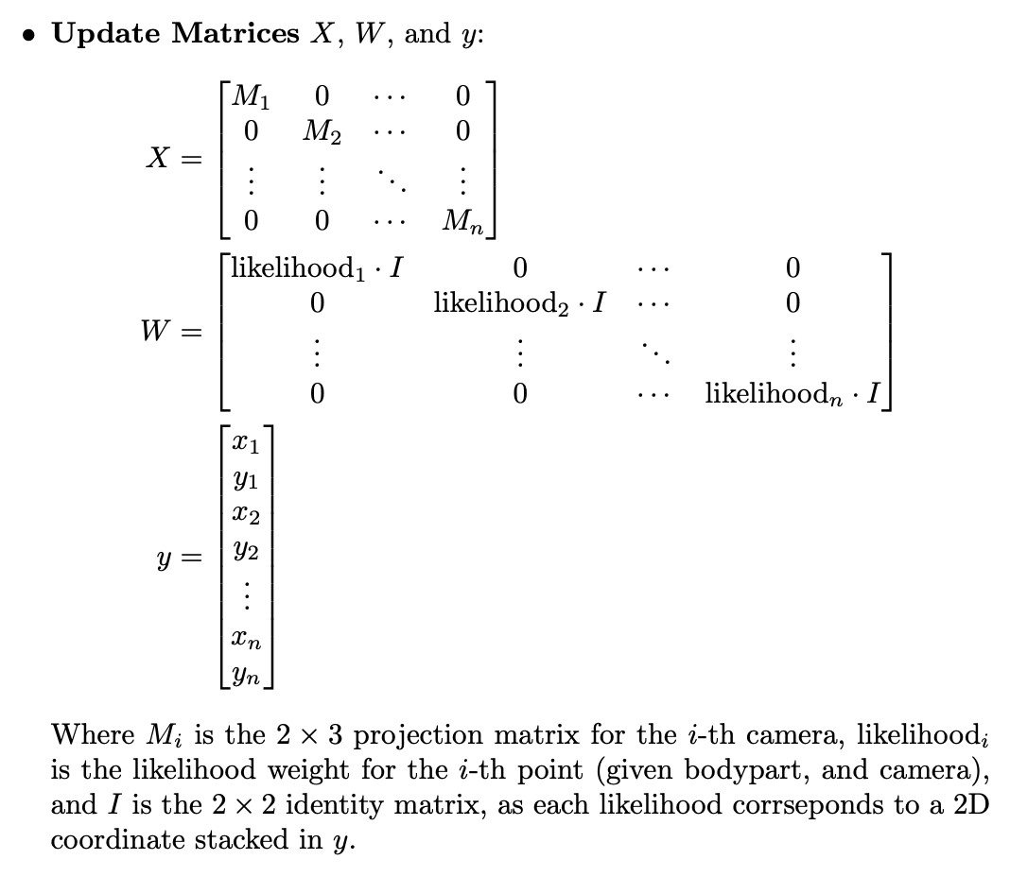
Weighted Least Squares Estimation 3D Body Part Trajectories

Slide 6
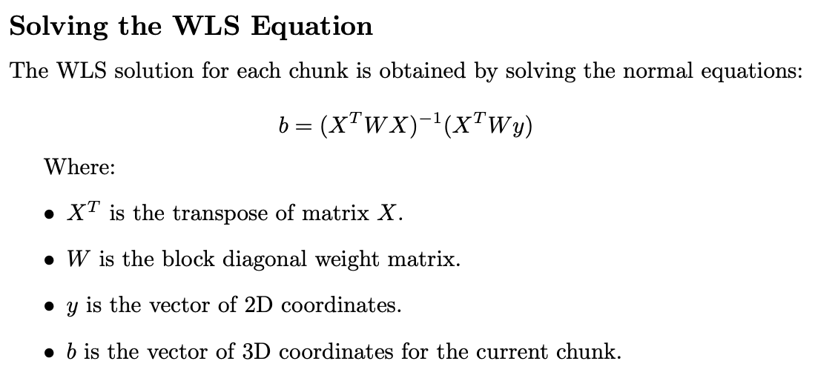
Weighted Least Squares Estimation 3D Body Part Trajectories

Slide 7
Weighted Least Squares Estimation 3D Body Part Trajectories

Slide 8
Weighted Least Squares Estimation 3D Body Part Trajectories
PERFORMANCE

Slide 9
Weighted Least Squares Estimation 3D Body Part Trajectories
Text

Slide 10


Weighted Least Squares Estimation 3D Body Part Trajectories
TEXTE
VIDEO/IMAGE 2/3 SCREEN
COURTINE ET AL. ¦ NATURE NEUROSCIENCE ¦ 2009

Slide 11


Weighted Least Squares Estimation 3D Body Part Trajectories
TEXTE
VIDEO/IMAGE
(NO BORDER)
COURTINE ET AL. ¦ NATURE NEUROSCIENCE ¦ 2009

Slide 12

Weighted Least Squares Estimation 3D Body Part Trajectories
VIDEO/IMAGE FULL SCREEN

Slide 13


Weighted Least Squares Estimation 3D Body Part Trajectories
TEXTE
VIDEO/IMAGE 2/3 SCREEN
COURTINE ET AL. ¦ NATURE NEUROSCIENCE ¦ 2009

Slide 14

Weighted Least Squares Estimation 3D Body Part Trajectories
TEXTE
VIDEO/IMAGE
(NO BORDER)
COURTINE ET AL. ¦ NATURE NEUROSCIENCE ¦ 2009

Slide 15
Weighted Least Squares Estimation 3D Body Part Trajectories
Text

Slide 16

Weighted Least Squares Estimation 3D Body Part Trajectories
Text

Slide 17

Weighted Least Squares Estimation 3D Body Part Trajectories
Text

Slide 18

Weighted Least Squares Estimation 3D Body Part Trajectories
Text

Slide 19

Weighted Least Squares Estimation 3D Body Part Trajectories
Text

Slide 20

Weighted Least Squares Estimation 3D Body Part Trajectories
Text

Slide 21
Weighted Least Squares Estimation 3D Body Part Trajectories
Text

Slide 22

Weighted Least Squares Estimation 3D Body Part Trajectories
Text

