Slide 1
N. Saadat
Weighted Least Squares Estimation of 3D Body Part Trajectories

Slide 2

Weighted Least Squares Estimation 3D Body Part Trajectories
OLD FORMULAS

Slide 3

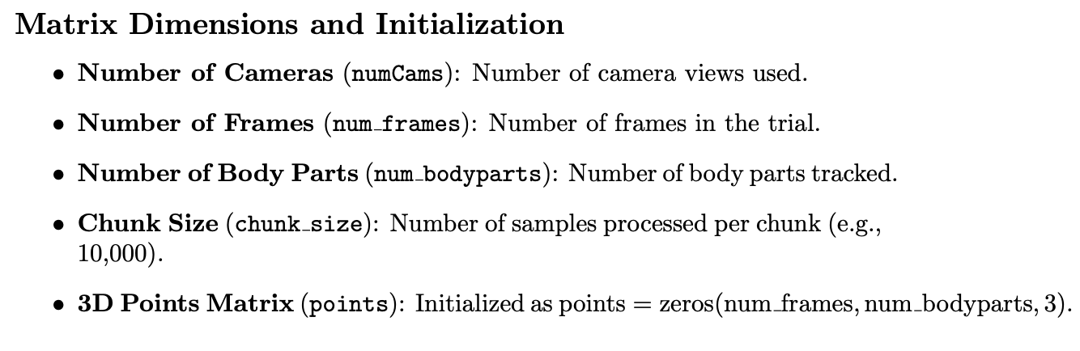
Weighted Least Squares Estimation 3D Body Part Trajectories

Slide 4
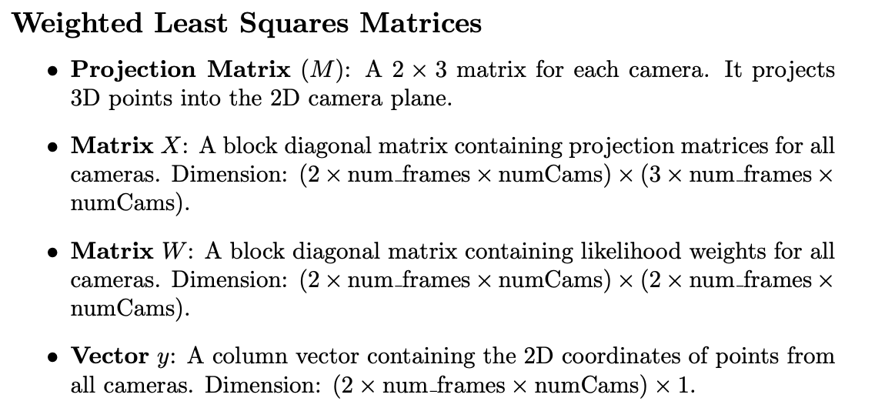
Weighted Least Squares Estimation 3D Body Part Trajectories

Slide 5
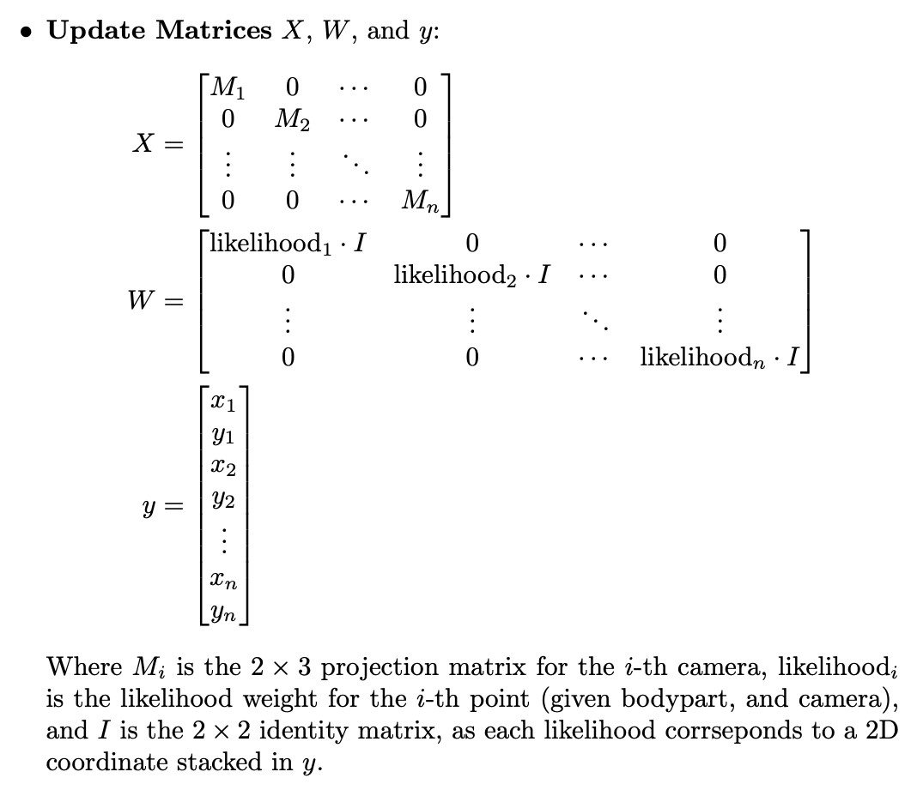
Weighted Least Squares Estimation 3D Body Part Trajectories

Slide 6
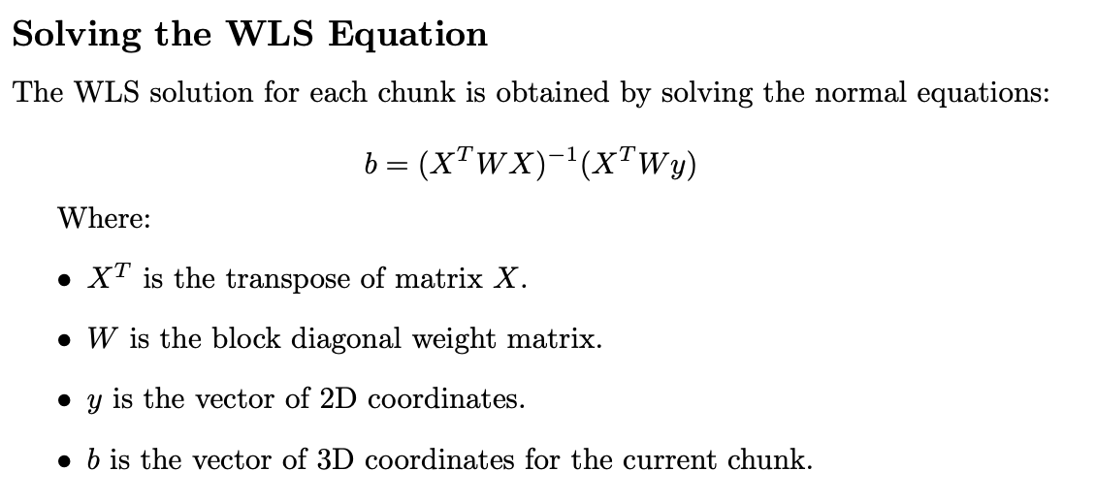
Weighted Least Squares Estimation 3D Body Part Trajectories

Slide 7
Weighted Least Squares Estimation 3D Body Part Trajectories
Logic Flaw:
Constructing X with projections M along diagonal enforces linear independence between camera angles
Quasi-square matrix X with repeating sequence of projection matrices forces X to be (2*frames*angles)x(3*frames*angles) per chunk
Large X and W increase size of matrix inversion task, contributing to slowness

Slide 8
Weighted Least Squares Estimation 3D Body Part Trajectories
Plan For Revision

Slide 9
Weighted Least Squares Estimation 3D Body Part Trajectories
Single-frame iterative approach:
Construct equation for estimating one 3D point at a time
Minimize size of matrices for inversion
Capitalize on CPU speed vs. large linear operations
Continuously update projection matrix for each point to minimize transformation error

Slide 10
Weighted Least Squares Estimation 3D Body Part Trajectories
TASK #1
Retrain DLC model to follow keypoints. Write Matlab script to convert noisy tracking data for keypoints into discrete positions + transition times.
TASK #2
Refactor Rust WLS implementation to store frame-associated projections and to estimate 3D points individually. Implement likelihood and slew-rate gating, then interpolate missing points.
TASK #3
Verify performance at each stage; Overlay random selection of keypoints from processed coordinates; Estimate 5 3D points before and after a projection change.

Slide 11
Weighted Least Squares Estimation 3D Body Part Trajectories
TASK 1

Slide 12
Weighted Least Squares Estimation 3D Body Part Trajectories
TASK 1 — 2D Pose & Keypoint Tracking, Mark Events
Keypoint-Shift Segmentation
Goal: Split 2D tracking data of keypoints for each camera when the position of one point moves. The resulting segments containing constant keypoint positions from the camera’s perspective are used to generate a series of projection matrices for that perspective, which will be used during triangulation for an online/continuously updated 3D transformation.

Slide 13
Weighted Least Squares Estimation 3D Body Part Trajectories
TASK 1 — 2D Pose & Keypoint Tracking, Mark Events
DLC Model Retrain for Keypoint Analysis
Retraining the DLC model to track multiple fixed keypoints such as the vertices of the NHP enclosure enable the online updating of the 3D transformation used in triangulation of multiple 2D trajectories into a common 3D space referenced to said enclosure.

Slide 14
Weighted Least Squares Estimation 3D Body Part Trajectories
TASK 1 — 2D Pose & Keypoint Tracking, Mark Events
Event Marking
Marking events in each session enables segmentation of Blackrock neural recordings by annotated timesteps, when taking the differing sample-rates and camera triggers into account. Active reaching phases are marked with 7 distinct phases — Reach start, Hand at object, (Hand to mouth start), (Hand to mouth end), Pull start, Pull end, Release end — with the addition of a Junk phase. Resting periods are inferred when no other phase is marked for a range of frames/samples.

Slide 15


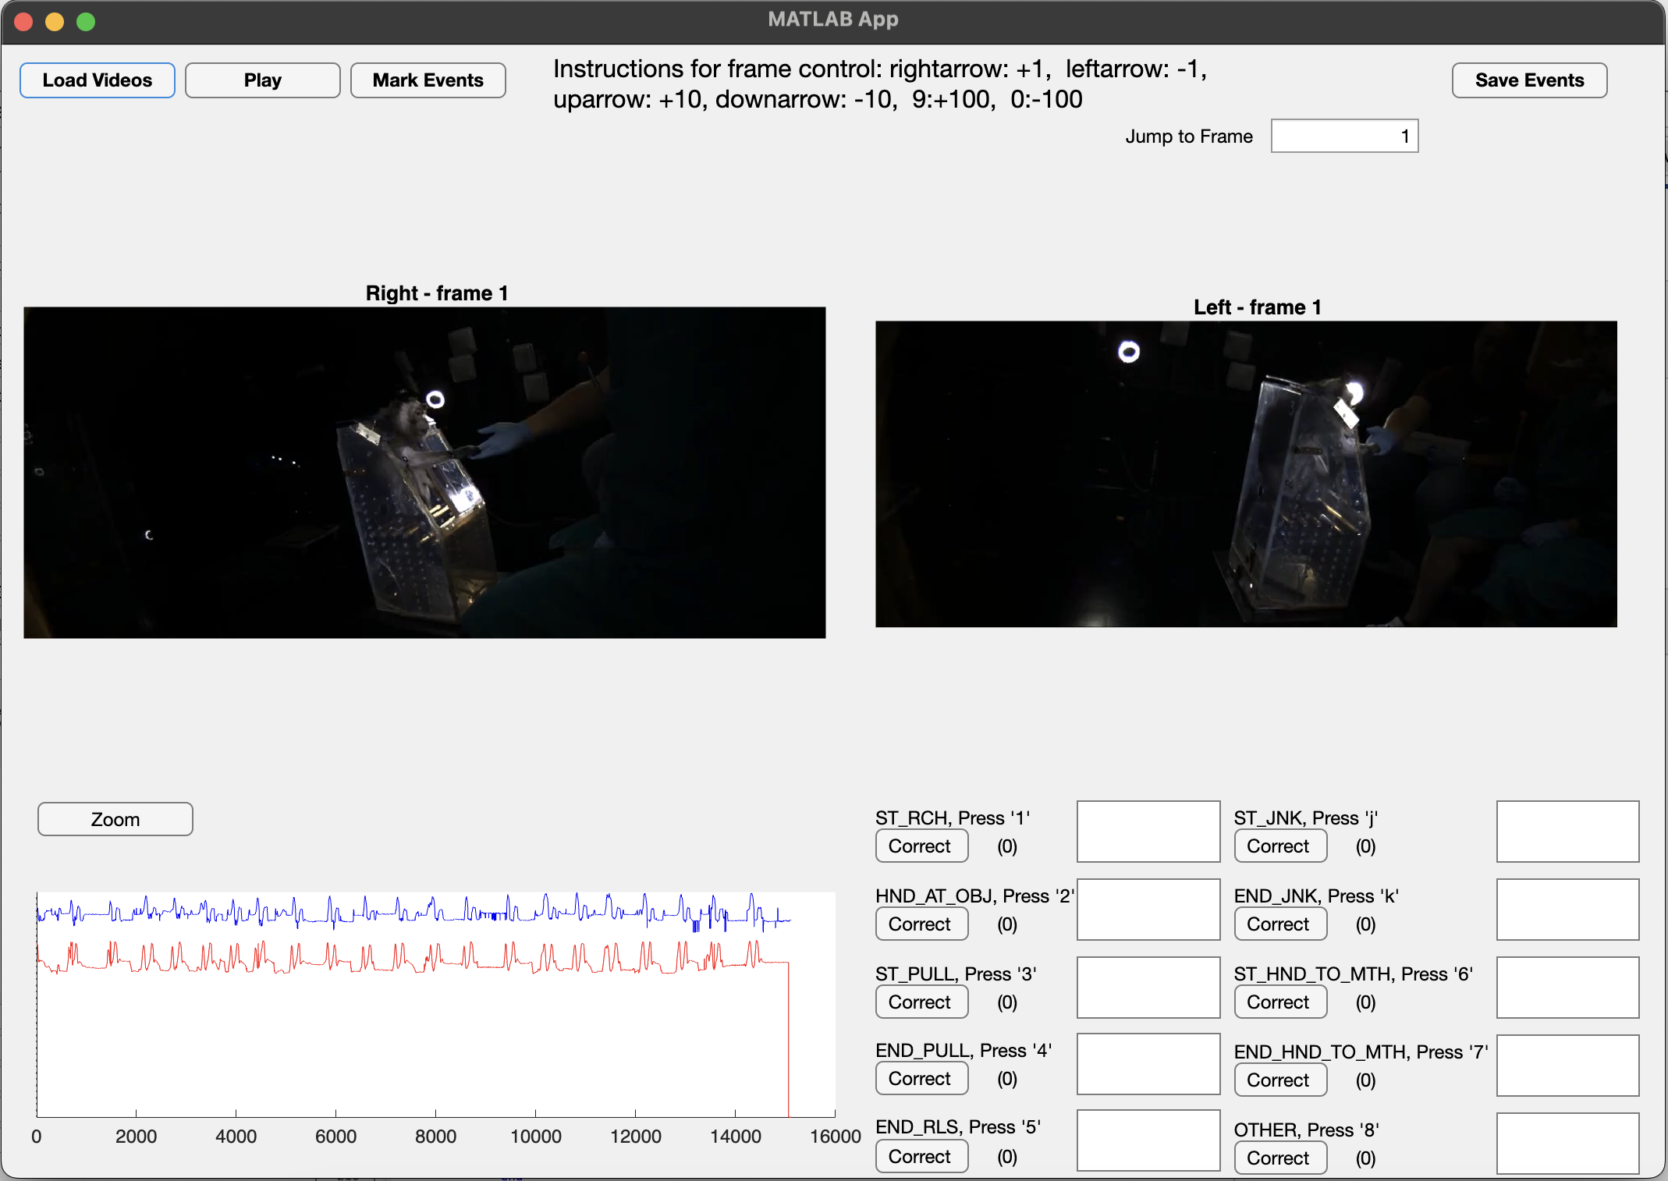

Weighted Least Squares Estimation 3D Body Part Trajectories
TASK 1 — 2D Pose & Keypoint Tracking, Mark Events
Event Marking
Reencode AVI
Mark Events
Bundle Output
Event Marks
ECoG Ns5/6
3D Trajectory

Slide 16

Weighted Least Squares Estimation 3D Body Part Trajectories
TASK 1 — 2D Pose & Keypoint Tracking, Mark Events
Event Marking :: Bundle Output
Event Marks
ECoG Ns5/6
3D Trajectory

Slide 17
Weighted Least Squares Estimation 3D Body Part Trajectories
TASK 2

Slide 18
Weighted Least Squares Estimation 3D Body Part Trajectories
TASK 3

Slide 19

Weighted Least Squares Estimation 3D Body Part Trajectories
TEXTE
VIDEO/IMAGE 2/3 SCREEN
COURTINE ET AL. ¦ NATURE NEUROSCIENCE ¦ 2009

Slide 20


Weighted Least Squares Estimation 3D Body Part Trajectories
TEXTE
VIDEO/IMAGE
(NO BORDER)
COURTINE ET AL. ¦ NATURE NEUROSCIENCE ¦ 2009

Slide 21

Weighted Least Squares Estimation 3D Body Part Trajectories
VIDEO/IMAGE FULL SCREEN

Slide 22


Weighted Least Squares Estimation 3D Body Part Trajectories
TEXTE
VIDEO/IMAGE 2/3 SCREEN
COURTINE ET AL. ¦ NATURE NEUROSCIENCE ¦ 2009

Slide 23

Weighted Least Squares Estimation 3D Body Part Trajectories
TEXTE
VIDEO/IMAGE
(NO BORDER)
COURTINE ET AL. ¦ NATURE NEUROSCIENCE ¦ 2009

Slide 24
Weighted Least Squares Estimation 3D Body Part Trajectories
Text

Slide 25

Weighted Least Squares Estimation 3D Body Part Trajectories
Text

Slide 26

Weighted Least Squares Estimation 3D Body Part Trajectories
Text

Slide 27

Weighted Least Squares Estimation 3D Body Part Trajectories
Text

Slide 28

Weighted Least Squares Estimation 3D Body Part Trajectories
Text

Slide 29

Weighted Least Squares Estimation 3D Body Part Trajectories
Text

Slide 30
Weighted Least Squares Estimation 3D Body Part Trajectories
Text

Slide 31

Weighted Least Squares Estimation 3D Body Part Trajectories
Text

