Slide 1
N. Saadat
Weighted Least Squares Estimation of 3D Body Part Trajectories

Slide 2

Weighted Least Squares Estimation 3D Body Part Trajectories
OLD FORMULAS

Slide 3

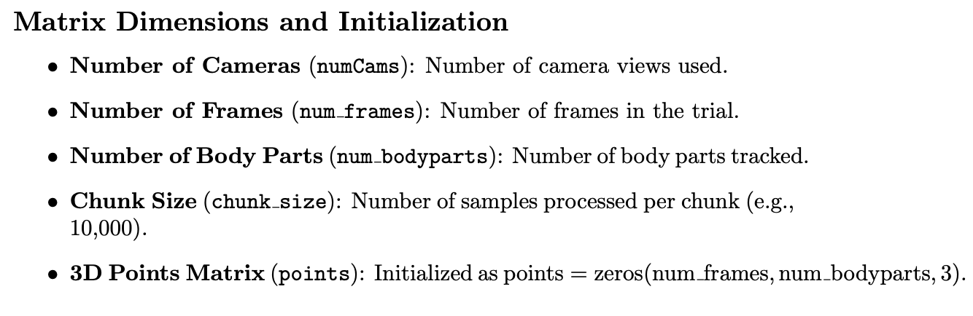
Weighted Least Squares Estimation 3D Body Part Trajectories

Slide 4
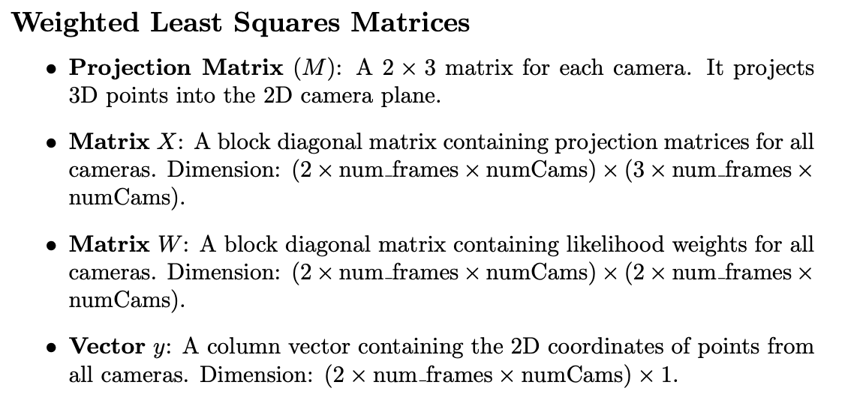
Weighted Least Squares Estimation 3D Body Part Trajectories

Slide 5
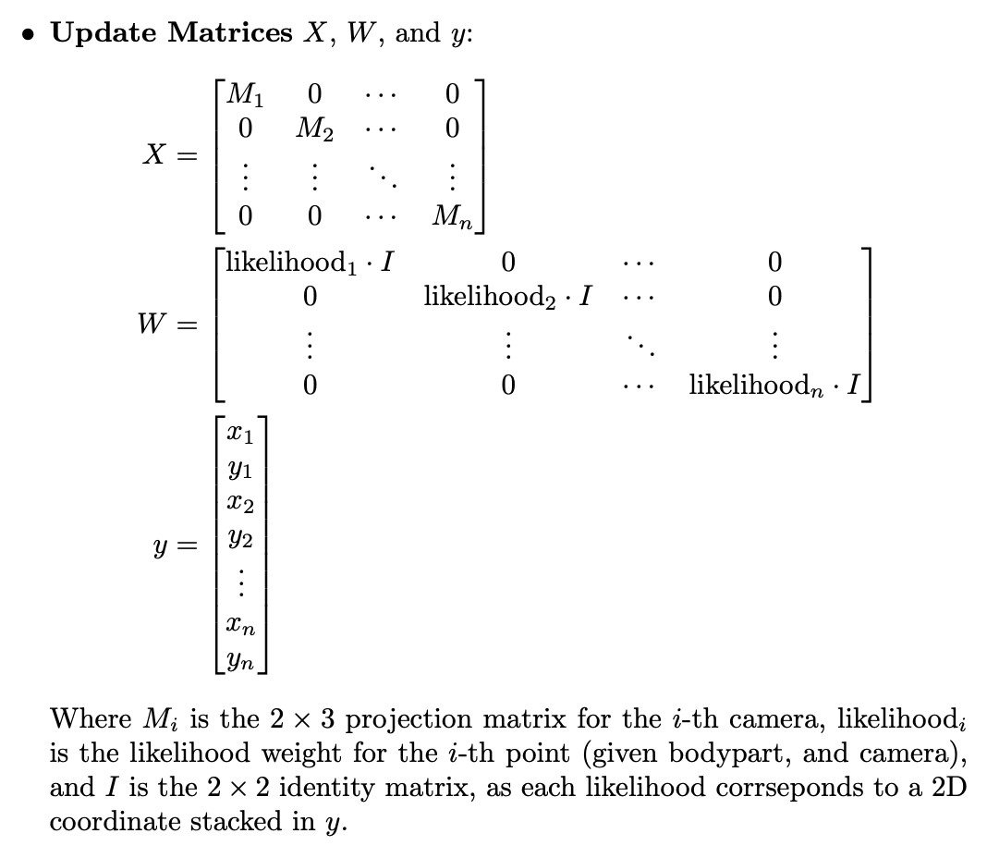
Weighted Least Squares Estimation 3D Body Part Trajectories

Slide 6
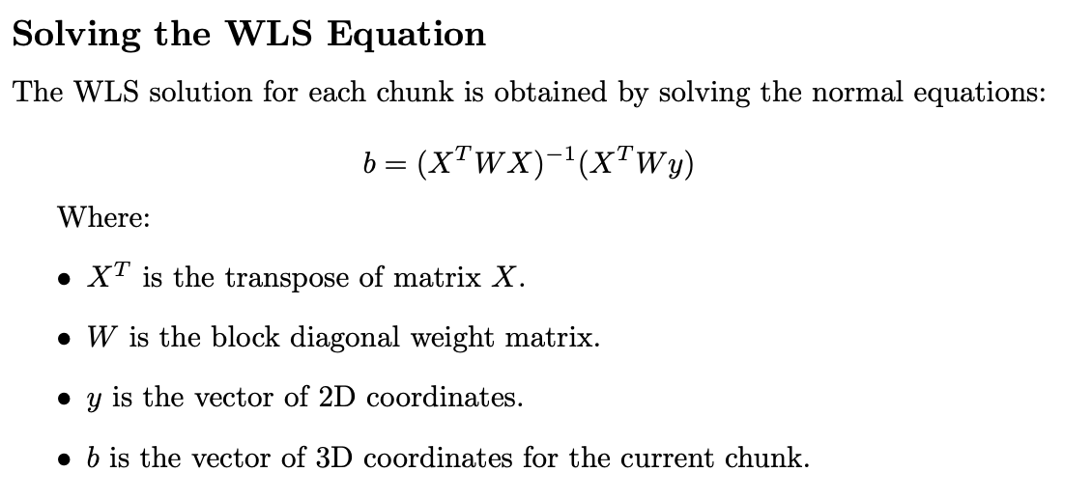
Weighted Least Squares Estimation 3D Body Part Trajectories

Slide 7
Weighted Least Squares Estimation 3D Body Part Trajectories
Logic Flaw:
Constructing X with projections M along diagonal enforces linear independence between camera angles
Quasi-square matrix X with repeating sequence of projection matrices forces X to be (2*frames*angles)x(3*frames*angles) per chunk
Large X and W increase size of matrix inversion task, contributing to slowness

Slide 8
Weighted Least Squares Estimation 3D Body Part Trajectories
Event Marking Application

Slide 9
Weighted Least Squares Estimation 3D Body Part Trajectories
Event Marking Application :: Introduction
Custom GUI for Marking Behavioral Events
Summarize the app here

Slide 10
Weighted Least Squares Estimation 3D Body Part Trajectories
Event Marking Application :: Debug
Description of Bug
When crossing the threshold for a chunk of frames, the video views would flash frames not corresponding to the current place in the video, and the DLC tracking points would fall out of sync with the video. Additionally, some regions of the video not falling on a chunk delimiter would experience a freeze for several frames, also corresponding with the tracking points falling out of sync for the video.

Slide 11
Weighted Least Squares Estimation 3D Body Part Trajectories
Event Marking Application :: Debug
Hypotheses
Flashing frames out-of-index suggested that, when scrolling across a chunk delimiter at a high framerate, if the next chunk was not loaded in time for the next frame to be displayed, the first frame of the previous chunk — still loaded in memory — was recalled until the new chunk frames were made available.

Slide 12
Weighted Least Squares Estimation 3D Body Part Trajectories
Event Marking Application :: Debug
Hypotheses
Freezing frames did not correspond to the videos falling out of sync, but they did cause tracking points to. It is possible that DLC omits rows where points are out of view, and the GUI cannot display frames without corresponding tracking points, therefore causing an offset to the tracking point of the frozen video afterwards while the unaffected video displays no out-of-sync behavior. This would be supported by the number of DLC points being less than the number of video frames, and it may require revisiting the dlc_to_simi_mat script.

Slide 13
Weighted Least Squares Estimation 3D Body Part Trajectories
Plan For Revision

Slide 14
Weighted Least Squares Estimation 3D Body Part Trajectories
Single-frame iterative approach:
Construct equation for estimating one 3D point at a time
Minimize size of matrices for inversion
Capitalize on CPU speed vs. large linear operations
Continuously update projection matrix for each point to minimize transformation error

Slide 15
Weighted Least Squares Estimation 3D Body Part Trajectories
TASK #1
Retrain DLC model to follow keypoints. Write Matlab script to convert noisy tracking data for keypoints into discrete positions + transition times.
TASK #2
Refactor Rust WLS implementation to store frame-associated projections and to estimate 3D points individually. Implement likelihood and slew-rate gating, then interpolate missing points.
TASK #3
Verify performance at each stage; Overlay random selection of keypoints from processed coordinates; Estimate 5 3D points before and after a projection change.

Slide 16
Weighted Least Squares Estimation 3D Body Part Trajectories
TASK 1

Slide 17
Weighted Least Squares Estimation 3D Body Part Trajectories
TASK 1 — 2D Pose & Keypoint Tracking, Mark Events
Keypoint-Shift Segmentation
Goal: Split 2D tracking data of keypoints for each camera when the position of one point moves. The resulting segments containing constant keypoint positions from the camera’s perspective are used to generate a series of projection matrices for that perspective, which will be used during triangulation for an online/continuously updated 3D transformation.

Slide 18
Weighted Least Squares Estimation 3D Body Part Trajectories
TASK 1 — 2D Pose & Keypoint Tracking, Mark Events
DLC Model Retrain for Keypoint Analysis
Retraining the DLC model to track multiple fixed keypoints such as the vertices of the NHP enclosure enable the online updating of the 3D transformation used in triangulation of multiple 2D trajectories into a common 3D space referenced to said enclosure.

Slide 19
Weighted Least Squares Estimation 3D Body Part Trajectories
TASK 1 — 2D Pose & Keypoint Tracking, Mark Events
Event Marking
Marking events in each session enables segmentation of Blackrock neural recordings by annotated timesteps, when taking the differing sample-rates and camera triggers into account. Active reaching phases are marked with 7 distinct phases — Reach start, Hand at object, (Hand to mouth start), (Hand to mouth end), Pull start, Pull end, Release end — with the addition of a Junk phase. Resting periods are inferred when no other phase is marked for a range of frames/samples.

Slide 20

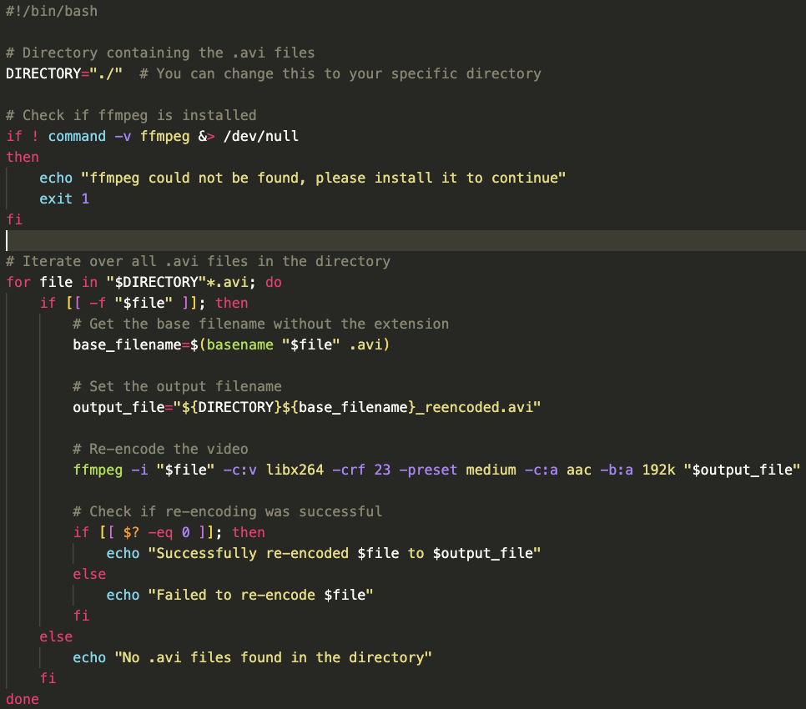
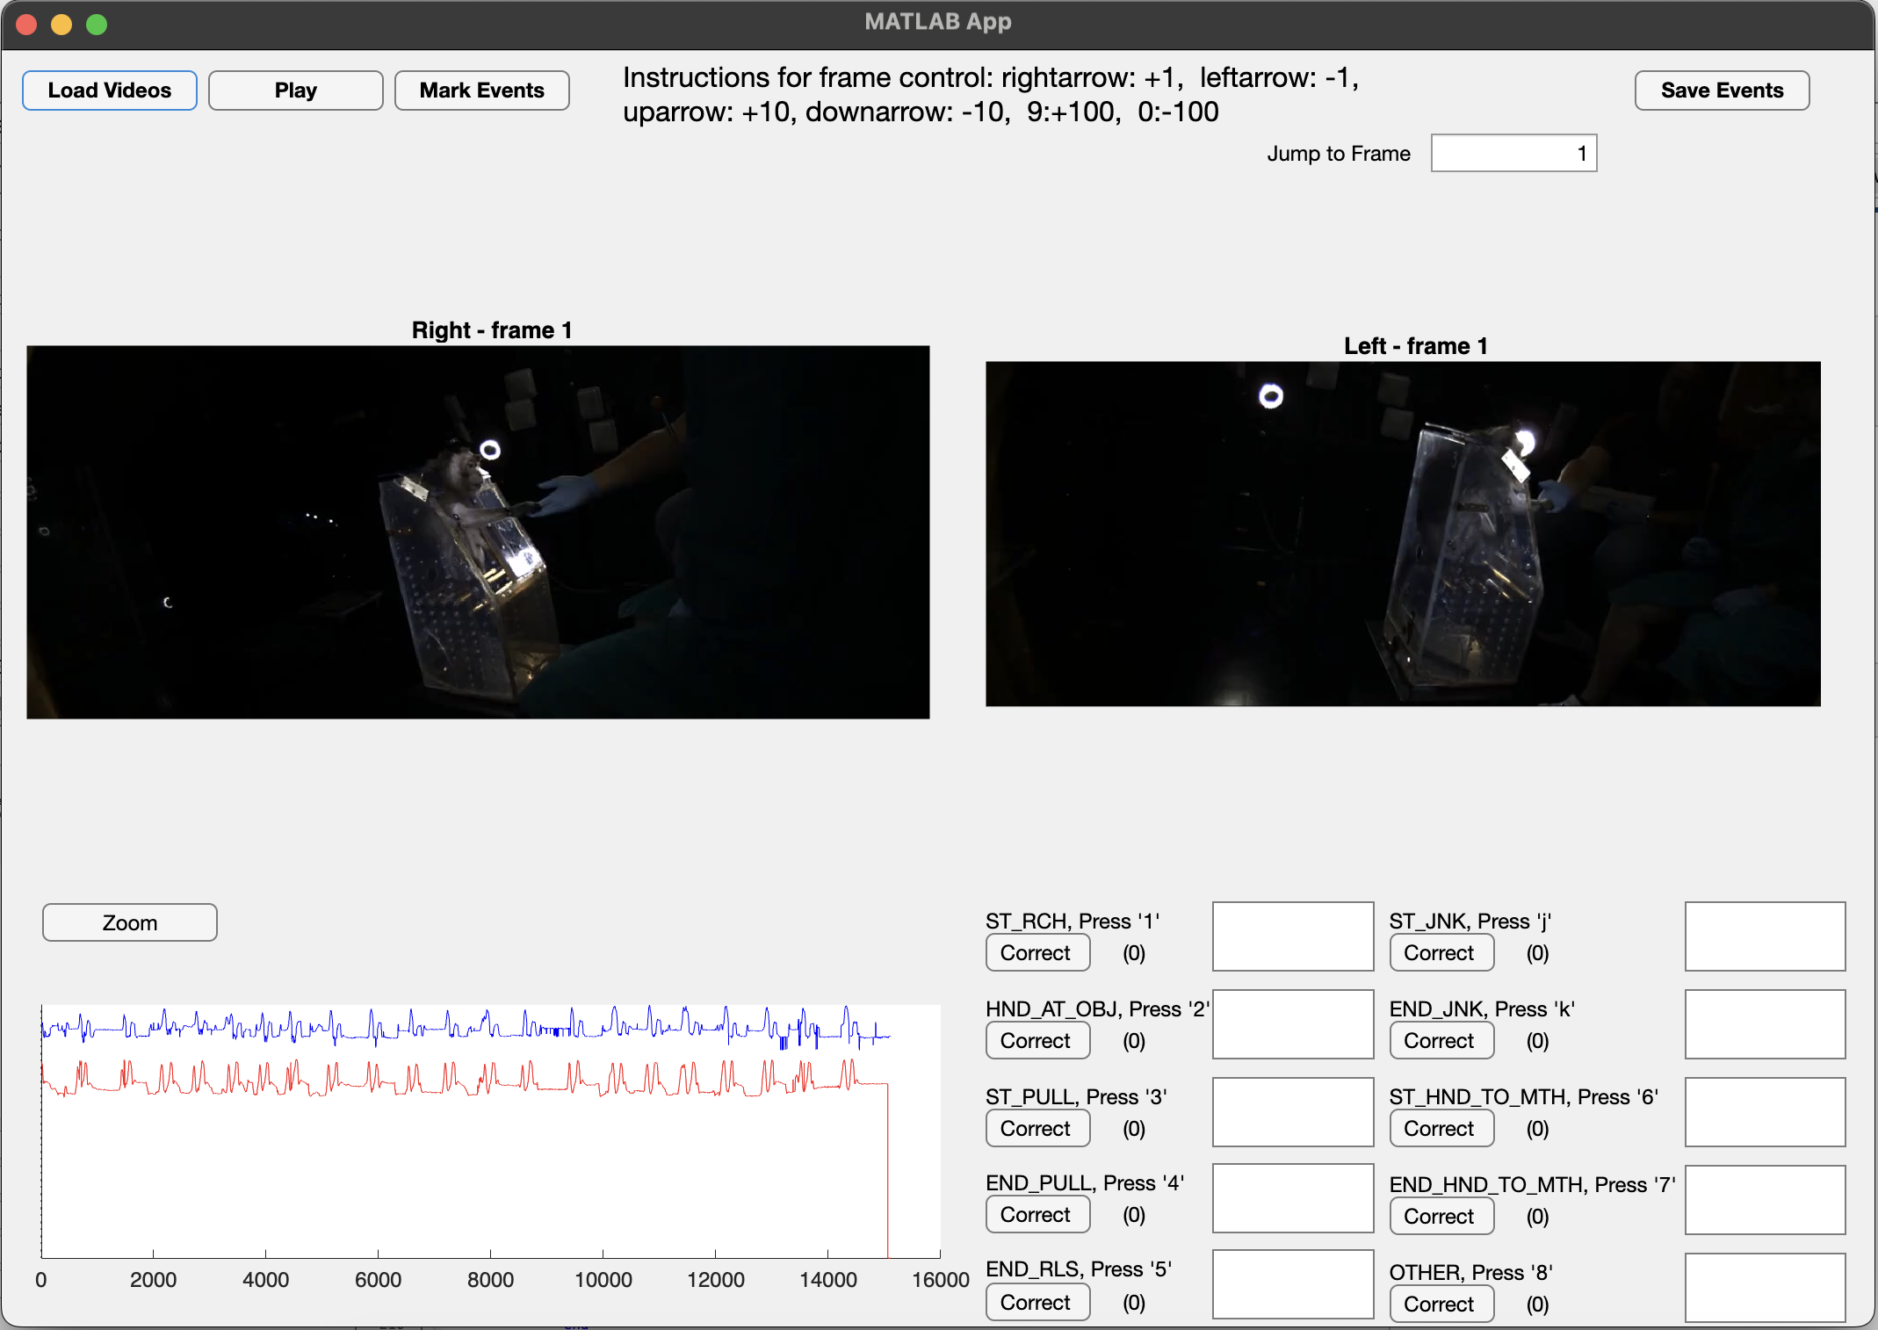

Weighted Least Squares Estimation 3D Body Part Trajectories
TASK 1 — 2D Pose & Keypoint Tracking, Mark Events
Event Marking
Reencode AVI
Mark Events
Bundle Output
Event Marks
ECoG Ns5/6
3D Trajectory

Slide 21

Weighted Least Squares Estimation 3D Body Part Trajectories
TASK 1 — 2D Pose & Keypoint Tracking, Mark Events
Event Marking :: Bundle Output
Event Marks
File Preview
Plot
Marks
ECoG Ns5/6
File Preview
Plot
ECoG
3D Trajectory
File Preview
Plot
3D Pts

Slide 22
Weighted Least Squares Estimation 3D Body Part Trajectories
TASK 2

Slide 23
Weighted Least Squares Estimation 3D Body Part Trajectories
TASK 3

Slide 24

Weighted Least Squares Estimation 3D Body Part Trajectories
TEXTE
VIDEO/IMAGE 2/3 SCREEN
COURTINE ET AL. ¦ NATURE NEUROSCIENCE ¦ 2009

Slide 25


Weighted Least Squares Estimation 3D Body Part Trajectories
TEXTE
VIDEO/IMAGE
(NO BORDER)
COURTINE ET AL. ¦ NATURE NEUROSCIENCE ¦ 2009

Slide 26

Weighted Least Squares Estimation 3D Body Part Trajectories
VIDEO/IMAGE FULL SCREEN

Slide 27


Weighted Least Squares Estimation 3D Body Part Trajectories
TEXTE
VIDEO/IMAGE 2/3 SCREEN
COURTINE ET AL. ¦ NATURE NEUROSCIENCE ¦ 2009

Slide 28

Weighted Least Squares Estimation 3D Body Part Trajectories
TEXTE
VIDEO/IMAGE
(NO BORDER)
COURTINE ET AL. ¦ NATURE NEUROSCIENCE ¦ 2009

Slide 29
Weighted Least Squares Estimation 3D Body Part Trajectories
Text

Slide 30

Weighted Least Squares Estimation 3D Body Part Trajectories
Text

Slide 31

Weighted Least Squares Estimation 3D Body Part Trajectories
Text

Slide 32

Weighted Least Squares Estimation 3D Body Part Trajectories
Text

Slide 33

Weighted Least Squares Estimation 3D Body Part Trajectories
Text

Slide 34

Weighted Least Squares Estimation 3D Body Part Trajectories
Text

Slide 35
Weighted Least Squares Estimation 3D Body Part Trajectories
Text

Slide 36

Weighted Least Squares Estimation 3D Body Part Trajectories
Text

