Slide 1
N. Saadat
Weighted Least Squares Estimation of 3D Body Part Trajectories

Slide 2

Weighted Least Squares Estimation 3D Body Part Trajectories
OLD FORMULAS

Slide 3

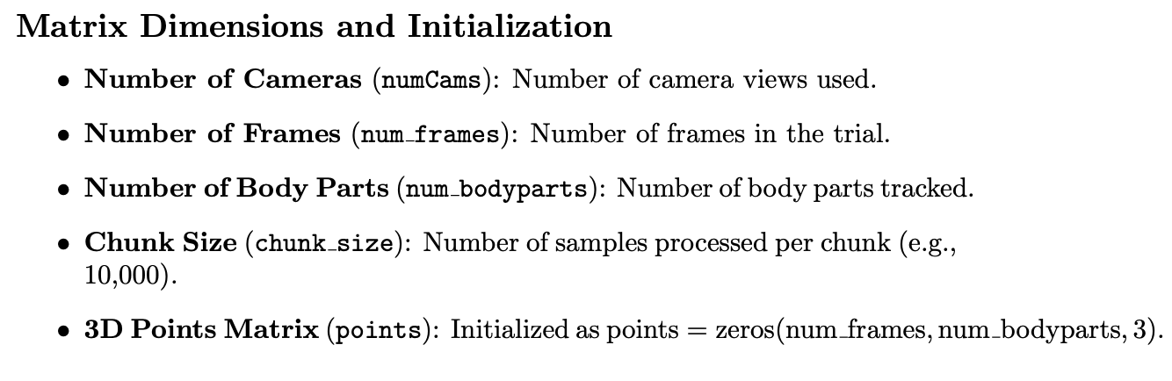
Weighted Least Squares Estimation 3D Body Part Trajectories

Slide 4
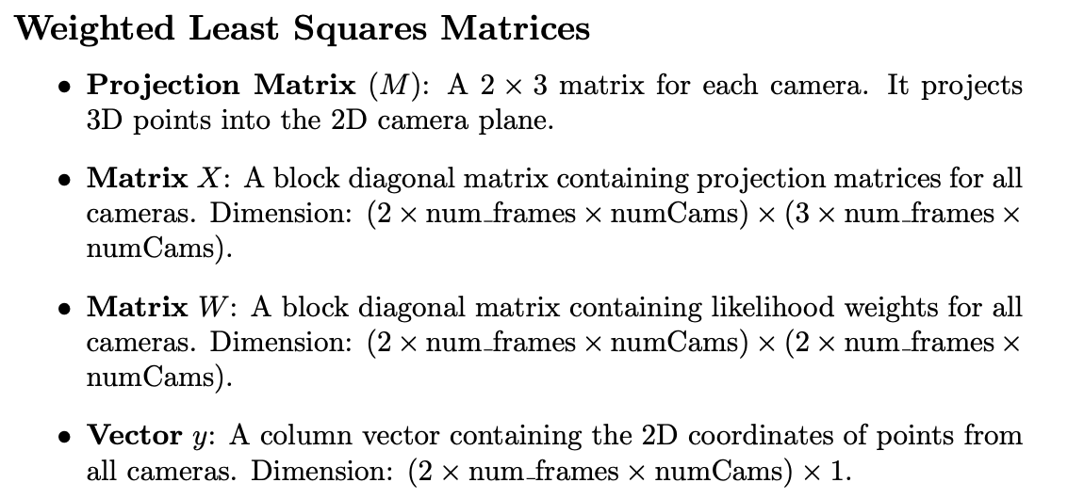
Weighted Least Squares Estimation 3D Body Part Trajectories

Slide 5
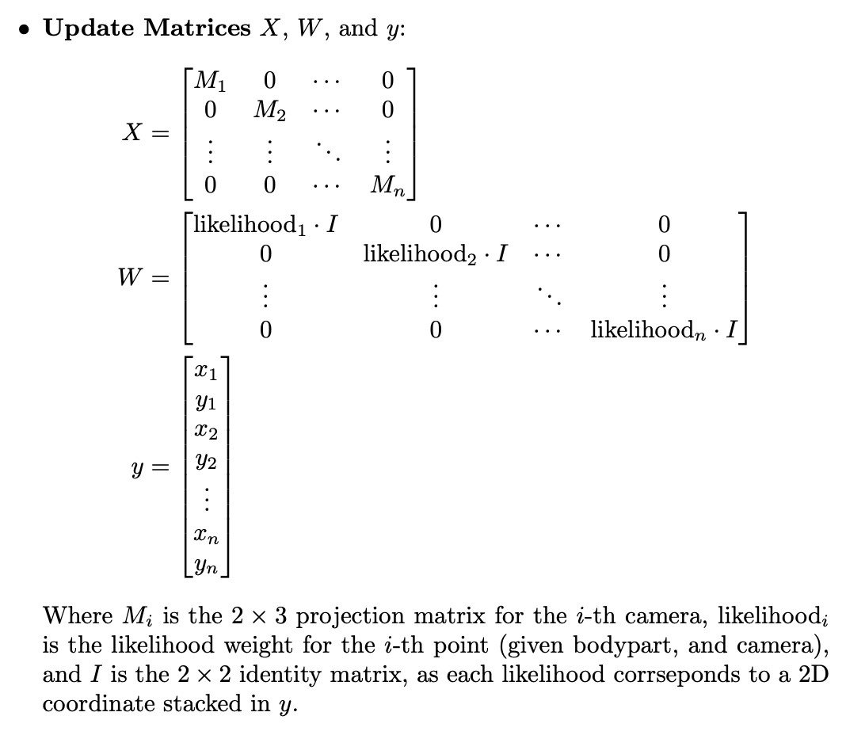
Weighted Least Squares Estimation 3D Body Part Trajectories

Slide 6
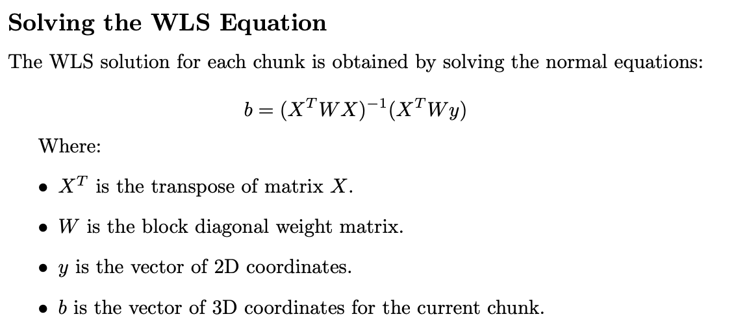
Weighted Least Squares Estimation 3D Body Part Trajectories

Slide 7
Weighted Least Squares Estimation 3D Body Part Trajectories
Logic Flaw:
Constructing X with projections M along diagonal enforces linear independence between camera angles
Quasi-square matrix X with repeating sequence of projection matrices forces X to be (2*frames*angles)x(3*frames*angles) per chunk
Large X and W increase size of matrix inversion task, contributing to slowness

Slide 8
Weighted Least Squares Estimation 3D Body Part Trajectories
Plan For Revision

Slide 9
Weighted Least Squares Estimation 3D Body Part Trajectories
Single-frame iterative approach:
Construct equation for estimating one 3D point at a time
Minimize size of matrices for inversion
Capitalize on CPU speed vs. large linear operations
Continuously update projection matrix for each point to minimize transformation error

Slide 10
Weighted Least Squares Estimation 3D Body Part Trajectories
TASK #1
Retrain DLC model to follow keypoints. Write Matlab script to convert noisy tracking data for keypoints into discrete positions + transition times.
TASK #2
Refactor Rust WLS implementation to store frame-associated projections and to estimate 3D points individually. Implement likelihood and slew-rate gating, then interpolate missing points.
TASK #3
Verify performance at each stage; Overlay random selection of keypoints from processed coordinates; Estimate 5 3D points before and after a projection change.

Slide 11
Weighted Least Squares Estimation 3D Body Part Trajectories
TITLE

Slide 12


Weighted Least Squares Estimation 3D Body Part Trajectories
TEXTE
VIDEO/IMAGE 2/3 SCREEN
COURTINE ET AL. ¦ NATURE NEUROSCIENCE ¦ 2009

Slide 13


Weighted Least Squares Estimation 3D Body Part Trajectories
TEXTE
VIDEO/IMAGE
(NO BORDER)
COURTINE ET AL. ¦ NATURE NEUROSCIENCE ¦ 2009

Slide 14

Weighted Least Squares Estimation 3D Body Part Trajectories
VIDEO/IMAGE FULL SCREEN

Slide 15


Weighted Least Squares Estimation 3D Body Part Trajectories
TEXTE
VIDEO/IMAGE 2/3 SCREEN
COURTINE ET AL. ¦ NATURE NEUROSCIENCE ¦ 2009

Slide 16

Weighted Least Squares Estimation 3D Body Part Trajectories
TEXTE
VIDEO/IMAGE
(NO BORDER)
COURTINE ET AL. ¦ NATURE NEUROSCIENCE ¦ 2009

Slide 17
Weighted Least Squares Estimation 3D Body Part Trajectories
Text

Slide 18

Weighted Least Squares Estimation 3D Body Part Trajectories
Text

Slide 19

Weighted Least Squares Estimation 3D Body Part Trajectories
Text

Slide 20

Weighted Least Squares Estimation 3D Body Part Trajectories
Text

Slide 21

Weighted Least Squares Estimation 3D Body Part Trajectories
Text

Slide 22

Weighted Least Squares Estimation 3D Body Part Trajectories
Text

Slide 23
Weighted Least Squares Estimation 3D Body Part Trajectories
Text

Slide 24

Weighted Least Squares Estimation 3D Body Part Trajectories
Text

