Slide 1
Status Report: Object Detection in Form-16
Neel Kanabar • ML Engineer Intern • Searce

Slide 2
Overview
Explored Different models such as MMOCR, Tesseract, YOLO’s different versions such as YOLOv4-tiny(Darknet), YOLOv5(Roboflow).
Didn’t get satisfying results with NLP libraries such as MMOCR & tesseract
Used YOLOv4-tiny(Darknet) for faster processing and YOLOv5(Roboflow) for relatively more accurate detection

Slide 3
Progress - Pre-Processing
Makesense
Used Makesense.ai for Data labelling
Exported annotations in .xml format
Roboflow
Used Roboflow for Data Populating and Data Augmentation
Used to split data into train, validation and test

Slide 4
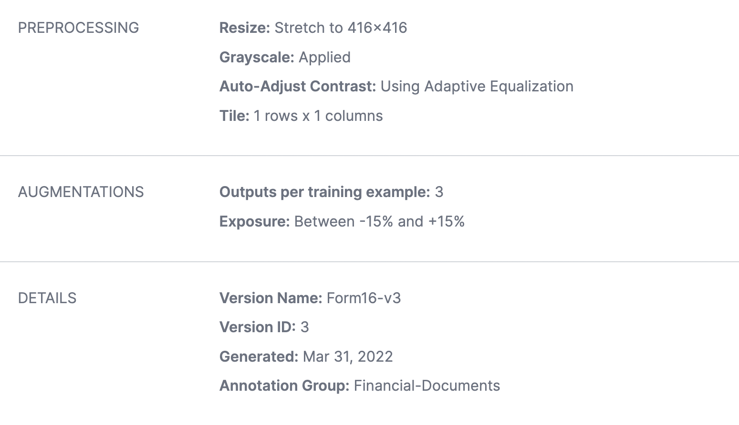
Pre-Processing(Roboflow)

Slide 5
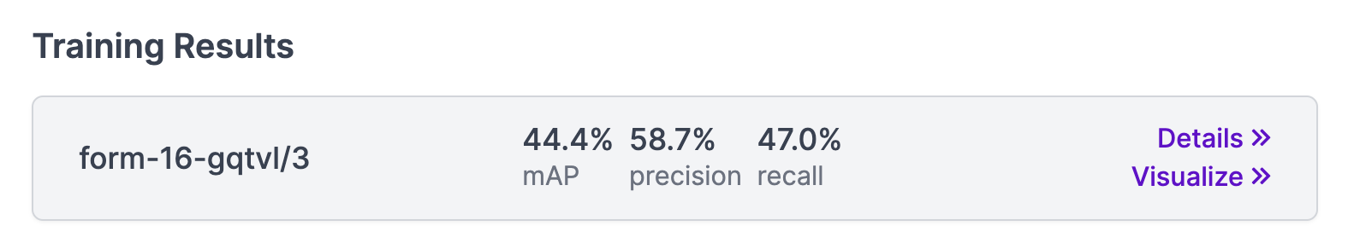
Progress - Training & Testing
Google colab
Used for module dependencies and training
Provides output in labels on input Images
Roboflow Inference API
We can extract response in .json format as well as image with labels on.
API utility for Easy model deployment

Slide 6
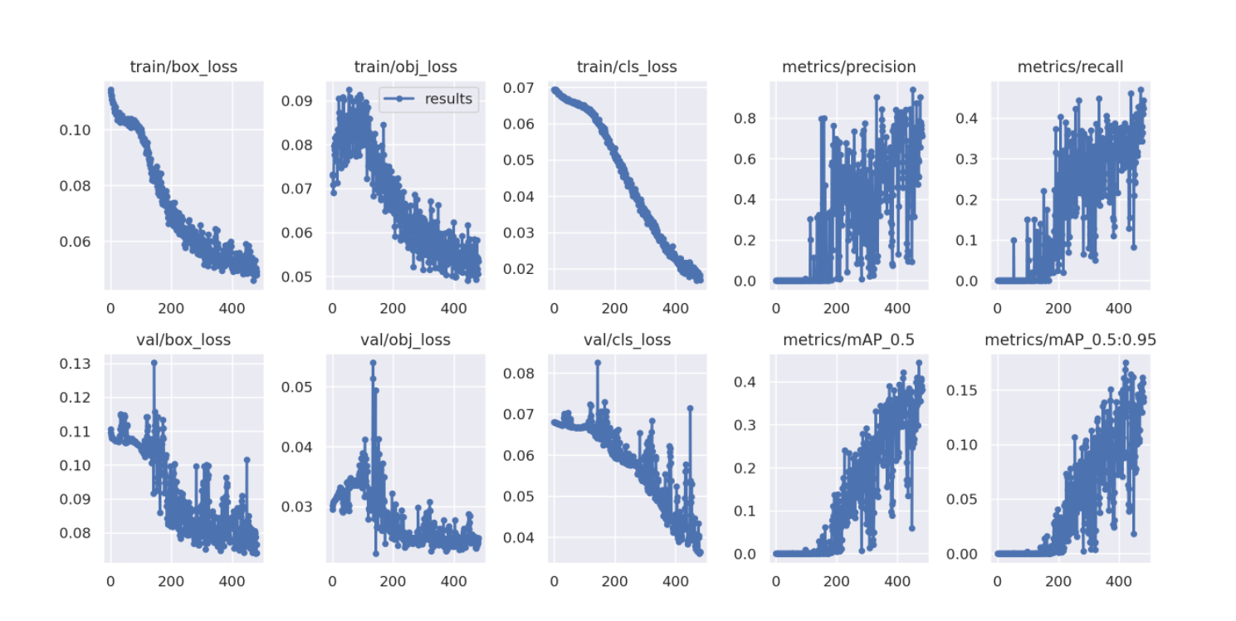
Training - Graphs

Slide 7
Things not Implemented
Text Extraction after Object Detection
Flask Application Deployment
Only Supports Image Formats such as .jpg, .jpeg, .png, .tiff and not the .pdf format as required

Slide 8
Thank You!

