Slide 1
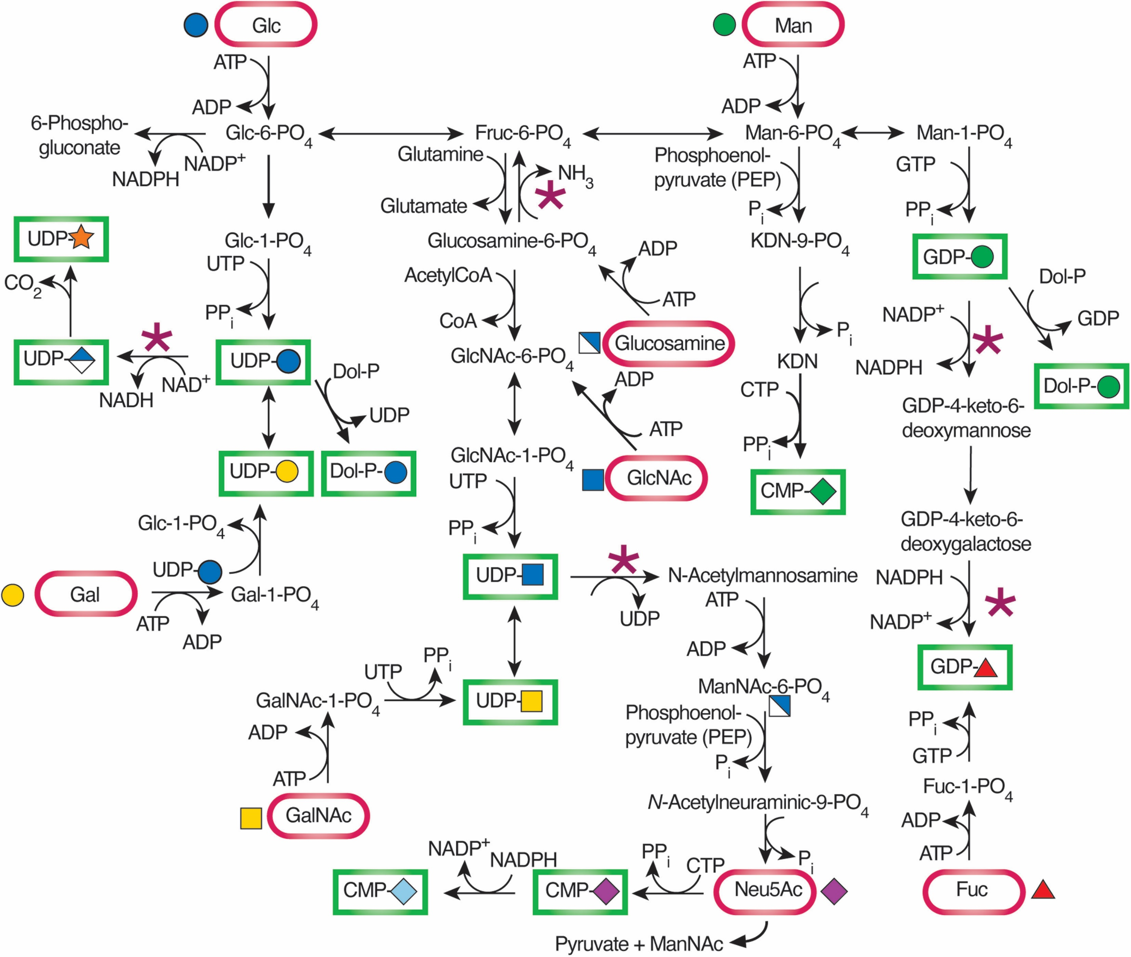
Biosynthesis and Interconversion of Monosaccharides
HK1
Chapter 5, Figure 1. Essentials of Glycobiology, Fourth Edition
Notes:
(Note: Embedded links are present but live only in the slide display mode.)
FIGURE 5.1. Biosynthesis and interconversion of monosaccharides. The relative contributions of each pathway under physiological conditions are unknown. (Rectangles) donors; (ovals) monosaccharides; (asterisks) control points; (Kdn) 2-keto-3-deoxy-D-glycero-D-galactonononic acid; (Dol) dolichol. See Online Appendix 1B for full names and designated symbols for monosaccharides.

