Slide 1

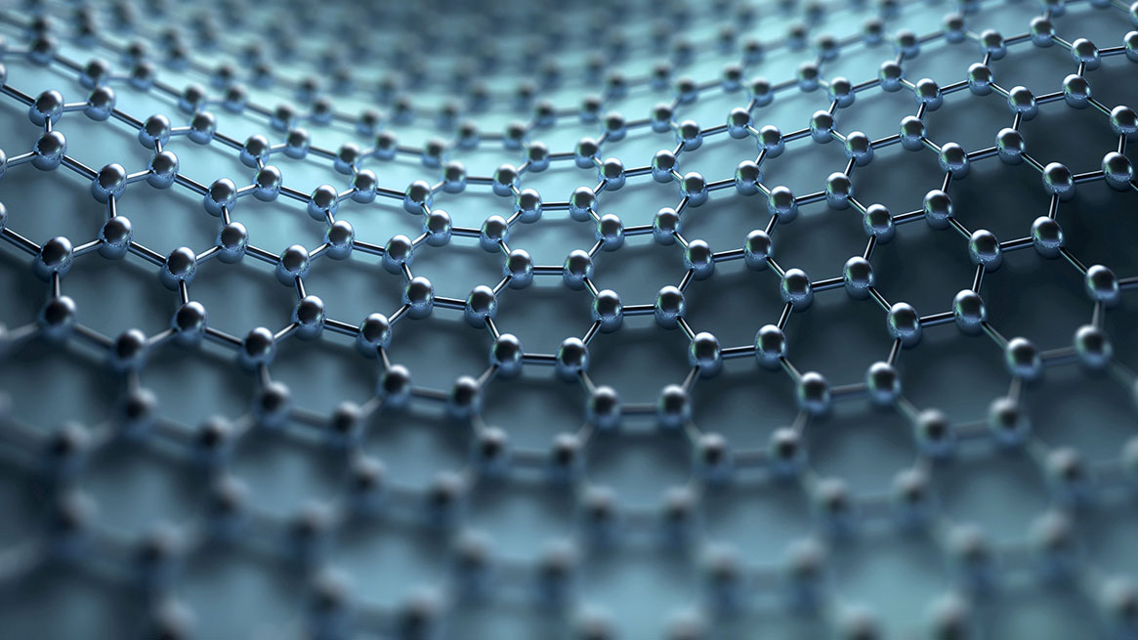
Photo Grouping Application
BY: KARAN PATEL(18IT089)
NEEL PATEL(18IT092)

Slide 2
Outline
Motivation for the Project
Project Goal
Project Description
Limitations of existing Projects
Innovation
Division of responsibility
Tools and Technologies, APIs
Requirements to run the Application
Functional and non-functional requirements
Learning outcome
Further Planning
Courses referred and References

Slide 3
Motivation
To provide photo classification without internet.

Slide 4
Project Goal
The clustering of images is done using machine Learning. The model is trained using unsupervised learning and to support python in app development, Kivy framework is used create a interactive UI.

Slide 5
Project Description
The user has to install this application in their phones.
After completion of installation the path to the dataset has to be provided by the user.
Then after the algorithm will cluster the images and store the images in respective folder.

Slide 6
Limitations of existing projects
Many companies provide the same functionality but we need to upload the images to their servers which uses a lot of internet.
If the server gets hacked, all of user’s data will get leaked.

Slide 7
Division of Responsibility
Karan: front-end of the application i.e. GUI, and linking the front-end and back-end
Neel: back-end of the application, help in linking front-end and back-end.

Slide 8
Flowchart which shows the overall structure and flow of the project (DFD)
Flow chart
Project structure
Encode.py
Encode.pickle
Cluster.py
Recognizing face from dataset using the feature extracted before.
Use:
It is used in serializing and deserializing the python object files.in our case it is features of the face.
Use:
Feature extraction and storing in pickle file
Use:
Face-Clustering
Encode.py
Cluster.py
Dataset
Encode.pickle

Slide 9
Tools and Technologies
Python
Kivy
Libraries
Kivy
KivyMD
Dlib
Cmake
OpenCV
Imutils
Scikit-learn
Algorithm
Histogram of Oriented Gradients (HOG)

Slide 10
Requirements
Hardware Requirement:
Processor: Intel I3 8th generation processor of 3.0GHZ or higher
RAM: Minimum 8 GB primary memory
Hard disk: Minimum 40 GB hard disk space
A keyboard and a mouse
Software Requirement:
Operating System: Any Operating System

Slide 11
Learning Outcome
We have learnt how to develop android app using python frameworks.
We have learned about how to implement clustering using Deep Learning.

Slide 12
Further Planning
We are planning to optimize this code so that the app can easily run on most of android devices.
Also we will be trying to increase the accuracy of the output.

Slide 13
References
https://kivy.org/doc/stable/api-kivy.html
https://kivymd.readthedocs.io/en/latest/index.html
https://www.youtube.com/watch?v=kRWtSkIYPFI&list=PLy5hjmUzdc0nMkzhphsqgPCX62NFhkell
https://en.wikipedia.org/wiki/Histogram_of_oriented_gradients
https://www.learnopencv.com/histogram-of-oriented-gradients/

Slide 14
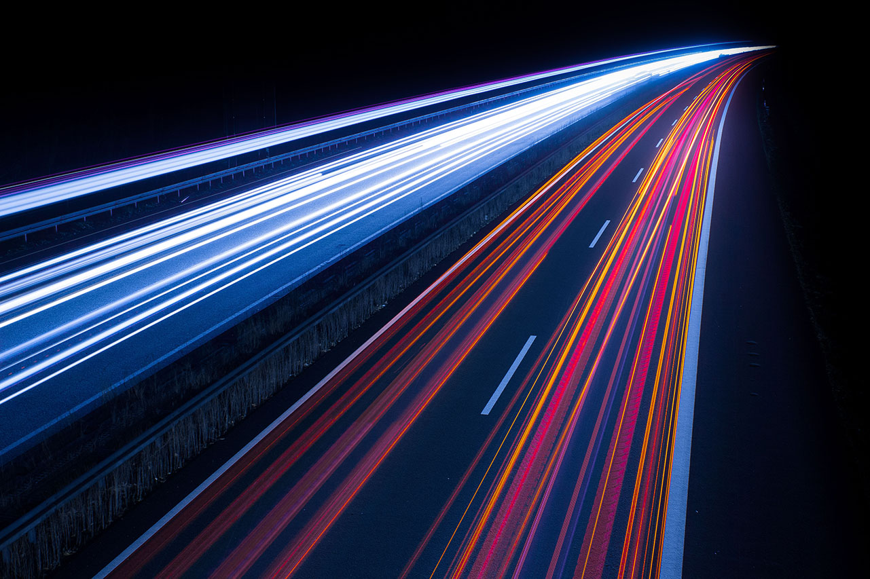
Thank You!

