Slide 1

Ch.4 THREADS
-Riddhi Joshi

Slide 2
Topics Covered
Processes and Threads
Multithreading
Thread Functionality
Example—Adobe PageMaker
User-Level and Kernel-Level Threads
Other Arrangements

Slide 3
Processes and Threads
Processes have two characteristics:
Resource ownership –
Process includes a virtual address space to hold the process image.
From time to time, a process may be allocated control or ownership of
resources, such as main memory, I/O channels, I/O devices, and files.
Scheduling/execution –
Follows an execution path that may be interleaved with other processes
These two characteristics are treated independently by the operating system.
The unit of dispatching is referred to as a thread or lightweight process.
The unit of resource ownership is referred to as a process or task.

Slide 4
Threads
A thread is a single sequence stream within a process.
Because threads have some of the properties of processes, They are called lightweight processes.
A thread (or lightweight process) consists of:
program counter, register set and stack space
A thread shares the following with peer threads:
code section, data section and OS resources (open files, signals)
Threads share code section, data section etc with other threads so the threads are not independent of one another like processes.

Slide 5
Comparison between Process and Threads:-
Similarities:-
Like processes threads share CPU and only one thread Running at a time.
Like processes, threads within a process execute sequentially.

Slide 6
Differences:-
SR. NO: | PROCESSES | THREADS
1 | Process is unit of allocation i.e. Resources, privileges, etc. | Threads are unit of execution which includes pc,sp and register
2 | Each process has one or more threads | Each thread belongs to one process.
3 | Inter process communication is expensive i.e Context switching required | Inter thread communication is cheap. Don't required process switching.
4 | These are secure because one process can not corrupt another process | These are not secure because a thread can write memory used by another thread.
5 | Take more time to create a process. | Takes less time to create a thread.
6 | Take more time to terminate a process | Takes less time to terminate a thread
7 | Take more time to switch between processes | Take less time to switch between threads
8 | It has more communication overheads | It has less communication overheads
9 | Processes are independent of one another. | Threads are not independent of one another.

Slide 7
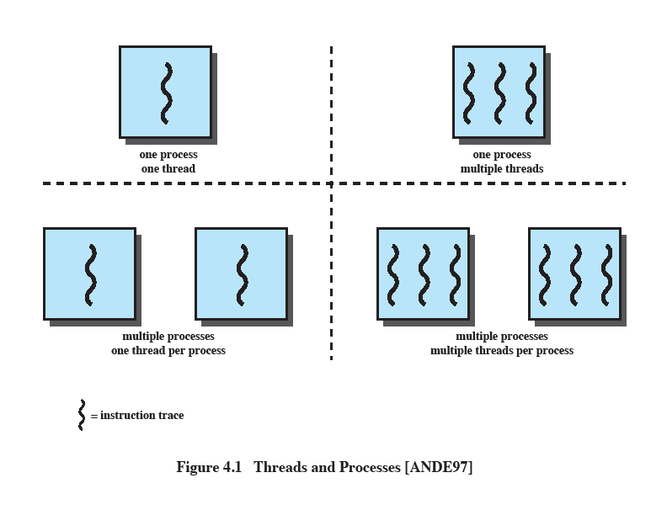
Multithreading
The ability of an OS to support multiple, concurrent paths of execution within a single process.
Notes:
Multithreading refers to the ability of an OS to support multiple, concurrent paths of execution within a single process.

Slide 8
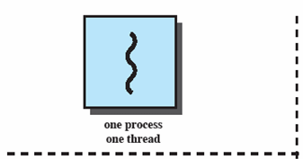
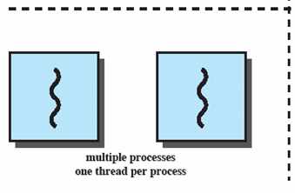
Single Thread Approaches
MS-DOS supports a single user process and a single thread.
Some UNIX, support multiple user processes but only support one thread per process
Notes:
Animated Slide
Onload Enlarges top-left to discuss DOS
Click1: Enlarges bottom-left for Unix
Single Threaded approach: The traditional approach of a single thread of execution per process, in which the concept of a thread is not recognized, examples are
MS DOS (single process, single thread)
Unix (multiple, single threaded processes)

Slide 9
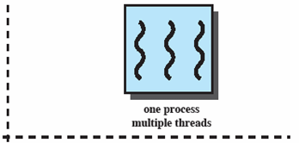
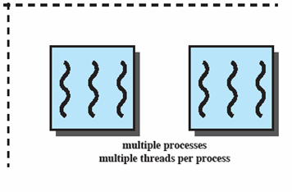
Multithreading
Java run-time environment is a single process with multiple threads
Multiple processes and threads are found in Windows, Solaris, and many modern versions of UNIX
Notes:
Animated Slide
Onload: Emphasis on top-right and JRE (single process, multiple thread),
Click 1: Emphasis on multiple processes with multiple threads – this is the main topic of this chapter
JRE is an example of a system of one process with multiple threads.
Of main interest in this chapter is the use of multiple processes, each of which support multiple threads.
Examples include:
Windows,
Solaris,
and many modern versions of UNIX.

Slide 10
Processes
In a multithreaded environment, a process is defined as the unit of resource
allocation and a unit of protection.
The following are associated with processes:
A virtual address space which holds the process image
Protected access to Processors, Other processes, Files, I/O resources
Within a process, there may be one or more threads
Each thread has
An execution state (running, ready, etc.)
Saved thread context when not running
An execution stack
Some per-thread static storage for local variables
Access to the memory and resources of its process (all threads of a process share this)
One way to view a thread is as an independent program counter operating within a process.
Notes:
In a multithreaded environment, a process is defined as the unit of resource allocation and a unit of protection.

Slide 11
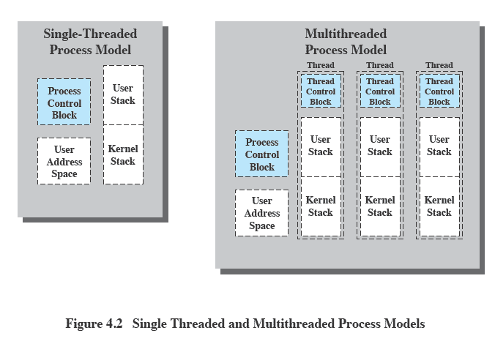
Threads vs. processes
Notes:
Distinction between threads and processes from the point of view of process management.
In a single-threaded process model, the representation of a process includes
its process control block
user address space,
user and kernel stacks to manage the call/return behaviour of the execution of the process.
While the process is running, it controls the processor registers. The contents of these registers are saved when the process is not running.
In a multithreaded environment,
there is still a single process control block and user address space associated with the process,
but separate stacks for each thread,
as well as a separate control block for each thread containing register values, priority, and other thread-related state information.
Thus, all of the threads of a process share the state and resources of that process.
They reside in the same address space and have access to the same data.
When one thread alters an item of data in memory, other threads see the results if and when they access that item.
If one thread opens a file with read privileges, other threads in the same process can also read from that file.

Slide 12
Threads vs. processes
In a single-threaded process model the representation of a process includes:-
process control block,
user address space,
user and kernel stacks to manage the call/return behavior of the process.
In a multithreaded environment, there is
a single process control block
Single user address space
But separate stacks for each thread,
separate control block for each thread containing register values, priority, and other thread-related state information.

Slide 13
Threads
The key benefits of threads derive from the performance implications:
(1) It takes far less time to create a new thread in an existing process than to create a brand-new process.
(2) It takes less time to terminate a thread than a process.
(3) It takes less time to switch between two threads within the same process than to switch between processes.
(4) Threads enhance efficiency in communication between different executing programs.

Slide 14
Thread use in a Single-User System
Uses of threads in a single-user multiprocessing system:
Foreground and background work :
e.g. Spreadsheet - one thread looking after display and Another thread updating results of formula.
Asynchronous processing:
e.g. Protection against power failure within a word processor-
A thread writes random access memory (RAM) buffer to disk once every minute.
this thread schedules itself directly with the OS;
Speed of execution:
A multithreaded process can compute one batch of data while reading the next batch from a device.
On a multiprocessor system, multiple threads from the same process may be able to execute simultaneously.
Notes:
Foreground and background work
e.g. Spreadsheet
– one thread looking after display
Another thread updating results of formulae
Asynchronous processing
E.G. protection against power failure within a word processor,
A thread writes random access memory (RAM) buffer to disk once every minute.
this thread schedules itself directly with the OS;
no need for fancy code in the main program to provide for time checks or to coordinate input and output.
Speed of execution
- On thread can compute one batch of data while another thread reading the next batch from a device.
On a multiprocessor system, multiple threads from the same process may be able to execute simultaneously.
Even though one thread may be blocked for an I/O operation to read in a batch of data, another thread may be executing.
Modular program structure
- Threads make it easier to design programs which involve a variety of activities or a variety of sources and destinations of input and output.

Slide 15
Thread use in a Single-User System
Modular program structure:
Threads make it easier to design programs which involve a variety of activities or a variety of sources and destinations of input and output
Threads
Several actions that affect all of the threads in a process
The OS must manage these at the process level.
Examples:
Suspending a process involves suspending all threads of the process
Termination of a process, terminates all threads within the process

Slide 16
Thread Execution States
The key states for a thread are Running, Ready, and Blocked.
There are four basic thread operations associated with a change in thread state
(1)Spawn (another thread):-
When a new process is spawned, a thread for that process is also spawned.
A thread within a process may spawn another thread within the same process.
(2)Block:-
When a thread needs to wait for an event, it will block
(3)Unblock:-
When the event for which a thread is blocked occurs, the thread is moved to
the Ready queue.
(4)Finish :-
When a thread completes, its register context and stacks are deallocated.
Notes:
A significant issue is whether the blocking of a thread results in the blocking of the entire process.
If one thread in a process is blocked, does this prevent the running of any other thread in the same process even if that other thread is in a ready state?
Clearly, some of the flexibility and power of threads is lost if the one blocked thread blocks an entire process.

Slide 17
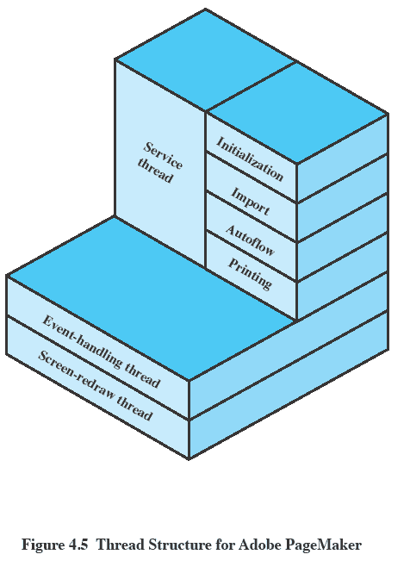
Example:- Adobe PageMaker
An example of the use of threads is the Adobe PageMaker application running under a shared system.
PageMaker is a writing, design, and production tool for desktop publishing.
Notes:
An example of the use of threads is the Adobe PageMaker application running under a shared system.
Three threads are always active:
an event-handling thread,
a screen-redraw thread,
a service thread.

Slide 18
Que:- Write a note on categories of thread implementation.
Categories of Thread Implementation
There are two broad categories of thread implementation: user-level threads
User Level Thread (ULT)
Kernel level Thread (KLT) also called:
kernel-supported threads
lightweight processes.
User Threads
Thread management done by user-level threads library
Supported above the kernel, via a set of library calls at the user level.
Threads do not need to call OS and cause interrupts to kernel - fast.
Example thread libraries:
POSIX threads
Win32 threads
Java threads

Slide 19
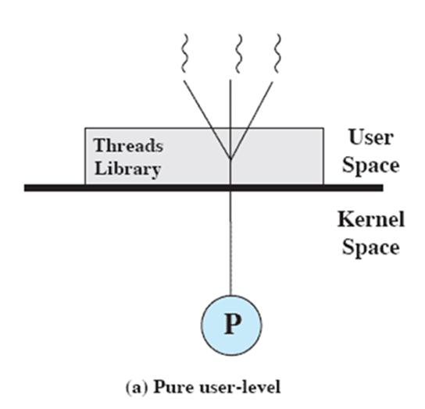
User-Level Threads
All thread management is done by the application
The kernel is not aware of the existence of threads
Figure 4.6a illustrates the pure ULT approach.
Any application can be programmed to be multithreaded by using a threads library, which is a package of routines for ULT management.
By default, an application begins with a single thread and begins running in that thread.
This application and its thread are allocated to a single process managed by the kernel.

Slide 20
Disadvantages Of User-Level Threads
There are two distinct disadvantages of ULTs compared to KLTs:
1.
In a typical OS, many system calls are blocking.
As a result, when a ULT executes a system call, not only is that thread blocked, but
also all of the threads within the process are blocked.
2.
In a pure ULT strategy, a multithreaded application cannot take advantage of
multiprocessing.
A kernel assigns one process to only one processor at a time.
Therefore, only a single thread within a process can execute at a time.

Slide 21
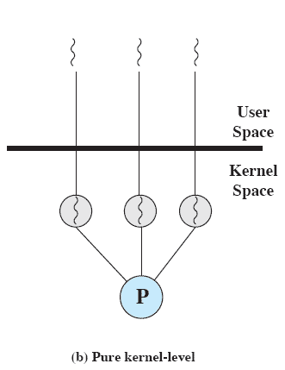
Kernel -Level Threads
All of the work of thread management is
done by the kernel.
There is no thread management code in the
application level.
Figure 4.6b depicts the pure KLT approach.
The kernel maintains context information for the process as a whole and for individual threads within the process.
Scheduling by the kernel is done on a thread basis.

Slide 22
Advantages of KLT
The kernel can simultaneously schedule multiple threads from the same process on multiple processors.
If one thread in a process is blocked, the kernel can schedule another thread of the same process.
Kernel routines themselves can be multithreaded.
Disadvantages of KLT
The transfer of control from one thread to another within the same process requires a mode switch to the kernel

Slide 23
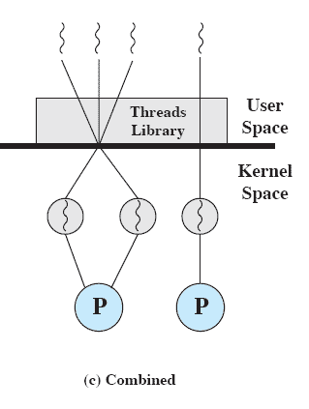
Combined Approaches
Thread creation is done completely in user space, as is the bulk of the scheduling and synchronization of threads within an application.
The multiple ULTs from a single application are mapped onto some (smaller or equal) number of KLTs
Multiple threads within the same
application can run in parallel on multiple
processors, and a blocking system call need
not block the entire process
Notes:
In a combined approach, multiple threads within the same application can run in parallel on multiple processors,
and a blocking system call need not block the entire process.
If properly designed, this approach should combine the advantages of the pure ULT and KLT approaches while minimizing the disadvantages.

Slide 24
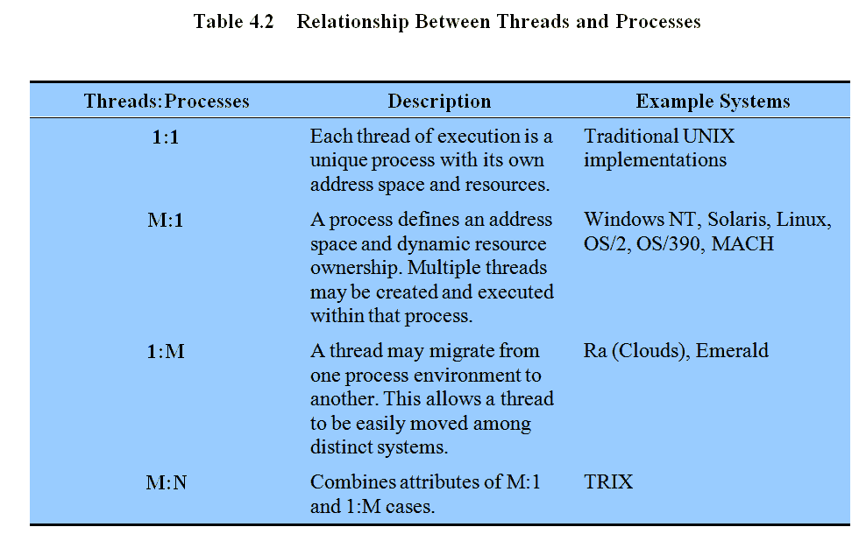
Relationship Between Thread and Processes
Notes:
The concepts of resource allocation and dispatching unit have traditionally been embodied in the single concept of the process; that is, as a 1 : 1 relationship between threads and processes.
There has been much interest in providing for multiple threads within a single process, which is a many-to-one relationship
.
However, as the table shows, the other two combinations have also been investigated, namely,
a many-to-many relationship and
a one-to-many relationship.

Slide 25
Questions
Q-1: Write a note on Relationship between Thread & Processes.
(comparision and difference)
Q-2: Explain The two broad categories of Threads

