Slide 1
UNIT -5
DISTRIBUTED SYSTEMS
Ch.16
DISTRIBUTED PROCESSING, CLIENT/SERVER, AND CLUSTERS
Riddhi Joshi

Slide 2
Roadmap
Client/Server Computing
Distributed message passing
Remote Procedure Calls
Clusters
Notes:
We begin with an introduction to the topic of Distributed Data Processing then move on to examine some of the key concepts in distributed software, including client/server architecture, message passing, and remote procedure calls.
Then we examine the increasingly important cluster architecture.

Slide 3
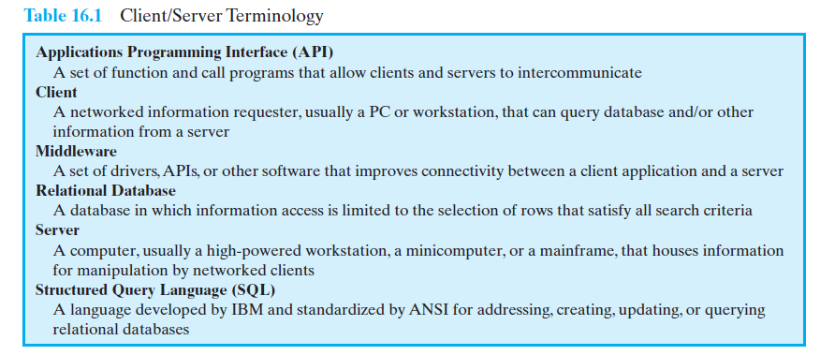
Client/Server Terminology

Slide 4
Client/Server Computing
The client machines are generally single-user PCs or workstations that provide a
highly user-friendly interface to the end user.
The client-based station generally presents the type of graphical interface that
is most comfortable to users, including the use of windows and a mouse.
Microsoft Windows and Macintosh OS provide examples of such interfaces.
Client-based applications are tailored for ease of use and include such familiar
tools as the spreadsheet.
Each server in the client/server environment provides a set of shared services to the
clients.
The most common type of server currently is the database server, usually
controlling a relational database.
The server enables many clients to share access to the same database and
enables the use of a high-performance computer system to manage the
database.

Slide 5
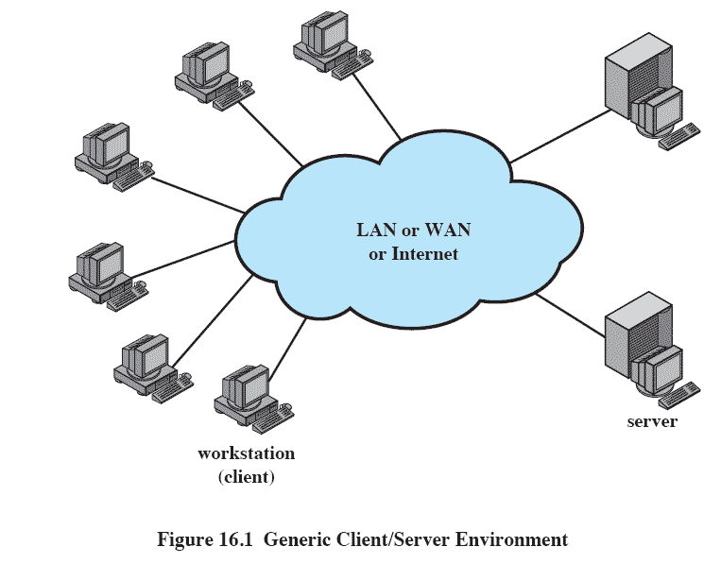
Generic Client/Server Environment
Notes:
The third essential ingredient of the client/server environment is the network.
Client/server computing is typically distributed computing.
Users, applications, and resources are distributed in response to business requirements and linked by a single LAN or WAN or by an internet of
networks.

Slide 6
Generic Client/Server Environment
The third essential ingredient of the client/server environment is
the network.
Client/server computing is typically distributed computing.
Users, applications, and resources are distributed in response to
business requirements and linked by a single LAN or WAN or by
an internet of networks.

Slide 7
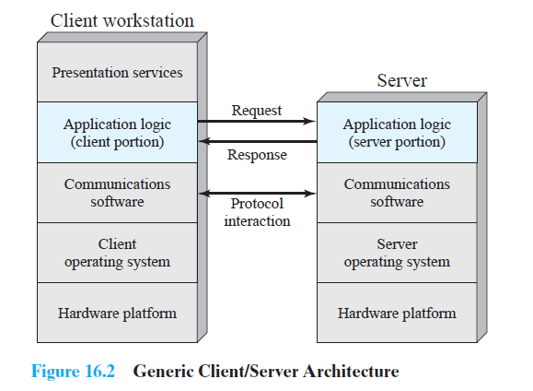
Client/Server Applications
The key feature of a client/server architecture is the allocation of application-level
tasks between clients and servers.

Slide 8
Client/Server Applications
In both client and server, the basic software is an operating system running on the
hardware platform.
It is the communications software that enables client and server to interoperate.
The principal example of such software is TCP/IP.
Ideally, the actual functions performed by the application can be split up between
client and server in a way that optimizes the use of resources.
In some cases, depending on the application needs, the bulk of the applications
software executes at the server, while in other cases, most of the application logic
is located at the client.
An essential factor in the success of a client/server environment is the way in
which the user interacts with the system as a whole.
In most client/server systems, there is heavy emphasis on providing a graphical
user interface (GUI).
Thus, we can think of a presentation services module in the client workstation that
is responsible for providing a user-friendly interface.

Slide 9
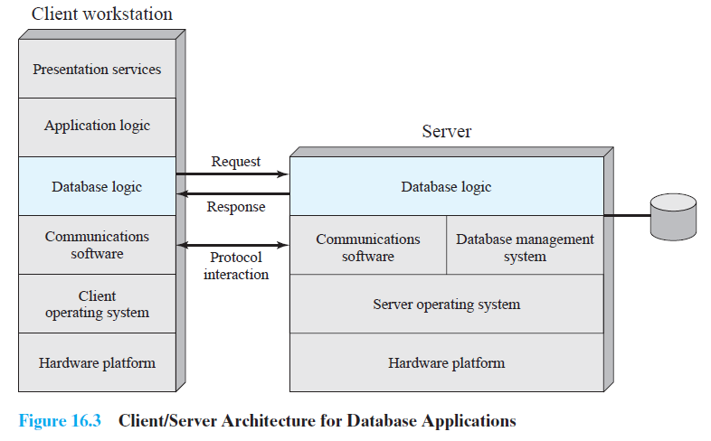
Database Applications

Slide 10
Database Applications
In this, the server is essentially a database server
client makes a database request and receives a database response.
Figure 16.3 suggests that all of the application other types of data
analysis—is on the client side, while the server is only concerned
with managing the database

Slide 11
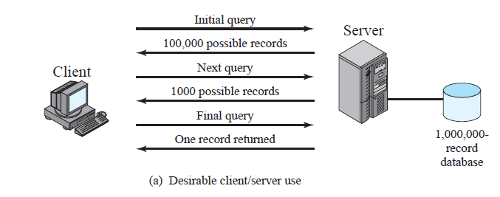
Client/Server Data base Usage

Slide 12
Client/Server Database Usage
Figure 16.4a, Suppose that the server is maintaining a database of 1 million
records and the user wants to perform a lookup that should result in zero, one,
or at most a few records.
The user could search for these records using a number of search criteria
An initial client query may yield a server response that there are 100,000
records that satisfy the search criteria.
The user then adds additional qualifiers and issues a new query.This time, a
response indicating that there are 1000 possible records is returned.
Finally, the client issues a third request with additional qualifiers. The resulting
search criteria yield a single match, and the record is returned to the client.

Slide 13
Classes of Client/Server Architecture
A spectrum of implementations exist.
Four general classes are:
Host-based processing
Server-based processing
Cooperative processing
Client-based processing
Notes:
Within the general framework of client/server, there is a spectrum of implementations that divide the work between client and server differently.
There are other ways of classifying client/server arrangements.

Slide 14
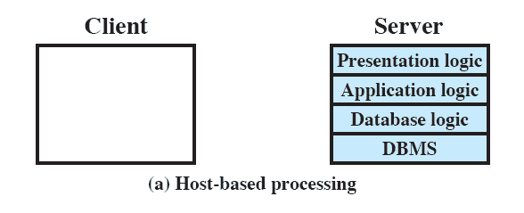

Host-based processing
Not true client/server computing
Traditional mainframe environment
all or virtually all of the processing is done on a central host.
Host-based processing is not true client/server computing as the term is generally used.
Rather, host-based processing refers to the traditional mainframe environment in which all or
virtually all of the processing is done on a central host.
Often the user interface is via a dumb terminal.
Even if the user is employing a microcomputer, the user’s station is generally limited to
the role of a terminal emulator.
Notes:
Host-based processing is not true client/server computing as the term is generally used.
Rather, host-based processing refers to the traditional mainframe environment in which all or virtually all of the processing is done on a central host.
Often the user interface is via a dumb terminal.
Even if the user is employing a microcomputer, the user’s station is generally limited to the role of a terminal emulator.

Slide 15
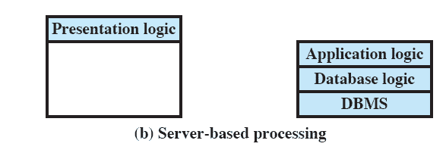
Server-based processing
Server does all the processing
Client provides a graphical user interface
Figure 16.5b is representative of a thin client approach.
Notes:
The most basic class of client/server configuration is one in which the client is principally responsible for providing a graphical user interface, while virtually all of the processing is done on the server.
This configuration is typical of early client/server efforts, especially departmental-level systems.
The rationale behind such configurations is that the user workstation is best suited to providing a user-friendly interface and that databases and applications can easily be maintained on central systems.
Although the user gains the advantage of a better interface, this type of configuration does not generally lend itself to any significant gains in productivity or to any fundamental changes in the actual business functions that the system supports.

Slide 16
Server-based processing
The most basic class of client/server configuration is one in which the client is principally responsible for providing a graphical user interface, while virtually all of the processing is done on the server.
This configuration is typical of early client/server efforts, especially departmental-level systems.
The rationale behind such configurations is that the user workstation is best suited to providing a user-friendly interface and that databases and applications can easily be maintained on central systems.
Although the user gains the advantage of a better interface, this type of configuration does not generally lend itself to any significant gains in productivity or to any fundamental changes in the actual business functions that the system supports.

Slide 17
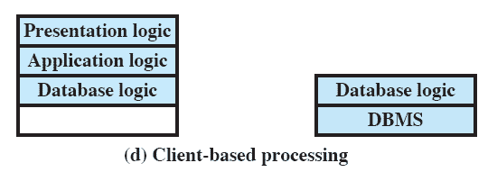
Client-based processing
All application processing done at the client
Data validation routines and other database logic functions are done at the server
Notes:
Virtually all application processing may be done at the client, with the exception of data validation routines and other database logic functions that are best performed at the server.
Generally, some of the more sophisticated database logic functions are housed on the client side.
This architecture is perhaps the most common client/server approach in current use.
It enables the user to employ applications tailored to local needs.

Slide 18
Client-based processing
Virtually all application processing may be done at the client, with the exception of data validation routines and other database logic functions that are best performed at the server.
Generally, some of the more sophisticated database logic functions are housed on the client side.
This architecture is perhaps the most common client/server approach in current use.
It enables the user to employ applications tailored to local needs.
Figures 16.5c and d correspond to configurations in which a
considerable fraction of the load is on the client. This so-called fat client
model.

Slide 19
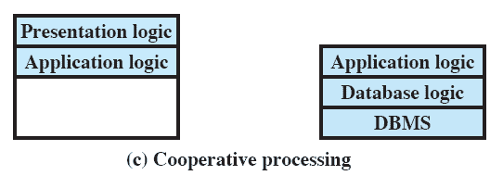
Cooperative processing
Application processing is performed in an optimized fashion
Complex to set up and maintain
Offers greater productivity and efficiency
The application processing is performed in an optimized fashion, taking advantage of the strengths of both client and server machines and of the distribution of data.
Such a configuration is more complex to set up and maintain but, in the long run, this type of configuration may offer greater user productivity gains and greater network efficiency than other client/server approaches.
Notes:
The application processing is performed in an optimized fashion, taking advantage of the strengths of both client and server machines and of the distribution of data.
Such a configuration is more complex to set up and maintain but, in the long run, this type of configuration may offer greater user productivity gains and greater network efficiency than other client/server approaches.

Slide 20
Three-tier Client/Server Architecture
The traditional client/server architecture involves two levels, or tiers:
a client tier and
a server tier.
A three-tier architecture is also common.
The application software is distributed among three types of machines:
a user machine,
a middle-tier server, and
a backend server.
The middle-tier machines are essentially gateways between the thin user clients and a variety of backend database servers.
The middle-tier machines can convert protocols and map from one type of database query to another.
Also, the middle-tier machine can merge/integrate results from different data sources.
The middle-tier machine can serve as a gateway between the desktop applications and the backend legacy applications by mediating between the two worlds.
The interaction between the middle-tier server and the backend server also follows the client/server model.
Thus, the middle-tier system acts as both a client and a server.

Slide 21
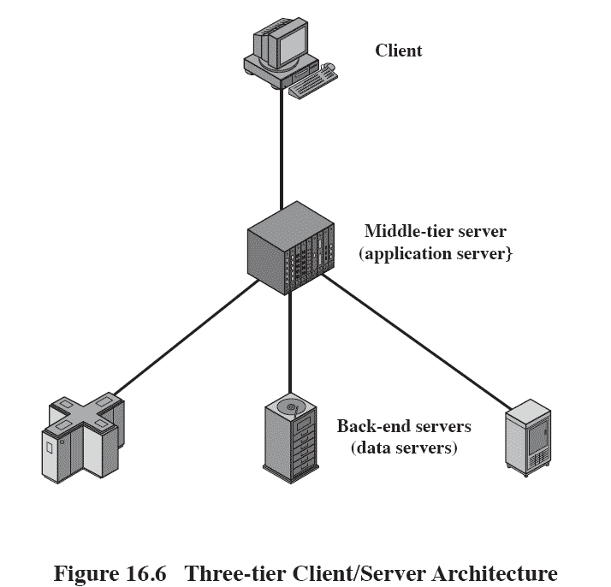
Three-tier Client/Server Architecture

Slide 22
Middleware Architecture
Figure 16.8 suggests the role of middleware in a client/server
architecture.
Note that there is both a client and server component of
middleware.
The basic purpose of middleware is to enable an application or
user at a client to access a variety of services on servers without
being concerned about differences among servers .

Slide 23
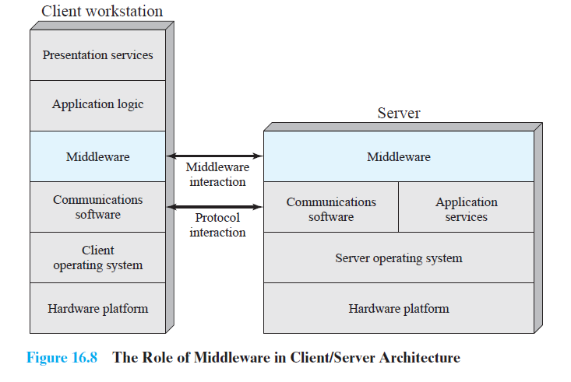
Middleware Architecture

Slide 24
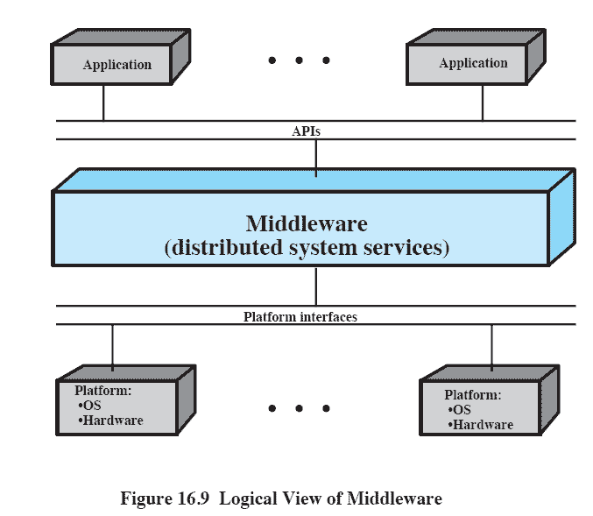
Logical View of Middleware
Notes:
This figure looks at the role of middleware from a logical, rather than an implementation, point of view.
Middle-ware enables the realization of the promise of distributed client/server computing.
The entire distributed system can be viewed as a set of applications and resources available to users.
Users need not be concerned with the location of data or indeed the location of applications.
All applications operate over a uniform applications programming interface (API).
The middleware, which cuts across all client and server platforms, is responsible for routing client requests to the appropriate server.

Slide 25
Logical View of Middleware
This figure looks at the role of middleware from a logical, rather than an implementation, point of view.
Middle-ware enables the realization of the promise of distributed client/server computing.
The entire distributed system can be viewed as a set of applications and resources available to users.
Users need not be concerned with the location of data or indeed the location of applications.
All applications operate over a uniform applications programming interface (API).
The middleware, which cuts across all client and server platforms, is responsible for routing client requests to the appropriate server.

Slide 26
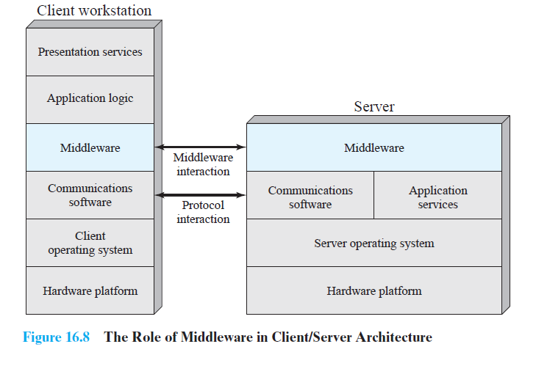
Logical View of Middleware

Slide 27
Roadmap
Client/Server Computing
Distributed message passing
Remote Procedure Calls
Clusters

Slide 28
Interprocess Communication (IPC)
Usually, in a distributed processing system, the computers do not share main memory.
Each is an isolated computer system.
Interprocessor communication techniques that rely on shared memory, such as semaphores, cannot be used.
Instead, techniques that rely on message passing are used.
Notes:
Usually, in a distributed processing system, the computers do not share main memory.
Each is an isolated computer system.
Interprocessor communication techniques that rely on shared memory, such as semaphores, cannot be used.
Instead, techniques that rely on message passing are used.

Slide 29
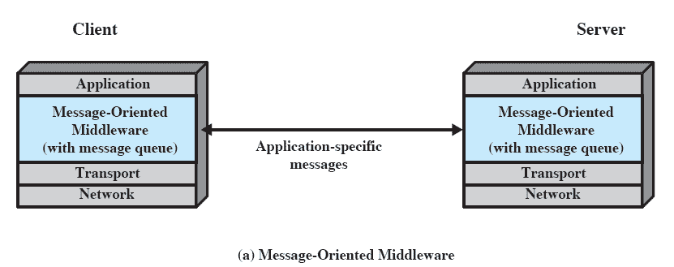

Distributed Message Passing
Notes:
This figure shows the use of message passing to implement client/server functionality.
A client process requires some service (e.g., read a file, print)
It sends a message containing a request for service to a server process.
The server process honours the request and sends a message containing a reply.
In its simplest form, only two functions are needed: Send and Receive.

Slide 30
Distributed Message Passing
This figure shows the use of message passing to implement client/server functionality.
A client process requires some service (e.g., read a file, print)
It sends a message containing a request for service to a server process.
The server process honours the request and sends a message containing a reply.
In its simplest form, only two functions are needed: Send and Receive.

Slide 31
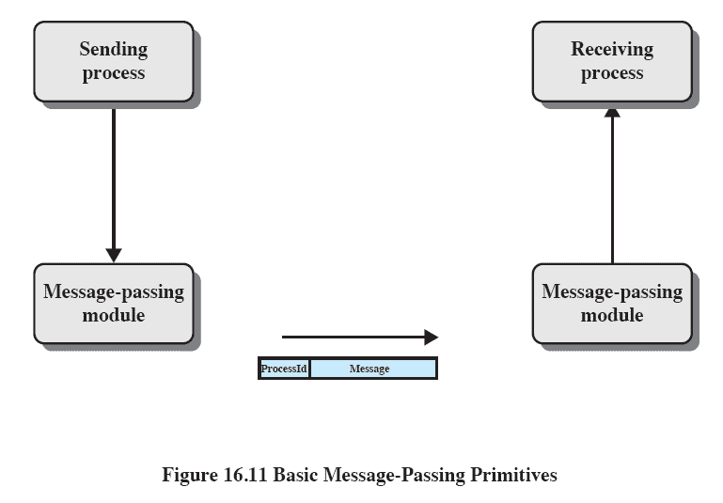
Basic Message-Passing Primitives
Notes:
This figure suggests an implementation for message passing.
Processes make use of the services of a message-passing module.
Service requests can be expressed in terms of primitives and parameters.
A primitive specifies the function to be performed, and the parameters are used to pass data and control information.
The actual form of a primitive depends on the message-passing software.
It may be a procedure call or it may itself be a message to a process that is part of the operating system.

Slide 32
Basic Message-Passing Primitives
This figure suggests an implementation for message passing.
Processes make use of the services of a message-passing module.
Service requests can be expressed in terms of primitives and parameters.
A primitive specifies the function to be performed, and the parameters are used to pass data and control information.
The actual form of a primitive depends on the message-passing software.
It may be a procedure call or it may itself be a message to a process that is part of the operating system.

Slide 33
Roadmap
Client/Server Computing
Distributed message passing
Remote Procedure Calls
Clusters

Slide 34
Remote Procedure Calls
A variation on the basic message-passing model is the remote procedure call.
This is now a widely accepted and common method for encapsulating communication
in a distributed system.
The essence of the technique is to allow programs on different machines to interact using
simple procedure call/return semantics, just as if the two programs were on the same
machine.
That is, the procedure call is used for access to remote services.
The popularity of this approach is due to the following advantages.
1. The procedure call is a widely accepted, used, and understood abstraction.
2. The use of remote procedure calls enables remote interfaces to be specified as a set of
named operations with designated types.
Thus, the interface can be clearly documented and distributed programs can be
statically checked for type errors.
3. Because a standardized and precisely defined interface is specified, the communication
code for an application can be generated automatically
4. Because a standardized and precisely defined interface is specified, developers can write
client and server modules that can be moved among computers and operating systems
with little modification and recoding.

Slide 35
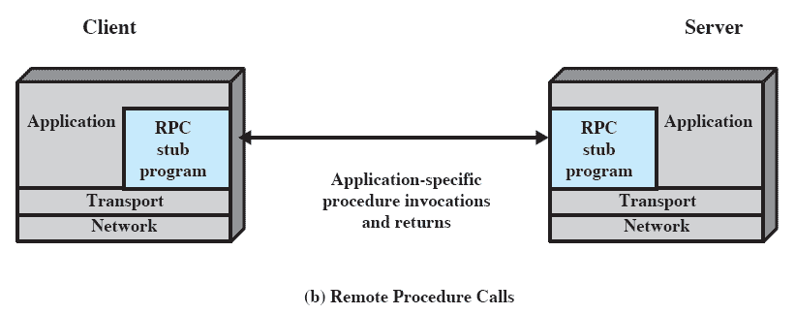
RPC Architecture
Notes:
This figure illustrates the general architecture of a RPC

Slide 36
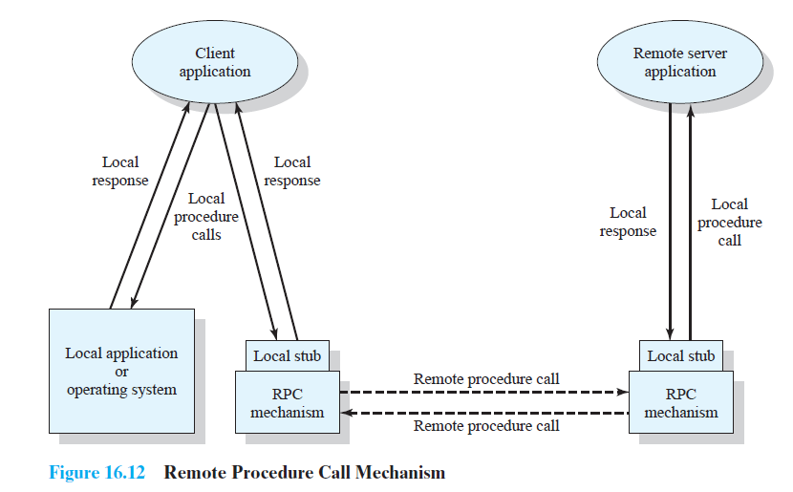
Remote Procedure Call Mechanism

Slide 37
Remote Procedure Call Mechanism
The calling program makes a normal procedure call with parameters on its machine.
For example, CALL P(X,Y) where
P = procedure name
X = passed arguments
Y = returned values
This procedure creates a message that identifies the procedure being called and includes
the parameters.
It then sends this message to a remote system and waits for a reply
When a reply is received, the stub procedure returns to the calling program, providing the
returned values.
At the remote machine, another stub program is associated with the called procedure.
When a message comes in, it is examined and a local CALL P(X, Y) is generated.
This remote procedure is thus called locally, so its normal assumptions about where to find n
parameters, the state of the stack, and so on are identical to the case of a purely local
procedure call.

Slide 38
Design issues - RPC
Parameter Passing
Most programming languages allow parameters to be passed as values -call by
value or call by reference
Call by value is simple for a remote procedure call:
the parameters are simply copied into the message and sent to the remote system.
It is more difficult to implement call by reference.
A unique, system wide pointer is needed for each object.
Parameter Representation
Another issue is how to represent parameters and results in messages.
If the called and calling programs are in identical programming languages on the same type of
machines with the same operating system, then the representation requirement may present
no problems.
If there are differences in these areas, then there will probably be differences in the ways in
which numbers and even text are represented.
The best approach to this problem is to provide a standardized format for common objects,
such as integers, floating-point numbers, characters, and character strings.
Then the native parameters on any machine can be converted to and from the standardized
representation.

Slide 39
Client/Server Binding
Binding specifies how the relationship between a remote procedure and the calling
Program will be established.
A binding is formed when two applications have made a logical connection and are
prepared to exchange commands and data.
Nonpersistent binding means that a logical connection is established between the two
processes at the time of the remote procedure call and that as soon as the values are
returned, the connection is dismantled.
Because a connection requires the maintenance of state information on both ends, it
consumes resources.
The non-persistent style is used to conserve those resources.
But, the overhead involved in establishing connections makes nonpersistent binding
inappropriate for remote procedures that are called frequently by the same caller.
With persistent binding, a connection that is set up for a remote procedure call is sustained
after the procedure return.
The connection can then be used for future remote procedure calls.
If a specified period of time passes with no activity on the connection, then the
connection is terminated.
For applications that make many repeated calls to remote procedures, persistent binding
maintains the logical connection and allows a sequence of calls and returns to use the same
connection.

Slide 40
Synchronous versus Asynchronous
The concepts of synchronous and asynchronous remote procedure calls are
analogous to the concepts of blocking and nonblocking messages.
The traditional remote procedure call is synchronous, which requires that the
calling process wait until the called process returns a value.
Thus, the synchronous RPC behaves much like a sub-routine call.
The synchronous RPC is easy to understand and program because its behaviour
is predictable.
However, it fails to exploit fully the parallelism inherent in distributed
applications.
To provide greater flexibility, various asynchronous RPC facilities have been
implemented to achieve a greater degree of parallelism while retaining the
familiarity and simplicity of the RPC.
Asynchronous RPCs do not block the caller;
the replies can be received as and when they are needed, thus allowing
client execution to proceed locally in parallel with the server invocation.

Slide 41
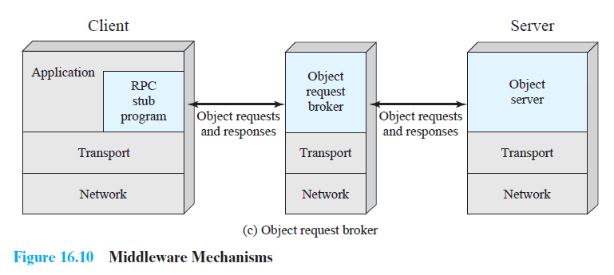
Object-Oriented Mechanisms

Slide 42
Object-Oriented Mechanisms
As object-oriented technology becomes more prevalent in operating system design, client/server designers have begun to embrace this approach.
In this approach, clients and servers ship messages back and forth between objects.
Object communications may rely on an underlying message or RPC structure or be
developed directly on top of object-oriented capabilities in the operating system.
A client that needs a service sends a request to an object request broker, which acts as a directory of all the remote service available on the network.
The broker calls the appropriate object and passes along any relevant data.
Then the remote object services the request and replies to the broker, which returns the response to the client.

Slide 43
Roadmap
Client/Server Computing
Distributed message passing
Remote Procedure Calls
Clusters

Slide 44
Clusters
Clustering is an alternative to symmetric multiprocessing (SMP) as an approach
to providing high performance and high availability and is particularly attractive
for server applications.
A cluster as a group of interconnected, whole computers working together as a
unified computing resource that can create the illusion of being one machine.
The term whole computer means a system that can run on its own, apart from
the cluster;
Each computer in a cluster is typically referred to as a node.

Slide 45
Benefits of Clusters
Absolute scalability:
It is possible to create large clusters that far surpass the power of even the largest standalone machines.
A cluster can have dozens or even hundreds of machines, each of which is a multiprocessor.
Incremental scalability:
A cluster is configured in such a way that it is possible to add new systems to the cluster in small increments.
Thus, a user can start out with a modest system and expand it as needs grow, without having to go through a major upgrade in which an existing small system is replaced with a larger system.
High availability:
Because each node in a cluster is a standalone computer, the failure of one node does not mean loss of service.
In many products, fault tolerance is handled automatically in software.
Superior price/performance:
By using commodity building blocks, it is possible to put together a cluster with equal or greater computing power than a single large machine, at much lower cost.

Slide 46
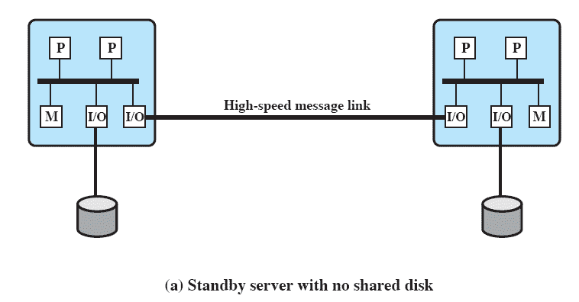
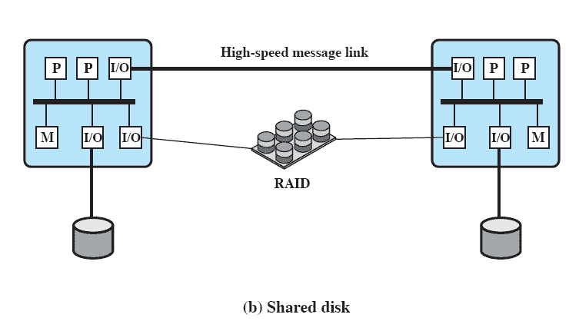
Cluster Configuration
Figure 16.13 Cluster Configurations

Slide 47
Cluster Configuration
Clusters are classified in a number of different ways.
Perhaps the simplest classification is based on whether the computers in a cluster share access to the same disks.
Figure “a” shows a two-node cluster in which the only interconnection is by means of a high-speed link that can be used for message exchange to coordinate cluster activity.
The link can be a LAN that is shared with other computers that are not part of the cluster
or the link can be a dedicated interconnection facility.
Figure – “b” shows the other alternative – a shared-disk cluster.
In this case, there generally is still a message link between nodes.
Also there is a disk subsystem that is directly linked to multiple computers within the cluster.
In Figure “b”, the common disk subsystem is a RAID system.
The use of RAID or some similar redundant disk technology is common in clusters so that the high availability achieved by the presence of multiple computers is not compromised by a shared disk that is a single point of failure.

Slide 48
Clustering Methods:
Passive standby:-
It is simply to have one computer handle all of the processing load while the other
computer remains inactive, standing by to take over in the event of a failure of the primary.
To coordinate the machines, the active, or primary, system periodically sends a “heartbeat” message to the standby machine.
If these messages stop arriving, the standby assumes that the primary server has failed and puts itself into operation.
Active secondary:-
The passive standby is generally not referred to as a cluster.
The term cluster is reserved for multiple interconnected computers that are all actively doing processing while maintaining the image of a single system to the outside world.
The term Active secondary is often used in referring to this configuration.

Slide 49
Three classifications of clustering can be identified
Separate server:-
In one approach to clustering, each computer is a separate server with its own disks and
there are no disks shared between systems (Figure 16.13a).
For this to happen, data must constantly be copied among systems
Servers Connected to Disks
To reduce the communications overhead, most clusters now consist of servers
connected to common disks (Figure 16.13b)
In one variation of this approach, called shared nothing, the common disks are partitioned
into volumes, and each volume is owned by a single computer
Servers Share Disks
It is also possible to have multiple computers share the same disks at the same time (called
the shared disk approach),
so that each computer has access to all of the volumes on all of the disks.
This approach requires the use of some type of locking facility to ensure that data can only
be accessed by one computer at a time.

Slide 50
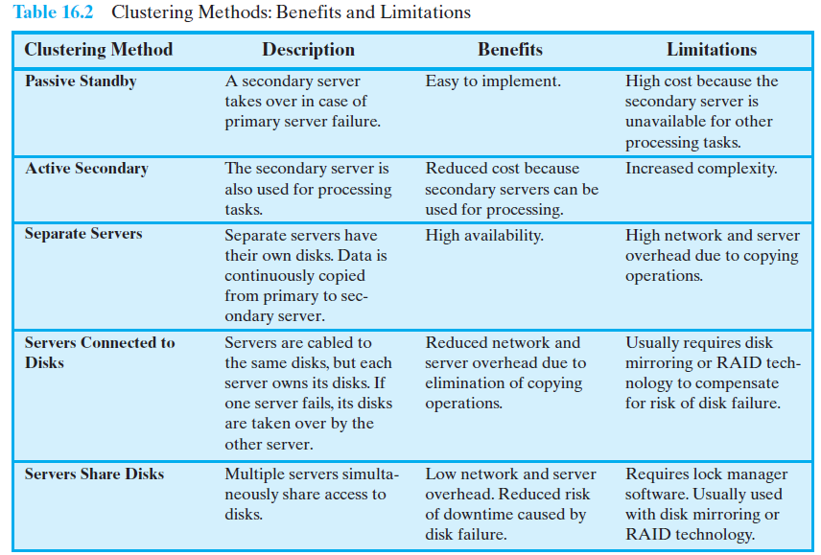

Slide 51
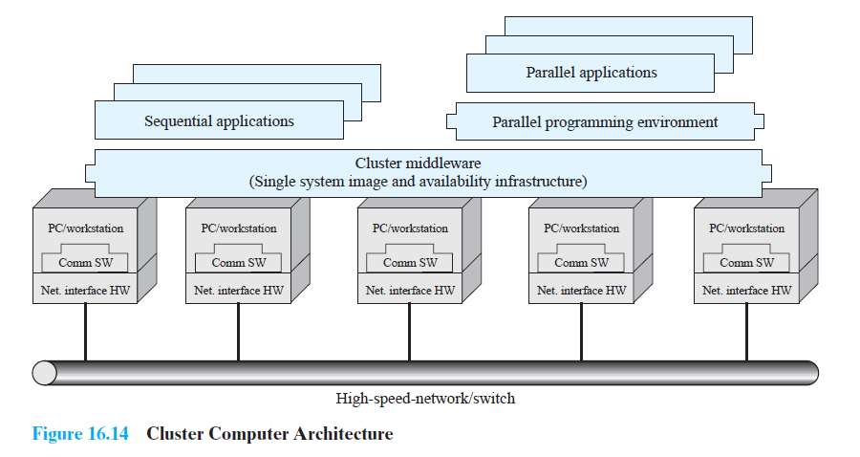
Cluster Computer Architecture
Figure 16.14 shows a typical cluster architecture

Slide 52
Cluster Computer Architecture
The individual computers are connected by some high-speed LAN or switch hardware.
Each computer is capable of operating independently.
In addition, a middleware layer of software is installed in each computer to enable cluster
operation.
The cluster middleware provides a unified system image to the user, known as a single-
system image.
Cluster middleware services and functions:
Single entry point:
A user logs onto the cluster rather than to an individual computer.
Single file hierarchy:
The user sees a single hierarchy of file directories under the same root directory.
Single control point:
There is a default node used for cluster management and control.
Single virtual networking:
Any node can access any other point in the cluster, even though the actual cluster
configuration may consist of multiple interconnected networks. There is a single virtual network operation.
Single memory space:
Distributed shared memory enables programs to share Variables.

Slide 53
Cluster Computer Architecture
Single job-management system:
Under a cluster job scheduler, a user can submit a job without specifying the host computer to execute the job.
• Single user interface:
A common graphic interface supports all users, regardless of the workstation from which they enter the cluster.
• Single I/O space:
Any node can remotely access any I/O peripheral or disk device without knowledge of its physical location.
• Single process space:
A uniform process-identification scheme is used. A process on any node can create or communicate with any other process on a remote node.
• Checkpointing:
This function periodically saves the process state and intermediate computing results, to allow rollback recovery after a failure.
• Process migration:
This function enables load balancing.
The last four items on the preceding list enhance the availability of the cluster.
The remaining items are concerned with providing a single system image.
In Figure 16.14, a cluster will also include software tools for enabling the efficient execution of programs that are capable of parallel execution.

Slide 54
Questions
What are fat clients and thin clients?
What is middleware?
List some benefits and disadvantages of blocking and nonblocking primitives for message passing.
4. List some benefits and disadvantages of nonpersistent and persistent binding for RPCs.
5. List some benefits and disadvantages of synchronous and asynchronous RPCs.
6. List and briefly define four different clustering methods

