Slide 1
Cursor

Slide 2
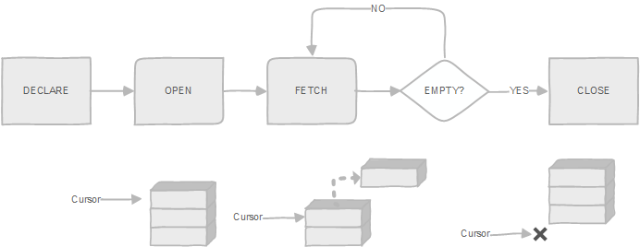

Slide 3
CURSOR
BEGIN;
DECLARE mycur CURSOR FOR
SELECT * FROM EMP WHERE empid > 100;
FETCH NEXT FROM mycur;
FETCH 2 FROM mycur;
CLOSE mycur;
END;

Slide 4
CURSOR
FETCH DIRECTION CAN BE:-
  NEXT
  PRIOR
  FIRST
  LAST
  ALL
  FORWARD
  BACKWARD
  …ETC

Slide 5
CURSOR
create or replace function get_emp_nm(joiningdate date) returns text as $$
declare
name text default '';
emprec record;
cur_emp cursor(joiningdate date)
for select empnm, gender, doj
from emp
where doj = joiningdate;

Slide 6
begin
open cur_emp(joiningdate);
loop
fetch cur_emp into emprec;
exit when not found;
if emprec.gender='F' then
name := emprec.empnm || ' , ' || emprec.doj;
end if;
end loop;
close cur_emp;
return name;
end; $$
language plpgsql;

Slide 7
TO RUN
SELECT get_emp_nm(‘2020-08-05’);

Slide 8
NOSQL
Types of NoSQL Databases
  Document-Based Database
  Key-Value Database
  Wide Column Based Database
  Graph-Based Database
Different NoSQL Databases
  MongoDB (Uber, Google, eBay, Nokia, Coinbase)
  Cassandra (Facebook, Instagram, Netflix, Spotify, Coursera ,etc)
  ElasticSearch ( Slack, Udemy, Medium, and Stackoverflow.) chatbots
  Amazon DynamoDB(Snapchat, Lyft, and Samsung) can deal with data consistency
  Hbase( Hike, Pinterest, and HubSpot)
  HBase was written in JAVA and runs on top of the Hadoop Distributed File System (HDFS).

