Slide 1
Chapter 14: Transactions

Slide 2
Outline
Transaction Concept
Transaction State
Concurrent Executions
Serializability
Recoverability
Implementation of Isolation
Transaction Definition in SQL
Testing for Serializability.
Notes:
‹#›

Slide 3
Transaction Concept
A transaction is a unit of program execution that accesses and possibly updates various data items.
E.g., transaction to transfer $50 from account A to account B:
1. read(A)
2. A := A – 50
3. write(A)
4. read(B)
5. B := B + 50
6. write(B)
Two main issues to deal with:
Failures of various kinds, such as hardware failures and system crashes
Concurrent execution of multiple transactions
Notes:
‹#›

Slide 4
Required Properties of a Transaction
Consider a transaction to transfer $50 from account A to account B:
1. read(A)
2. A := A – 50
3. write(A)
4. read(B)
5. B := B + 50
6. write(B)
Atomicity requirement
If the transaction fails after step 3 and before step 6, money will be “lost” leading to an inconsistent database state
Failure could be due to software or hardware
The system should ensure that updates of a partially executed transaction are not reflected in the database
Durability requirement — once the user has been notified that the transaction has completed (i.e., the transfer of the $50 has taken place), the updates to the database by the transaction must persist even if there are software or hardware failures.
Notes:
‹#›

Slide 5
Required Properties of a Transaction
Consistency requirement in above example:
The sum of A and B is unchanged by the execution of the transaction
In general, consistency requirements include
Explicitly specified integrity constraints such as primary keys and foreign keys
Implicit integrity constraints
e.g., sum of balances of all accounts, minus sum of loan amounts must equal value of cash-in-hand
A transaction, when starting to execute, must see a consistent database.
During transaction execution the database may be temporarily inconsistent.
When the transaction completes successfully the database must be consistent
Erroneous transaction logic can lead to inconsistency
Notes:
‹#›

Slide 6
Required Properties of a Transaction
Isolation requirement — if between steps 3 and 6 (of the fund transfer transaction) , another transaction T2 is allowed to access the partially updated database, it will see an inconsistent database (the sum A + B will be less than it should be).
T1 T2
1. read(A)
2. A := A – 50
3. write(A) read(A), read(B), print(A+B)
4. read(B)
5. B := B + 50
6. write(B)
Isolation can be ensured trivially by running transactions serially
That is, one after the other.
However, executing multiple transactions concurrently has significant benefits.
Notes:
‹#›

Slide 7
ACID Properties
A transaction is a unit of program execution that accesses and possibly updates various data items. To preserve the integrity of data the database system must ensure:
Atomicity. Either all operations of the transaction are properly reflected in the database or none are. Transaction management component is responsible for maintaining atomicity
Consistency. Execution of a transaction in isolation preserves the consistency of the database. System programmer is responsible for it.
Isolation. Although multiple transactions may execute concurrently, each transaction must be unaware of other concurrently executing transactions. Intermediate transaction results must be hidden from other concurrently executed transactions. Concurrency control component is responsible for Isolation
That is, for every pair of transactions T_{i} and T_{j}, it appears to T_{i} that either T_{j}, finished execution before T_{i} started, or T_{j} started execution after T_{i} finished.
Notes:
‹#›

Slide 8
ACID Properties
Durability. After a transaction completes successfully, the changes it has made to the database persist, even if there are system failures. Recovery Management component responsible for durability.
Notes:
‹#›

Slide 9
Transaction State
Active – the initial state; the transaction stays in this state while it is executing
Partially committed – after the final statement has been executed.
Failed -- after the discovery that normal execution can no longer proceed.
Aborted – after the transaction has been rolled back and the database restored to its state prior to the start of the transaction. Two options after it has been aborted:
Restart the transaction
can be done only if no internal logical error
Kill the transaction
Committed – after successful completion.
Notes:
‹#›

Slide 10
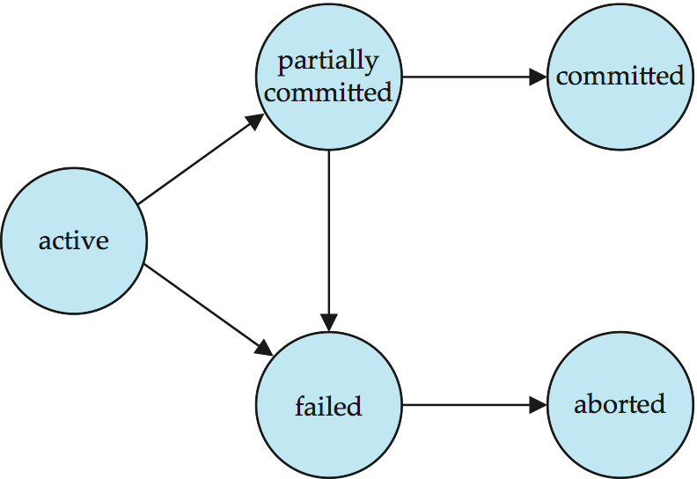
Transaction State (Cont.)
Permanently store
r/w operations
h/w or s/w failure
Terminated
h/w or s/w failure
rollback
Notes:
‹#›

Slide 11
Concurrent Executions
Multiple transactions are allowed to run concurrently in the system. Advantages are:
Increased processor and disk utilization, leading to better transaction throughput
E.g. one transaction can be using the CPU while another is reading from or writing to the disk
Reduced average response time for transactions: short transactions need not wait behind long ones.
Reduced waiting time
Increases efficiency
Concurrency control schemes – mechanisms to achieve isolation
That is, to control the interaction among the concurrent transactions in order to prevent them from destroying the consistency of the database
Schedules - represent the chronological order in which instructions are executed in the system
Notes:
‹#›

Slide 12
Unrepeatable Read Problem
T1 T2
read(A)
read(A)
A := A+1
write(A)
read(A)
10
11
10
11
Notes:
‹#›

Slide 13
Phantom Read Problem
T1 T2
read(A)
read(A)
delete(A)
read(A)
10
10
Err: variable does not exist
Notes:
‹#›

Slide 14
Lost Update Problem(Write –write conflict)
T1 T2
read(A)
A := A+1
write(A)
Write(A)
commit
commit
10
11
A = 50
Notes:
‹#›

Slide 15
Schedules
Schedule – a sequences of instructions that specify the chronological order in which instructions of concurrent transactions are executed
A schedule for a set of transactions must consist of all instructions of those transactions
Must preserve the order in which the instructions appear in each individual transaction.
A transaction that successfully completes its execution will have a commit instructions as the last statement
By default transaction assumed to execute commit instruction as its last step
A transaction that fails to successfully complete its execution will have an abort instruction as the last statement
Notes:
‹#›

Slide 16
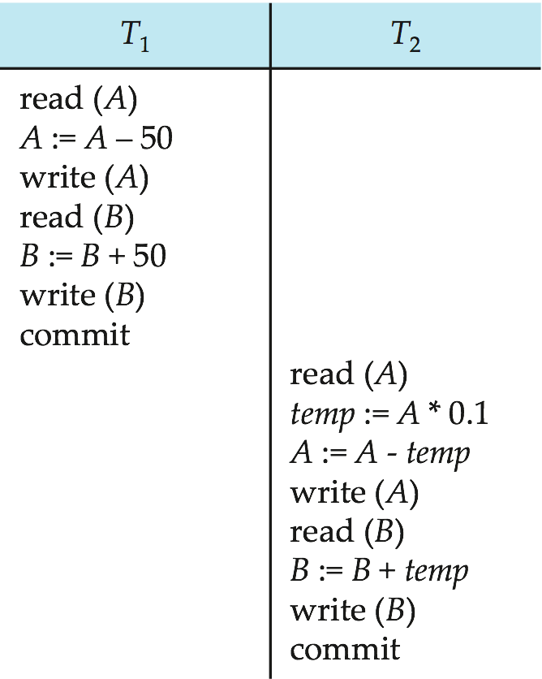
Schedule 1
Let T₁ transfer $50 from A to B, and T₂ transfer 10% of the balance from A to B.
An example of a serial schedule in which T₁ is followed by T₂ :
Let A=100,B = 100
A = 50
B = 150
A = 50
Temp = 5
A = 45
B = 150
B = 155
A + B = 200
Notes:
‹#›

Slide 17
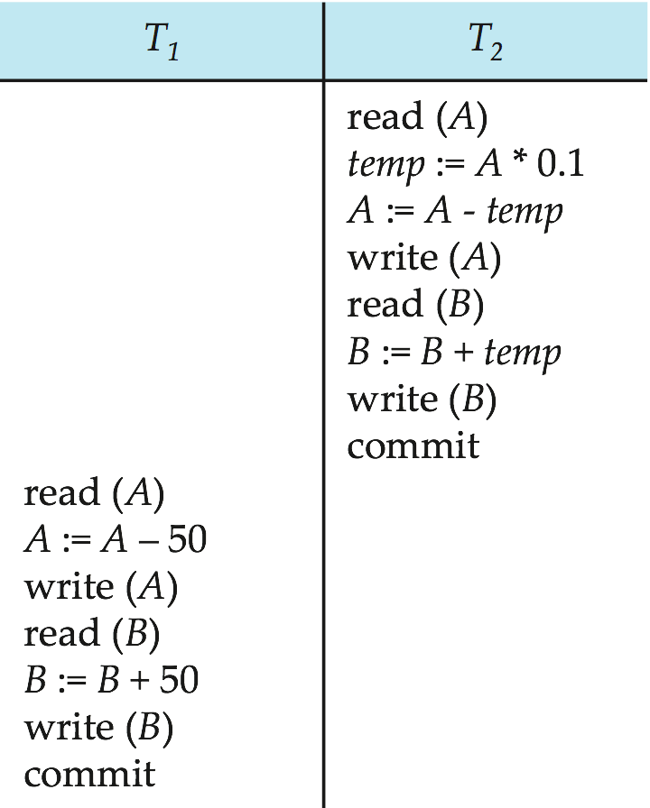
Schedule 2
A serial schedule in which T₂ is followed by T₁ :
A = 100
Temp = 10
A =90
B = 100
B = 110
A = 90
A = 40
B = 110
B = 160
A + B = 200
Notes:
‹#›

Slide 18
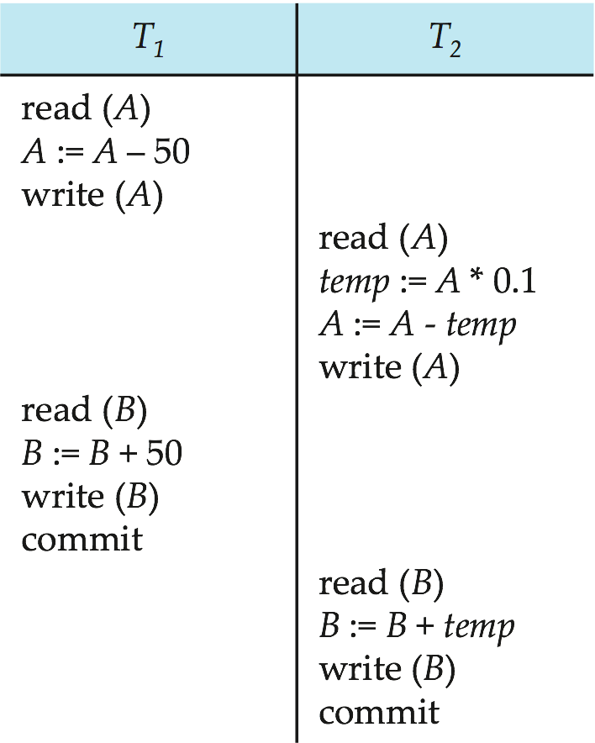
Schedule 3
Let T₁ and T₂ be the transactions defined previously. The following schedule is not a serial schedule, but it is equivalent to Schedule 1.
A = 100
A = 50
Dirty Read
A = 50
Temp = 5
A = 45
B = 100
B = 150
B = 150
B = 155
Note -- In schedules 1, 2 and 3, the sum “A + B” is preserved.
A + B = 200
Notes:
‹#›

Slide 19
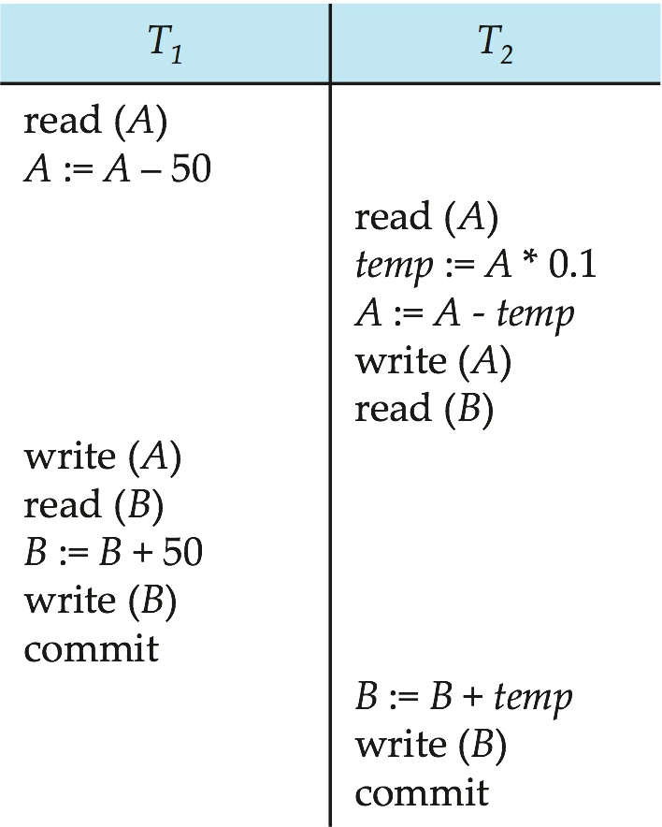
Schedule 4
The following concurrent schedule does not preserve the sum of “A + B”
A = 100
A = 50
A = 50
Temp = 5
A = 45
B = 100
A = 50
B = 100
B = 150
B = 105
A + B = 155
Notes:
‹#›

Slide 20
Serializability
Basic Assumption – Each transaction preserves database consistency.
Thus, serial execution of a set of transactions preserves database consistency.
A (possibly concurrent) schedule is serializable if it is equivalent to a serial schedule.
Different forms of schedule equivalence give rise to the notions of:
1. conflict serializability
2. view serializability
Notes:
‹#›

Slide 21
Simplified view of transactions
We ignore operations other than read and write instructions
We assume that transactions may perform arbitrary computations on data in local buffers in between reads and writes.
Our simplified schedules consist of only read and write instructions.
Notes:
‹#›

Slide 22
Conflicting Instructions
Let l_{i} and l_{j} be two Instructions of transactions T_{i} and T_{j} respectively. Instructions l_{i} and l_{j} conflict if and only if there exists some item Q accessed by both l_{i} and l_{j}, and at least one of these instructions wrote Q.
1. l_{i} = read(Q), l_{j} = read(Q). l_{i} and l_{j} don’t conflict. 2. l_{i} = read(Q), l_{j} = write(Q). They conflict. 3. l_{i} = write(Q), l_{j} = read(Q). They conflict 4. l_{i} = write(Q), l_{j} = write(Q). They conflict
Intuitively, a conflict between l_{i} and l_{j} forces a (logical) temporal order between them.
If l_{i} and l_{j} are consecutive in a schedule and they do not conflict, their results would remain the same even if they had been interchanged in the schedule.
Notes:
‹#›

Slide 23
Conflict Serializability
If a schedule S can be transformed into a schedule S´ by a series of swaps of non-conflicting instructions, we say that S and S´ are conflict equivalent.
We say that a schedule S is conflict serializable if it is conflict equivalent to a serial schedule
Notes:
‹#›

Slide 24
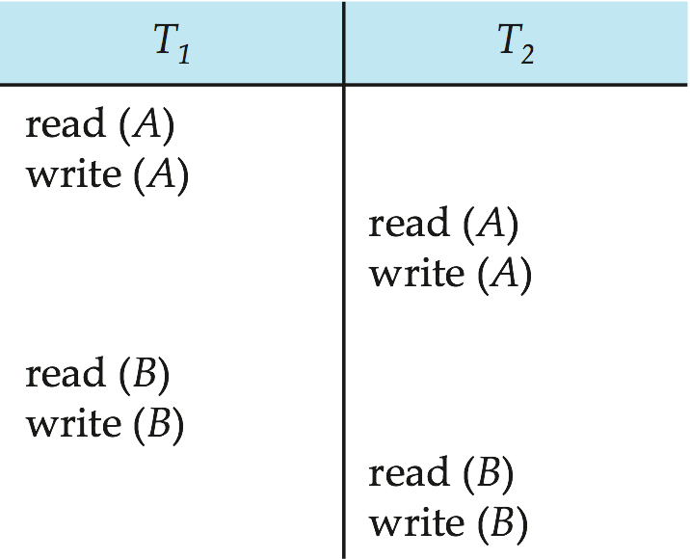
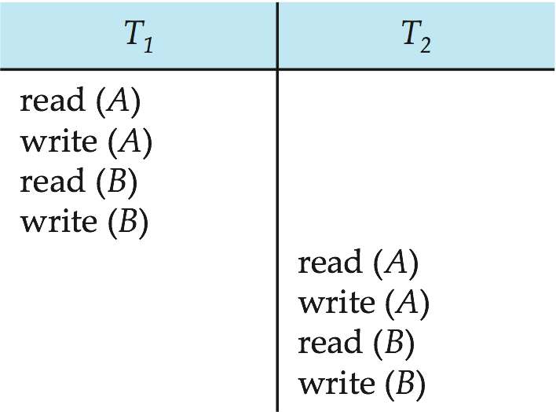
Conflict Serializability (Cont.)
Schedule 3 can be transformed into Schedule 6 -- a serial schedule where T₂ follows T₁, by a series of swaps of non-conflicting instructions. Therefore, Schedule 3 is conflict serializable.
Schedule 3
Schedule 6
Notes:
‹#›

Slide 25
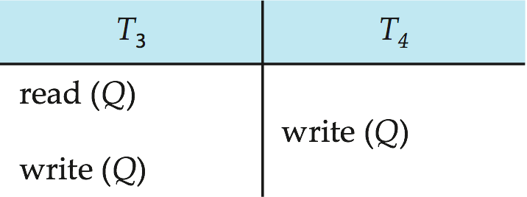
Conflict Serializability (Cont.)
Example of a schedule that is not conflict serializable:
We are unable to swap instructions in the above schedule to obtain either the serial schedule < T₃, T₄ >, or the serial schedule < T₄, T₃ >.
Blind Write
Notes:
‹#›

Slide 26
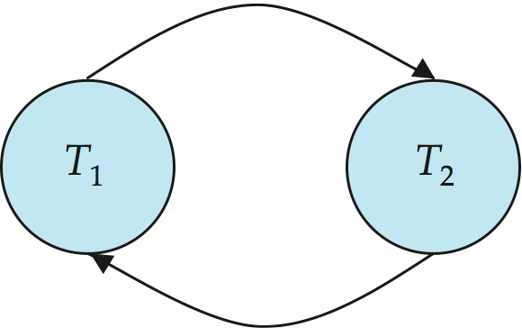
Precedence Graph
Consider some schedule of a set of transactions T₁, T₂, ..., T_{n}
Precedence graph — a direct graph where the vertices are the transactions (names).
We draw an arc from T_{i} to T_{j} if the two transaction conflict, and T_{i} accessed the data item on which the conflict arose earlier.
We may label the arc by the item that was accessed.
Example
Notes:
‹#›

Slide 27
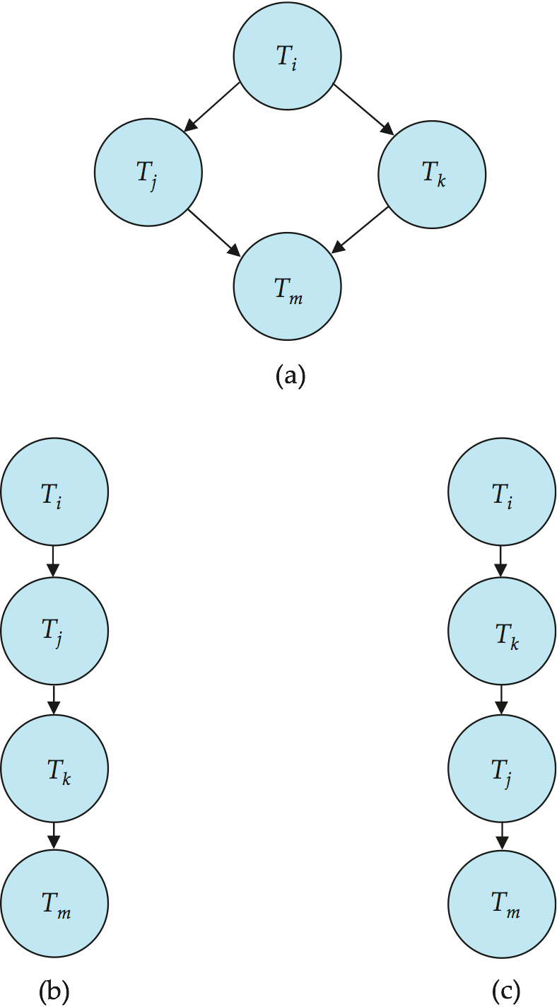
Testing for Conflict Serializability
A schedule is conflict serializable if and only if its precedence graph is acyclic.
Cycle-detection algorithms exist which take order n² time, where n is the number of vertices in the graph.
(Better algorithms take order n + e where e is the number of edges.)
If precedence graph is acyclic, the serializability order can be obtained by a topological sorting of the graph.
That is, a linear order consistent with the partial order of the graph.
For example, a serializability order for the schedule (a) would be one of either (b) or (c)
Notes:
‹#›

Slide 28
Conflict Serializability
Find whether the given transactions are conflict serializable or not
T1 T2 T3
R(X)
R(Z)
W(Z)
R(Y)
R(Y)
W(Y)
W(X)
W(Z)
W(X)
T1
T2
T3
It is not conflict serializable
Notes:
‹#›

Slide 29
Conflict Serializability
Find whether the given transactions are conflict serializable or not
T1 T2 T3
R(X)
R(Y)
R(Y)
W(Y)
W(X)
W(X)
R(X)
W(X)
T1
T2
T3
It is conflict serializable
It can be converted to serial Schedule
Order of schedule :-
T1 -🡪 T3 -🡪 T2
Notes:
‹#›

Slide 30
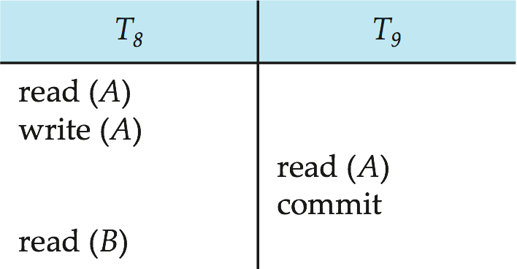
Recoverable Schedules
Recoverable schedule — if a transaction T_{j} reads a data item previously written by a transaction T_{i} , then the commit operation of T_{i} must appear before the commit operation of T_{j}.
The following schedule is not recoverable if T₉ commits immediately after the read(A) operation.
If T₈ should abort, T₉ would have read (and possibly shown to the user) an inconsistent database state. Hence, database must ensure that schedules are recoverable.
Notes:
‹#›

Slide 31
Find whether Schedule is recoverable?
T1 T2 T3
R(X)
R(X)
R(Z)
R(X)
R(Y)
W(X)
W(Y)
R(Y)
W(Z)
W(Y)
Notes:
‹#›

Slide 32
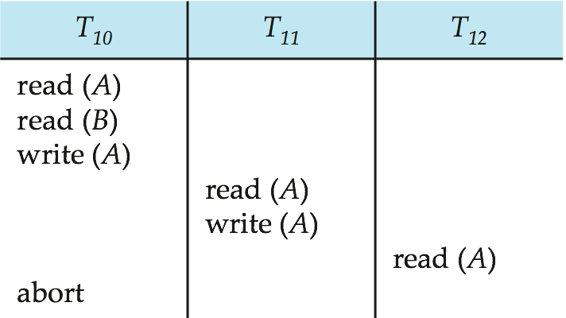
Cascading Rollbacks
Cascading rollback – a single transaction failure leads to a series of transaction rollbacks. Consider the following schedule where none of the transactions has yet committed (so the schedule is recoverable) If T₁₀ fails, T₁₁ and T₁₂ must also be rolled back.
Can lead to the undoing of a significant amount of work
Notes:
‹#›

Slide 33
Cascadeless Schedules
Cascadeless schedules — for each pair of transactions T_{i} and T_{j} such that T_{j} reads a data item previously written by T_{i}, the commit operation of T_{i} appears before the read operation of T_{j}.
Every cascadeless schedule is also recoverable
It is desirable to restrict the schedules to those that are cascadeless
Example of a schedule that is NOT cascadeless
R
CL
Notes:
‹#›

Slide 34
Find whether Schedule is cascadeless?
T1 T2 T3
R(X)
W(X)
R(X)
W(X)
R(X)
C
C
C
It is not recoverable
Notes:
‹#›

Slide 35
Find whether Schedule is cascadeless?
T1 T2 T3
R(X)
W(X)
R(X)
W(X)
R(X)
C
C
C
It is recoverable
Notes:
‹#›

Slide 36
Find whether Schedule is cascadeless?
T1 T2 T3
R(X)
W(X)
C
R(X)
W(X)
C
R(X)
C
It is recoverable as well as cascadeless schedule
Notes:
‹#›

Slide 37
Concurrency Control
A database must provide a mechanism that will ensure that all possible schedules are both:
Conflict serializable.
Recoverable and preferably cascadeless
A policy in which only one transaction can execute at a time generates serial schedules, but provides a poor degree of concurrency
Concurrency-control schemes tradeoff between the amount of concurrency they allow and the amount of overhead that they incur
Testing a schedule for serializability after it has executed is a little too late!
Tests for serializability help us understand why a concurrency control protocol is correct
Goal – to develop concurrency control protocols that will assure serializability.
Notes:
‹#›

Slide 38
Weak Levels of Consistency
Some applications are willing to live with weak levels of consistency, allowing schedules that are not serializable
E.g., a read-only transaction that wants to get an approximate total balance of all accounts
E.g., database statistics computed for query optimization can be approximate (why?)
Such transactions need not be serializable with respect to other transactions
Tradeoff accuracy for performance
Notes:
‹#›

Slide 39
Levels of Consistency in SQL-92
Serializable — default
Repeatable read — only committed records to be read, repeated reads of same record must return same value. However, a transaction may not be serializable – it may find some records inserted by a transaction but not find others.
Read committed — only committed records can be read, but successive reads of record may return different (but committed) values.
Read uncommitted — even uncommitted records may be read.
Lower degrees of consistency useful for gathering approximate information about the database
Warning: some database systems do not ensure serializable schedules by default
E.g., Oracle and PostgreSQL by default support a level of consistency called snapshot isolation (not part of the SQL standard)
Notes:
‹#›

Slide 40
Transaction Definition in SQL
Data manipulation language must include a construct for specifying the set of actions that comprise a transaction.
In SQL, a transaction begins implicitly.
A transaction in SQL ends by:
Commit work commits current transaction and begins a new one.
Rollback work causes current transaction to abort.
In almost all database systems, by default, every SQL statement also commits implicitly if it executes successfully
Implicit commit can be turned off by a database directive
E.g. in JDBC, connection.setAutoCommit(false);
Notes:
‹#›

Slide 41
View Serializability
To find whether the schedule is view serializable or not is a NP complete problem
It always contain at least one blind write
Steps:
Create all possible serial schedules for non serial schedule
Match with each serial schedule for view equivalence
CS
VS
consistent
Inconsistent
Notes:
‹#›

Slide 42
View Serializability
Let S and S´ be two schedules with the same set of transactions. S and S´ are view equivalent if the following three conditions are met, for each data item Q,
If in schedule S, transaction T_{i} reads the initial value of Q, then in schedule S’ also transaction T_{i} must read the initial value of Q.
If in schedule S transaction T_{i} executes read(Q), and that value was produced by transaction T_{j} (if any), then in schedule S’ also transaction T_{i} must read the value of Q that was produced by the same write(Q) operation of transaction T_{j} .
The transaction (if any) that performs the final write(Q) operation in schedule S must also perform the final write(Q) operation in schedule S’.
As can be seen, view equivalence is also based purely on reads and writes alone.
Notes:
‹#›

Slide 43
View Serializability
T1 T2
R(X)
W(X)
R(X)
W(X)
R(Y)
W(Y)
R(Y)
W(Y)
T1 T2
R(X)
W(X)
R(Y)
W(Y)
R(X)
W(X)
R(Y)
W(Y)
S
S’
Notes:
‹#›

Slide 44
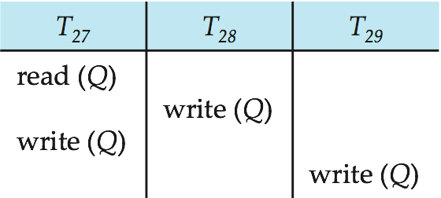
View Serializability (Cont.)
A schedule S is view serializable if it is view equivalent to a serial schedule.
Every conflict serializable schedule is also view serializable.
Below is a schedule which is view-serializable but not conflict serializable.
What serial schedule is above equivalent to?
Every view serializable schedule that is not conflict serializable has blind writes.
Here no. of transactions are 3 so possible serial schedules can be 3! = 6.
T27
T28
T29
Notes:
‹#›

Slide 45
View Serializability (Cont.)
T27 T28 T29
read(Q)
write(Q)
write(Q)
write(Q)
S1
S
Notes:
‹#›

Slide 46
Test for View Serializability
The precedence graph test for conflict serializability cannot be used directly to test for view serializability.
Extension to test for view serializability has cost exponential in the size of the precedence graph.
The problem of checking if a schedule is view serializable falls in the class of NP-complete problems.
Thus, existence of an efficient algorithm is extremely unlikely.
However ,practical algorithms that just check some sufficient conditions for view serializability can still be used.
Notes:
‹#›

Slide 47
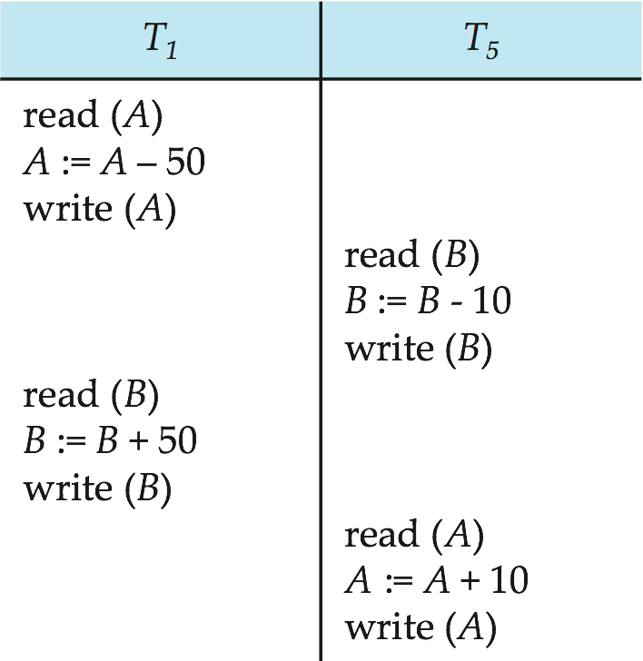
More Complex Notions of Serializability
The schedule below produces the same outcome as the serial schedule < T₁, T₅ >, yet is not conflict equivalent or view equivalent to it.
If we start with A = 1000 and B = 2000, the final result is 960 and 2040
Determining such equivalence requires analysis of operations other than read and write.
Notes:
‹#›

