Slide 1
Introduction to Triggers

Slide 2
Introduction to Triggers
You can write triggers that fire whenever one of the following operations occurs:
  DML statements (INSERT, UPDATE, DELETE) on a particular table or view, issued by any user
  DDL statements (CREATE or ALTER primarily) issued either by a particular schema/user or by any schema/user in the database
  Database events, such as logon/logoff, errors, or startup/shutdown, also issued either by a particular schema/user or by any schema/user in the database

Slide 3
Triggers vs. Procedures
Triggers are similar to stored procedures.
A trigger stored in the database can include SQL and PL/SQL or Java statements to run as a unit and can invoke stored procedures.
However, procedures and triggers differ in the way that they are invoked.
A procedure is explicitly run by a user, application, or trigger.
Triggers are implicitly fired by Oracle when a triggering event occurs, no matter which user is connected or which application is being used.

Slide 4
How Triggers Are Used
You can also use triggers to:
  Automatically generate derived column values
  Prevent invalid transactions
  Enforce complex security authorizations
  Enforce referential integrity across nodes in a distributed database
  Enforce complex business rules
  Provide transparent event logging
  Provide auditing
  Maintain synchronous table replicates
  Gather statistics on table access
  Modify table data when DML statements are issued against views
  Publish information about database events, user events, and SQL statements to subscribing applications

Slide 5
Some Cautionary Notes about Triggers
Although triggers are useful for customizing a database, use them only when necessary.
Excessive use of triggers can result in complex interdependencies, which can be difficult to maintain in a large application.
For example, when a trigger fires, a SQL statement within its trigger action potentially can fire other triggers, resulting in cascading triggers. This can produce unintended effects

Slide 6
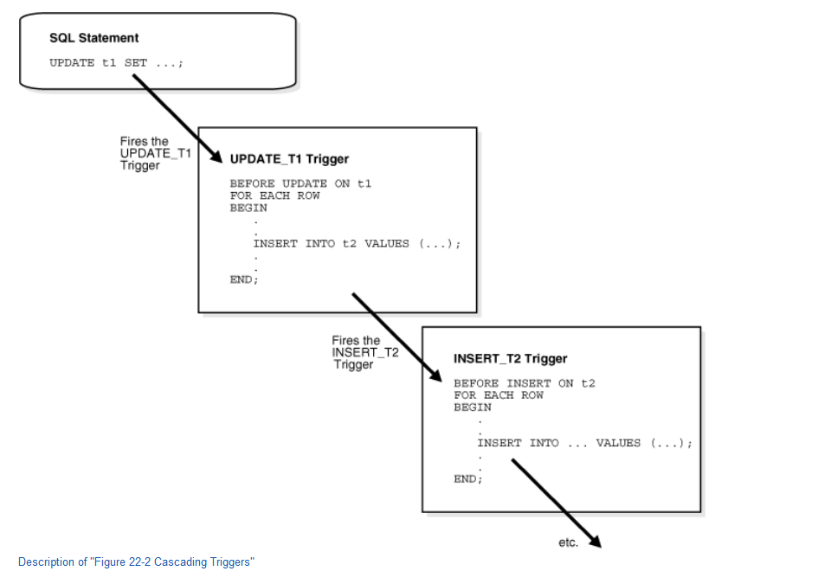

Slide 7
Parts of a Trigger
A trigger has three basic parts:
  A triggering event or statement
  A trigger restriction
  A trigger action

Slide 8
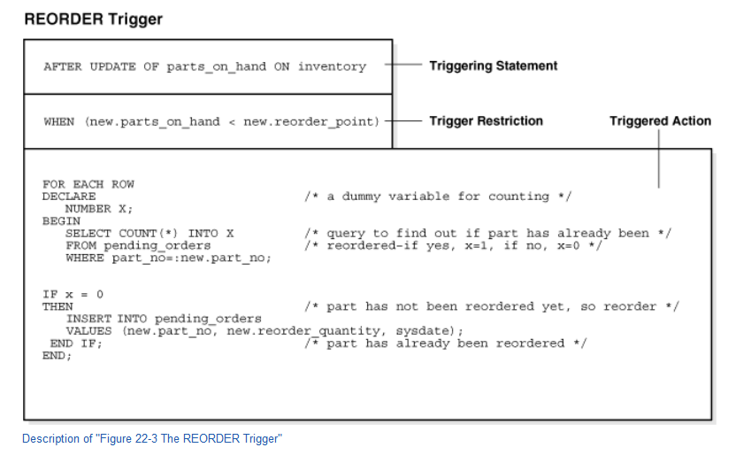

Slide 9
Triggers on DML Statements
BEFORE INSERT and AFTER INSERT triggers fire for each row inserted into the table.
BEFORE UPDATE and AFTER UPDATE triggers fire for each row updated in the table.
BEFORE DELETE and AFTER DELETE triggers fire for each row deleted from the table.

Slide 10
Trigger Execution
Enabled
  An enabled trigger runs its trigger action if a triggering statement is issued and the trigger restriction (if any) evaluates to true.
Disabled
  A disabled trigger does not run its trigger action, even if a triggering statement is issued and the trigger restriction (if any) would evaluate to true.

Slide 11
Syntax
CREATE [OR REPLACE ] TRIGGER trigger_name
{BEFORE | AFTER | INSTEAD OF }
{INSERT [OR] | UPDATE [OR] | DELETE} [OF col_name] ON table_name
[REFERENCING OLD AS o NEW AS n]
[FOR EACH ROW] WHEN (condition)
DECLARE
Declaration-statements
BEGIN
Executable-statements
EXCEPTION
Exception-handling-statements
END;

Slide 12
Where:
CREATE [OR REPLACE] TRIGGER trigger_name − Creates or replaces an existing trigger with the trigger_name.
{BEFORE | AFTER | INSTEAD OF} − This specifies when the trigger will be executed. The INSTEAD OF clause is used for creating trigger on a view.
{INSERT [OR] | UPDATE [OR] | DELETE} − This specifies the DML operation.
[OF col_name] − This specifies the column name that will be updated.
[ON table_name] − This specifies the name of the table associated with the trigger.
[REFERENCING OLD AS o NEW AS n] − This allows you to refer new and old values for various DML statements, such as INSERT, UPDATE, and DELETE.
[FOR EACH ROW] − This specifies a row-level trigger, i.e., the trigger will be executed for each row being affected. Otherwise the trigger will execute just once when the SQL statement is executed, which is called a table level trigger.
WHEN (condition) − This provides a condition for rows for which the trigger would fire. This clause is valid only for row-level triggers.

Slide 13
Employee table
create table emp1
(id integer primary key,
salary integer);

Slide 14
Check_bal() function
create function check_bal() returns trigger as $$
BEGIN
if NEW.salary <1000 then
raise exception 'Min bal should be 1000’;
end if;
return NEW;
END;
$$
LANGUAGE plpgsql;

Slide 15
Trigger
create trigger bal_check
BEFORE INSERT OR UPDATE
ON emp1
FOR EACH ROW
EXECUTE PROCEDURE check_bal();

Slide 16
Execute
insert into emp1 values(101,500);
insert into emp1 values(101,5000);
insert into emp1 values(102,2000);
update emp1 set salary=700 where id=101;
update emp1 set salary=7000 where id=101;

Slide 17
Emp_Audit
create table emp_audit(
operation character(1) not null,
stamp timestamp not null,
userid text not null,
empname text not null,
sal integer );

Slide 18
do_emp_audit()
CREATE OR REPLACE FUNCTION do_emp_audit() RETURNS TRIGGER AS $emp_audit$
BEGIN
IF (TG_OP = 'DELETE') THEN
INSERT INTO emp_audit
SELECT 'D’ , now(), user , OLD.*;
RETURN OLD;

Slide 19
do_emp_audit()
ELSIF (TG_OP = 'UPDATE') THEN
INSERT INTO emp_audit SELECT 'U’, now(), user, NEW.*;
RETURN NEW;
ELSIF (TG_OP = 'INSERT') THEN
INSERT INTO emp_audit SELECT 'I’, now(), user, NEW.*;
RETURN NEW;
END IF;
RETURN NULL;
END;
$emp_audit$ LANGUAGE PLPGSQL;

Slide 20
Trigger
CREATE TRIGGER emp_audit
AFTER INSERT OR UPDATE OR DELETE ON emp1
FOR EACH ROW EXECUTE PROCEDURE do_emp_audit();
Now execute:-
Insert into emp1 values(103,5000);

Slide 21
Triggers
DROP TRIGGER [ IF EXISTS ] name ON table_name [ CASCADE | RESTRICT ]
  Ex:- DROP TRIGGER [ IF EXISTS ] emp_audit ON emp1[ CASCADE | RESTRICT ]
ALTER TABLE emp1
DISABLE TRIGGER emp_audit / All;
ALTER TABLE emp1
ENABLE TRIGGER emp_audit / All;

