Slide 1



What is Web Development ?

Slide 2


Why we make website ?

Slide 3

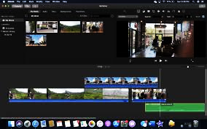

Software ,WEBSITE ,APPLICATION

Slide 4

Front-End
2) Back-End

Slide 5
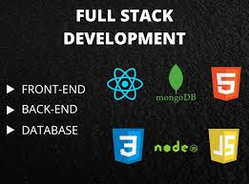

Slide 6


FRONT-END DEVELOPMENT

Slide 7
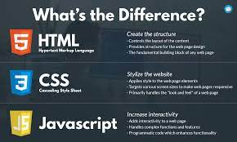
Front-end is so EASy

Slide 8



JQUERY,AZAX,JSON

Slide 9
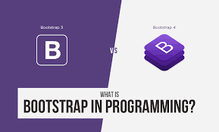
BOOTSTRAP-css FRAMEWORK

Slide 10
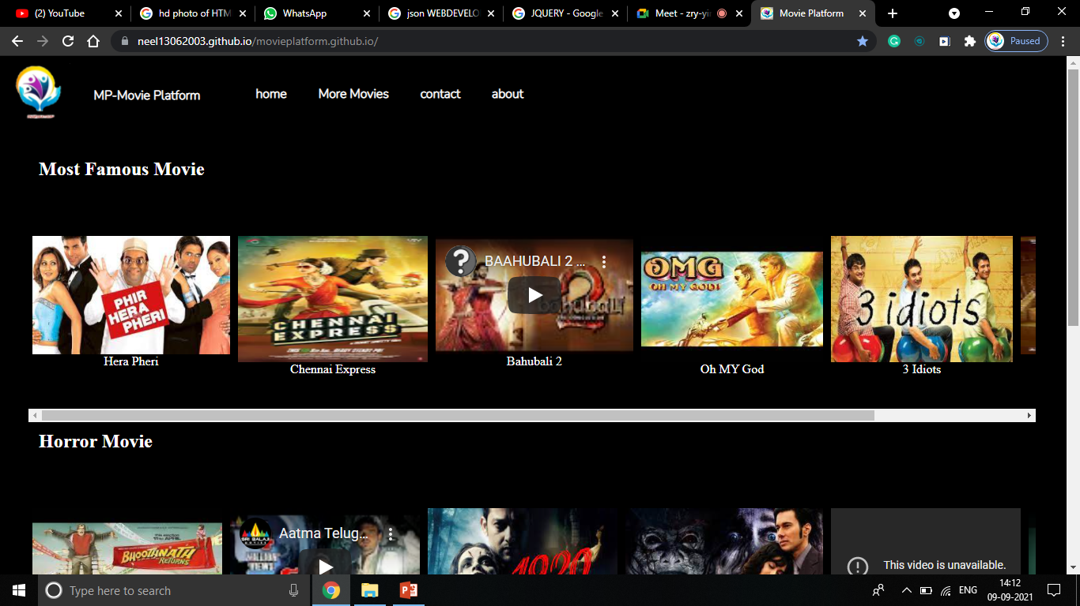
Static Website

Slide 11
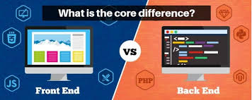

Slide 12
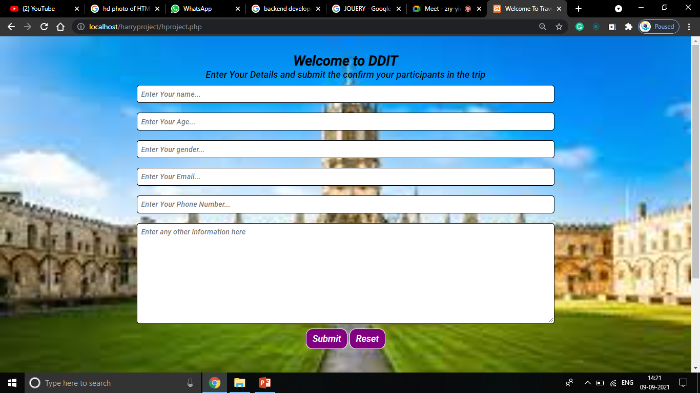
BACK-END DEVELOPMENT

Slide 13

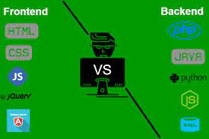
Which Language is Best?

Slide 14


Back-End Language & Database

Slide 15


Some MYTHS & Rumors

Slide 16


જો તમે શીખો તો તમે વિમાન ચલાવી શકો છો પરંતુ, જો તમે ન શીખ્યા તો તમે સાઇકલ પણ ચલાવી શકતા નથી

Slide 17

Till everything is all about basics of
Web Development

Slide 18


How TO PUBLISH WEBSITE ?
Hostinger
000webhost
Godaddy, InfinityFree, etc…

Slide 19

GitHub
1) Free Open Source platform
2) Multiple people make separate changes to
web pages at the same time
3) Backup & Security

Slide 20
How To Use GitHub &
How to publish our website on github ???

Slide 21

Thank You Everyone…
Created by
Soni Neel
Patel Vraj

