Slide 1
UNKOWN FAILURE DETECTION OF CALL STACK TREE IN IOT DEVICES
BY
DODDA SAI CHANDRANEEL

Slide 2
Purpose of the project
The purpose of this project to detect failures in the IOT devices. A GUI application is built using java which has two modes called training mode and detection mode.
An input trace file is taken which builds a call stack tree when the iot device is tested which is done in training mode.
In detection mode ,the call stack tree is compared by the online call stack by call stack monitor. If it matches it gives output as “pass” or else “fail”.
In this project we can also discuss different types of failures that occur in the IOT devices

Slide 3
What is a IOT and its application?
How failures are occurred in IOT devices?
What kind of methodology is used to detect failures in IOT devices?
What are different types of failures occur in IOT?

Slide 4
IOT DEVICES
Iot is the inter-networking of physical devices such as connected devices like buildings , software, sensor which enables them to collect data and also exchange data.
It allows object to be controlled remotely which creates direct integration of physical world in network infrastructure.
This results in improved accuracy and efficiency in addition to reduced human intervention.
This one is used in technologies like smart grids, virtual power plants and smart cities.
Each thing is known through its embedded computing system which functions within present internet infrastructure is able to offer advanced connectivity of devices and system.
This includes beyond machine to machine(M2M) communication ,protocols ,domains and applications. These devices are used to generate large amounts of data from different locations

Slide 5
APPLICATIONS
Media
Environmental monitoring
Infrastructure management
Manufacturing
Energy management
Medical and health care
Building and home automation
Transportation
Consumer applications

Slide 6
IOT DEVICE FAILURES
After IoT devices are developed and tested, they are integrated with system and deployed. Due complex nature of IoT systems however they may fail due to deployment.
Individual Iot devices has mechanism which can report their own problem. The issue is they are only able to report known failures that occur in devices. Self-diagnosis techniques can be employed to handle unknown failures.
But low end devices can’t afford this type of techniques due to their tight resource constraints.
In this situation Iot devices does not work which makes them unable to recognize or report the problem
An automated and generalized methodology is required for examining several heterogenous devices. Well the methodology is based on a very lightweight processor level architectural support.
A hardware-based monitoring agent within processor and connected to a separate monitoring device when an examination is required. By analyzing information we can determine if the device is working or not. The monitoring agent keeps track of the function call stack.

Slide 7
PROPOSED APPROACH
When IOT device fails after deployment and no device reports a failure
The first step is to examine all devices to identify the failed one. The problem with the failed device can be classified as
Operational problem (user error)
Device failure(device needs to be replaced)
Design error(device needs further debugging)

Slide 8
Cont…
To this we need a run time monitoring system .which as following requirements
Automation-tool helps whether or not the device is working correctly
Standardization-interface of the system should be standardized to enable the examination of multiple devices
Non-intrusiveness- over head of monitoring system should be minimized
Hot-plug-monitoring system should be able to connect to IOT device. While IOT device is running

Slide 9
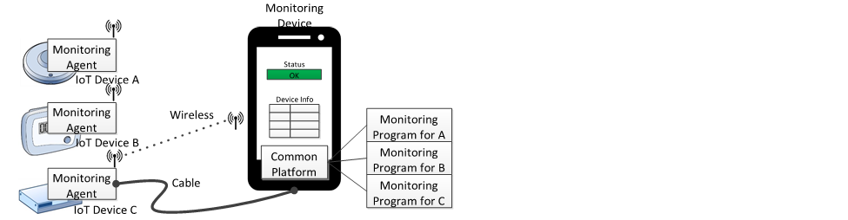
OVERVIEW OF THE PROPOSED MONITORING SYSTEM FOR THE EXAMINATION OF IOT Devices

Slide 10
hardware-based monitoring agent
Instruction grained monitoring techniques monitor the architectural state of every instruction
Function calls are monitored for examination.
By monitoring function calls we can detect failure caused by processor and also peripheral hardware outside the processor
Processor that is equipped with the proposed monitoring agent. The key component is the call stack monitor which keeps track of function call stack
The call stack should be compared against a reference which a call stack tree

Slide 11
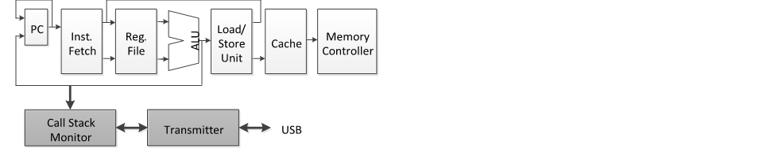

Slide 12
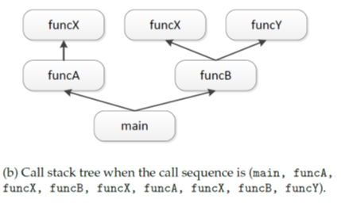
Call stack tree
A call stack tree is used as a refer-ence for failure detection.
A call stack tree is a collection of reachable call stack snapshots, represented as a tree.
The call stack tree is built when the IoT device is being tested.

Slide 13
Cont..
Above figure shows an example of a call stack tree. If main, funcA and funcX are called in this order, the call stack maintains main, funcA and funcX in the same order from the bottom to the top.
This is represented by the left-most path of the tree (from main to the left-most funcX). After funcX and funcA are returned, let us suppose funcB is called at a certain moment, but funcX and funcY are not yet called.
At this moment, the call stack comprises main and funcB. It is represented by the right path of the tree (from main to funcB).
Therefore, the call stack tree captures all reachable call stack snapshots in a tree form.

Slide 14
Detection of unknown failures
A call stack tree is a collection of reachable call stack snapshots represented as a tree.
The call stack tree is built when the IoT device is being tested. We will refer to the time when the call stack tree is being built as the “training” mode
The time when the call stack tree is being compared with the online call stack collected by the call stack monitor as the “detection” mode.
In the detection mode, if the on-line call stack does not match with the call stack tree, a fault is declared.

Slide 15
While the tree is being built (training mode), the length of time it takes for each function to be executed will be measured to detect hanging (deadlock or livelock).
For each function, the statistics of the average and standard deviation of execution time will be calculated in the training mode.
In the detection mode, if a function takes longer than the threshold, which is pre-determined based on statistics obtained in the training mode, a fault is detected

Slide 16
Types of failures
• If unknown failures eventually lead to known failures: When known faults occur, their corresponding exception handlers are usually called. The IoT device may have a reporting mechanism but, if the reporting mechanism itself has a fault, the fault cannot be reported. If the call stack tree contains any of the exception handlers, it means known faults have occurred.
• If the device is hanging: If the IoT device is stuck at any point, it can be detected based on the statistics of execution time as explained above.
• If the device seemingly keeps working but incorrectly: If the on-line call stack does not match with the call stack tree, a fault can be detected.
However, it cannot detect the following type of unknown failure.
• If unknown failures affect the output, but the output is still in a legitimate form: To detect this type of failures, the output should be compared with a golden model. To address this, we will investigate an assertion-based examination methodology in our future work.

Slide 17
Trace file
The input of the system is a trace file.
Each line indicates function call or return. The format of the trace file is as follows: <timestamp> <C or R> <Target address if it is a function call>
For example,
1000 C funcA
1010 C funcB
1020 C funcC
1030 R
1040 C funcD
1050 R
1060 R
1070 R

Slide 18
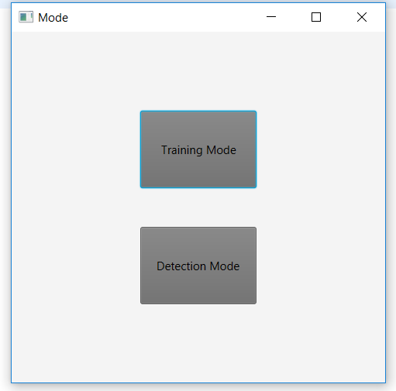
output
GUI displayed when the program is executed

Slide 19
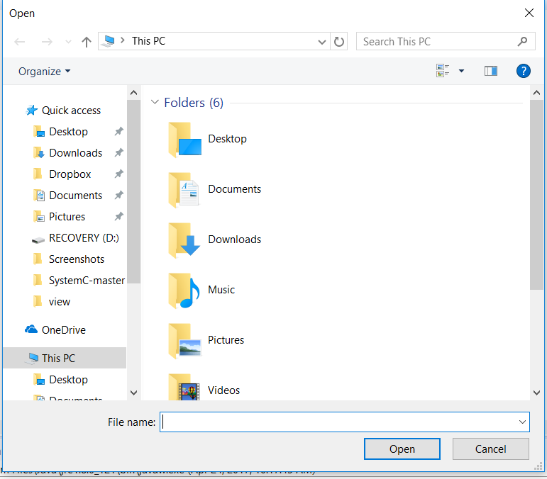
Training output:
When the training mode is selected it displays a dialog box which is used to select the trace file

Slide 20
abego TreeLayout
Efficiently create compact, highly customizable tree layouts
Introduction
The Tree Layout creates tree layouts for arbitrary trees. It is not restricted to a specific output or format, but can be used for any kind of two-dimensional diagram.
Examples are Swing based components, SVG files, and many more. This is possible because Tree Layout separates the layout of a tree from the actual rendering.
To use the Tree Layout you mainly need to supply an instance of the Tree Layout class with the nodes of the tree (including "children" links),together with the "size" of each node.
In addition you can configure the layout by specifying parameters like "gap between levels" etc..

Slide 21
Properities of tree layout
1. The layout displays the hierarchical structure of the tree, i.e. the y-coordinate of a node is given by its level. (*)
2. The edges do not cross each other and nodes on the same level have a minimal horizontal distance.
3. The drawing of a subtree does not depend on its position in the tree, i.e. isomorphic subtrees are drawn identically up to translation.
4. The order of the children of a node is displayed in the drawing.
5. The algorithm works symmetrically, i.e. the drawing of the reflection of a tree is the reflected drawing of the original tree.

Slide 22
EXAMPLE LAYOUT:

Slide 23
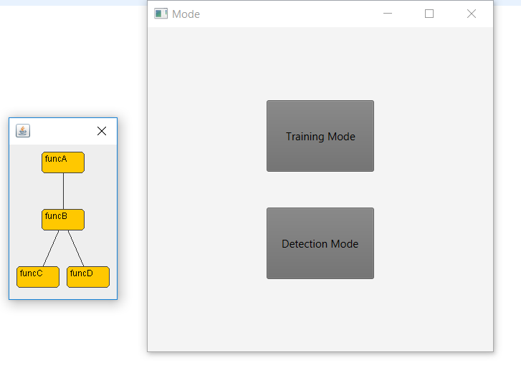
Call stack tree
By using abego tree layout algorithm call stack tree is developed

Slide 24
Detection output
When the detection mode is selected the dialog box is created which selects the on stack trace file

Slide 25
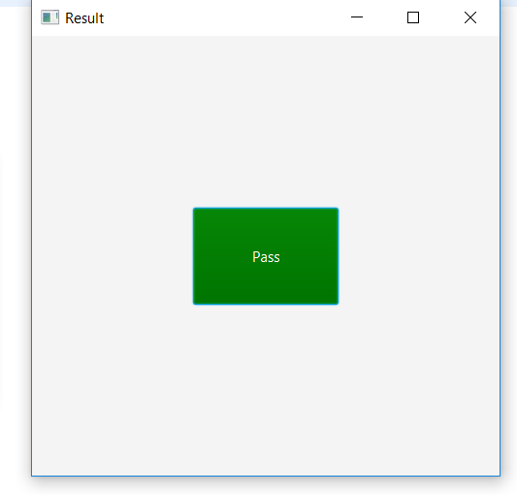
Pass case
If it matches it gives a output as
pass

Slide 26
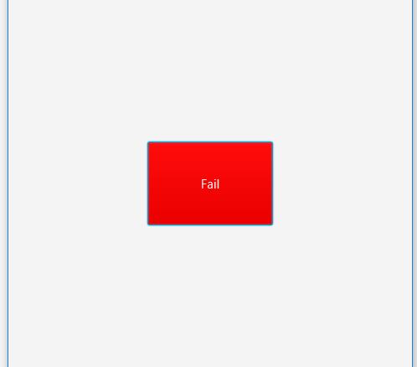
Fail case
If it doesn’t match it gives as fail

Slide 27
Future work
If multiple processes are running on the IoT device, their call stacks should be monitored separately. The call stack monitor needs scheduling information – specifically, which process is currently running – from the operating system to keep track of the current call stack,
The call stack monitor will need additional information from the operating system. These issues will be addressed in our future work. One such example is assertion-based verification. Since it automatically checks the sanity of software and is applicable to any device, it is suitable for examination of IOT devices.
To reduce performance overhead, a hardware-software cooperative solution may be adopted

Slide 28
conclusion
A GUI-based application will be developed .The call stack tree is built when the Iot device is being tested .The time when the call stack tree is being built as training mode. Comparing the call stack tree with the online call stack collected by call stack monitor as detection mode. Thus if it does not match a fault is declared

Slide 29
Thank You

