Slide 1
A report on- Swara Music Classes
By
-- Suhaas Neel
--21f1004498

Slide 2
Looking for Data
Looking for shops
Approaching the owners
Instilling Confidence
Narrowing it down

Slide 3
Data Tables Received
Student-City-Data
Student-City-Fee-Data (differential fee data)
Household Wise expenditure (Cleaning Issues)

Slide 4
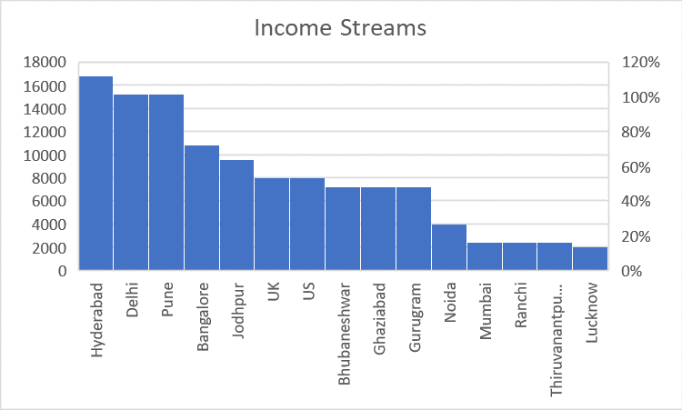
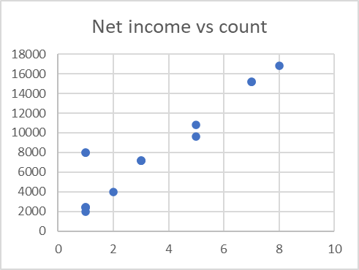
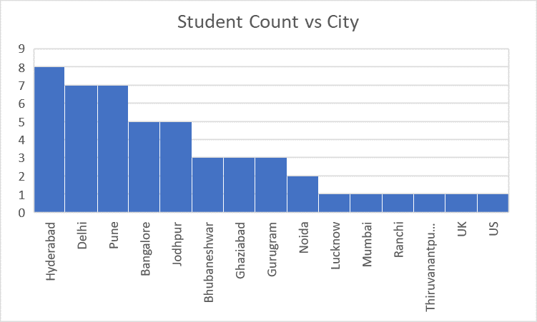
Analysis – Differential Fee data

Slide 5
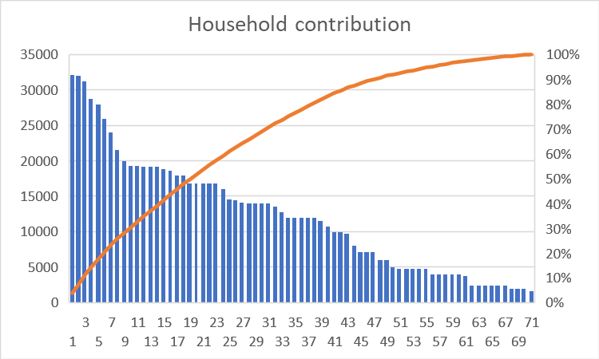
Analysis - Household

Slide 6
Inferences
People from Hyderabad, Delhi, Pune and Bangalore are a major source of students.
Students from UK/USA pay much higher(Outlier).
50 percent of students make for 80 percent of the income.
Given the end of the pandemic when the schools are reopening, there is a shortage of spots in time slots.
Given some students are not regular(pay as you take model), it makes time management much trickier and unrewarding at the same time.

