Slide 1
DYNAMIC API DOCUMENTATION GENERATOR
Presented By:
Neel Desai Mansi Vekariya Ruchitha Reddy Koluguri

Slide 2
Project Overview
CLI-Based Tool:
Users provide their main file with API code as input.
The tool generates documentation in Markdown format, including examples for requests, responses, and parameter usage.
Key Features:
Supports both Full File and API-by-API modes.
Uses GPT-based LLMs for efficient generation.

Slide 3
Importance of Documentation
Foundation of Development:
Documentation is the backbone of API usability, enabling seamless understanding and integration.
Provides a clear reference point for developers, reducing ambiguity.
Accelerates Developer Onboarding:
Speeds up the learning curve for new developers.
Saves time by avoiding dependency on senior developers for explanations.
Improves Collaboration:
Standardizes communication between development, QA, and external teams.
Enhances API adoption for third-party consumers.
Reduces Long-term Costs:
Minimizes errors caused by unclear or outdated documentation.
Supports faster debugging and troubleshooting.

Slide 4
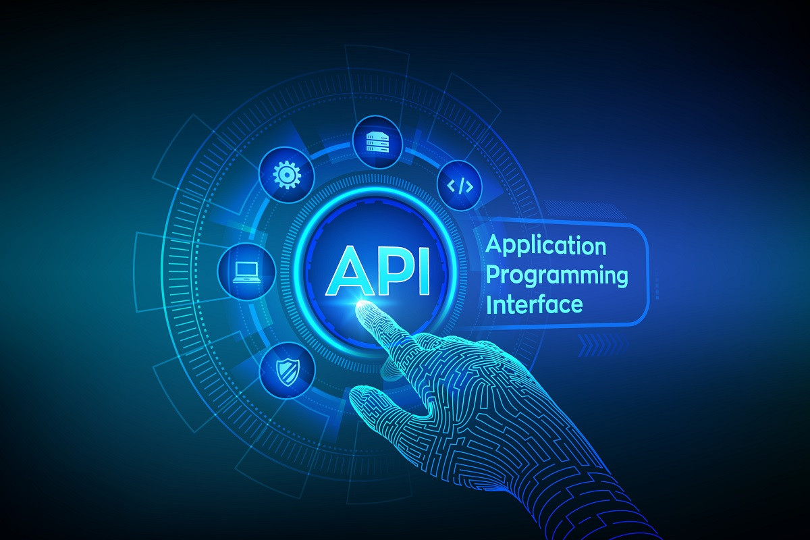
Challenges in Manual Documentation
Time-Consuming Process:
Writing and maintaining API documentation manually is tedious and resource-intensive.
Neglected During Tight Deadlines:
In fast-paced development environments, documentation often becomes a low priority.
Inconsistent and Outdated Documentation:
Lack of standard templates creates inconsistency across teams.
Manually updating documentation becomes challenging.
Impact of Poor Documentation:
Leads to integration issues and delays.
Creates confusion for both internal and external developers.

Slide 5
Introducing the Solution:
Dynamic API Documentation Generator

Slide 6
Purpose:
Automate API documentation generation and maintenance.
Use LLMs (Large Language Models) to analyze code and generate high-quality documentation.
Key Features:
Input: API source code
Output:
Clean, professional API documentation in Markdown format.
Why It Matters:
Reduces manual effort and ensures up-to-date documentation.
Consistent formatting for better clarity and usability.
Who Benefits:
Development teams, product owners, and external API consumers.

Slide 7
Two possible approaches
Full File Mode
API-by-API Mode
>> How It Works:
Processes the entire API file in one go.
>> Advantages:
Faster for smaller files.
Generates complete documentation in a single attempt.
>> Disadvantages:
Struggles with large files due to context window limits of LLMs.
Risk of missing details if the file is too complex.
>> How It Works:
Processes endpoints one by one.
>> Advantages:
Handles large and complex APIs efficiently.
Produces granular, detailed documentation for each endpoint.
>>Disadvantages:
Slightly slower for small APIs.
Requires multiple LLM requests.

Slide 8
Different Models: GPT-4o vs GPT-4o-mini
GPT-4o:
Best For: Full File Mode.
Handles large context windows, making it ideal for processing entire API files.
GPT-4o mini:
Best For: API-by-API Mode.
Lightweight, faster, and more cost-efficient.
Suitable when context window requirements are smaller.
Conclusion: Use GPT-4o for bulk generation and GPT-4o-mini for endpoint-level precision.

Slide 9
Prompt Versions and Evaluation
Why It’s Important:
As documentation is LLM-generated, evaluating and optimizing prompts is crucial for quality.
Evaluation Methodology:
Use a critic LLM to compare outputs generated by different prompts on the same sample file.
Score each response based on:
Completeness
Accuracy
Relevance
Clarity
Iterative Improvement:
This approach enables prompt refinement and ensures better outputs over time.

Slide 10
Demonstrating Prompt Versions and Evaluation
Workflow:
Input: Multiple versions of prompt ( ex. v1, v2)
Critic LLM output: Compares the feedback and scores for each prompt versions.
Final Decision: Choose the prompt with highest score across all matrices.
Benefits:
Data driven selection of prompts.
Enhanced quality and reliability generated documentation.

Slide 11
Future Scope
Enhance Prompt Quality with System-level information
Integrate system-level metadata (e.g., dependencies, configurations) to improve response quality.
Ensure richer and more relevant documentation.
CI/CD Pipeline Integration
Automate documentation generation during deployment.
Keeps documentation in sync with code changes, reducing manual intervention.
Advance prompt Versions
Develop smarter prompts tailored for complex APIs.
Experiment with chain-of-thought prompting to handle edge cases better.

Slide 12
Thanks!
Presented By Team Pi

