Slide 1
Revolutionizing Edge Computing with Large Language Models
Exploring the Fusion of Edge General Intelligence (EGI) and LLMs for Smarter Systems
By Neel Desai

Slide 2
Introduction
Technologies like AI and IoT are transforming everyday life. Examples include smart homes, autonomous vehicles, and predictive maintenance systems.
Edge General Intelligence (EGI): The next step in computing evolution where edge devices possess human-like cognitive abilities.
Large Language Models (LLMs) bring capabilities such as reasoning, learning, and adapting to edge devices.
This talk explores how EGI combined with LLMs can revolutionize industries like healthcare, transportation, and smart cities.

Slide 3
What is Edge Computing
Edge computing processes data closer to the source (e.g., IoT devices, smartphones) rather than sending it to distant cloud servers.
Advantages:
Reduced Latency: Immediate data processing ensures faster decision-making, essential for autonomous vehicles and smart manufacturing.
Bandwidth Savings: Local processing reduces data transmission to the cloud, saving resources.
Enhanced Privacy: Data stays local, minimizing exposure to cybersecurity risks.
Applications: Smart sensors in agriculture, real-time video analytics, and wearable health devices.

Slide 4
The Role of Edge Intelligence
Edge intelligence infuses AI capabilities into edge devices for autonomous decision-making without relying on the cloud.
Key Benefits:
Real-Time Decision-Making: Enables immediate responses in critical scenarios, like detecting anomalies in medical devices.
Data Security: Minimizes data transfer, reducing risks of breaches.
Dynamic Adaptation: Devices can learn and adapt to their environments, like adjusting to traffic patterns in real-time.
Example Use Cases:
Autonomous drones navigating disaster zones.
AI-powered cameras identifying threats in smart cities.

Slide 5
What are Large Language Models (LLMs)?
LLMs are AI systems trained on massive datasets to process and generate human-like text.Core Capabilities:
Reasoning: Solving complex problems or answering queries logically.
Adaptability: Adjusting to various scenarios and contexts.
Generation: Producing coherent text, plans, or even code.
Examples include GPT-40 for natural conversations and LLaMA for domain-specific tasks.
Their human-like intelligence enables applications such as chatbots, virtual assistants, and decision-support systems.

Slide 6
Why Combine LLMs with Edge Computing?
LLMs enhance edge devices by providing cognitive abilities that were previously exclusive to centralized systems.
Key Synergies:
Smarter Systems: Devices can understand nuanced commands and adapt in real time.
Latency Reduction: Processing data locally avoids delays caused by cloud communication.
Enhanced Privacy: Sensitive data remains on the device.
Examples:
Smart homes where assistants adjust based on user preferences and voice commands.
Autonomous vehicles interpreting dynamic traffic patterns and local signage.

Slide 7
Cognitive Capabilities of LLMs
Comprehension: Ability to understand and summarize vast amounts of data accurately.
Reasoning: Logical inference to solve problems or make decisions in real time.
Generation: Producing text, code, or plans that are coherent and contextually relevant.
Adaptability: Quickly adjusting to dynamic environments or varied tasks.
Multimodality: Handling diverse inputs like text, images, and audio, enabling richer interactions.
Contextualization: Maintaining awareness of prior inputs for continuity in responses.

Slide 8
Overview of System Architectures for EGI
Different architectures balance computation, privacy, and latency for edge systems.
Three main types: Centralized, Hybrid, and Decentralized. .

Slide 9
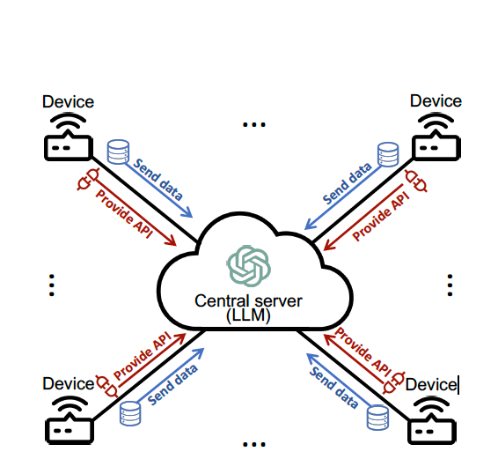
Centralized Architecture

Slide 10
Centralized Architecture
Definition: Intelligence resides entirely on a central server.
Advantages:
High computational power and scalability.
Ideal for resource-intensive tasks.
Challenges:
Network congestion and latency issues.
Privacy risks due to data transfers.
Vulnerability to single points of failure.
Example Use Case:
Smart Traffic Management: Cameras send real-time data to a central server for accident detection and traffic flow optimization.

Slide 11
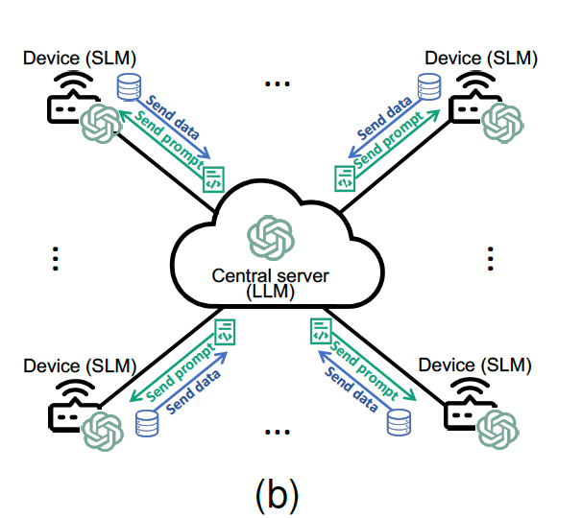
Hybrid Architecture

Slide 12
Hybrid Architecture
Definition: Combines centralized servers hosting LLMs with edge devices running lightweight Small Language Models (SLMs).
Advantages:Reduces latency for simple tasks handled locally by SLMs.
Balances computational efficiency and resource constraints.
Challenges:Coordination between LLM and SLMs.
Higher deployment costs.
Example Use Case:Smart Home Automation: Simple commands like “Turn on the lights” handled locally; complex queries sent to the central LLM.

Slide 13
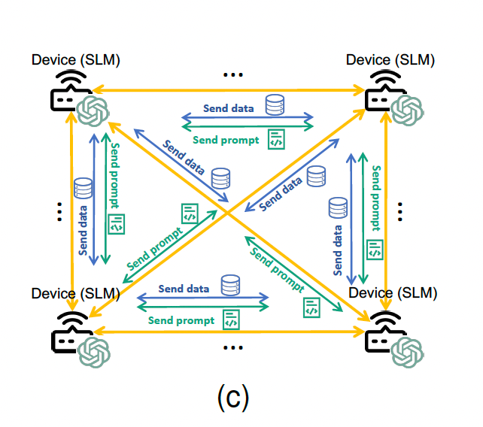
Decentralized Architecture

Slide 14
Decentralized Architecture
Definition: Each edge device has its own SLM and collaborates with others as needed.
Advantages:
Enhanced privacy and robustness (no single point of failure).
Scalable as devices operate independently.
Challenges:
Limited by the computational power of individual devices.
Complex coordination between devices.
Example Use Case:
Disaster Recovery in Remote Areas: Drones equipped with SLMs map disaster zones and coordinate rescue efforts autonomously.

Slide 15
Comparison of Architectures
Aspect | Centralized | Hybrid | Decentralized
Processing Location | Central server | Mix of server and local devices | Local devices
Communication | Server-to-device | Device-to-server and device-to-device | Peer-to-peer
Response Speed | Medium (dependent on network) | Faster for local tasks | Fastest for local tasks
Scalability | Limited by server capacity | Flexible | Highly scalable, no single point of failure
Privacy | Low (data sent to server) | Moderate | High (data stays local)

Slide 16
Conclusion
The integration of Large Language Models (LLMs) with Edge Computing is a game-changing revolution in intelligent systems.
Benefits:
Enables smarter, faster, and more adaptive devices.
Enhances privacy by keeping sensitive data local.
Opens up new possibilities in domains like healthcare, smart cities, and autonomous vehicles.
The system architectures (Centralized, Hybrid, Decentralized) offer flexibility to tailor solutions for specific needs, balancing computational power, scalability, and privacy.

