Slide 1




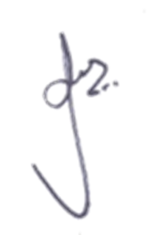
Certificate
Of Participation
This certificate is proudly presented to
Mr. / Miss………………………………………………………………………………………………..
Nikhil Patil
As an acknowledgment of successful and active participation in Alacrity, held from 20th to 22nd February 2023.
Your participation in
Poster Presentation
have earned you this recognition.
………………………………………………………………………..
Dr. P. B. Mane
Principal, AISSMS IOIT

Slide 2
Certificate
Of Participation
This certificate is proudly presented to
Vitthal Ghangal
Mr. / Miss………………………………………………………………………………………………..
As an acknowledgment of successful and active participation in Alacrity, held from 20th to 22nd February 2023.
Your participation in
Poster Presentation
have earned you this recognition.
………………………………………………………………………..
Dr. P. B. Mane
Principal, AISSMS IOIT

Slide 3
Certificate
Of Participation
This certificate is proudly presented to
Neel Wadake
Mr. / Miss………………………………………………………………………………………………..
As an acknowledgment of successful and active participation in Alacrity, held from 20th to 22nd February 2023.
Your participation in
Poster Presentation
have earned you this recognition.
………………………………………………………………………..
Dr. P. B. Mane
Principal, AISSMS IOIT

