Slide 1
Python for Data Analysis
Project by:
Neel Shah (104853226)

Slide 2
CONTENT
INTRODUCTION
OVERVIEW OF PYTHON LIBRARIES
DATA PREPARATION
DATA PLOTTING
DATA PREDICTION

Slide 3
What is Data Analysis ?
Data analysis is a process of inspecting , cleansing, transforming and modeling data.
The goal of Data Analysis is to discover useful information from the data and make supporting conclusions and decision.

Slide 4
Why Python for Data Analysis and Machine Learning
Python is growing at a fast pace and it’s popularity has allowed it to enter into some of the most popular and complex processes like Artificial Intelligence (AI), Machine Learning (ML), natural language processing, data science etc.
Main reasons for Choosing python are. :
Less code
Inbuilt Libraries
Developer Support
Popularity
Notes:
Less code : AI involves algorithms - a LOT of them. Python provides ease of testing - one of the best among competitors. Python helps in easy writing and execution of codes. Python can implement the same logic with as much as 1/5th code as compared to other OOPs languages. Thanks to its interpreted approach which enables check as you code methodology.
built Libraries:
Python has a lot of libraries for every need of your AI project. Few names include Numpy for scientific computation, Scipy for advanced computing and Pybrain for machine learning. AIMA - Python implementation of algorithms from Russell and Norvig's 'Artificial Intelligence: A Modern Approach' is one of the best library available for Artificial Intelligence till today. Such a dedicated library saves developer’s time spent on coding base level items.
Developer Support
Python is a completely open source with a great community. There is a host of resources available which can get any developer up to speed in no time. Not to forget, there is a huge community of active coders willing to help programmers in every stage of developing cycle.
Popularity
Python is winning the heart of millennials. Its ease of learning is attracting millennials to learn this language. Though AI Projects need a highly experienced programmer yet Python can smoothen the learning curve.

Slide 5
Python Libraries for Data Analysis
Many popular Python toolboxes/libraries:
NumPy
SciPy
Pandas
SciKit-Learn
Visualization libraries
matplotlib
Seaborn

Slide 6
Numpy
Numpy introduces objects for multidimensional arrays and matrices, as well as functions that allow to easily perform advanced mathematical and statistical operations on those objects
provides vectorization of mathematical operations on arrays and matrices which significantly improves the performance

Slide 7
Scipy
Built on NumPy
Scipy is library of algorithms and mathematical tools built to work with Numpy arrays.
collection of algorithms for linear algebra, differential equations, numerical integration, optimization, statistics and more
Link: https://www.scipy.org/scipylib/
Notes:
SciPy contains additional routines needed in scientific work: for example, routines for computing integrals numerically, solving differential equations, optimization, and sparse matrices.

Slide 8
Pandas
Data Tool Built on top of Numpy
It Provides built in data structures which simplify the manipulation and analysis of data sets.
Provides tools for data manipulation: reshaping, merging, sorting, joining etc.
Link: http://pandas.pydata.org/

Slide 9
Scikit-Learn
provides machine learning algorithms: classification, regression, clustering, model validation etc.
built on NumPy, SciPy and matplotlib
Link: http://scikit-learn.org/

Slide 10
Matplotlib
python 2D plotting library which produces publication quality figures in a variety of hardcopy formats
a set of functionalities similar to those of MATLAB
line plots, scatter plots, barcharts, histograms, pie charts etc.
relatively low-level; some effort needed to create advanced visualization
Link: https://matplotlib.org/

Slide 11
Seaborn
It is built on top of Matplotlib
It is similar to Matplot lib but provides much better graphs.
It comes with many different customizable themes and High level interface for attractive graph plotting and mapping.
Seaborn is usually for statistical data visualization – mainly used when creating heatmaps.
Notes:
matplotlib is for basic plotting -- bars, pies, lines, scatter plots, etc.
Seaborn is for statistical visualization -- use it if you're creating heatmaps or somehow summarizing your data and still want to show the distribution of your data

Slide 12
DATA PREPARATION

Slide 13
Jupyter Notebooks :
“The Jupyter Notebook is an open-source web application that allows you to create and share documents that contain live code, equations, visualizations and explanatory text.
Uses include: data cleaning and transformation, numerical simulation, statistical modeling, machine learning and much more.”
“Contain live code, equations, visualizations and explanatory text”
Notes:
The Jupyter Notebook App is a server-client application that allows editing and running notebook documents via a web browser. The Jupyter Notebook App can be executed on a local desktop requiring no internet access (as described in this document) or can be installed on a remote server and accessed through the internet.

Slide 14
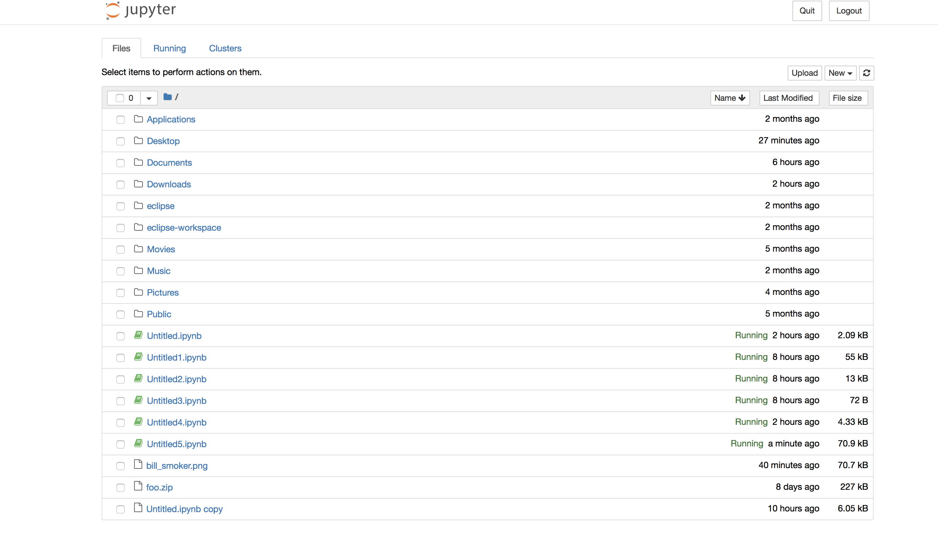
Notes:
The Jupyter Notebook App is a server-client application that allows editing and running notebook documents via a web browser. The Jupyter Notebook App can be executed on a local desktop requiring no internet access (as described in this document) or can be installed on a remote server and accessed through the internet.

Slide 15
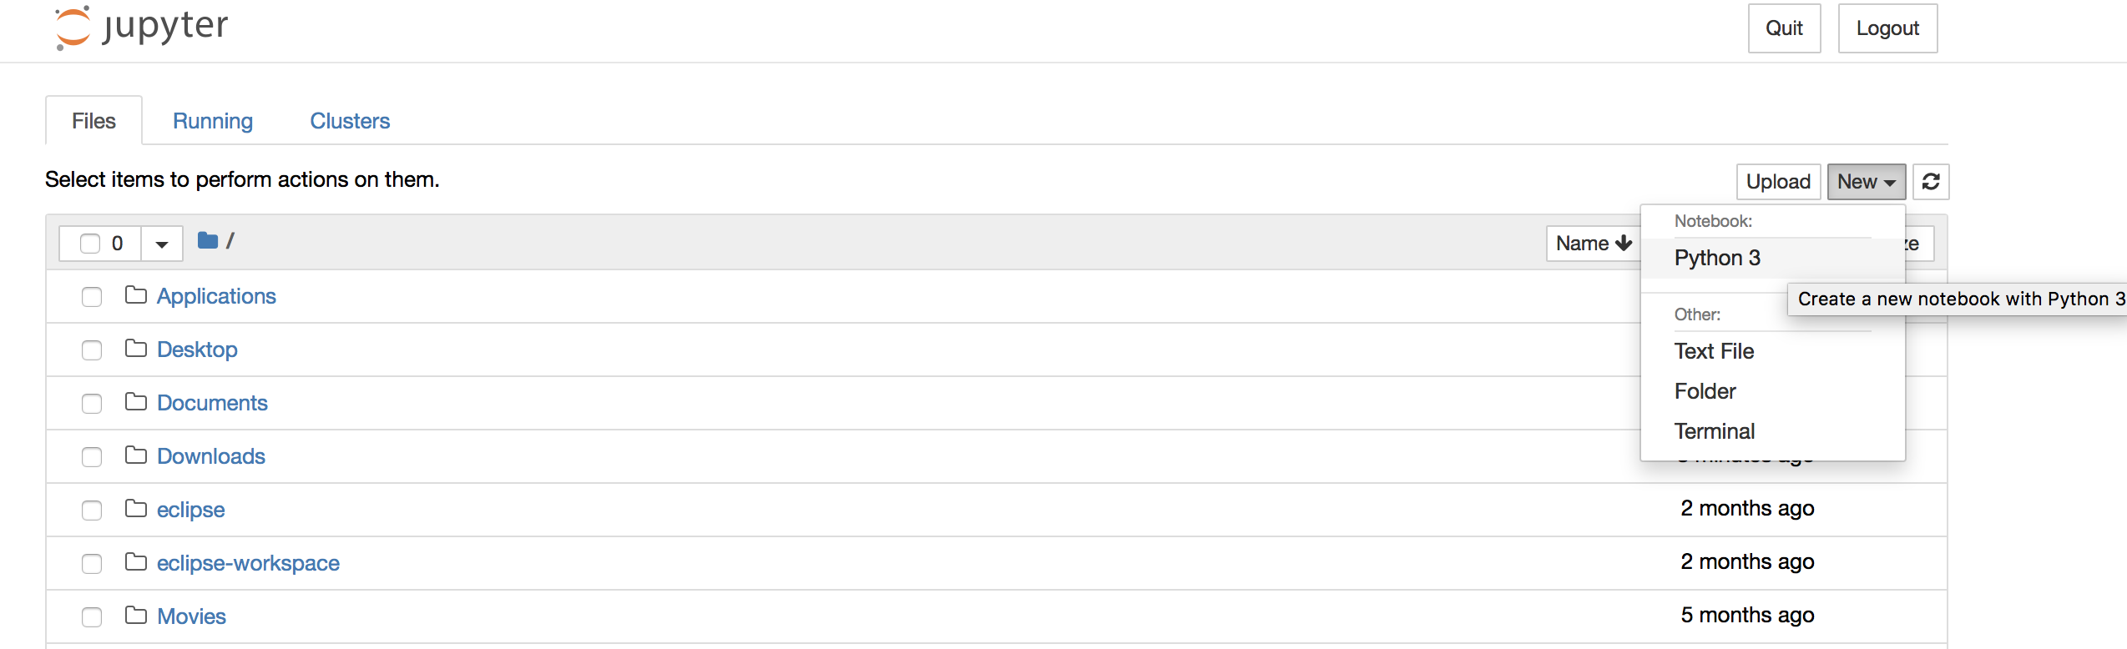
Making a new python file in Jupyter

Slide 16
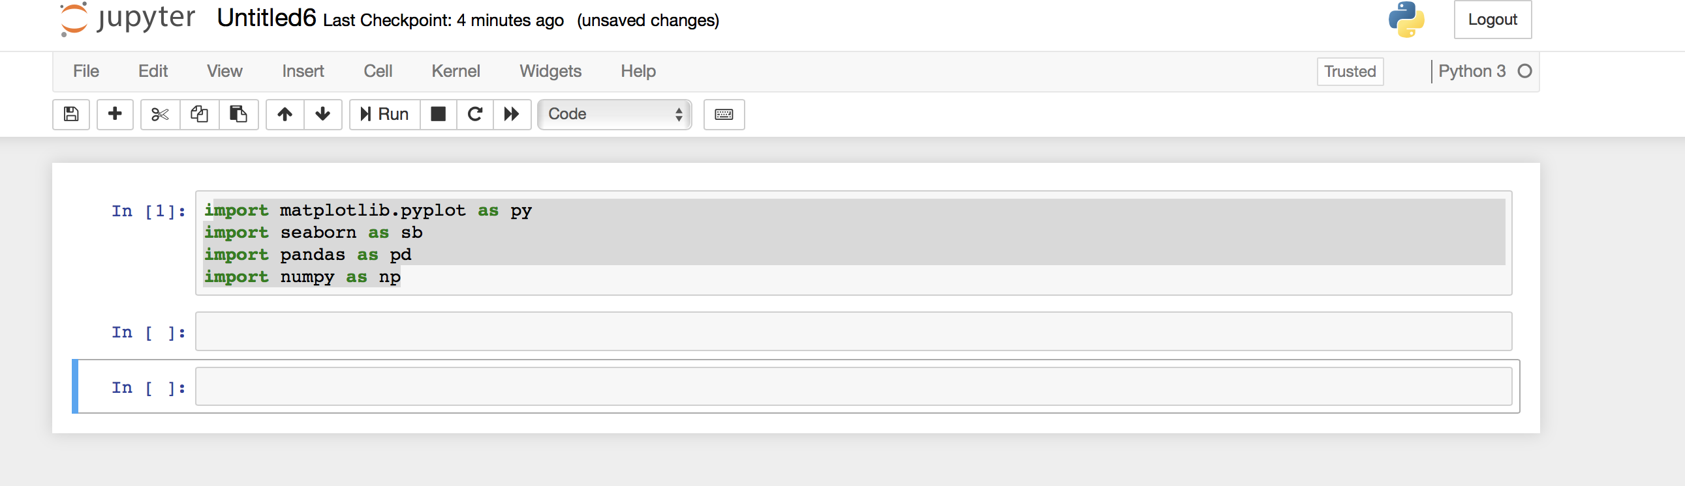
Loading Data Analysis Libraries(
Notes:
Explain the libraries.

Slide 17
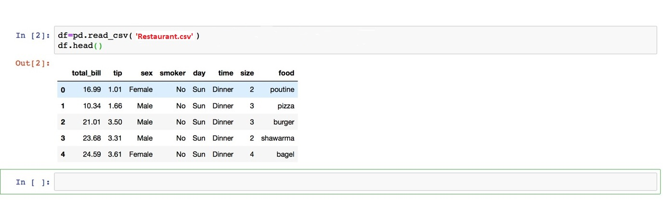
Reading the data set (to be replaced)
Notes:
Explain what is happening what is pd etc etc

Slide 18
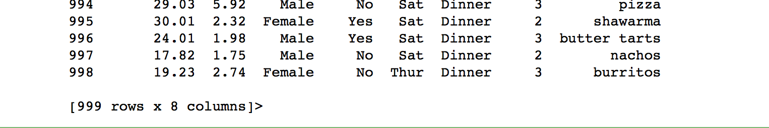
Describing Data
Notes:
Generates descriptive statistics that summarize the central tendency, dispersion and shape of a dataset’s distribution, excluding NaN values.
Analyzes both numeric and object series, as well as DataFrame column sets of mixed data types. The output will vary depending on what is provided. Refer to the notes below for more detail.

Slide 19
GRAPHS

Slide 20
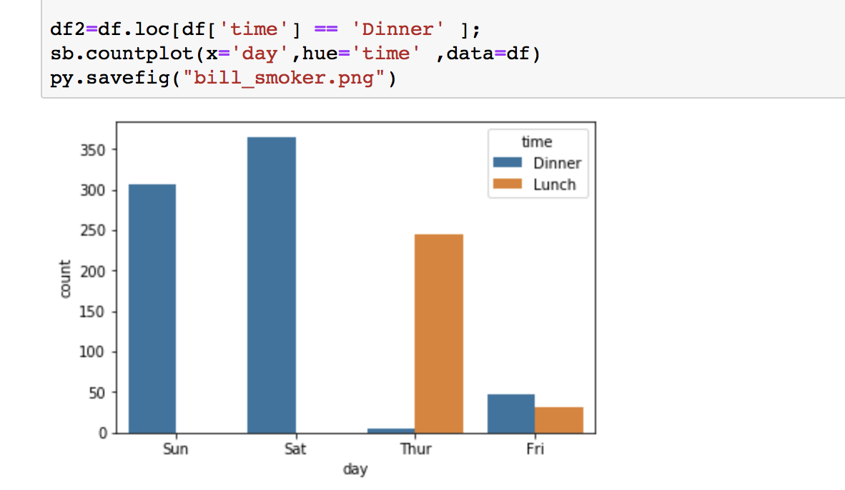
Max Rush
Familiar style of plot that accomplishes this goal is a bar plot.
In seaborn, the barplot() function operates on a full dataset and shows an arbitrary estimate

Slide 21
GRAPH: MAXIMUM TIP

Slide 22
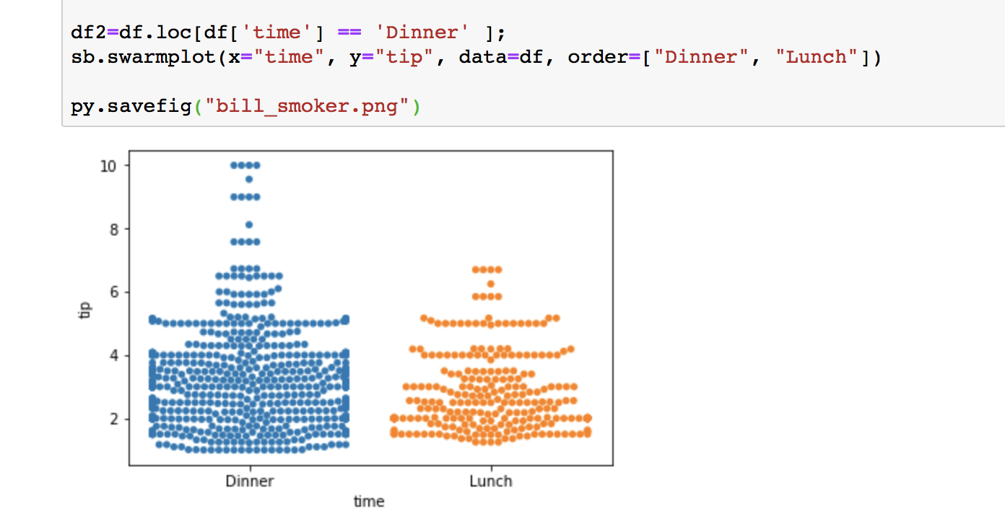
Representation(1)

Slide 23
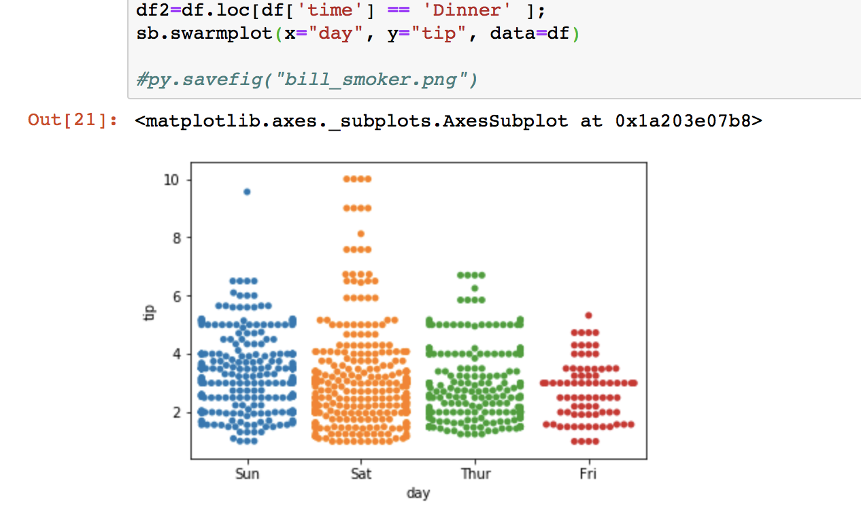
Representation(2)
Notes:
On what day → max tip

Slide 24
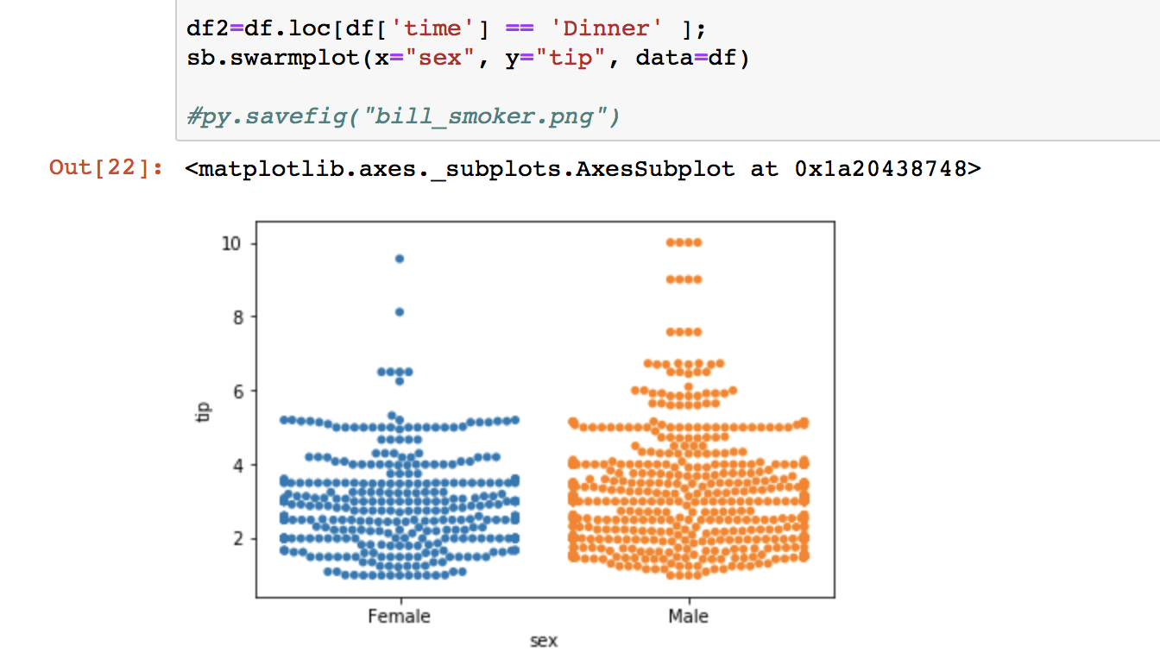
Representation(3)
Notes:
Who gives more tip male or female ?

Slide 25
GRAPH: Who Pays the Bill ?

Slide 26
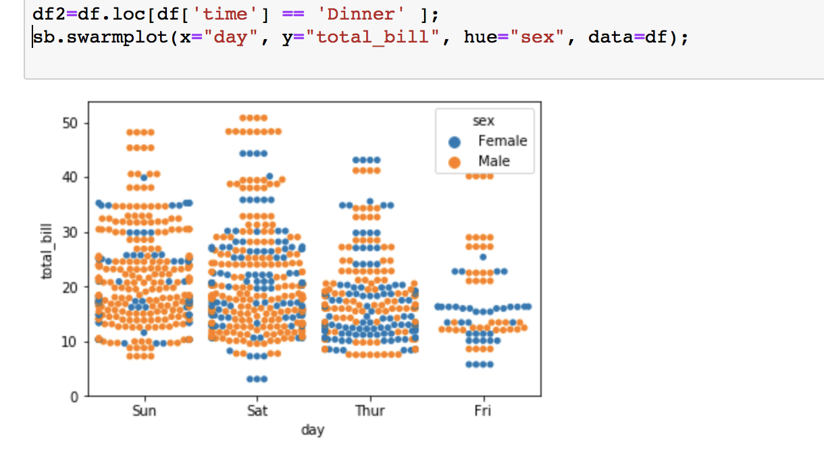
Representation (1)

Slide 27
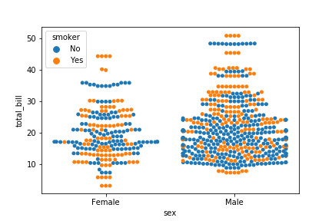
Representation(2)

Slide 28
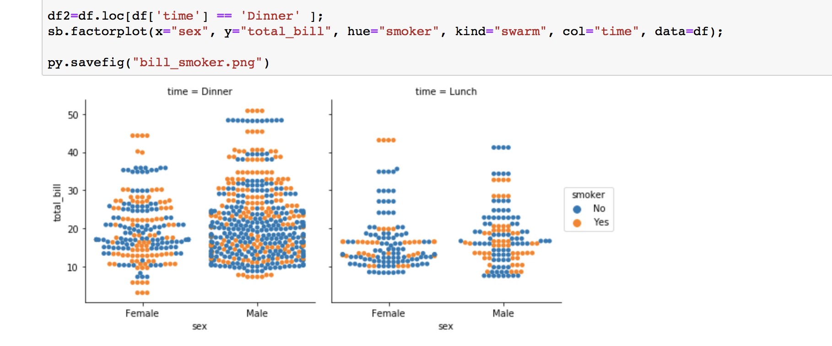
Representation(3)

Slide 29
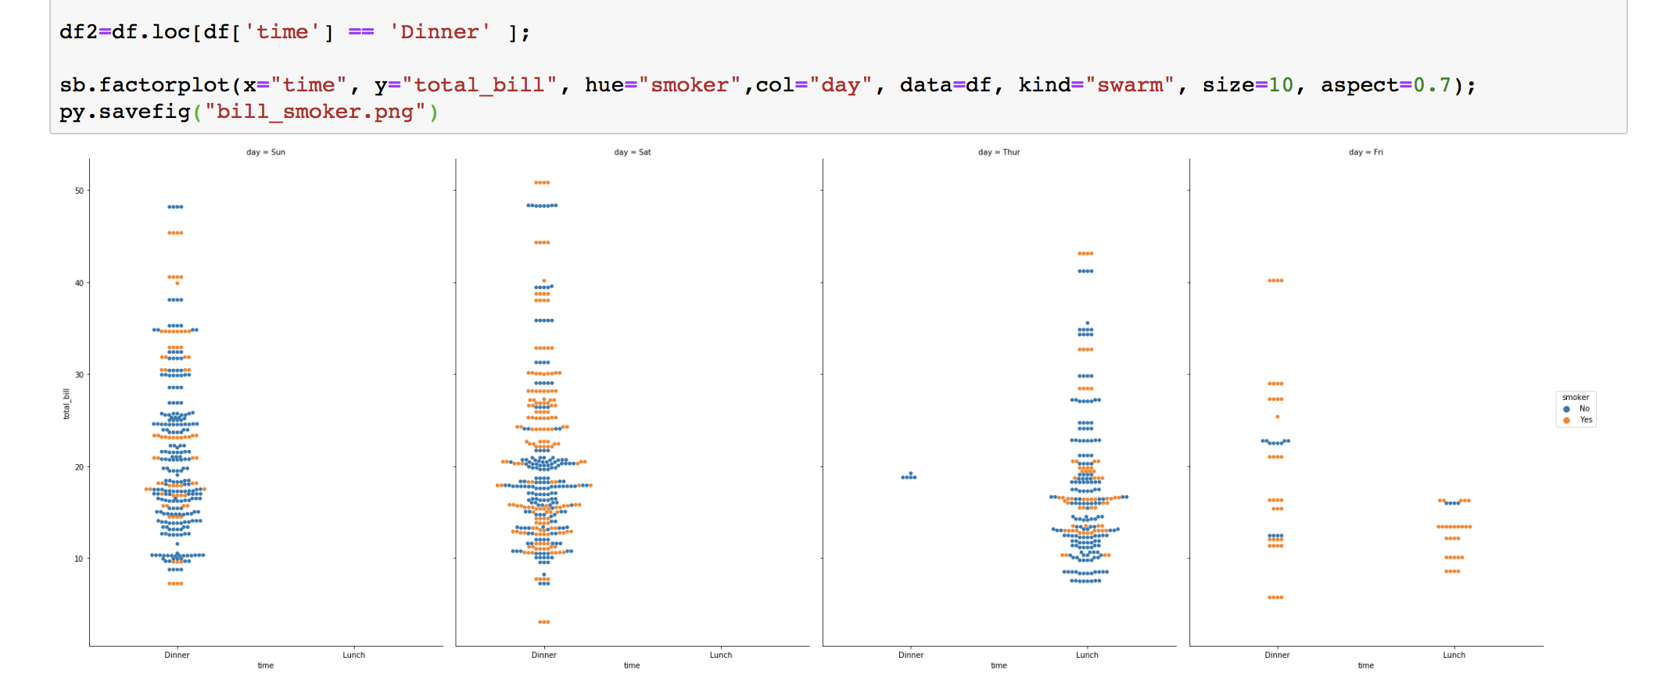
Representation(4)

Slide 30
PREDICTIONS

Slide 31
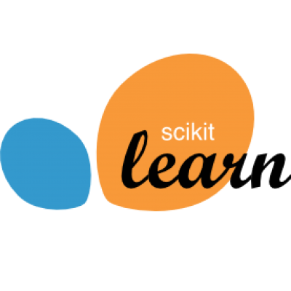
Library used: Scikit- learn
Machine learning algorithm used :- Linear regression

Slide 32
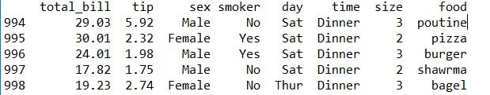
DataSet: Restaurant
The dataset contains tip & food data from different customers females and males smokers and non smokers from days Thursday to Sunday, dinner or lunch and from different tables size.

Slide 33
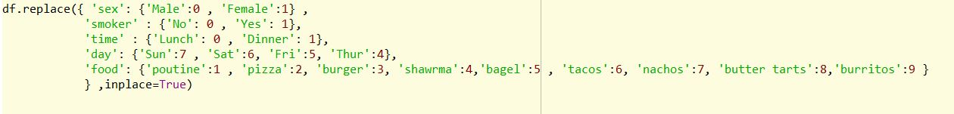
Prediction Process
Reading .csv data using Panda Framework.
Transform and clean the data

Slide 34


Building Machine Learning model
Create a list of features as X and predicted as Y
split the data into test and train so we can test our model before we use it – we decide to split 75% – 25%:

Slide 35


Training the model using train data
Predicting using test data

Slide 36
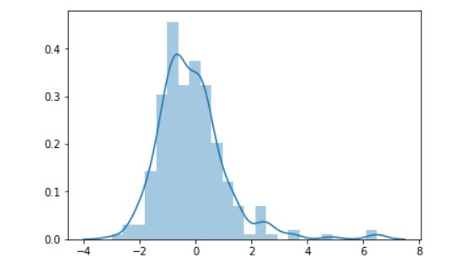

Slide 37
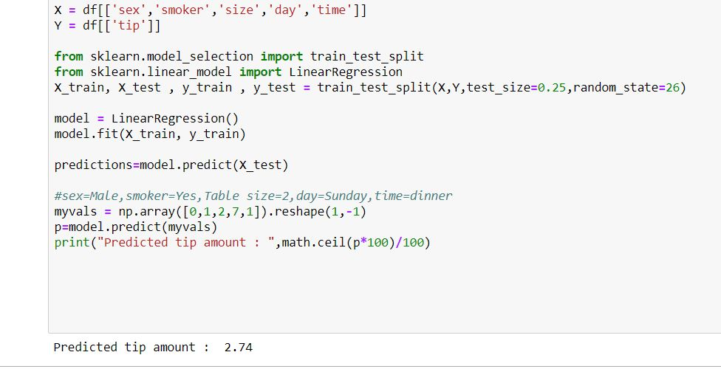
Prediction (1) : Predicting Tip amount

Slide 38
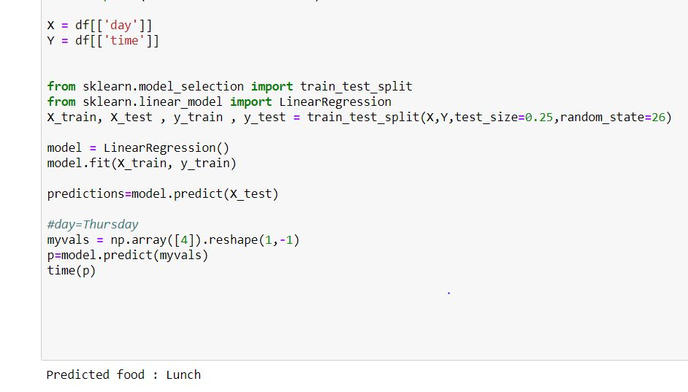
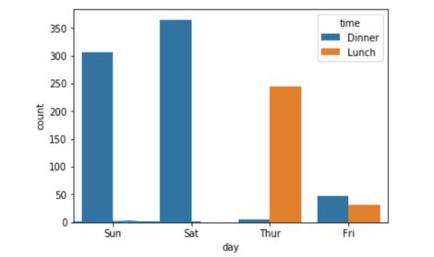
Prediction (2) : At what time people may come on a particular day

Slide 39
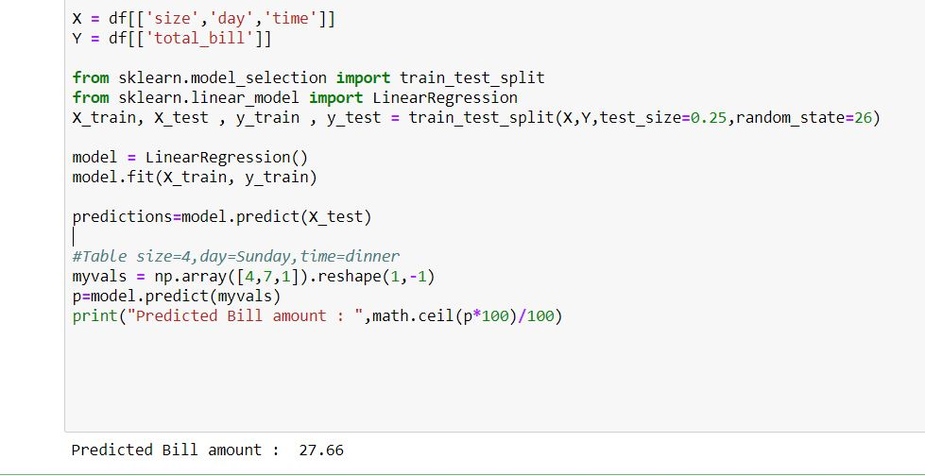
Prediction(3) : Predicted Bill amount .

Slide 40
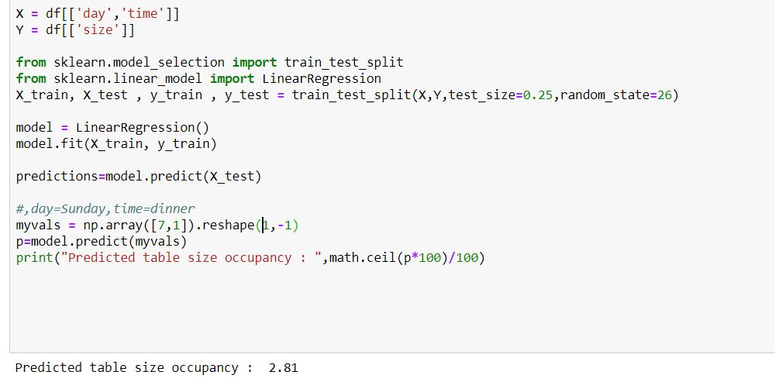
Prediction(4) : Expected table to be occupied on a particular day and time
Notes:
Explain that the hotel might have limited tables , with this prediction they can expect how many people may sit on a table.

Slide 41
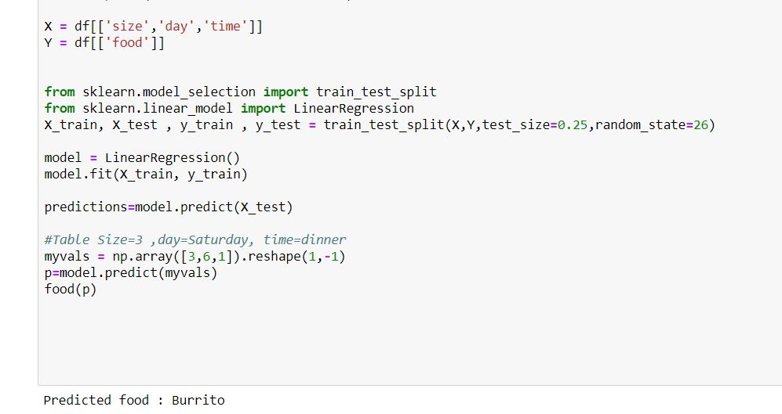
Prediction(5) : Predicted food on a particular day and time

Slide 42
References
http://jupyter-notebook-beginner-guide.readthedocs.io/en/latest/what_is_jupyter.html
http://www.numpy.org
http://scikit-learn.org/stable/index.html
https://seaborn.pydata.org/tutorial/distributions.html
https://elitedatascience.com/python-seaborn-tutorial
https://pandas.pydata.org/

Slide 43
THANK YOU

