Slide 1

MANIPAL UNIVERSITY JAIPUR
Department of Computer and Communications Engineering
TEAM NAME
Team Kavach
TEAM ID
HXXXX
PROBLEM STATEMENT ID
AI-01
PROBLEM STATEMENT TITLE
Voice-Clone Detection for Phone Scams
THEME / DOMAIN
36-HOUR HACKATHON • 24–25 OCTOBER 2026
AI / ML · Cyber Safety
BUILD / INNOVATE / CREATE
CATEGORY
Software
hypnexismuj.com | @hypnexis.muj | hypnexis2026@muj.manipal.edu

Slide 2
KAVACH: CATCHING CLONED VOICES
Team Kavach | HXXXX
PROBLEM STATEMENT
OUR SOLUTION
3–10 s of audio is enough. A reel, a WhatsApp voice note or a short "wrong number" call gives scammers a voice to copy.
Free tools clone it in minutes. "Papa, accident ho gaya, jaldi paise bhejo" arrives in the real person's voice.
Families trust the voice. Phones give no signal that a voice is synthetic, and instant transfers leave no time to check.
Detectors fail in practice. Most learn one cloner's quirks or dataset shortcuts like silence length, and break on new tools, phone lines and short clips.
Kavach listens to 2–10 s of speech and answers REAL, NOT SURE or FAKE in under a second.
Detects the vocoder fingerprint, not the tool: every cloner ends in a vocoder, so it keeps working on cloners it has never seen.
Built for real calls: phone codecs, noise, live streaming every 0.5 s and the exact faked seconds inside a call.
HOW THE SCAM WORKS
REAL
real person
NOT SURE
verify another way
FAKE
hang up, call back
Collect
voice note
Clone
minutes
Call
panic
Pay
UPI / IMPS

Slide 3
TECHNICAL APPROACH
Team Kavach | HXXXX
SYSTEM ARCHITECTURE
CORE TECHNOLOGIES
1 Clean
trim silence, equal loudness
Model: PyTorch, XLS-R 300M + layer-mix MLP
Data: In-the-Wild, LibriSpeech, edge-tts + Kokoro TTS
App: FastAPI + WebSocket, ffmpeg, Demucs
Runs on: RTX 4050 laptop GPU, or CPU
2 Phone
8 kHz line, AMR / Opus codec, noise (training)
3 Ears: XLS-R 300M
frozen, pretrained on 436k h, 128 languages
4 Mixer
learned weights over all 25 layers
UNIQUE POINTS
Frozen backbone: only a small head is trained, so it cannot overfit one cloner
Shortcut-proof: silence and loudness removed; a shortcut-only model scores 47% EER (coin toss)
Honest output: NOT SURE instead of a guess; partial-fake localisation
5 Judge
small MLP → score 0–100
6 Verdict
REAL / NOT SURE / FAKE + 0.5 s timeline

Slide 4
RESULTS ON UNSEEN DATA
Team Kavach | HXXXX
TESTED ONLY ON SPEAKERS AND CLONING TOOLS IT NEVER SAW
Test (never in training) | EER | Flagged FAKE | n
In-the-Wild, unseen speakers, 4 s | 2.0% | 97.1% | 4026
Same, 2 s clips | 2.3% | 96.8% | 4026
Same, phone-line audio | 3.0% | 95.0% | 4026
Unseen modern TTS (MS neural, Kokoro) | 0.5% | 98.0% | 204
Same, replayed speaker → mic | 10.3% | 93.1% | 204
Unseen cloner: RVC voice conversion | 1.0% | 95.9% | 97
Unseen cloner: SNAC neural codec | 8.7% | 42.0% | 300
EER = equal error rate (lower is better, 50% = coin toss). Every number comes from scripts in the repo (runs/*.json).
Weak spot we report: SNAC codec clones (vocoder-only fingerprint).

Slide 5
PHASE 2: REAL CALL CONDITIONS
Team Kavach | HXXXX
R1 CODECS & NOISE · R2 PARTIAL FAKES · R3 LIVE STREAM · R4 PHASE 1 HOLDS
80.5%
R2 partial-fake F1
faked 1–3 s found at 0.5 s resolution
precision 79.9% · recall 81.0%
500 ms
R3 live call updates
WebSocket stream, 25.7 ms median compute
p95 31.4 ms per update
≤ 0.3 pts
R4 Phase 1 EER change
all Phase 1 tests within 2 points
unseen speakers 2.3% → 2.0%
Worst case noise = 1.94× clean EER (target ≤ 2.5×). Real ffmpeg encoders.

Slide 6
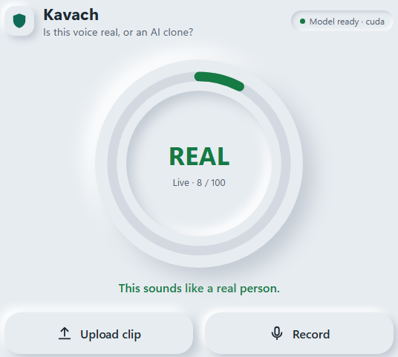
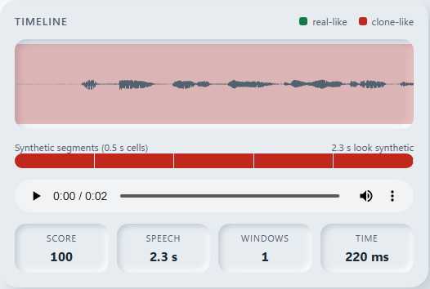
USER EXPERIENCE & DESIGN
Team Kavach | HXXXX
USER INTERFACE
USER FLOW
DESIGN GOAL
One big verdict dial in green, amber or red
Upload, record or live-call mode
Timeline marks the faked seconds
Large type, colour plus words
1
Upload or record a clip, or start a live call
A parent with no tech background should know in one second whether to trust the voice, and what to do next.
2
Score updates every 0.5 s; faked seconds turn red
3
Clear advice: "Hang up, call back on a saved number"

Slide 7
FEASIBILITY AND VIABILITY
Team Kavach | HXXXX
TECHNICAL FEASIBILITY
ECONOMIC FEASIBILITY
OPERATIONAL VIABILITY
Working prototype today: upload, record and live-call modes
Speed: median 318 ms per clip, 0 errors in 60 concurrent requests
Tested: 53 unit / API / streaming / security tests + 13/13 browser end-to-end
Modular: swap backbone or head without touching the app
Prototype cost: ₹0 in licences, open-source stack, one laptop GPU
Scaling: frozen backbone, one GPU serves many calls; CPU fallback
Hardware guard: ~₹1,300 Bluetooth device for parents' phones
Revenue: per-call API for banks, telecom licence
Deploy: on-premise API, browser app, later phone app
Risk: new cloners. Fix: retrain head only, held-out tool tests
Risk: replay false alarms (~19%). Fix: NOT SURE band + noise shield
Privacy: audio in memory only, never stored or logged
318 ms
₹0
0
median time to a verdict
licence cost, open-source stack
audio files stored or logged

Slide 8
IMPACT AND BENEFITS
Team Kavach | HXXXX
1
SOCIAL IMPACT
2
PRIVACY & EFFICIENCY
Protects families and elderly people from "emergency" voice scams
Works on Indian phone audio, Hindi and Hinglish voices
Only a small head is trained: low compute, no huge training runs
Runs locally; no audio sent to or stored in the cloud
3
TECHNICAL IMPACT
4
EDUCATIONAL IMPACT
Generalises to unseen cloners via frozen speech foundation model
Localises the faked seconds inside a real call (F1 80.5%)
Shows people that a familiar voice is no longer proof
Open, reproducible results with weak spots reported

Slide 9
BUSINESS MODEL & SUSTAINABILITY
Team Kavach | HXXXX
TARGET USERS
REVENUE & COST MODEL
SUSTAINABILITY
Families: parents and elderly on phone calls
Banks & call centres: verify callers who claim to be customers
Telecoms: flag suspicious calls on the network
Early adopters: fintech, cyber-cell awareness drives
Pilot: free web app + campus / cyber-cell demo
B2B API: pay per verified call or monthly SaaS
Consumer: free app; paid Bluetooth guard device
Cost: GPU hosting; head retrains are cheap
Partners: banks, telecoms, cyber police
Next: more Indian languages, scam-phrase detection
Keep up: add each new cloner as a held-out test
Open benchmark of Indian-language clone calls
3 segments
Free + B2B
Head only
families · banks · telecoms
free for families, paid per call for business
cheap retrain when new cloners appear

Slide 10
RESEARCH AND REFERENCES
Team Kavach | HXXXX
KEY TECH & RESEARCH SOURCES
XLS-R: Babu et al., "XLS-R: Self-supervised cross-lingual speech representation learning at scale", arXiv:2111.09296, 2021
In-the-Wild: Müller et al., "Does Audio Deepfake Detection Generalize?", Interspeech 2022
SSL + augmentation: Tak et al., "Automatic speaker verification spoofing and deepfake detection using wav2vec 2.0 and data augmentation", Odyssey 2022
ASVspoof: Wang et al., "ASVspoof 2019: A large-scale public database of synthesized, converted and replayed speech", 2020
LibriSpeech: Panayotov et al., ICASSP 2015 (real speech)
Cloners tested: Kokoro TTS, Microsoft edge-tts, RVC, SNAC (Siuzdak 2024), F5-TTS (Chen et al. 2024)
Tools: PyTorch, Hugging Face Transformers, FastAPI, ffmpeg, Demucs (Défossez et al.)

Slide 11
KAVACH
Catching AI-cloned voices
before the money moves.
THANK YOU
REAL · NOT SURE · FAKE
Team Kavach | HXXXX | AI-01 Voice-Clone Detection
CREATE / AN / IMPACT

