Slide 1
HYPNEXIS'26 · TRACK 01 · AI-01
Kavach
FAKE
Catching AI-cloned voices before the money moves
likely AI-cloned
Voice-clone detection that keeps working on cloning tools it has never seen
Kavach · HYPNEXIS'26 · AI-01

Slide 2
THE PROBLEM
Seconds of your voice are enough to rob your family
1 Collect
2 Clone
3 Call
4 Pay
A reel, a WhatsApp voice note or a short "wrong number" call gives the scammer 3–10 s of audio.
Free open-source tools copy the voice in minutes.
"Papa, accident ho gaya, jaldi paise bhejo." Same voice, real panic.
Money leaves by instant transfer before anyone checks.
Why it works
People trust a familiar voice, and today's phones give no signal that a voice might be synthetic.
Kavach · HYPNEXIS'26 · AI-01

Slide 3
WHY DETECTION FAILS
Most detectors learn the wrong thing
Unseen cloners
Shortcuts
Trained on known tools, they memorise those tools' quirks and miss new ones.
Benchmarks leak the answer through silence length and loudness. Models learn that instead of the voice.
Short clips
Many languages
2–10 s carries little evidence.
Training data is mostly English. Scam calls in India are not.
Kavach · HYPNEXIS'26 · AI-01

Slide 4
OUR INSIGHT
Every cloner ends in a vocoder
Text + target voice
Cloning model
Vocoder / codec
what to say, in whose voice
changes with every new tool
turns it into sound: leaves fingerprints
So we detect the fingerprint, not the tool
XLS-R, a speech model pretrained on 436,000 hours of real speech in 128 languages, is kept frozen. It already knows what real speech looks like at every level. We read all 25 of its layers, learn which ones carry the fake signal, and train only a small classifier on top. A frozen model cannot overfit to one cloner's artifacts.
Kavach · HYPNEXIS'26 · AI-01

Slide 5
HOW IT WORKS
From a 2–10 second clip to a verdict in under a second
Clean
Phone
Ears
Mixer
Judge
Verdict
trim silence
equal loudness
8 kHz line,
codec, noise
XLS-R 300M
frozen, 25 layers
learned layer
weights
small MLP
score 0–100
REAL / NOT SURE
/ FAKE
REAL
NOT SURE
FAKE
This sounds like a real person.
Can't be sure. Verify another way.
Likely AI-cloned. Hang up, call back on a saved number.
Kavach · HYPNEXIS'26 · AI-01

Slide 6
BEATING THE SHORTCUTS
Proving the model listens to the voice, not the silence
Shortcut-only classifier
Our score vs shortcut features
Uses only duration, silence and loudness.
EER on unseen speakers: 47.0%
Correlation (0 = unrelated):
duration: 0.17
total silence: -0.25
leading silence: -0.27
loudness db: -0.34
What we do about it
Every clip is silence-trimmed and loudness-normalised before the model sees it, so neither carries any information. Training also sees phone-line versions (8 kHz, μ-law codec, noise) so call audio does not confuse it.
Kavach · HYPNEXIS'26 · AI-01

Slide 7
RESULTS
Tested only on speakers and cloners it never saw
Test | What it proves | EER | n
In-the-Wild, unseen speakers, 4 s | Works on people it never heard | 2.3% | 4026
Same, 2 s clips | Very short evidence | 2.6% | 4026
Same, 10 s clips | More evidence | 2.3% | 4026
Same, phone-line audio | Survives a phone call | 2.9% | 4026
Unseen cloner: KOKORO | Never in training | 0.1% | 46
Unseen cloner: RVC | Never in training | 1.0% | 97
Unseen cloner: SNAC | Never in training | 8.7% | 300
EER = equal error rate: real voices called fake = fake voices called real. Lower is better; 50% is a coin toss. Every number is produced by scripts in the repo (runs/*.json).
Kavach · HYPNEXIS'26 · AI-01

Slide 8
CLOSING THE MODERN-VOICE GAP
Modern AI voices and replayed audio
Test (never seen in training) | Why it matters | EER | Flagged FAKE | n fake
Unseen modern TTS voices (Microsoft neural, Kokoro) | GPT / Gemini-class quality | 0.5% | 98.0% | 204
Same voices played through a speaker into a mic | How a scam call is overheard | 10.3% | 93.1% | 204
In-the-Wild, unseen speakers | Internet deepfakes | 2.0% | 97.1% | 1687
Clean real speech (LibriSpeech) | Real voices must not be flagged | – | false alarm 0.0% | 450 real
Clean real speech, replayed | Real voices must not be flagged | – | false alarm 18.9% | 450 real
First model (In-the-Wild only) called GPT/Gemini voices REAL. We added modern neural TTS and simulated speaker-to-mic replay to training, holding out 25% of voices for this test.
Kavach · HYPNEXIS'26 · AI-01

Slide 9
UNSEEN CLONERS
Share of clones flagged FAKE, by cloning tool
The four tools
SNAC: real voice passed through a neural codec (vocoder fingerprint only)
Kokoro: open TTS, English + Hindi voices
Veena: Indian Hindi/Hinglish TTS
RVC: voice conversion into a team member's voice (with consent)
Kavach · HYPNEXIS'26 · AI-01

Slide 10
PHASE 2 · R1
Survives phone lines, codecs and noise
Target met
Worst case: noise = 1.94× clean EER
Target ≤ 2.5×
How
Real encoders via ffmpeg (AMR-NB = mobile calls, Opus = WhatsApp/VoIP). Training sees random channels on real and fake alike.
Kavach · HYPNEXIS'26 · AI-01

Slide 11
PHASE 2 · R2
Finding the faked seconds inside a real call
F1 80.5%
Example 1: true fake 3.5–6.2 s
at 0.5 s resolution on 100 partial fakes
precision 79.9% · recall 81.0%
Example 2: true fake 1.0–3.6 s
Partial fakes
Real clip of a speaker with 1–3 s replaced by a fake of the same speaker, loudness-matched, 20 ms crossfade. Threshold set on 60 separate calibration fakes.
Example 3: true fake 3.1–5.8 s
Top strip = true fake cells · bottom strip = Kavach's 0.5 s cells
Kavach · HYPNEXIS'26 · AI-01

Slide 12
PHASE 2 · R3 + R4
Live call mode, and Phase 1 still holds
Phase 1 test | Phase 1 | Phase 2 | Change
Unseen speakers 4 s | 2.3% | 2.0% | -0.30 pts
2 s clips | 2.6% | 2.3% | -0.30 pts
10 s clips | 2.3% | 2.0% | -0.25 pts
Phone line | 2.9% | 3.0% | +0.10 pts
Streaming every 500 ms
Browser streams the call over a WebSocket. Every 0.5 s the latest 2 s is scored.
Processing per update: median 25.7 ms, p95 31.4 ms (cuda)
All Phase 1 EERs within 2 points ✓
In the app
Live call: mic or simulated call, score line updating twice a second, alert after the voice looks cloned.
Kavach · HYPNEXIS'26 · AI-01

Slide 13
RED-TEAM TEST
A 4-second WhatsApp note was enough to clone a voice
 | FAKE | NOT SURE | REAL (missed)
Clones · before noise shield | 12 | 0 | 6
Clones · with noise shield | 16 | 2 | 0
Real voice note · with shield | 0 | 1 | 5
The attack
Zero-shot cloner F5-TTS (never in training) copied a speaker from a 3.9 s WhatsApp voice note, then we laundered the clones: WhatsApp Opus, phone AMR, street noise, speaker-to-mic replay.
Noise shield on 300 held-out clips
Noisy fakes (15 dB): caught 76% (was 54%), NOT SURE 10%. Noisy real voices wrongly FAKE: 2%. Clean real voices wrongly FAKE: 1%.
How: when a clip is noisy (estimated SNR < 24 dB), Kavach also scores it after removing background noise with Demucs. A red FAKE needs a strong denoised score; a weaker one gives amber NOT SURE instead of a red accusation.
Kavach · HYPNEXIS'26 · AI-01

Slide 14
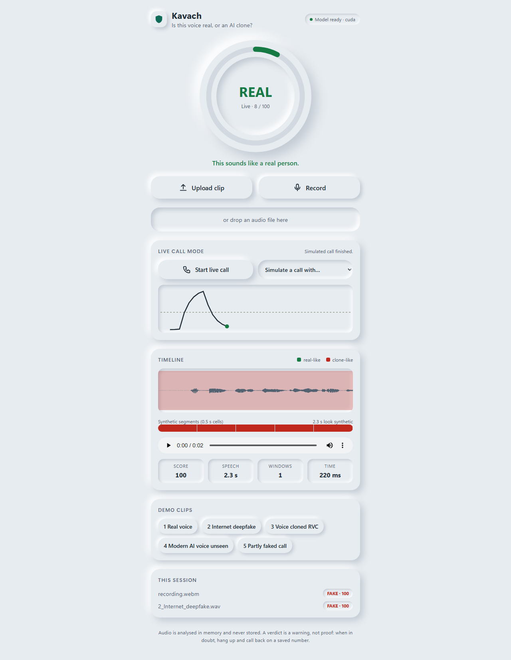
LIVE PROTOTYPE
Upload or record, verdict in under a second
Speed (RTX 4050 laptop)
Median 318 ms per clip, p95 728 ms; 0 errors in 60 concurrent requests.
Demo
1. Team member's real voice → REAL
2. Same person, cloned: "Mummy, I'm in trouble, send ₹50,000" → FAKE
3. A cloner it never saw → still FAKE
4. A judge speaks into the mic → REAL
Kavach · HYPNEXIS'26 · AI-01

Slide 15
BUILT TO BE TRUSTED
Safety, privacy and testing
Safety
Privacy
Tested
NOT SURE instead of guessing
Advice always says: verify by calling back
Thresholds set on a separate calibration split
Audio analysed in memory, never stored
No audio in logs
Every cloned voice belongs to a consenting team member
53 unit, API, streaming and security tests: all pass
Browser end-to-end: 13/13
Semgrep (226 rules) and Bandit: 0 open findings
Upload caps, decode timeout, origin-checked WebSocket, strict CSP
Kavach · HYPNEXIS'26 · AI-01

Slide 16
IMPACT
Where Kavach goes next
Banks and call centres
Telecom networks
Flag cloned voices impersonating customers.
Warn on suspicious calls at network level.
Families
Next
Phone app, or a ₹1,300 Bluetooth guard for parents (apps cannot read call audio).
Live call mode, more Indian languages, combine with scam-phrase detection.
Kavach · HYPNEXIS'26 · AI-01

