Slide 1
Battle of Neighbourhoods
Finding out the best possible location for buying or renting home in UttarPradesh for Immigrants from other cities

Slide 2
Problem
The purpose of this Project is to help people (new immigrants) in exploring better facilities around their neighbourhood. It will help people making smart and efficient decision on selecting great neighbourhood out of numbers of other neighbourhoods in Uttar Pradesh, India based on amenities & budget.
Lots of people come to Uttar Pradesh for job, education & business purpose and needed lots of research for good housing prices and reputed schools for their children. This project is for those people who are looking for better neighbourhoods. For ease of accessing to Cafe, School, Super market, medical shops, grocery shops, mall, theatre, hospital, like minded people, etc.
It will help people to get awareness of the area and neighbourhood before moving to a new city, state, country or place for their work or to start a new fresh life.

Slide 3
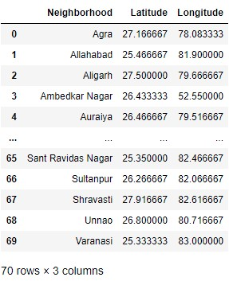
Data Source & DataFrame
Fetching the data of districts in UttarPradesh from
https://www.indianmirror.com/india-post/indianpincode.html

Slide 4
Methodology
Using Geopy library for getting geographical coordinates of Uttar Pradesh
The geograpical coordinate of Uttar Pradesh are 27.1303344, 80.859666.
Creating a map of Uttar Pradesh with neaby cities superimposed on top
Using Foursquare API to explore points of interest in each city within a radius of 40km
There are 123 unique venue category in Uttar Pradesh

Slide 5
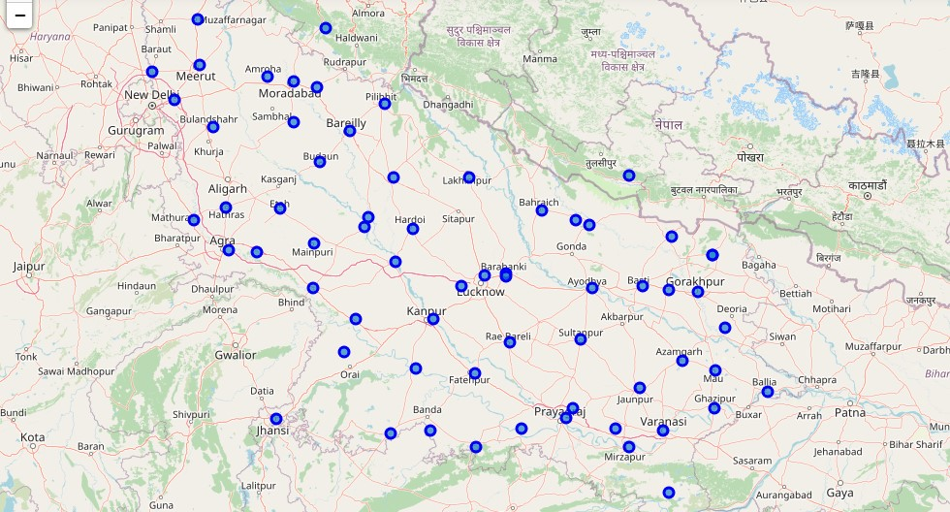
Uttar Pradesh with cities

Slide 6
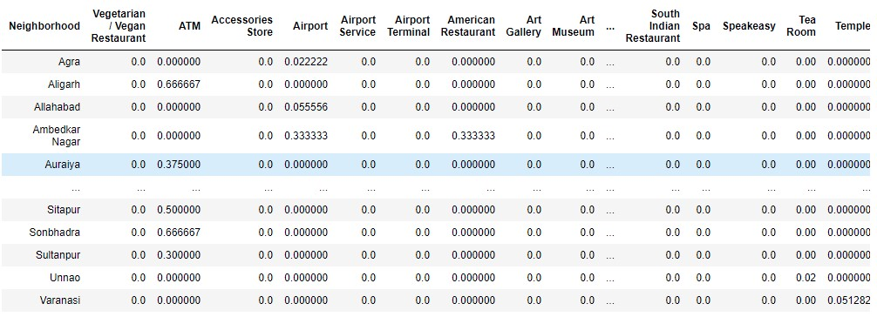
Methodology
Analyzing each city by converting each venue category into dummy values
For K-Means Clustering approach group rows by neighbourhood city & taking the mean of the frequency of occurrence of each category in each city

Slide 7
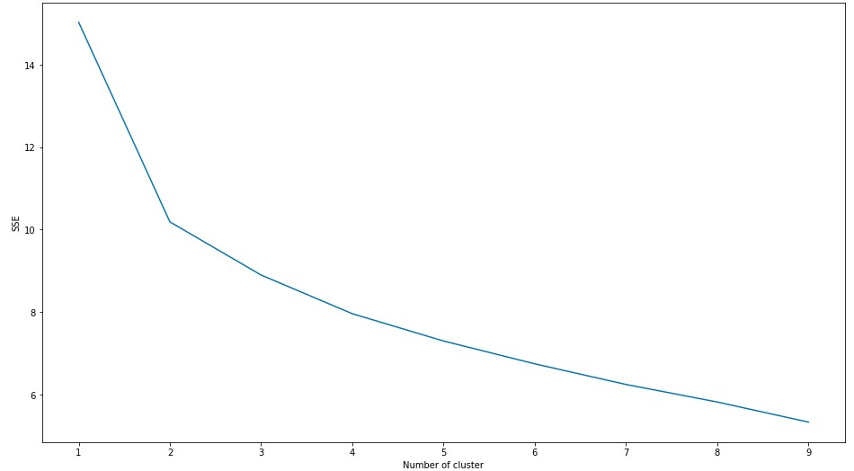
Methodology
For getting optimum number of clusters into which cities can be categorised based on amenities & budget, Elbow method is used first for getting an idea of number of clusters

Slide 8

Methodology
Based on Elbow plot, I decided to cluster the cities into 2, 3, 4, 5, 6 clusters. Now, for getting accuracy, I used Silhouette score

Slide 9
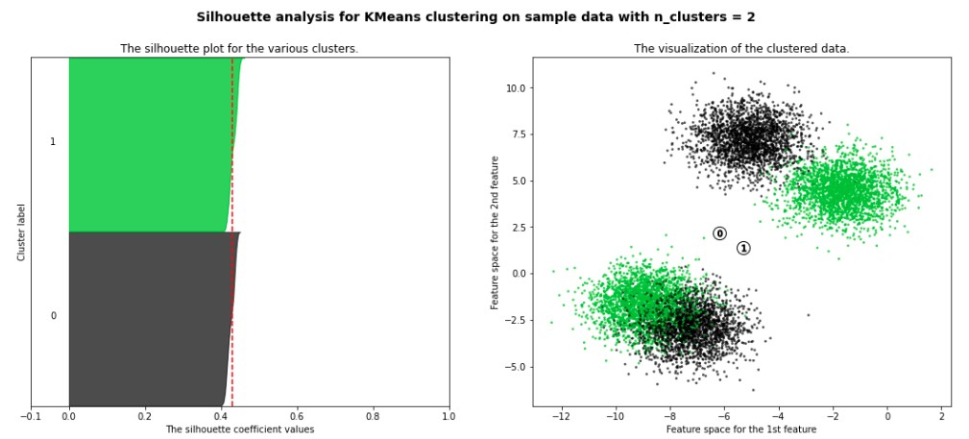
Methodology
Figure below showing Silhouette plot for n = 2 i.e. number of clusters = 2

Slide 10
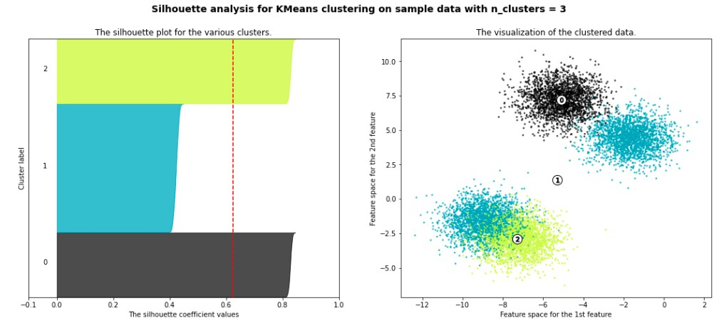
Methodology
Figure below showing Silhouette plot for n = 3 i.e. number of Clusters = 3

Slide 11
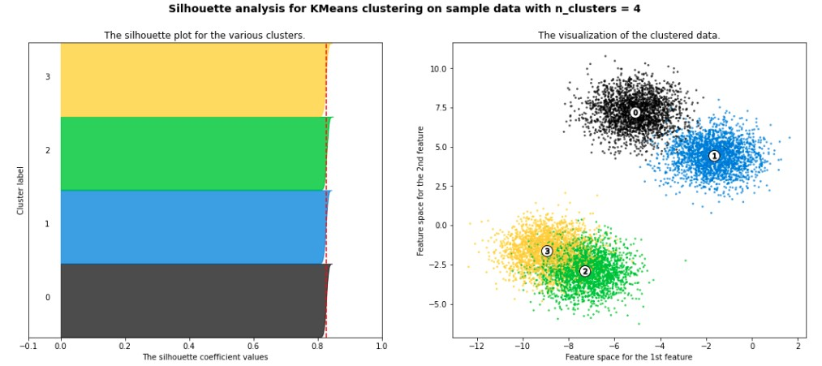
Methodology
Figure below showing Silhouette plot for n = 4 i.e. number of Clusters = 4

Slide 12
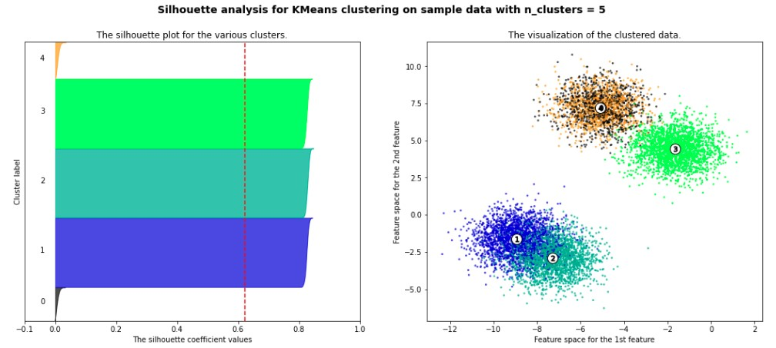
Methodology
Figure below showing Silhouette plot for n = 5 i.e. number of Clusters = 5

Slide 13
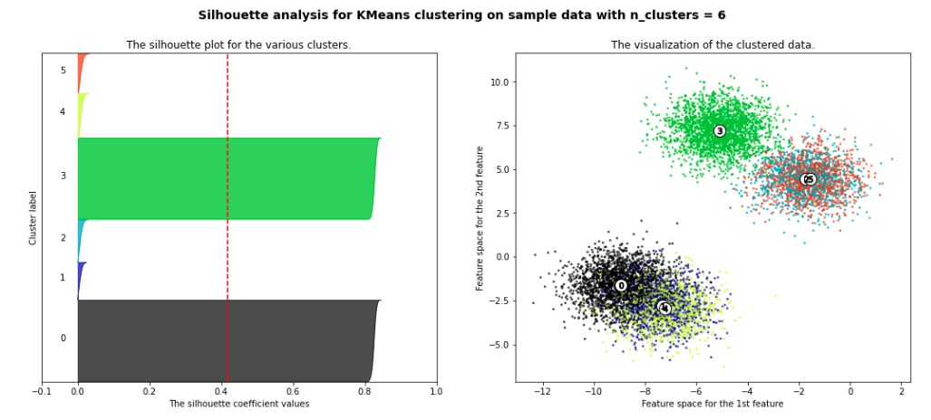
Methodology
Figure below showing the Silhouette plot for n = 6 i.e. number of clusters = 6

Slide 14
Methodology
As can be seen from the above plots, distributing cities into four clusters gives optimum results with Silhouette score value > 0.8 & also the thickness of each cluster label is more or less the same.
Finally, creating our Uttar Pradesh map with clustered data (see figure in the next slide)

Slide 15
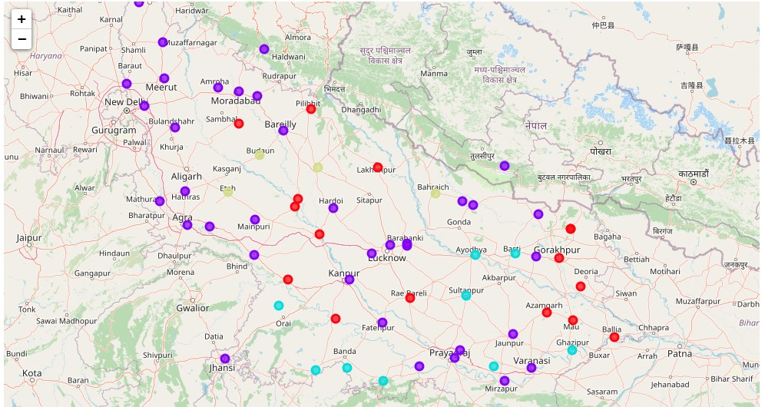
Clustered Map of Uttar Pradesh

Slide 16
Result & Observations
Cluster 1 (red dots), Cluster 2 (purple dots), Cluster 3(sky-blue dots) & Cluster 4 (Yellow dots).
Cluster 1 & Cluster 2 are amenities rich as they fulfil almost all the day-to-day life needs for people of business class. Cluster 4 consists of only four cities & is good for students & service class persons. Cluster 3 is ideal for families who want to live in some locality or gated society.

Slide 17
Future directions
This project can be continued for making it more precise in terms to find best residential location in every city of Uttar Pradesh. Best means on the basis of all required things(daily needs or things we need to live a better life around and also in terms of cost effective. But there is not enough data about schools and hospitals in Foursquare API for the location Uttar Pradesh. So thinking to use google maps API for getting the best results

