Slide 1
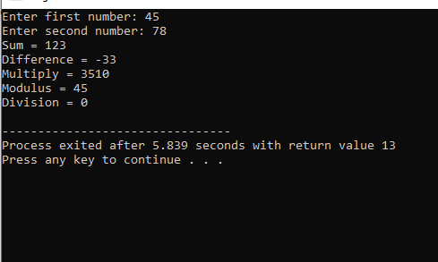
1. C program to perform all arithmetic operations.
#include <stdio.h>
void main()
{
int num1, num2;
int sum, diff, mul, div, mod;
printf("Enter first number: ");
scanf("%d", &num1);
printf("Enter second number: ");
scanf("%d", &num2);
sum = num1 + num2;
diff = num1 - num2;
mul = num1 * num2;
mod = num1 % num2;
div = num1 / num2;
printf("Sum = %d\n", sum);
printf("Difference = %d\n", diff);
printf("Multiply = %d\n", mul);
printf("Modulus = %d\n", mod);
printf("Division = %d\n", div);
}

Slide 2
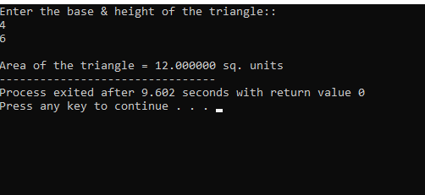
2. C program to find area of a triangle if base and height are given.
}
#include <stdio.h>
int main() {
float b, h, a;
printf("Enter the base & height of the triangle::\n");
scanf("%f%f", &b, &h);
// Calculate area of the triangle
a = (float)((b * h) / 2);
printf("\nArea of the triangle = %f sq. units", a);
return 0;
}

Slide 3
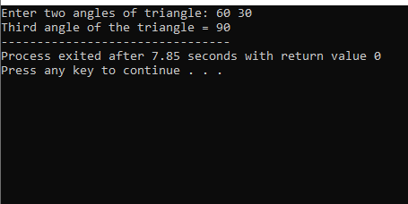
3. C program to find all angles of a triangle if two angles are given.
#include <stdio.h>
int main()
{
int a, b, c;
printf("Enter two angles of triangle: ");
scanf("%d%d", &a, &b);
c = 180 - (a + b);
printf("Third angle of the triangle = %d", c);
return 0;
}

Slide 4
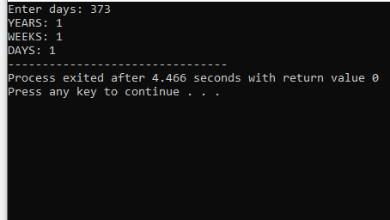
4. C program to convert days in to years , weeks and days.
#include <stdio.h>
int main()
{
int days, years, weeks;
printf("Enter days: ");
scanf("%d", &days);
years = (days / 365);
weeks = (days % 365) / 7;
days = days - ((years * 365) + (weeks * 7));
printf("YEARS: %d\n", years);
printf("WEEKS: %d\n", weeks);
printf("DAYS: %d", days);
return 0;
}

Slide 5
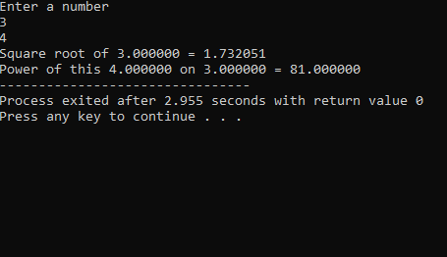
5. C program to find power and square root of any number.
#include<stdio.h>
#include <math.h>
int main () {
double x, y,result,result1;
printf("Enter a number\n");
scanf("%lf", &x);
scanf("%lf",&y);
result = sqrt(x);
result1= pow(x,y);
printf("Square root of %lf = %lf\n", x, result);
printf("Power of this %lf on %lf = %lf",y,x,result1);
return 0;
}

Slide 6
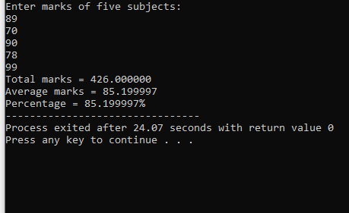
6. C program to calculate total, average and percentage and grades of five subjects.
#include <stdio.h>
int main()
{
float eng, phy, chem, math, comp;
float total, average, percentage;
printf("Enter marks of five subjects: \n");
scanf("%f%f%f%f%f", &eng, &phy, &chem, &math, &comp);
total = eng + phy + chem + math + comp;
average = total / 5.0;
percentage = (total / 500.0) * 100;
printf("Total marks = %2f\n", total);
printf("Average marks = %2f\n", average);
printf("Percentage = %2f%% ", percentage);
return 0;
}

Slide 7
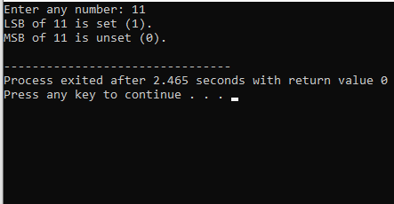
7. C program to check Least Significant Bit (LSB) and MSB of a number using bitwise operator.
#include <stdio.h>
int main()
{
int num, msb, BITS;
printf("Enter any number: ");
scanf("%d", &num);
msb = 1 << (BITS - 1);
if(num & 1)
printf("LSB of %d is set (1).\n", num);
else
printf("LSB of %d is unset (0).\n", num);
if(num & msb)
printf("MSB of %d is set (1).\n", num);
else
printf("MSB of %d is unset (0).\n", num);
return 0;
}

Slide 8
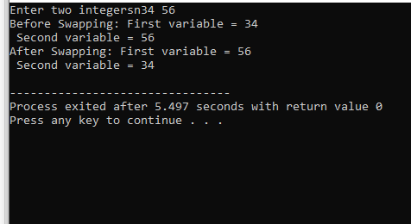
8a. C program to swap two numbers WITHOUT using 3RD VARIABLE.
}
#include <stdio.h>
int main()
{
int var1, var2;
printf("Enter two integersn");
scanf("%d%d", &var1, &var2);
printf("Before Swapping: First variable = %d\n Second variable = %d\n", var1, var2);
var1 = var1 + var2;
var2 = var1 - var2;
var1 = var1 - var2;
printf("After Swapping: First variable = %d\n Second variable = %d\n", var1, var2);
return 0;
}

Slide 9
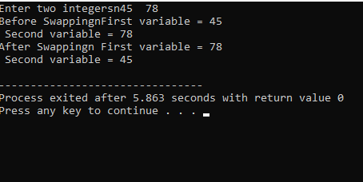
8b. C program to swap two numbers USING 3rd VARIABLE.
#include <stdio.h>
int main()
{
int var1, var2, temp;
printf("Enter two integersn");
scanf("%d%d", &var1, &var2);
printf("Before Swappingn First variable = %d\n Second variable = %d\n", var1, var2);
temp = var1;
var1 = var2;
var2 = temp;
printf("After Swappingn First variable = %d\n Second variable = %d\n", var1, var2);
return 0;
}

Slide 10
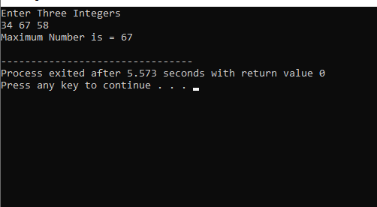
9. C program to find maximum between three numbers using conditional operator AND Ternary Operator.
#include<stdio.h>
int main() {
int a, b, c, max;
printf("Enter Three Integers\n");
scanf("%d %d %d", &a, &b, &c);
max = (a > b) ? ((a > c) ? a : c) : ((b > c) ? b : c);
printf("Maximum Number is = %d\n", max);
return 0;
}

Slide 11
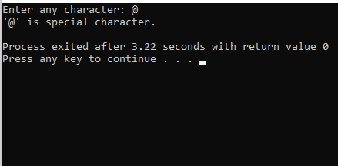
10. C program to check Alphabet, digit or special character using Conditional operator.
#include <stdio.h>
int main()
{
char ch;
printf("Enter any character: ");
scanf("%c", &ch);
if((ch >= 'a' && ch <= 'z') || (ch >= 'A' && ch <= 'Z'))
{
printf("'%c' is alphabet.", ch);
}
else if(ch >= '0' && ch <= '9')
{
printf("'%c' is digit.", ch);
}
else
{
printf("'%c' is special character.", ch);
}
return 0;
}

Slide 12
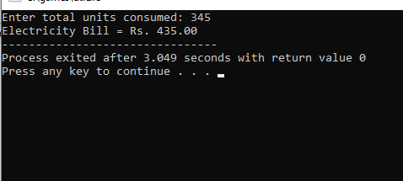
11. C program to calculate electricity bill.
#include <stdio.h>
int main(){
int unit;
float amt, total_amt, sur_charge;
printf("Enter total units consumed: ");
scanf("%d", &unit);
if(unit <= 50){
amt = unit * 0.50;
}
else if(unit <= 150){
amt = 25 + ((unit-50) * 0.75);
}
else if(unit <= 250) {
amt = 100 + ((unit-150) * 1.20);
}
else {
amt = 220 + ((unit-250) * 1.50);
}
sur_charge = amt * 0.20;
total_amt = amt + sur_charge;
printf("Electricity Bill = Rs. %.2f", total_amt);
return 0;}

Slide 13
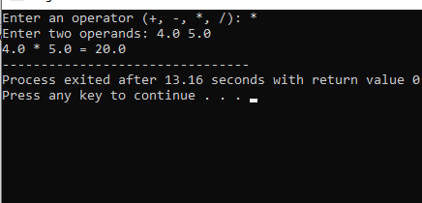
12a. C program to create Simple Calculator using switch case.
#include <stdio.h>
int main() {
char op;
double first, second;
printf("Enter an operator (+, -, *, /): ");
scanf("%c", &op);
printf("Enter two operands: ");
scanf("%lf %lf", &first, &second);
switch (op) {
case '+':
printf("%.1lf + %.1lf = %.1lf", first, second, first + second);
break;
case '-':
printf("%.1lf - %.1lf = %.1lf", first, second, first - second);
break;
case '*':
printf("%.1lf * %.1lf = %.1lf", first, second, first * second);
break;
case '/':
printf("%.1lf / %.1lf = %.1lf", first, second, first / second);
break;
default:
printf("Error! operator is not correct");
}
return 0;}

Slide 14
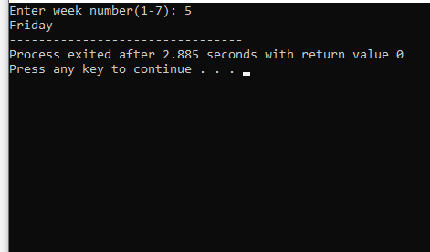
12b. C program to print day of week name using switch case.
#include <stdio.h>
int main()
{
int week;
printf("Enter week number(1-7): ");
scanf("%d", &week);
switch(week){
case 1:
printf("Monday");
break;
case 2:
printf("Tuesday");
break;
case 3:
printf("Wednesday");
break;
case 4:
printf("Thursday");
break;
case 5:
printf("Friday");
break;
case 6:
printf("Saturday");
break;
case 7:
printf("Sunday");
break;
default:
printf("Invalid input! Please enter week number between 1-7.");
}
return 0;}

Slide 15
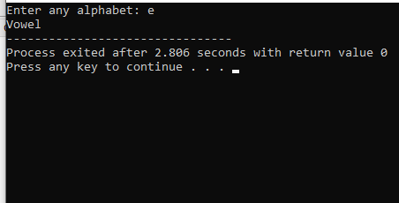
13. C program to check vowel or consonant using switch case.
#include <stdio.h>
int main(){
char ch;
printf("Enter any alphabet: ");
scanf("%c", &ch);
switch(ch){
case 'a':
printf("Vowel");
break;
case 'e':
printf("Vowel");
break;
case 'i':
printf("Vowel");
break;
case 'o':
printf("Vowel");
break;
case 'u':
printf("Vowel");
break;
case 'A':
printf("Vowel");
break;
case 'E':
printf("Vowel");
break;
case 'I':
printf("Vowel");
break;
case 'O':
printf("Vowel");
break;
case 'U':
printf("Vowel");
break;
default:
printf("Consonant");}
return 0;}

Slide 16
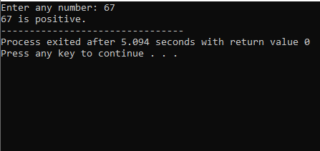
14. C program to check positive , negative or zero using switch case.
#include <stdio.h>
int main(){
int num;
printf("Enter any number: ");
scanf("%d", &num);
switch (num > 0){
case 1:
printf("%d is positive.", num);
break;
case 0:
switch (num < 0){
case 1:
printf("%d is negative.", num);
break;
case 0:
printf("%d is zero.", num);
break;}
break;
}
return 0;
}

Slide 17
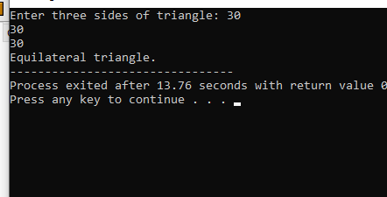
15. C program to check whether a triangle is Equilateral, Isosceles or Scalene.
#include <stdio.h>
int main(){
int side1, side2, side3;
printf("Enter three sides of triangle: ");
scanf("%d%d%d", &side1, &side2, &side3);
if(side1==side2 && side2==side3) {
printf("Equilateral triangle.");
}
else if(side1==side2 || side1==side3 || side2==side3) {
printf("Isosceles triangle.");
}
else {
printf("Scalene triangle.");
}
return 0;}

Slide 18
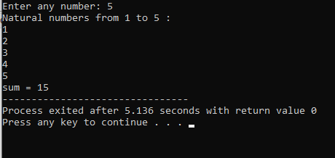
16. C program to print all natural numbers And sum of it from 1 to n.
#include <stdio.h>
int main()
{
int i, n,sum =0;
/* Input upper limit from user */
printf("Enter any number: ");
scanf("%d", &n);
printf("Natural numbers from 1 to %d : \n", n);
for(i=1; i<=n; i++)
{
printf("%d\n", i);
}
for(i=1;i<=n;i++){
sum=sum+i;
}
printf("sum = %d",sum);
return 0;}

Slide 19
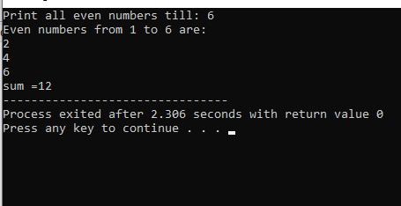
17. C program to print all even numbers And sum of it from 0 to n.
#include <stdio.h>
int main(){
int i, n,sum=0;
printf("Print all even numbers till: ");
scanf("%d", &n);
printf("Even numbers from 1 to %d are: \n", n);
for(i=1; i<=n; i++){
if(i%2 == 0){
printf("%d\n", i);
}}
for(i=2;i<=n;i+=2){
sum=sum+i;}
printf("sum =%d",sum);
return 0;
}

Slide 20
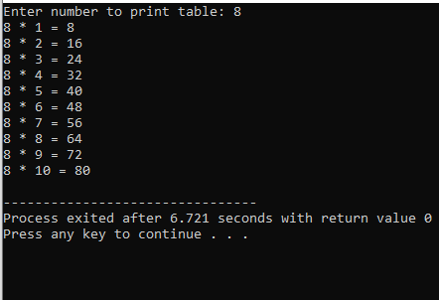
18. C program to print multiplication table of a number.
#include <stdio.h> int main() { int i, num; printf("Enter number to print table: "); scanf("%d", &num); for(i=1; i<=10; i++) { printf("%d * %d = %d\n", num, i, (num*i)); } return 0; } .

Slide 21
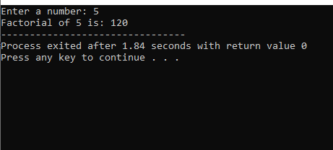
19. C program to calculate factorial of a number.
#include<stdio.h>
int main()
{
int i,fact=1,number;
printf("Enter a number: ");
scanf("%d",&number);
for(i=1;i<=number;i++){
fact=fact*i;
}
printf("Factorial of %d is: %d",number,fact);
return 0;
}

Slide 22
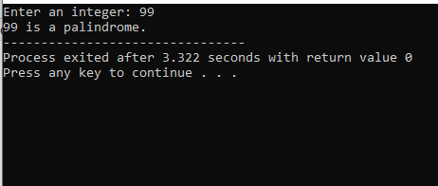
20. C program to check whether a number is palindrome or not.
#include <stdio.h>
int main(){
int n, reversed = 0, remainder, original;
printf("Enter an integer: ");
scanf("%d", &n);
original = n;
while (n != 0) {
remainder = n % 10;
reversed = reversed * 10 + remainder;
n /= 10;
}
if (original == reversed)
printf("%d is a palindrome.", original);
else
printf("%d is not a palindrome.", original);
return 0;
}

Slide 23
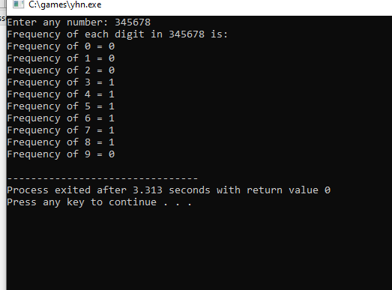
21.C program to count frequency of digits in a given number.
#include <stdio.h>
#define BASE 10
int main(){
long long num, n;
int i, lastDigit;
int freq[BASE];
printf("Enter any number: ");
scanf("%lld", &num);
for(i=0; i<BASE; i++){
freq[i] = 0;}
n = num;
while(n != 0){
lastDigit = n % 10;
n /= 10;
freq[lastDigit]++;
}
printf("Frequency of each digit in %lld is: \n", num);
for(i=0; i<BASE; i++){
printf("Frequency of %d = %d\n", i, freq[i]);}
return 0;}

Slide 24
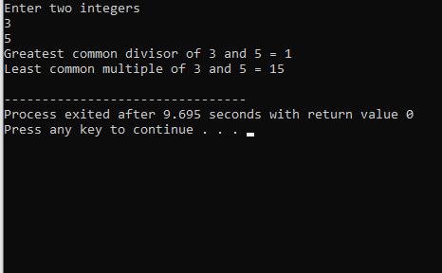
22. C program to find HCF and LCM of two numbers.
#include <stdio.h>
int main() {
int a, b, x, y, t, gcd, lcm;
printf("Enter two integers\n");
scanf("%d%d", &x, &y);
a = x;
b = y;
while (b != 0) {
t = b;
b = a % b;
a = t;}
gcd = a;
lcm = (x*y)/gcd;
printf("Greatest common divisor of %d and %d = %d\n", x, y, gcd);
printf("Least common multiple of %d and %d = %d\n", x, y, lcm);
return 0;}

Slide 25
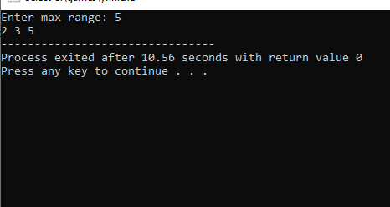
23. C program to print all prime numbers between 1 to n.
#include<stdio.h>
int main(){
int num,i,count,n;
printf("Enter max range: ");
scanf("%d",&n);
for(num = 1;num<=n;num++){
count = 0;
for(i=2;i<=num/2;i++){
if(num%i==0){
count++;
break;}}
if(count==0 && num!= 1)
printf("%d ",num);}
return 0;}

Slide 26
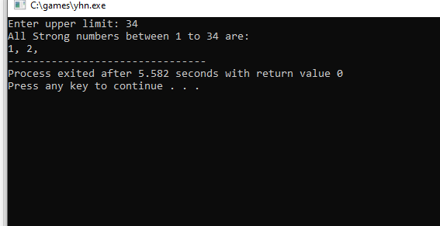
24. C program to print all strong Numbers between 1 to n.
#include <stdio.h>
int main(){
int i, j, cur, lastDigit, end;
long long fact, sum;
printf("Enter upper limit: ");
scanf("%d", &end);
printf("All Strong numbers between 1 to %d are:\n", end);
for(i=1; i<=end; i++){
cur = i;
sum = 0;
while(cur > 0){
fact = 1ll;
lastDigit = cur % 10;
for( j=1; j<=lastDigit; j++){
fact = fact * j;}
sum += fact;
cur /= 10;}
if(sum == i){
printf("%d, ", i);}}
return 0;}

Slide 27
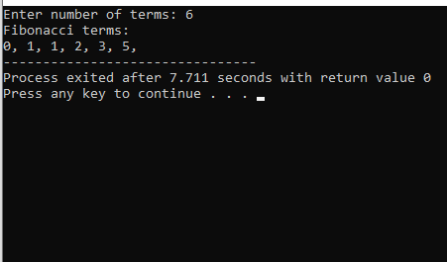
25. C program to print fibonacci series up to n terms.
#include <stdio.h>
int main()
{
int a, b, c, i, terms;
printf("Enter number of terms: ");
scanf("%d", &terms);
a = 0;
b = 1;
c = 0;
printf("Fibonacci terms: \n");
for(i=1; i<=terms; i++)
{
printf("%d, ", c);
a = b;
b = c;
c = a + b;
}
return 0;
}

Slide 28
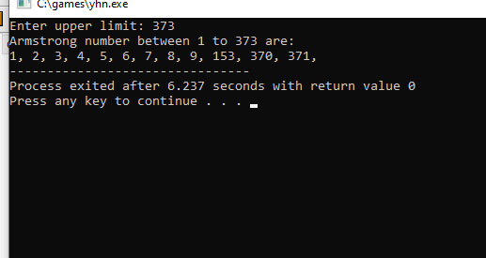
26. C program to print Armstrong numbers from 1 to n and check whether a given number is armstrong number is not .
#include <stdio.h>
#include <math.h>
int main(){
int num, lastDigit, digits, sum, i, end;
printf("Enter upper limit: ");
scanf("%d", &end);
printf("Armstrong number between 1 to %d are: \n", end);
for(i=1; i<=end; i++){
sum = 0;
num = i;
digits = (int) log10(num) + 1;
while(num > 0){
lastDigit = num % 10;
sum = sum + ceil(pow(lastDigit, digits));
num = num / 10;}
if(i == sum){
printf("%d, ", i);}}
return 0;}

Slide 29
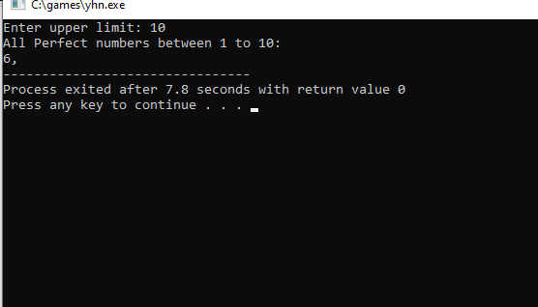
27. C program to print all Perfect numbers between 1 to n And check a given number is perfect number or not.
#include <stdio.h>
int main()
{
int i, j, end, sum;
printf("Enter upper limit: ");
scanf("%d", &end);
printf("All Perfect numbers between 1 to %d:\n", end);
for(i=1; i<=end; i++)
{
sum = 0;
for(j=1; j<i; j++)
{
if(i % j == 0)
{
sum += j;}}
if(sum == i)
{
printf("%d, ", i);
}}
return 0;}

Slide 30
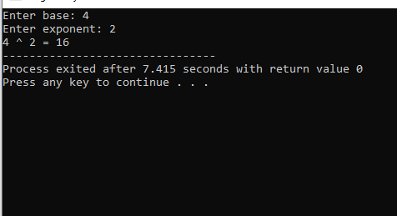
28. C program to find the power of any number using for loop.
#include <stdio.h>
int main(){
int base, exponent;
long long power = 1;
int i;
printf("Enter base: ");
scanf("%d", &base);
printf("Enter exponent: ");
scanf("%d", &exponent);
for(i=1; i<=exponent; i++)
{
power = power * base;
}
printf("%d ^ %d = %lld", base, exponent, power);
return 0;
}

Slide 31
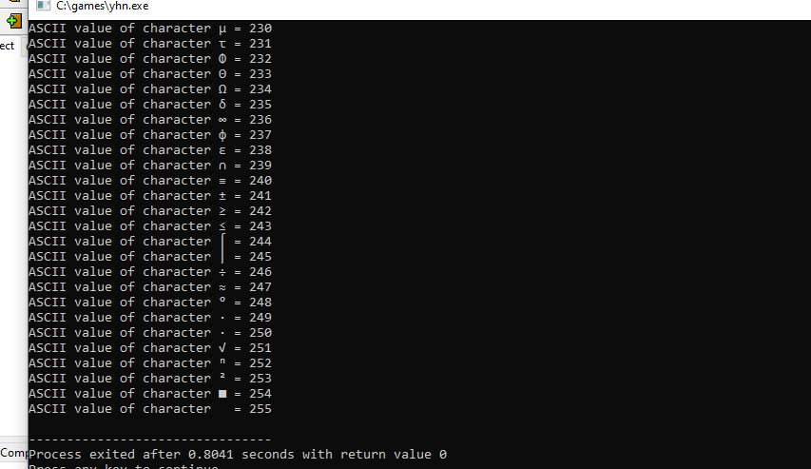
29.
C program to print ASCII values of all characters
#include <stdio.h> int main() { int i; for(i=0; i<=255; i++) { printf("ASCII value of character %c = %d\n", i, i); } return 0; }.

Slide 32
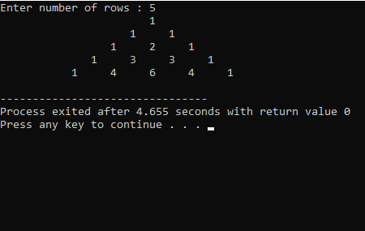
30. C program to print Pascal triangle up to n rows.
#include <stdio.h>
long long fact(int n);
int main(){
int n, k, num, i;
long long term;
printf("Enter number of rows : ");
scanf("%d", &num);
for(n=0; n<num; n++)
{
for(i=n; i<=num; i++)
printf("%3c", ' ');
for(k=0; k<=n; k++){
term = fact(n) / (fact(k) * fact(n-k));
printf("%6lld", term);}
printf("\n");}
return 0;}
long long fact(int n){
long long factorial = 1ll;
while(n>=1){
factorial *= n;
n--;}
return factorial;}

Slide 33
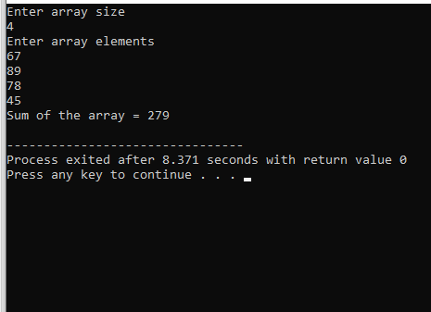
31. C program to find sum of all elements of array.
#include<stdio.h>
int main()
{
int arr[100], size, i, sum = 0;
printf("Enter array size\n");
scanf("%d",&size);
printf("Enter array elements\n");
for(i = 0; i < size; i++)
scanf("%d",&arr[i]);
for(i = 0; i < size; i++)
sum = sum + arr[i];
printf("Sum of the array = %d\n",sum);
return 0;
}

Slide 34
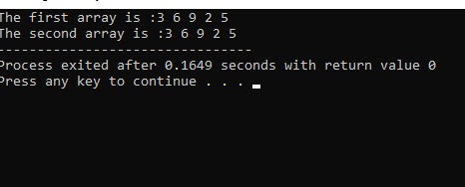
32. C program to copy one array to another array.
#include <stdio.h>
int main()
{
int a[5] = { 3, 6, 9, 2, 5 }, n = 5;
int b[n], i;
for (i = 0; i < n; i++) {
b[i] = a[i];
}
printf("The first array is :");
for (i = 0; i < n; i++) {
printf("%d ", a[i]);
}
printf("\nThe second array is :");
for (i = 0; i < n; i++) {
printf("%d ", b[i]);
}
return 0;
}

Slide 35
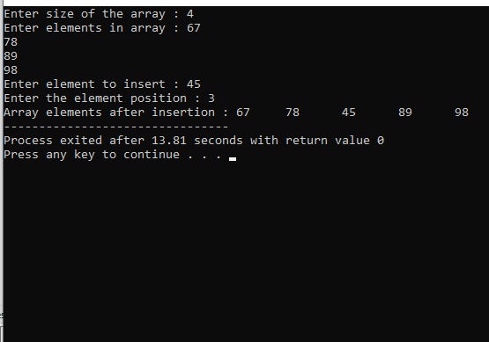
33. C program to insert an elements in array at specified position.
#include <stdio.h>
#define MAX_SIZE 100
int main(){
int arr[MAX_SIZE];
int i, size, num, pos;
printf("Enter size of the array : ");
scanf("%d", &size);
printf("Enter elements in array : ");
for(i=0; i<size; i++)
{
scanf("%d", &arr[i]);}
printf("Enter element to insert : ");
scanf("%d", &num);
printf("Enter the element position : ");
scanf("%d", &pos);
if(pos > size+1 || pos <= 0)
{
printf("Invalid position! Please enter position between 1 to %d", size);
}
else{
for(i=size; i>=pos; i--){
arr[i] = arr[i-1];}
arr[pos-1] = num;
size++;
printf("Array elements after insertion : ");
for(i=0; i<size; i++){
printf("%d\t", arr[i]);
}}
return 0;}

Slide 36
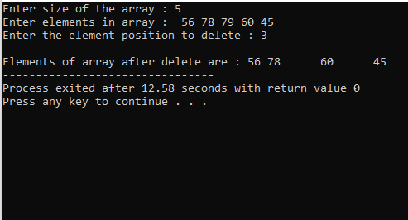
34. C program to delete an element in array at specified position.
#include <stdio.h>
#define MAX_SIZE 100
int main(){
int arr[MAX_SIZE];
int i, size, pos;
printf("Enter size of the array : ");
scanf("%d", &size);
printf("Enter elements in array : ");
for(i=0; i<size; i++){
scanf("%d", &arr[i]);}
printf("Enter the element position to delete : ");
scanf("%d", &pos);
if(pos < 0 || pos > size){
printf("Invalid position! Please enter position between 1 to %d", size);}
else{
for(i=pos-1; i<size-1; i++){
arr[i] = arr[i + 1];}
size--;
printf("\nElements of array after delete are : ");
for(i=0; i<size; i++){
printf("%d\t", arr[i]);
}}
return 0;}

Slide 37
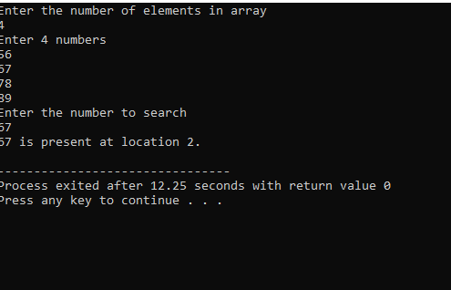
35. C program to search element in array using linear Search .
#include <stdio.h>
int main(){
int array[100], search, c, number;
printf("Enter the number of elements in array\n");
scanf("%d",&number);
printf("Enter %d numbers\n", number);
for ( c = 0 ; c < number ; c++ )
scanf("%d",&array[c]);
printf("Enter the number to search\n");
scanf("%d",&search);
for ( c = 0 ; c < number ; c++ )
{
if ( array[c] == search )
{
printf("%d is present at location %d.\n", search, c+1);
break;}}
if ( c == number )
printf("%d is not present in array.\n", search);
return 0;}

Slide 38
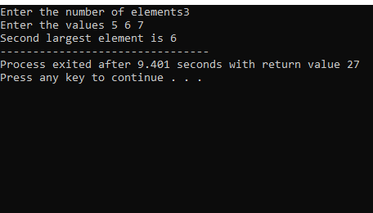
36. C program to find second largest number and sorting using bubble sort in an array.
#include <stdio.h>
void main(){
int a[100],i,j,n,temp;
printf ("Enter the number of elements");
scanf ("%d",&n);
printf("Enter the values");
for (i=0;i<n;i++){
scanf("%d",&a[i]);
}
for(i=0;i<n;i++)
{
for(j=i+1;j<n;j++)
{
if(a[i]>a[j])
{
temp = a[i];
a[i]=a[j];
a[j]=temp;}}}
printf("Second largest element is %d",a[n-2]);
}

Slide 39
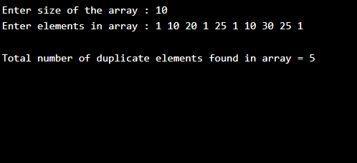
37. C program to count total number of duplicate elements in an array.
#include <stdio.h>
#define MAX_SIZE 100
int main(){
int arr[MAX_SIZE];
int i, j, size, count = 0;
printf("Enter size of the array : ");
scanf("%d", &size);
printf("Enter elements in array : ");
for(i=0; i<size; i++){
scanf("%d", &arr[i]);}
for(i=0; i<size; i++){
for(j=i+1; j<size; j++)
{
if(arr[i] == arr[j]){
count++;
break;}}}
printf("\nTotal number of duplicate elements found in array = %d", count);
return 0;
}

Slide 40
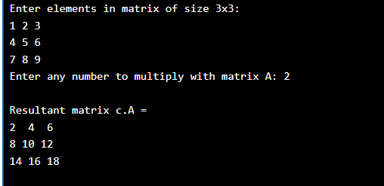
38. C program to perform scalar matrix multiplication
#include <stdio.h>
#define SIZE 3
int main()
{
int A[SIZE][SIZE];
int num, row, col;
printf("Enter elements in matrix of size %dx%d: \n", SIZE, SIZE);
for(row=0; row<SIZE; row++)
{
for(col=0; col<SIZE; col++)
{
scanf("%d", &A[row][col]);
}
}
printf("Enter any number to multiply with matrix A: ");
scanf("%d", &num);
for(row=0; row<SIZE; row++)
{
for(col=0; col<SIZE; col++)
{
A[row][col] = num * A[row][col];
}
}
printf("\nResultant matrix c.A = \n");
for(row=0; row<SIZE; row++)
{
for(col=0; col<SIZE; col++)
{
printf("%d ", A[row][col]);
}
printf("\n");
}return 0;}

Slide 41
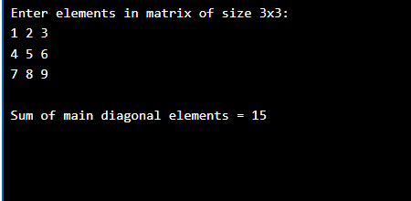
39. C program to find sum of main diagonal elements of a matrix .
#include <stdio.h>
#define SIZE 3
int main()
{
int A[SIZE][SIZE];
int row, col, sum = 0;
printf("Enter elements in matrix of size %dx%d: \n", SIZE, SIZE);
for(row=0; row<SIZE; row++)
{
for(col=0; col<SIZE; col++)
{
scanf("%d", &A[row][col]);
}
}
for(row=0; row<SIZE; row++)
{
sum = sum + A[row][row];
}
printf("\nSum of main diagonal elements = %d", sum);
return 0;}

Slide 42
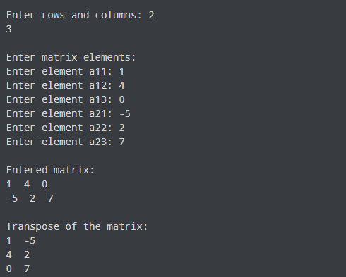
40. C program to check sparse AND transpose matrix.
#include <stdio.h>
int main() {
int a[10][10], transpose[10][10], r, c;
printf("Enter rows and columns: ");
scanf("%d %d", &r, &c);
printf("\nEnter matrix elements:\n");
for (int i = 0; i < r; ++i)
for (int j = 0; j < c; ++j) {
printf("Enter element a%d%d: ", i + 1, j + 1);
scanf("%d", &a[i][j]);}
printf("\nEntered matrix: \n");
for (int i = 0; i < r; ++i)
for (int j = 0; j < c; ++j) {
printf("%d ", a[i][j]);
if (j == c - 1)
printf("\n");}
for (int i = 0; i < r; ++i)
for (int j = 0; j < c; ++j) {
transpose[j][i] = a[i][j];}
printf("\nTranspose of the matrix:\n");
for (int i = 0; i < c; ++i)
for (int j = 0; j < r; ++j) {
printf("%d ", transpose[i][j]);
if (j == r - 1)
printf("\n");}
return 0;}

Slide 43
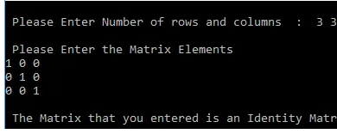
41. C program to check whether a matrix is Identity matrix or not.
#include<stdio.h>
int main(){
int i, j, rows, columns, a[10][10], Flag = 1;
printf("\n Please Enter Number of rows and columns : ");
scanf("%d %d", &i, &j);
printf("\n Please Enter the Matrix Elements \n");
for(rows = 0; rows < i; rows++){
for(columns = 0; columns < j; columns++){
scanf("%d", &a[rows][columns]);
}}
for(rows = 0; rows < i; rows++)
{
for(columns = 0; columns < j; columns++)
{
if(a[rows][columns] != 1 && a[columns][rows] != 0)
{
Flag = 0;
break;}}}
if(Flag == 1)
{
printf("\n The Matrix that you entered is an Identity Matrix ");
}
else
printf("\n The Matrix that you entered is Not an Identity Matrix ");
return 0;}

Slide 44
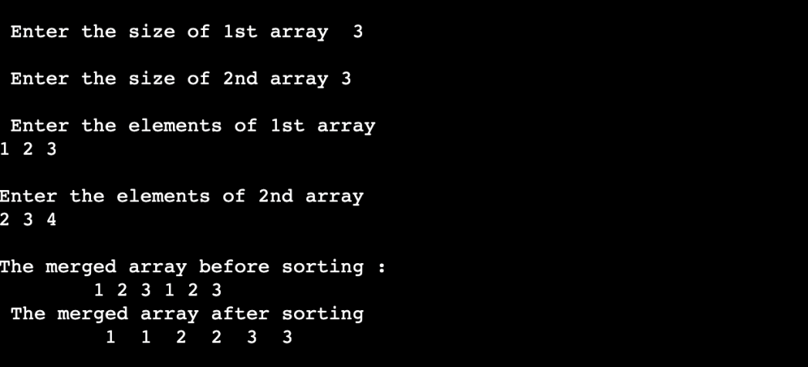
42. C program to merge two sorted array in ascending order.
#include <stdio.h>
int main() {
int s1, s2, s3;
printf("\n Enter the size of 1st array ");
scanf("%d", & s1);
printf("\n Enter the size of 2nd array ");
scanf("%d", & s2);
s3 = s1 + s2;
printf("\n Enter the elements of 1st array\n");
int arr1[s1], arr2[s2], arr3[s3];
for (int i = 0; i < s1; i++) {
scanf("%d", & arr1[i]);
arr3[i] = arr1[i];{
int k = s1;
printf("\nEnter the elements of 2nd array \n");
for (int i = 0; i < s2; i++){
scanf("%d", & arr2[i]);
arr3[k] = arr3[i];
k++;}
printf("\nThe merged array before sorting : \n\t");
for (int i = 0; i < s3; i++)
printf("%d ", arr3[i]);
printf("\n The merged array after sorting\n\t");
for (int i = 0; i < s3; i++){
int tem;
for (int j = i + 1; j < s3; j++) {
if (arr3[i] > arr3[j]) {
tem = arr3[i];
arr3[i] = arr3[j];
arr3[j] = tem;}}}
for (int i = 0; i < s3; i++)
printf(" %d ", arr3[i]);
}

Slide 45
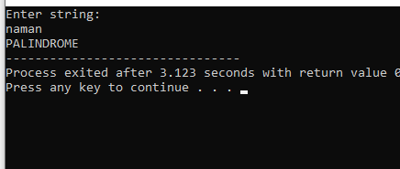
44. C program to check whether a string is palindrome or not without Compare Function of String.
#include<stdio.h>
int main(){
char string[40];
int length=0, flag=1,i;
printf("Enter string:\n");
gets(string);
for(i=0;string[i]!='\0';i++){
length++;}
for(i=0;i< length/2;i++)
{
if( string[i] != string[length-1-i] )
{
flag=0;
break;
}
}
if(flag==1)
{
printf("PALINDROME");
}
else
{
printf("NOT PALINDROME");
}
return 0;
}

Slide 46
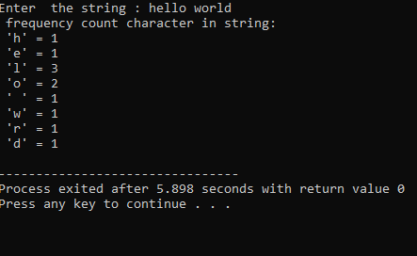
#include <stdio.h> #include <string.h> int main(){ char s[1000]; int i,j,k,count=0,n; printf("Enter the string : "); gets(s); for(j=0;s[j];j++); n=j; printf(" frequency count character in string:\n"); for(i=0;i<n;i++) { count=1; if(s[i]) { for(j=i+1;j<n;j++) { if(s[i]==s[j]){ count++; s[j]='\0'; }} printf(" '%c' = %d \n",s[i],count);} } return 0;}
45. C Program To Count Frequency Of Each Character In String

Slide 47
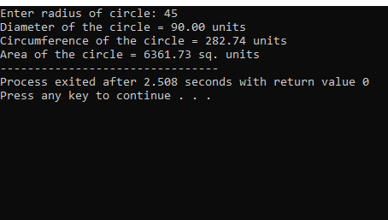
46. C program to find diameter, circumference and area of a circle using functions.
#include <stdio.h>
#include <math.h>
double getDiameter(double radius);
double getCircumference(double radius);
double getArea(double radius);
int main() {
float radius, dia, circ, area;
printf("Enter radius of circle: ");
scanf("%f", &radius);
dia = getDiameter(radius);
circ = getCircumference(radius);
area = getArea(radius);
printf("Diameter of the circle = %.2f units\n", dia);
printf("Circumference of the circle = %.2f units\n", circ);
printf("Area of the circle = %.2f sq. units", area);
return 0;
}
double getDiameter(double radius)
{
return (2 * radius);
}
double getCircumference(double radius)
{
return (2 * M_PI * radius);
}
double getArea(double radius)
{
return (M_PI * radius * radius);
}

Slide 48
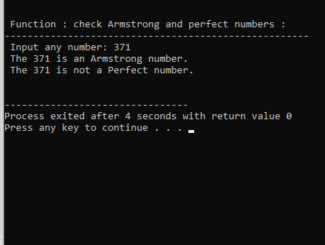
47. C program to check prime, armstrong and perfect numbers using functions.
#include <stdio.h>
int checkArmstrong(int n1);
int checkPerfect(int n1);
int main(){
int n1;
printf("\n\n Function : check Armstrong and perfect numbers :\n"); printf("-----------------------------------------------------\n");
printf(" Input any number: ");
scanf("%d", &n1);
if(checkArmstrong(n1)){
printf(" The %d is an Armstrong number.\n", n1);}
else{
printf(" The %d is not an Armstrong number.\n", n1);}
if(checkPerfect(n1)){
printf(" The %d is a Perfect number.\n\n", n1);}
else{
printf(" The %d is not a Perfect number.\n\n", n1);}
return 0;}
int checkArmstrong(int n1) {
int ld, sum, num;
sum = 0;
num = n1;
while(num!=0) {
ld = num % 10;
sum += ld * ld * ld;
num = num/10; }
return (n1 == sum);}
int checkPerfect(int n1) {
int i, sum, num;
sum = 0;
num = n1;
for(i=1; i<num; i++){
if(num%i == 0){
sum += i; }}
return (n1 == sum);}

Slide 49
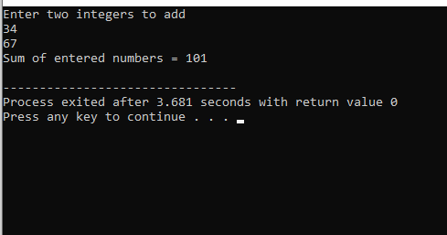
48. C program to add two numbers using pointers.
#include <stdio.h>
int main()
{
int first, second, *p, *q, sum;
printf("Enter two integers to add\n");
scanf("%d%d", &first, &second);
p = &first;
q = &second;
sum = *p + *q;
printf("Sum of entered numbers = %d\n",sum);
return 0;
}

Slide 50
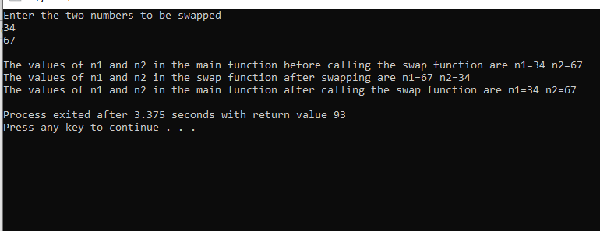
49a. Swap 2 numbers using call by Value
#include<stdio.h>
void swap(int,int);
void main( )
{
int n1,n2;
printf("Enter the two numbers to be swapped\n");
scanf("%d%d",&n1,&n2);
printf("\nThe values of n1 and n2 in the main function before calling the swap function are n1=%d n2=%d",n1,n2);
swap(n1,n2);
printf("\nThe values of n1 and n2 in the main function after calling the swap function are n1=%d n2=%d",n1,n2);}
void swap(int n1,int n2)
{
int temp;
temp=n1;
n1=n2;
n2=temp;
printf("\nThe values of n1 and n2 in the swap function after swapping are n1=%d n2=%d",n1,n2);
}

Slide 51

49b. Swap 2 numbers using call by reference.
#include <stdio.h>
void swap(int * num1, int * num2);
int main(){
int num1, num2;
printf("Enter two numbers: ");
scanf("%d%d", &num1, &num2);
printf("Before swapping in main n");
printf("Value of num1 = %d \n", num1);
printf("Value of num2 = %d \n\n", num2);
swap(&num1, &num2);
return 0;}
void swap(int * num1, int * num2){
int temp;
temp = *num1;
*num1= *num2;
*num2= temp;
printf("After swapping in swap function n");
printf("Value of num1 = %d \n", *num1);
printf("Value of num2 = %d \n\n", *num2);}

Slide 52

50. C program to reverse an array using pointers.
#include<stdio.h>
#define N 5
int main()
{
int a[N], i, *ptr;
printf("Enter %d integer numbers\n", N);
for(i = 0; i < N; i++)
scanf("%d", &a[i]);
ptr = &a[N - 1];
printf("\nElements of array in reverse order ...\n");
for(i = 0; i < N; i++)
printf("%5d", *ptr--);
return 0;
}

Slide 53

51. Square Star Pattern.
#include <stdio.h>
int main()
{
int i, j, N;
printf("Enter number of rows: ");
scanf("%d", &N);
for(i=1; i<=N; i++)
{
for(j=1; j<=N; j++)
{
printf("*");
}
printf("\n");
}
return 0;
}

Slide 54

52. Right Triangle Star Pattern.
#include <stdio.h>
int main()
{
int i, j, n;
printf("Enter value of n: ");
scanf("%d", &n);
for(i=1; i<=n; i++){
for(j=1; j<=i; j++)
{
printf("*");
}
printf("\n");
}
return 0;
}

Slide 55

53. Square Number 1 Pattern.
#include <stdio.h>
int main()
{
int rows, cols, i, j;
printf("Enter number of rows: ");
scanf("%d", &rows);
printf("Enter number of columns: ");
scanf("%d", &cols);
for(i=1; i<=rows; i++)
{
for(j=1; j<=cols; j++)
{
printf("1");
}
printf("\n");
}
return 0;
}

Slide 56

54. HALF Pyramind Star Pattern.
#include <stdio.h>
int main() {
int i, j, rows;
printf("Enter the number of rows: ");
scanf("%d", &rows);
for (i = 1; i <= rows; ++i) {
for (j = 1; j <= i; ++j) {
printf("* ");
}
printf("\n");
}
return 0;
}

Slide 57

55. Hollow Pyramind star pattern.
#include <stdio.h>
int main(){
int i, j, rows;
printf("Enter number of rows : ");
scanf("%d", &rows);
for(i=1; i<=rows; i++)
{
for(j=i; j<rows; j++)
{
printf(" ");
}
for(j=1; j<=(2*i-1); j++)
{
if(i==rows || j==1 || j==(2*i-1))
{
printf("*");
}
else
{
printf(" ");}}
printf("\n");
}
return 0;}

Slide 58


