Slide 1

E-COMMERCE DASHBOARD
Neelam Kushwaha

Slide 2
Objective
To design a Sales dashboard to analyze the sales based on various product categories. The company wants to add user control for product category, so that users can select a category and can see the trend month-wise and product-wise accordingly.

Slide 3
Benefits
User can easily understand the underlying trends in sales without processing thousands of spreadsheets.
User can easily understand the month wise sales and profit based on product category.
User can easily understand the region wise sales based on product category.

Slide 4
DaTASET
E Commerce Dashboard.xlsx file is provided by ineuron
Dataset consist of 21 columns with 51291 rows.
Product category , Sales(in USDollar), Sales(in USD) , Profits(in USD), Aging ( days between order date and ship data), Regions and months are some of the important columns from the dataset

Slide 5
EDA - DATA CLEANING AND PREPROCESSING
Checking the number of rows and columns
  The dataset has 21 columns and 51291 rows
  Checking the datatypes of the columns
  Handling Missing Values
  Dataset has no missing values.

Slide 6
CREATING DASHBOARD
Step 1: Create Histogram for Shipping Days(Aging)
  To create histogram, click the Data Tab, Under Analysis Group (Right Corner), Click Data Analysis.
  Now, select Histogram and click ok. A histogram dialog box will appear.
In the histogram dialog box, first click the Label’s Check box as we have labels in our data. After that, In the Input reference box select the range (“Sales Data!D1:D51291”) of our data and in the Bin Range Reference box select (“Working!K3:K7”).
In Output section, select range “Working!N3” for binning table, click Histogram check box and then ok.

Slide 7
Step 2- Create Combo box:
Insert Combo box for product category list in the Dashboard Sheet.
Click Developer Tab > Under Controls Panel > Click Combo box and draw. Pass the Input Range and Cell for the Combo box.
Right-click the country list Combo box > Click Format Control > Under Format Control Panel, Pass Input Range “Working!Q2:Q5” and Cell Link “Working!R2” from the working sheet.
Now, write the offset function in cell “R3” to fetch the product category based on the selection in the product category Combo box.
Write the equal sign and then the function name.
Pass the first argument as Cell “$Q$1.”
In the second argument, select the cell link cell “$R$2.”

Slide 8
Perform the same function to calculate the Quantity in Cell G7.
In G7, write the equal sign, and then enter the function name and open parenthesis.
The first Argument is Sum_Range, select range ‘Sales Data’!I:I, and then enter comma.
Now, pass the second argument Product Category column “criteria Range1” as ‘Sales Data’!F:F, and enter comma.
Pass the third argument “criteria1” “$R$3,” and enter comma.
For Profit
In K7, write the equal sign and then enter the function name and open parenthesis.
The first Argument is Sum_Range, select range ‘Sales Data’!K:K, and then enter comma.
Pass the second argument Product Category column “criteria Range1” as ‘Sales Data’!F:F, and enter comma.
Now, pass the third argument “criteria1” “$R$3”, and enter comma.

Slide 9
Step4: SUMIFS formula to calculate Sales and Profit month wise
Now write the sumifs formula to calculate the Sales and profit month-wise and sales region-wise.
Enter formula in Cell C4:
Enter the equal sign and then enter the function name and open parenthesis.
The first Argument is Sum_Range, select range ‘Sales Data’!H:H, and then enter comma.
Pass the second argument month column “criteria Range1” as ‘Sales Data’!U:U, and enter comma.
Now, pass the third argument “criteria1” “$B$4,” and enter comma.
Pass the fourth argument as Data!F:F product category column, and enter comma
Pass the fifth argument as “$R$3.”  Now, copy and paste the formula in Range C4:C15.

Slide 10
Step5: SUMIFS formula to calculate Sales region wise
Write the equal sign and then enter the function name and open parenthesis.
The first Argument is Sum_Range, select range ‘Sales Data’!H:H, and then enter comma.
Pass the second argument region column “criteria Range1” as ‘Sales Data’!T:T, and enter comma.
Now, pass the third argument “criteria1” “$F$4,”and enter comma.
Pass, the fourth argument as Data!F:F product category column, and enter comma.
Pass the fifth argument as “$R$3.”
Now, copy and paste the formula in Range G4:G15.

Slide 11
Step 6: Create Column Chart
Now, create the column chart for both region-wise and month-wise table.
Select table (B3:D15), click insert tab > under Charts Panel > Insert column chart.
Cut and Paste the chart in the Dashboard Sheet.
Perform the same steps for other tables to create chart.
Now, this is our sales Dashboard, we can apply any color in the interior of cells, and data series to format it.

Slide 12
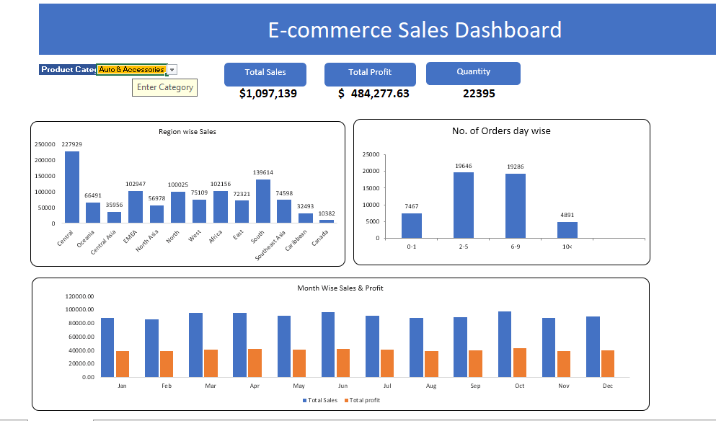
Final Outcome

Slide 13
Thank You
Neelam Kushwaha

