Slide 1


Amazon Sales Report
By: Neelam Kushwaha

Slide 2
Problem Statement
Sales management has gained importance to meet increasing competition and the need
for improved methods of distribution to reduce cost and to increase profits. Sales
management today is the most important function in a commercial and business
enterprise.
Do ETL : Extract-Transform-Load some Amazon dataset and find for me
Sales-trend -> month wise , year wise , yearly month wise.
Find key metrics and factors and show the meaningful relationships between attributes.
Do your own research and come up with your findings.

Slide 3
INTRODUCTION
Amazon Sales data refers to sales, high performing sellers and several other data points.
There are millions of Amazon sellers around the world. Amazon sales data Analysis focuses on the process of analyzing consumer behavior, sales, and several other attributes in order to make improved, data-driven decisions. It is key to successfully sustaining their businesses and earning profits and for this purpose, they analyze different metrics like
Total Sales, Sales Quantity, Total Profit, Sales, Last Year Sales and other metrics. By analyzing these different metrics, we will be able to increase and improve our performance. It can also help us to better understand the market trends and customers’ buying behaviors and help us to know what they really want.
3

Slide 4
Goal
The objective of the project is to Analyse Amazon Sales data to get a substantial data
which will help in bringing changes in a business in the future. It will help to reveals
flaws in the business model or in the way that one is going about conducting business. Sellers will be able to clearly see where they’re losing money, what the problem is, and reduce their losses accordingly. It facilitates coming up with strategic solutions to problems. This project aims to provide visual understanding of the data using Microsoft Power Bi
Extract-Transform-Load Data
Visualize the gathered Insights
Get Insights

Slide 5
DATA Source
File Name: Amazon Sales Data.csv
Dataset Size : 12.4KB
Number of Rows: 100
Number of columns: 14
Provided by Ineuron
5

Slide 6
Feature Description
ORDER ID -The ORDER ID is the ID given to the order.
ORDER DATE - The order date is the date when the product is ordered
REGION - The region in which the customer stays.
COUNTRY - The Country in which the customer reside.
ITEM TYPE - Item type is the varieties of item sales in the Amazon.
SALES CHANNEL - Mode of shopping Online or Offline.
ORDER PRIORITY - Priority of Sales Range between low to high
SHIP DATE - Ship date when the product is dispatched.
UNIT SOLD - Number of unit sold per product
.

Slide 7
UNIT PRICE - Selling Price of the product UNIT COST - Cost of the Product. TOTAL REVENUE - Total Sales of the Company. TOTAL COST - Total Cost of the Company. TOTAL PROFIT - Total Profit Earned by the Company.
1
8

Slide 8
Useful Insights
KPI
Profit Wise Analysis
Revenue wise Analysis
Cost wise Analysis
9

Slide 9
KPIS
93.18M
TOTAL COST
137.35M
TOTAL REVENUE
23
Avg Delivery Days
513K
UNIT SOLD
76
Countries
44.17M
TOTAL PROFIT
10

Slide 10
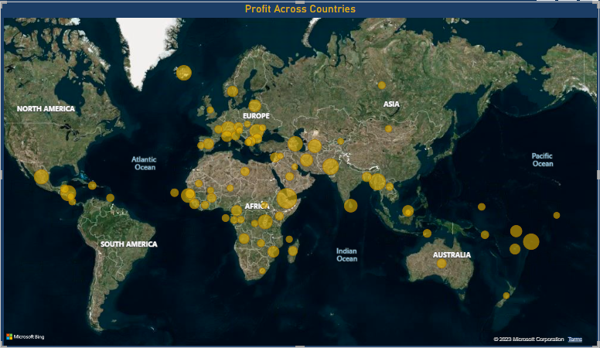
Detail Analysis
According to the visual the Profit is Highest in Djibouti and Lowest in Kuwait.
KUWAIT(1.26K)
DJIBOUT (2425.32k)
11

Slide 11
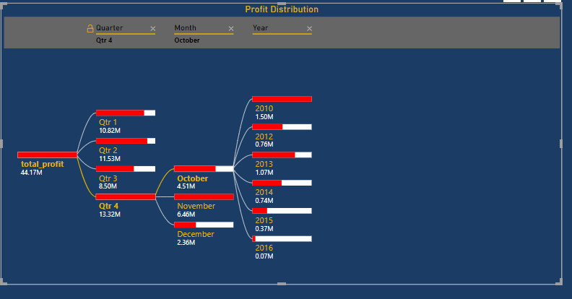
Profit Distribution
KEY INSIGHTS
According to the visual Profit is Highest in Fourth Quarter in the month of may on day 7, in the year 2013 and Least in third Quarter.

Slide 12
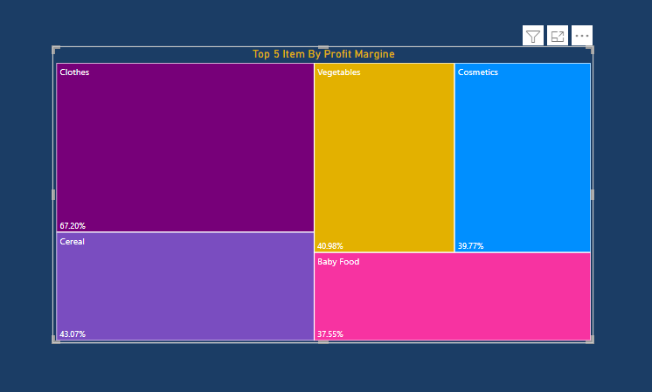
Top 5 Items by Profit Margin
KEY INSIGHTS
According to the visual we can see the Items which has highest Profit Margin which is Clothes having 67.2% and Office Supplies has Lowest Profit margin having 19.4%.

Slide 13
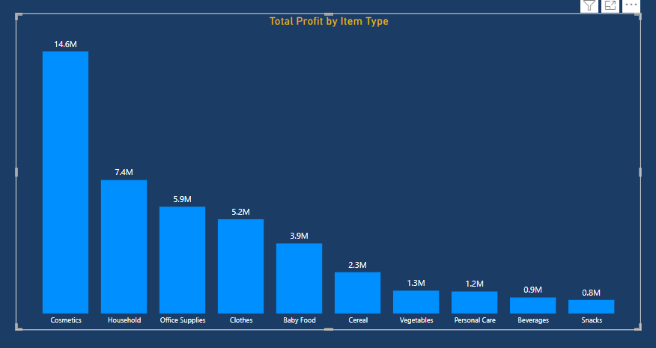
Profit Distribution
KEY INSIGHTS
According to the visual we can see Clearly that the Cosmetics Item has Highest Total Profit where as snacks and beverages has the Lowest
FRUITS
TOTAL PROFIT- 120.50K

Slide 14
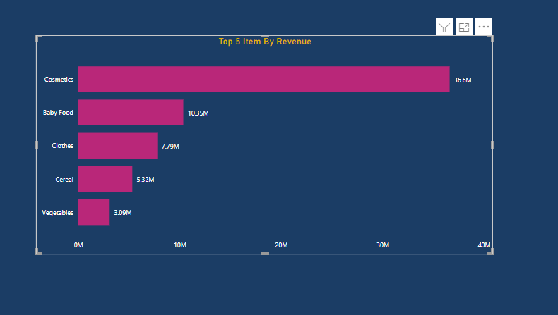
Detail Revenue Analysis
KEY INSIGHTS
According to the visual we can see that the Cosmetics Items are Top in terms of Contributing to revenue.

Slide 15
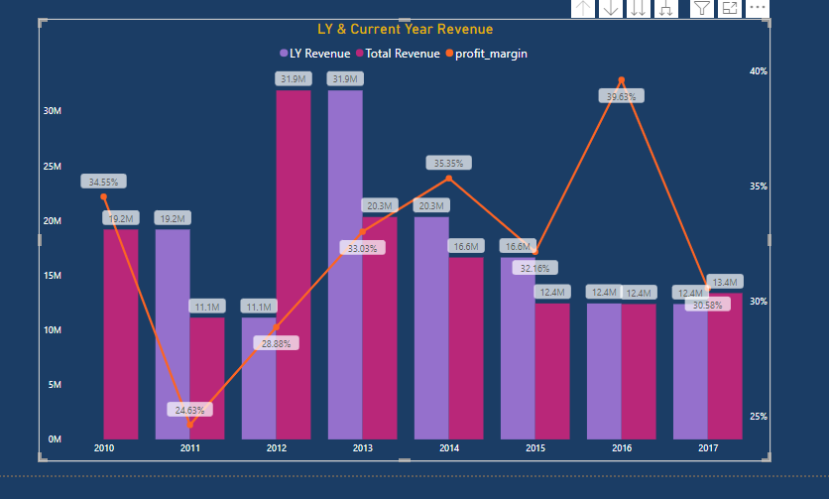
Last year , Total Revenue along with Profit %
KEY INSIGHTS
According to the visual we can see that 2012 heights total revenue and 2011 having the lowest revenue.
Though Profit percentage were high in 2016

Slide 16
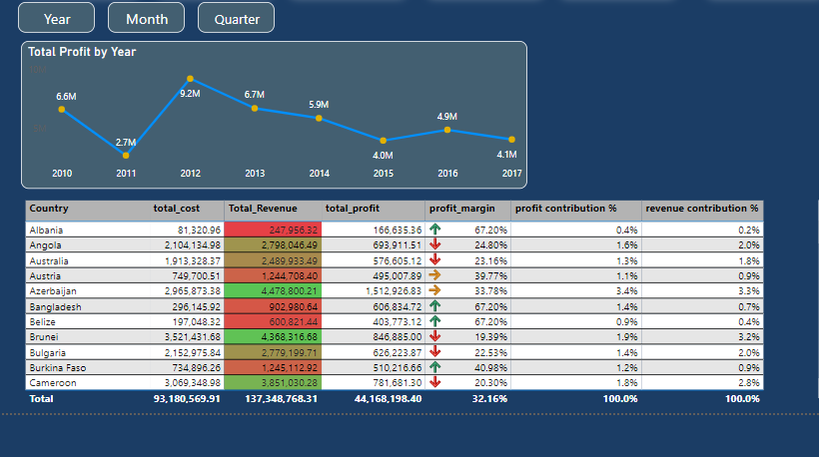
Sales Analysis
KEY INSIGHTS
According to the visual we can ee that 2012 has the highest Total Revenue of 31.90M and 2011 has the Lowest Total Revenue of 11.13M.
2012 has the highest Total Cost of 22.9M whereas 2016 has the lowest Total Cost of 39.6%.

