Slide 1
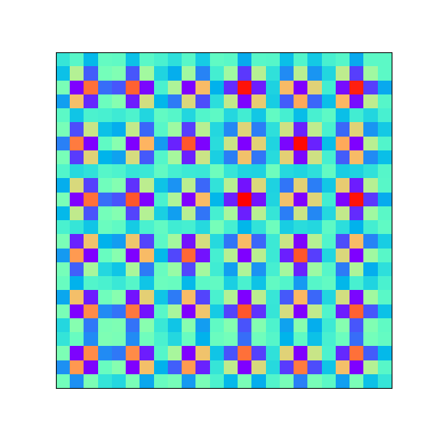
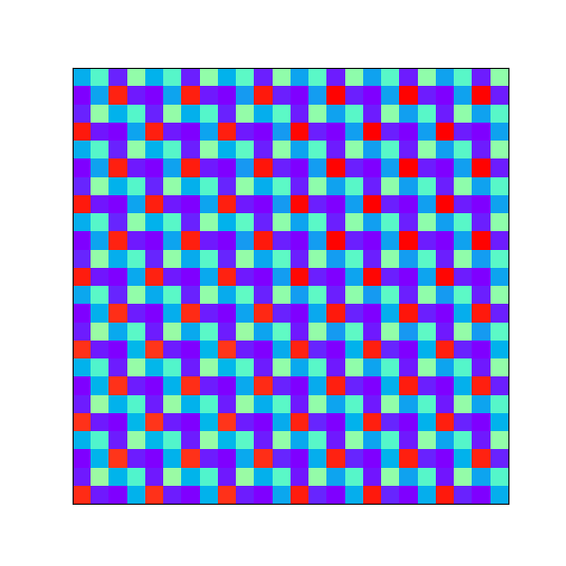
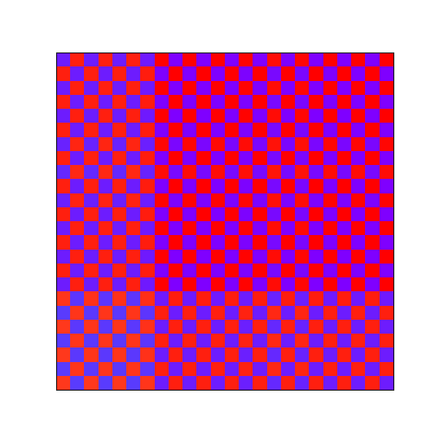
WAVEFORM DISTORTION(REAL TIME)

Slide 2
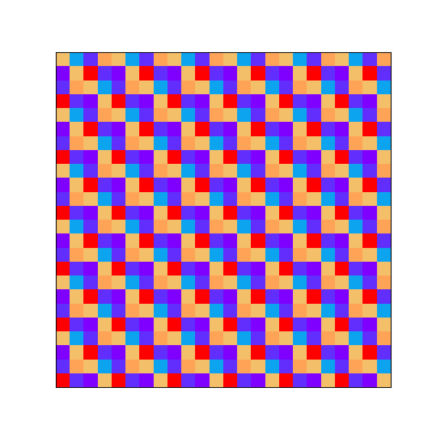
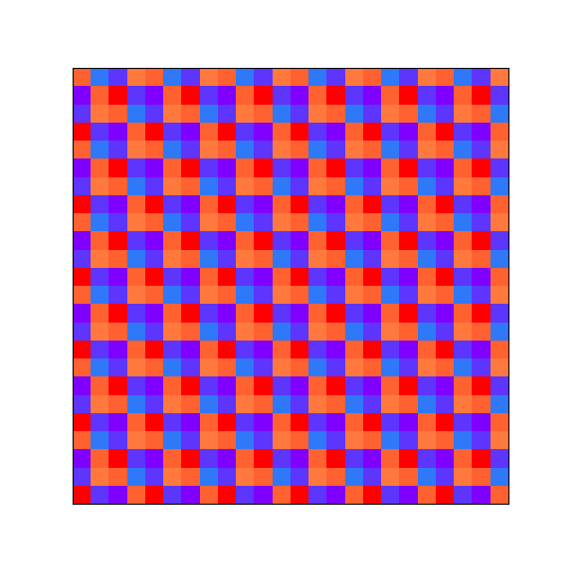
ABNORMAL FREQUENCY (REAL TIME DATA)

Slide 3
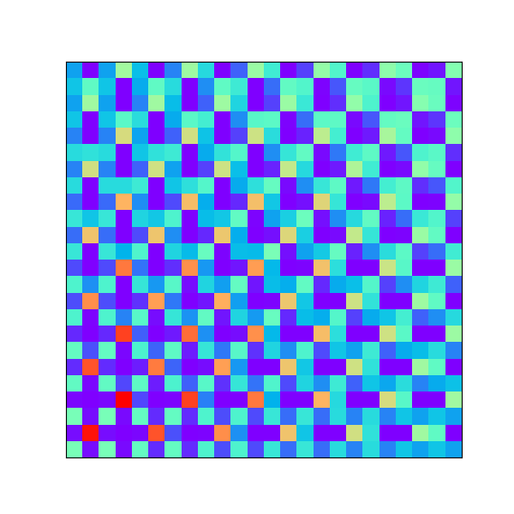
UNDER FREQUENCY + UNDER VOLTAGE(GENERATED DATA)

Slide 4
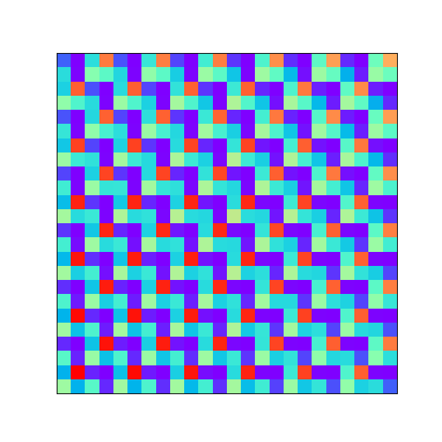
OVER FREQUENCY + OVER VOLTAGE (GENRATED DATA)

Slide 5
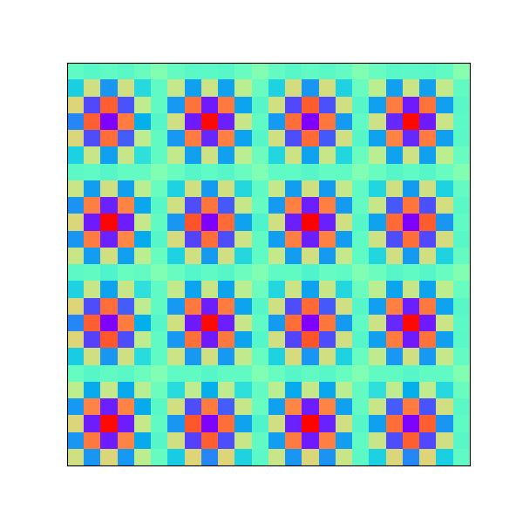
NORMAL DATA(REAL TIME DATA)

