Slide 1
DATA ANALYTICS HACKATHON | 2025 FLIGHT OPERATIONS
AVIATION OPERATIONS
& PROFITABILITY ANALYTICS
Turning flight, delay, passenger and cost data into operational decisions
PROJECT PRESENTATION
SQL Analysis • Power BI Dashboard • Business Recommendations
2025 DATA

Slide 2
01 | PROJECT OVERVIEW
Executive summary
FLIGHT RECORDS
OPERATED FLIGHTS
AVERAGE LOAD FACTOR
AVERAGE DEPARTURE DELAY
10,000
9,738
65.3%
9.2 min
Dataset rows analysed
262 cancelled records
Seats sold / available seats
Operated flights
BUSINESS QUESTION
ANALYTICAL OUTPUT
How can an airline improve punctuality, deploy capacity more effectively and protect route-level profitability?
A joined view of flight operations, delay drivers, route demand and unit economics—built with SQL analysis and Power BI reporting.
AVIATION OPERATIONS & PROFITABILITY ANALYTICS • DATA: 2025 FLIGHT RECORDS
02

Slide 3
02 | BUSINESS CONTEXT
Problem statement & objectives
• Airline performance is affected by delays, cancellations, uneven passenger demand and operating costs.
• Operational metrics alone do not explain whether a route is commercially healthy.
• Decision-makers need a single view that connects punctuality, load factor, revenue and cost.
• Project objective: identify delay hotspots, under-utilised routes and profit opportunities using flight-level data.
CORE OUTCOME
Move from descriptive reporting to clear, prioritised actions for airport operations and network planning.
AVIATION OPERATIONS & PROFITABILITY ANALYTICS • DATA: 2025 FLIGHT RECORDS
03

Slide 4
03 | DATA UNDERSTANDING
Dataset at a glance
RECORDS
FIELDS
ROUTES
AIRPORTS
10,000
24
20
10
Flight-level observations
Operational & financial attributes
Origin–destination pairs
Airport codes represented
DATA DOMAINS
ANALYSIS PERIOD
• Flight schedule & actual times
• Delay minutes, delay reason & flight status
• Aircraft type, seats available & seats sold
• Ticket / ancillary revenue and four cost categories
01 Jan 2025 – 31 Dec 2025
Source file: DA10_Aviation_Hackathon_Dataset.csv
10,000 flight records • 22 source columns
AVIATION OPERATIONS & PROFITABILITY ANALYTICS • DATA: 2025 FLIGHT RECORDS
04

Slide 5
04 | END-TO-END APPROACH
Methodology & analytical workflow
01 | DATA CHECK
02 | SQL ANALYSIS
03 | POWER BI
04 | DECISIONS
Validate fields, types, missing values and flight status
Aggregate delays, load factor, route profit and time-of-day KPIs
Create KPI cards, comparisons, route and airport visuals
Translate patterns into operational and commercial actions
›
›
›
Key calculated measures: delay minutes • load factor • total revenue • operating cost • profit per flight / route
AVIATION OPERATIONS & PROFITABILITY ANALYTICS • DATA: 2025 FLIGHT RECORDS
05

Slide 6
05 | KEY PERFORMANCE INDICATORS
Operational performance snapshot
AVG ARRIVAL DELAY
FLIGHTS DELAYED >15M
TOTAL REVENUE
OPERATING PROFIT
14.2 min
23.8%
₹398.1 Cr
₹318.2 Cr
Arrival delay across operated flights
Share of operated flights
Ticket + ancillary revenue
Revenue less listed operating costs
INTERPRETATION
The dataset supports a combined operational and financial view. Delay performance should be assessed alongside passenger utilisation and route economics—not in isolation.
AVIATION OPERATIONS & PROFITABILITY ANALYTICS • DATA: 2025 FLIGHT RECORDS
06

Slide 7
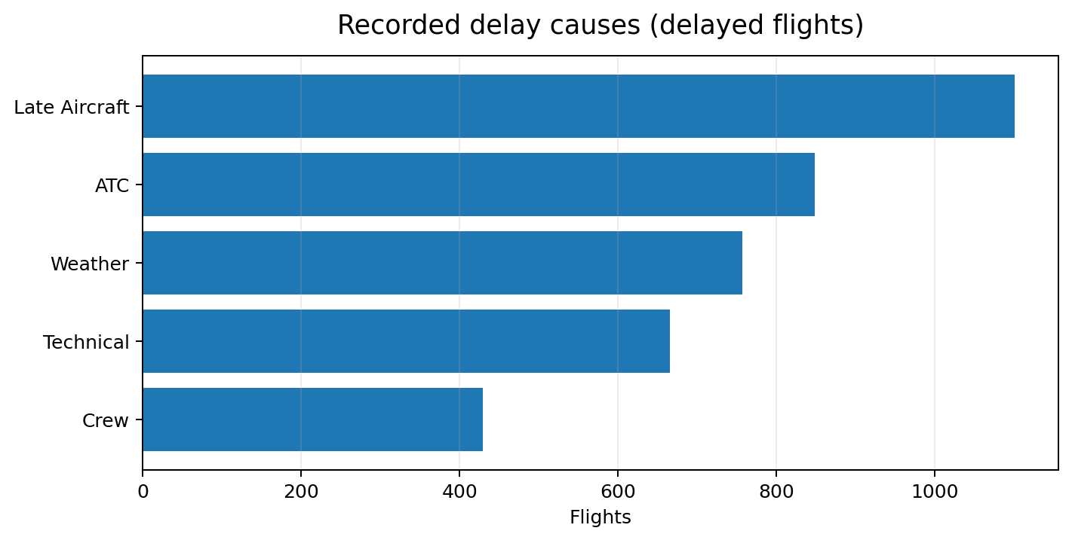
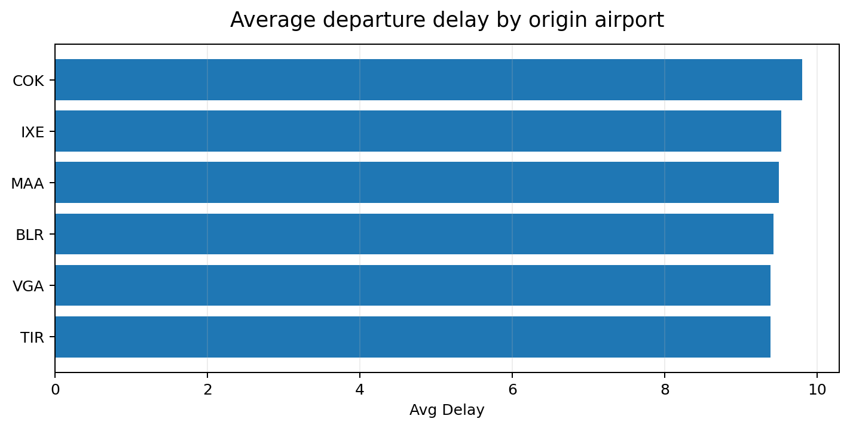
06 | PUNCTUALITY ANALYSIS
Delay drivers & airport hotspots
Highest recorded delay-reason count: Late Aircraft (1,101 flights with a reason and positive departure delay).
AVIATION OPERATIONS & PROFITABILITY ANALYTICS • DATA: 2025 FLIGHT RECORDS
07

Slide 8
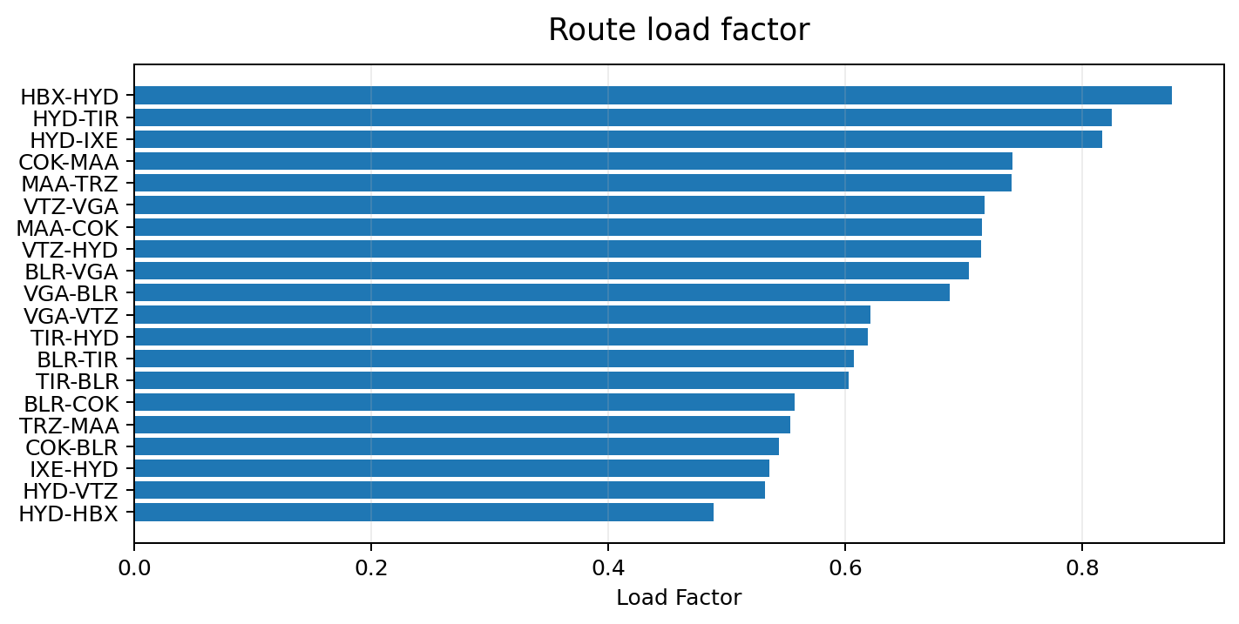
07 | LOAD-FACTOR ANALYSIS
Route demand & capacity utilisation
ROUTES BELOW 60% LOAD
6 of 20 routes
HYD-HBX, HYD-VTZ, IXE-HYD, COK-BLR, TRZ-MAA, BLR-COK
NETWORK AVERAGE
65.3% average load factor
Weighted route load factor is used for route comparisons.
AVIATION OPERATIONS & PROFITABILITY ANALYTICS • DATA: 2025 FLIGHT RECORDS
08

Slide 9
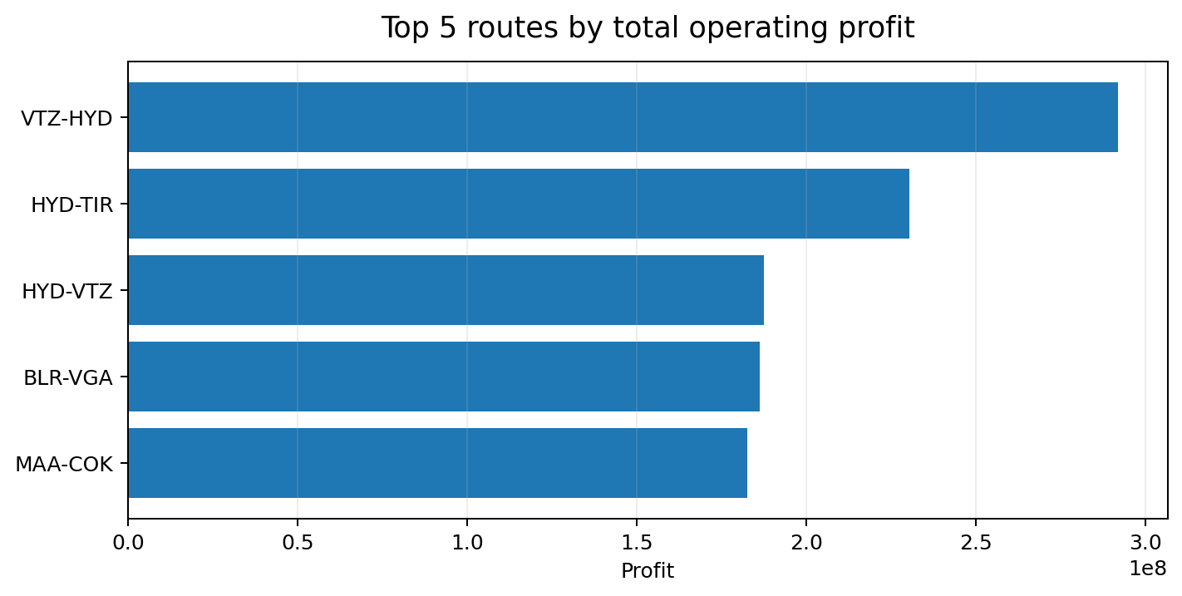
08 | FINANCIAL ANALYSIS
Route-level profitability
TOTAL REVENUE
₹398.09 crore
Ticket + ancillary revenue
TOTAL OPERATING COST
₹79.86 crore
Fuel, crew, airport & maintenance
TOTAL PROFIT
₹318.22 crore
AVIATION OPERATIONS & PROFITABILITY ANALYTICS • DATA: 2025 FLIGHT RECORDS
09

Slide 10
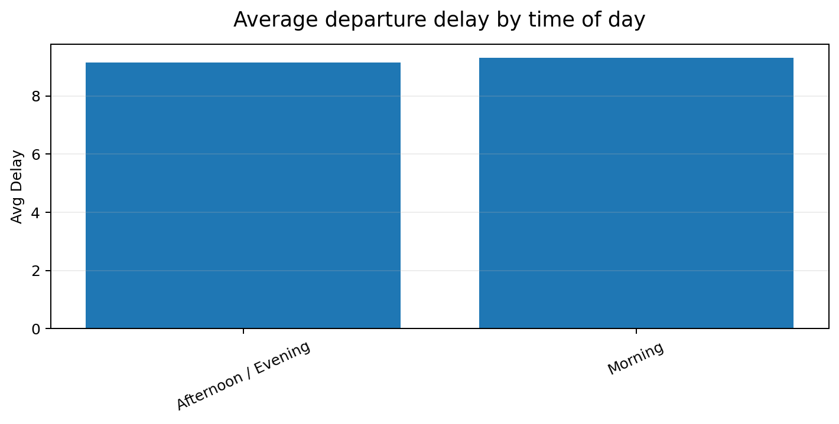
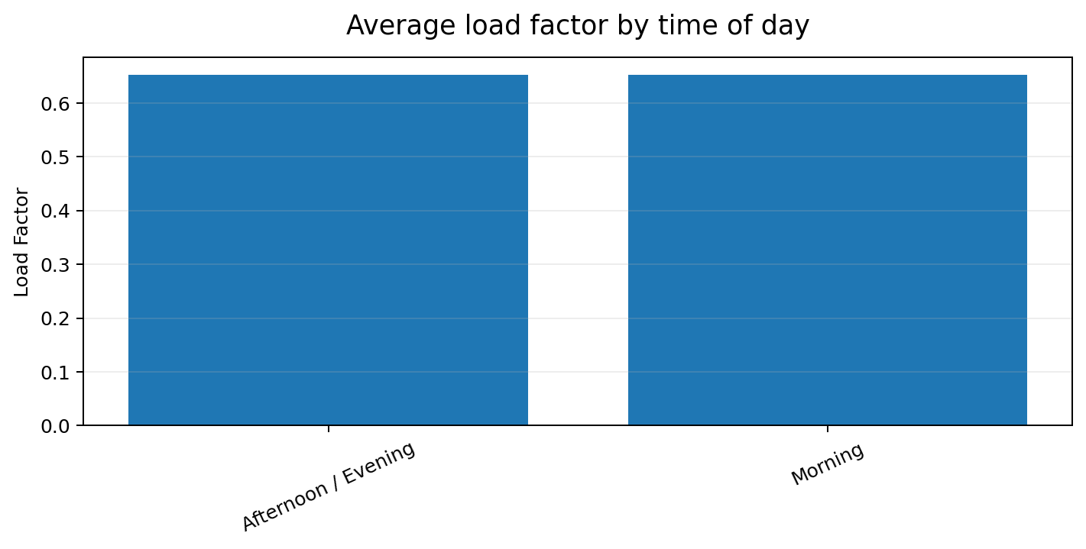
09 | SCHEDULE COMPARISON
Morning vs afternoon / evening flights
Morning: 3,943 operated flights | avg delay 9.3 min | load 65.3%
Afternoon / Evening: 5,795 operated flights | avg delay 9.2 min | load 65.3%
AVIATION OPERATIONS & PROFITABILITY ANALYTICS • DATA: 2025 FLIGHT RECORDS
10

Slide 11
10 | FROM INSIGHT TO ACTION
Business recommendations
PUNCTUALITY
Review the most frequent delay reasons and build airport-specific recovery plans.
CAPACITY
Reassess schedules, aircraft size and frequency on routes below 60% load factor.
PROFITABILITY
Protect high-contribution routes; examine cost drivers on low-margin routes before changing capacity.
MONITORING
Track departure delay, arrival delay, load factor and profit per flight in one Power BI scorecard.
AVIATION OPERATIONS & PROFITABILITY ANALYTICS • DATA: 2025 FLIGHT RECORDS
11

Slide 12
FINAL TAKEAWAYS
A clearer view of airline performance
• 10,000 flight records transformed into operational and financial insights.
• SQL provides repeatable calculations for delay, route demand and profitability.
• Power BI turns those calculations into an interactive decision-support dashboard.
• Next step: validate the highest-impact findings with operations and finance teams.
THANK YOU | QUESTIONS & DISCUSSION
12

