Slide 1
DBMS
SQL QUERIES
Neelam Rauf(110852)

Slide 2
OUTLINE
CHANGE BY USING ALTER
Day data_type
View in db
It’s Types
How to use joins?
MySQL implementation

Slide 3
Assignment
Essentially, it touches upon data definition (altering tables, views) and data manipulation (joins), along with basic user access control in MySQL.

Slide 4
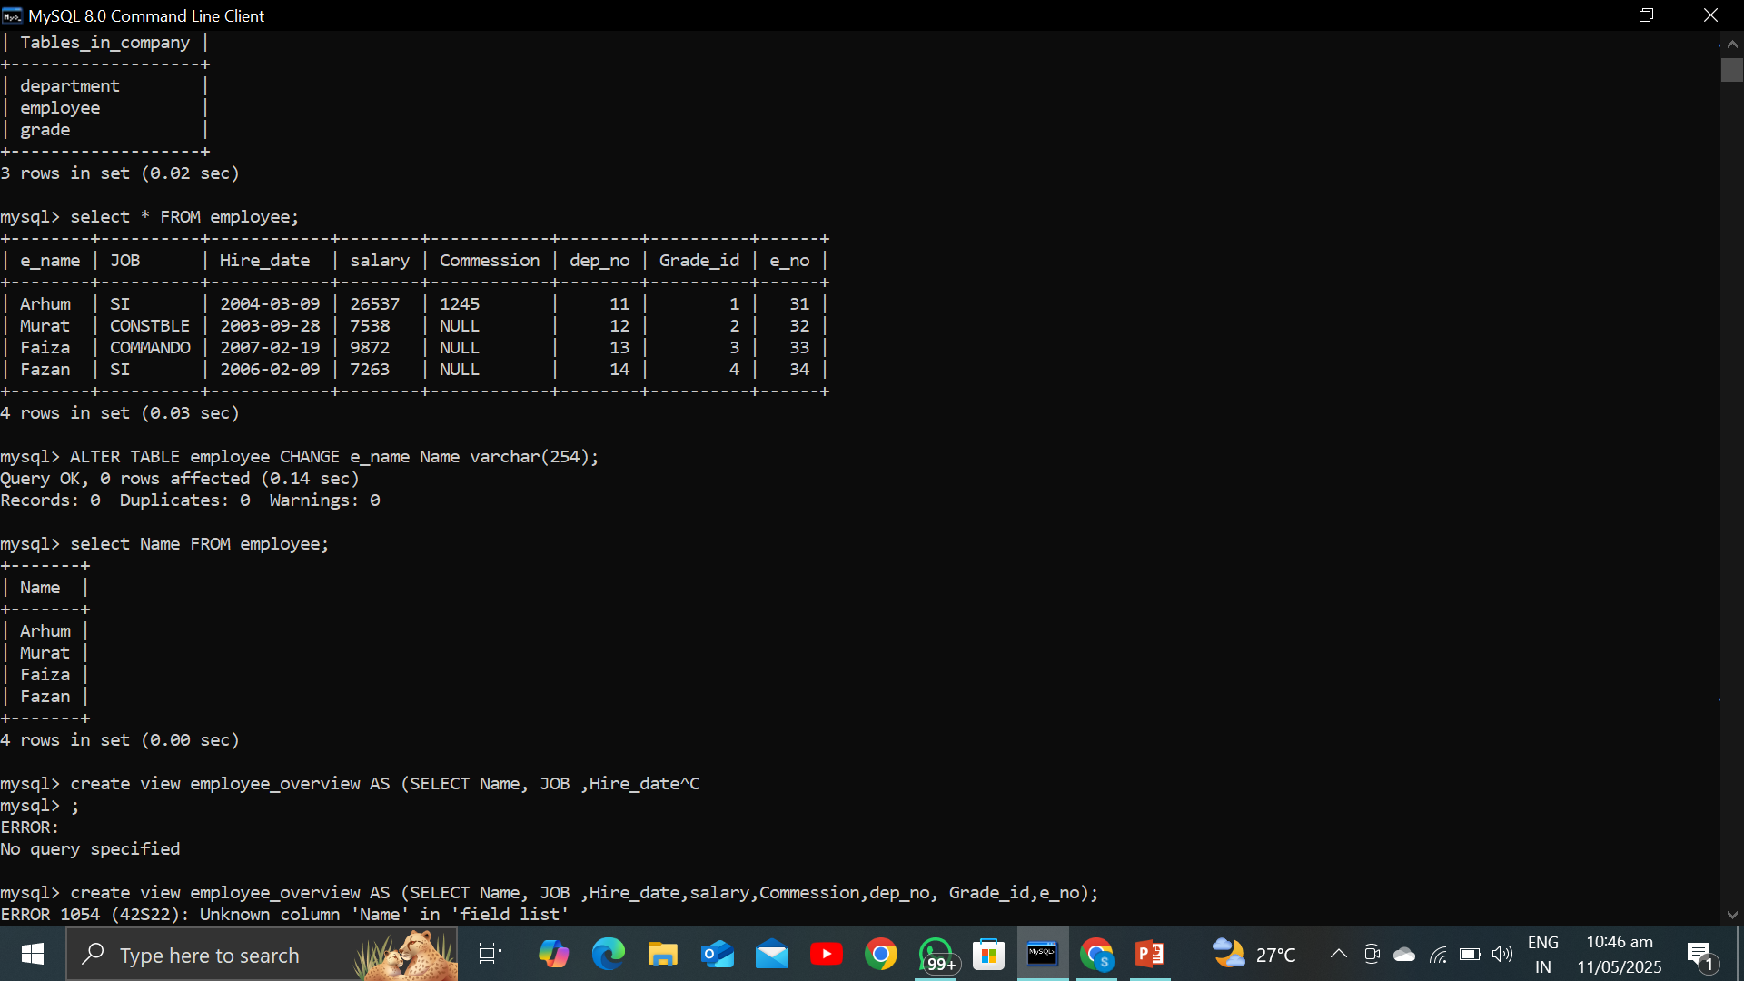
Changing an Attribute (Column):
Explanation:
To modify the definition of an existing column in a MySQL table, you use the ALTER TABLE statement. You can change its data type, constraints (like NOT NULL), and default value. There are two main clauses: MODIFY COLUMN (to change data type and constraints without renaming) and CHANGE COLUMN (to change the name, data type, and constraints).

Slide 5
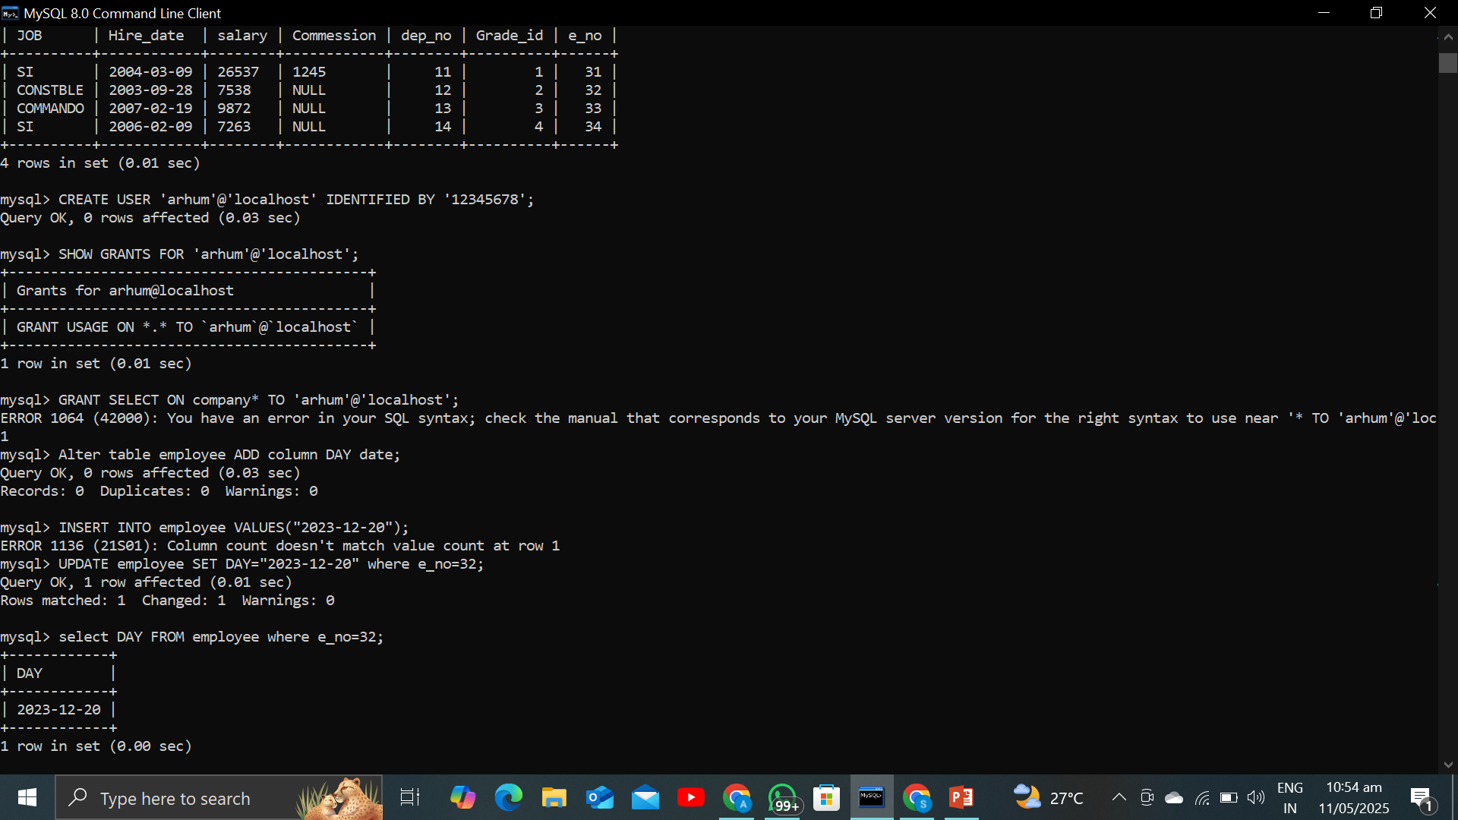
Entering a Datatype of "Day":
Explanation:
MySQL doesn't have a direct "day" datatype as a standalone unit. You typically represent a day within a date using the DATE datatype or as a text string using VARCHAR. You could also use ENUM or SET for a predefined list of days.

Slide 6
View:
SIMPLE | COMPLEX | MATERIALIZED
Based on a single table | Based on multiple tables (joins)
without aggregate functions or complex clauses | aggregate functions, GROUP BY

Slide 7
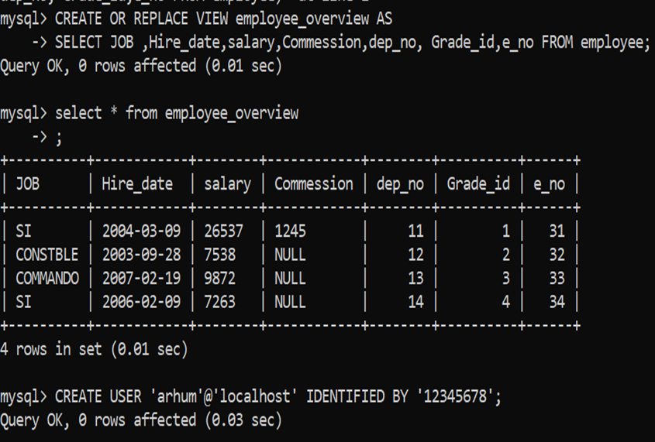
View Command:
.
Explanation: You create a view using the CREATE VIEW statement followed by the view name and the SELECT query that defines the view.
Query on MySQL:
CREATE VIEW view_name AS
SELECT column1, column2, ...
FROM table_name
WHERE condition;

Slide 8
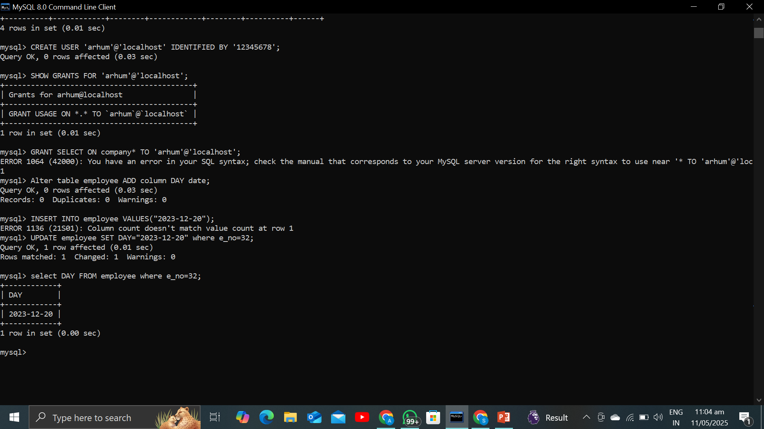
How can we provide write access to users on SQL? Explanation: You grant privileges to MySQL users using the GRANT statement. Write access typically involves INSERT, UPDATE, and DELETE privileges.

Slide 9
Other Grant :
GRANT INSERT, UPDATE, DELETE ON database_name.table_name TO 'username'@'host';
FLUSH PRIVILEGES;

Slide 10
How can we apply joins?
Explanation:
Joins are used to combine rows from two or more tables based on a related column. Different types of joins return different sets of rows.
JOINS are the crossproduct plus some conditions.
SELECT table1.column1, table2.column2
FROM table1
INNER JOIN table2 ON table1.common_column = table2.common_column;

Slide 11
JOINs:
INNER | LEFT | RIGHT
SELECT table1.column1, table2.column2 FROM table1 | SELECT table1.column1, table2.column2 FROM table1 | SELECT table1.column1, table2.column2 FROM table1
INNER JOIN table2 ON table1.common_column = table2.common_column | LEFT JOIN table2 ON table1.common_column = table2.common_column; | RIGHT JOIN table2 ON table1.common_column = table2.common_column;

