Slide 1
TORONTO CLUSTERING
To open a café in Scarborough

Slide 2
Business Problem
Scarborough is a former municipality and an administrative division of Toronto, Ontario, Canada.
It contains the Scarborough Bluffs, huge cliffs overlooking Lake Ontario, lined with parks, beaches, and hiking trails.
The area is also known for its diverse spread of restaurants, including regional Southeast Asian, Chinese, and Indian cuisine.
Our client, from India, wants to open a dessert café in Scarborough named “Sweet Tooth Cafe”.
His idea is to make and sell famous & favorite homemade dishes from all the corners of the world along with desserts too. It will represent idea of cultural diversity.

Slide 3
Requirements of client:
His idea is to open this café in a location which is accessible by young people, working class and old people.
It should be located in an area which should not be far away from the city. It should be in the middle of the town. A place whose permits will be easily available and rent shouldn’t be high enough.
The neighborhood of the café should have other cafes or restaurants but not more than 5. It can contain other shops so that customers will be available.
He wants to ensure that the neighborhood of the café should not get disturbed because of it.
This are the requirements of the client to open café in Scarborough.

Slide 4
Source of Data
The majority of the data will be covered from Foursquare API. We will need geospatial data of Scarborough, Toronto for longitudes and latitudes of registered regions.
From Foursquare API, we will call venues filtered with specialities like dessert, restaurants, cafes and so on. That data shall be from Scarborough, Toronto.
We will also require data of different types of shops in the neighborhood of the finalized area. Merged dataset will be created from both datasets and then analysis will be done.
For finalizing the location, we tend to ensure either government permission is there to run a café or not. And moreover, its neighborhood is fine with café or not.

Slide 5
Source of Data
We need to make sure the eatery shops should not be more than 5 in the nearby neighborhood as per client’s requirements.
The data should say whether its far away from the town or not. The location of the café should be in the middle of the town accessible by people from all the corners.
Data for permission of government will be got from Canadian Government website. Or it can be asked from official as well.
Data stating which dishes to be sold according to its visitors and residents will also be needed. That can be taken with help of Foursquare API by calling tips of users on venues. Or a survey can be conducted for the same which will be helpful in many ways.

Slide 6
Exploratory Data Analysis
First, we imported location data of Toronto. Cleaning was required in that dataset. It was done using dropping a column, grouping by Postal Code column with neighborhoods in a single cell. That was done with Apply method.
Two datasets were extracted from a single one with different conditions and then merged on a single column Postal Code.
Now, geospatial data of Toronto was downloaded and cleaning was done as required.
Both the final datasets were merged on Postal Code column and new dataframe is created. That dataframe consists of postal codes of different regions with their neighborhoods and values of latitude & longitude of respective areas.
Scaling of data is also done using Preprocessing Scalar library. Data type of Cluster Label column is changed to integer type from float type.

Slide 7
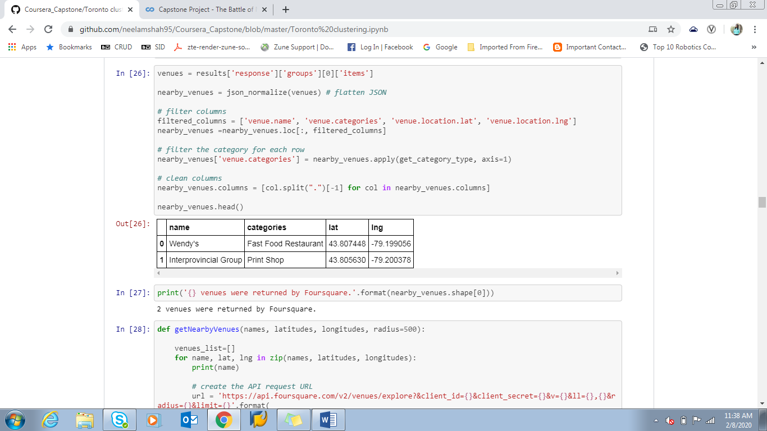

Slide 8
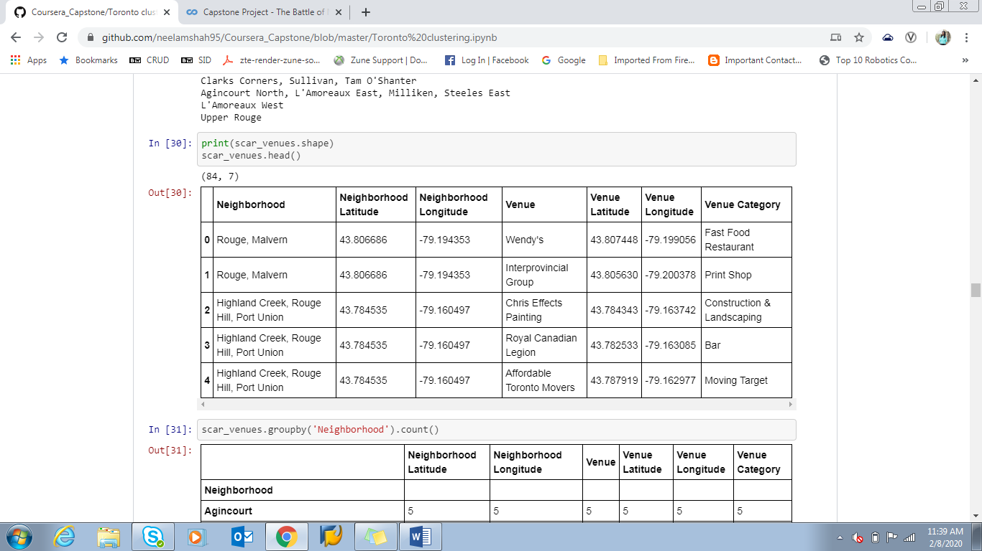

Slide 9
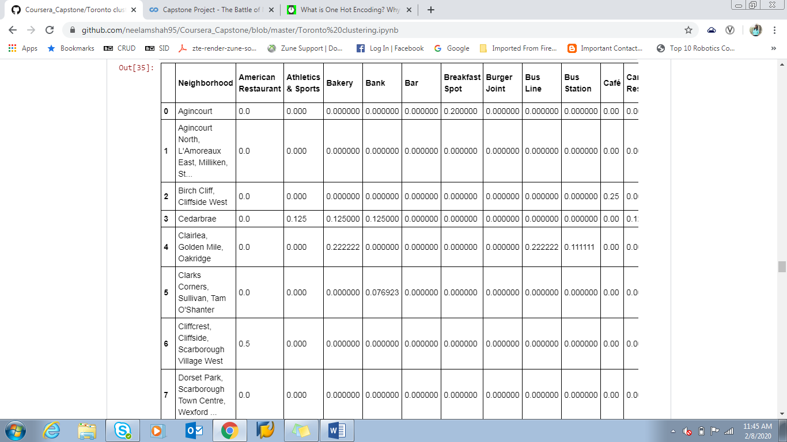
Before clustering the data, One hot Encoding technique is used to convert categorical variables into a form that could be provided to ML algorithms to do a better job in prediction. 0 indicates false values or non-existent and 1 indicates true values or existing ones. Example from current project as shown.

Slide 10
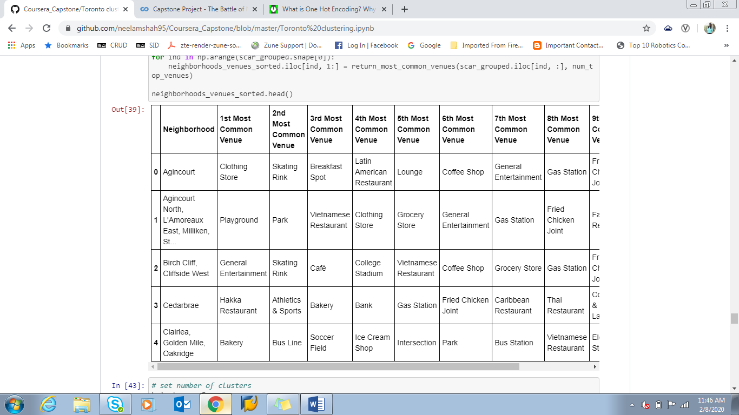
Clustering is used on above shown data with definition of k_clusters = 5.
Embedding clusters of places on map, it becomes easy to identify which area has more than 5 restaurants or cafes. Folium map is used to represent map.

Slide 11
Results
The final location decided, based on the dataframe scar_merged, is L'Amoreaux West. Same is embedded on folium map in the form of clusters.
Final map and dataframe is shown to client. 3 areas are selected and government permissions will be available for which area is checked. Moreover, data from the survey can also be used to decide the area. Survey is conducted in selected 3 areas and opinions of people is taken. This survey is conducted on social networking sites so that data is easily available for compilation and analysis.
After making clarity on all such points, final area selected becomes L'Amoreaux West.

Slide 12
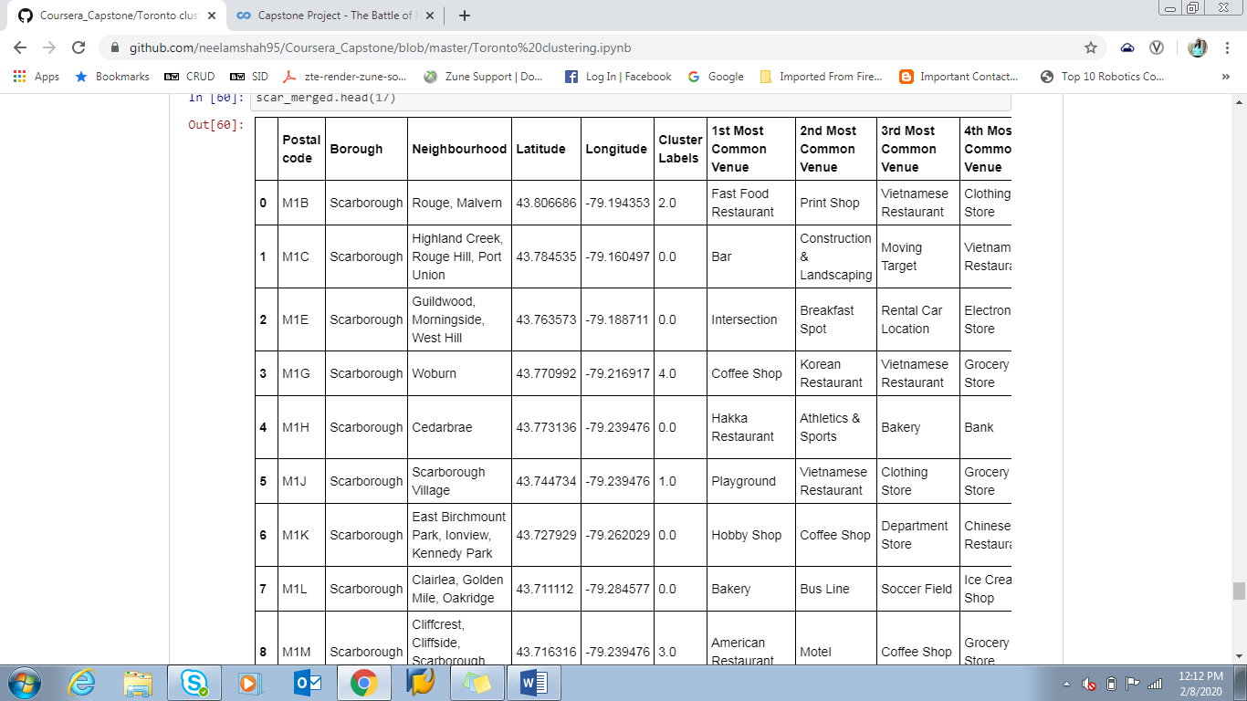

Slide 13
Conclusions
Hence, we can conclude on an area as of now to open a café in Scarborough.
We used K-means Clustering and one hot encoding technique to reach to the result.
This project does not end here unless all obstructions are cleared. Obstructions include government permissions, actually the café going onfloor and resident’s reviews too.

