Slide 1
ADAS Assignment
Experiment 2
Name and ID of the Student : Neelam Singh (2024HT65640)

Slide 2
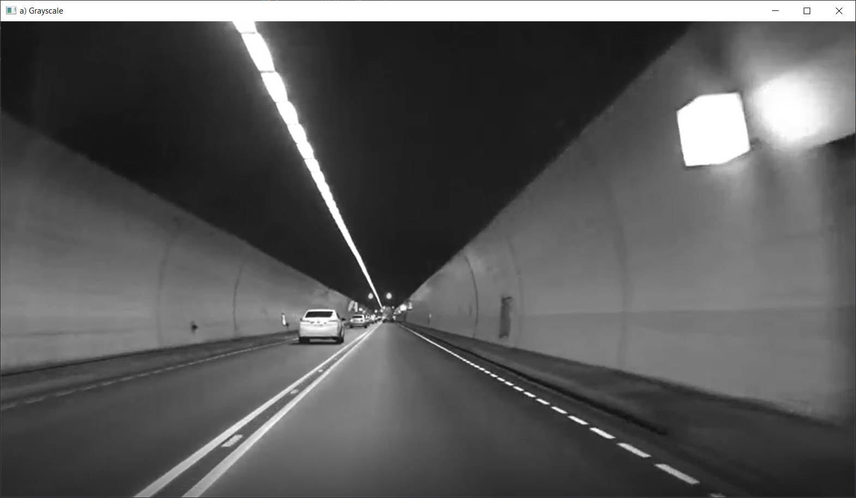
1. Grayscale

Slide 3

2. Gaussian Blur

Slide 4
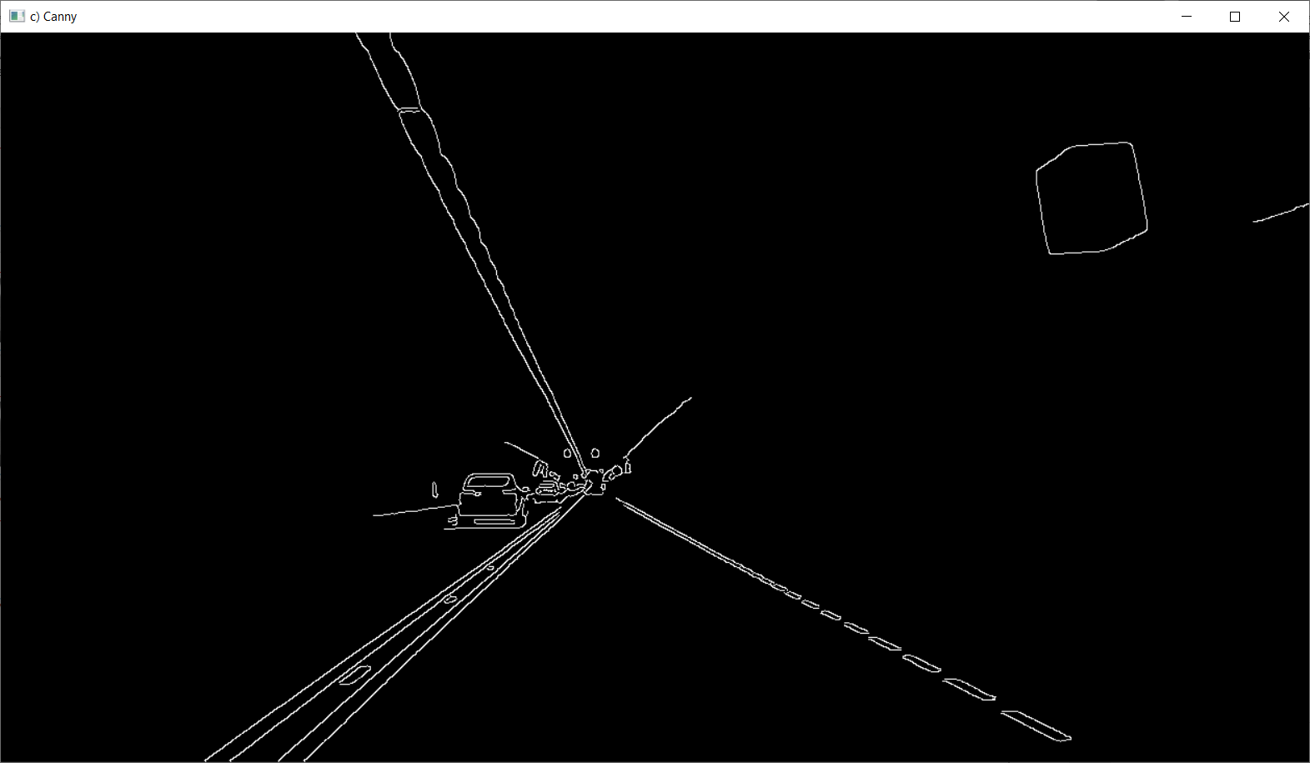
3. Canny

Slide 5
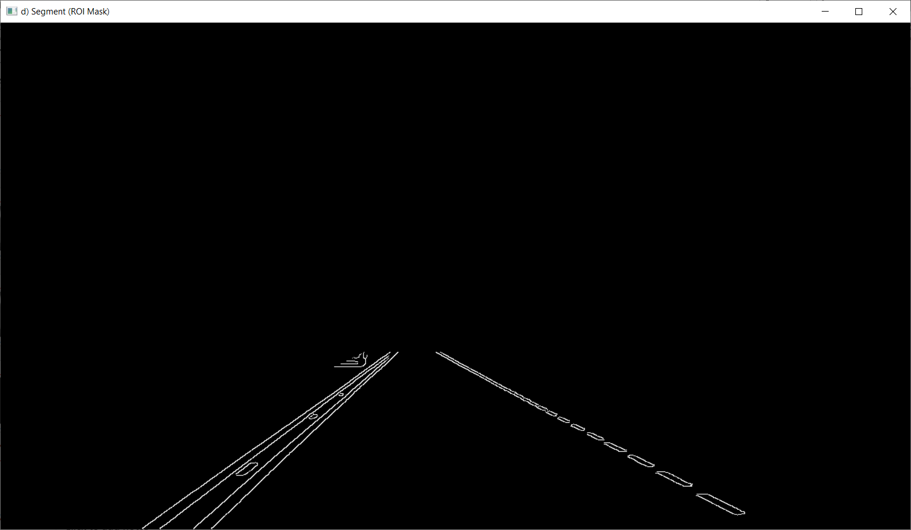
4. Segment (ROI Mask)

Slide 6
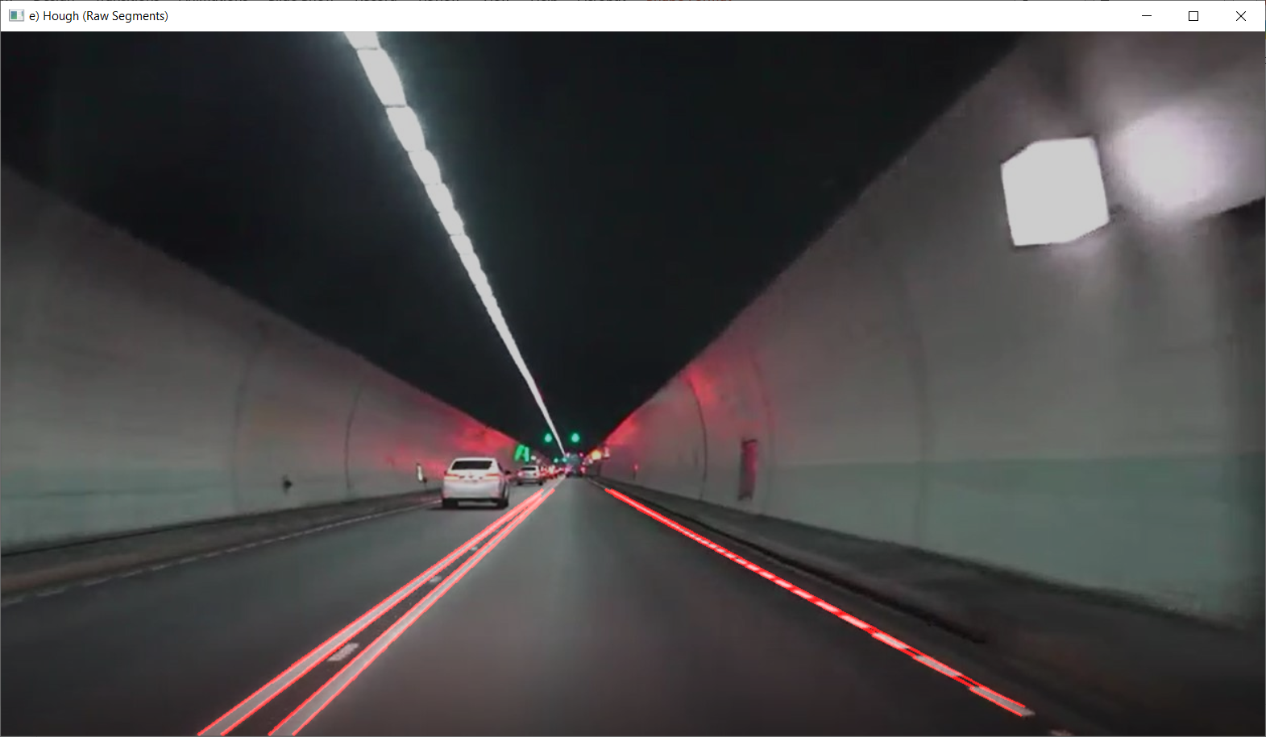
5. Hough (Raw Segments)

Slide 7
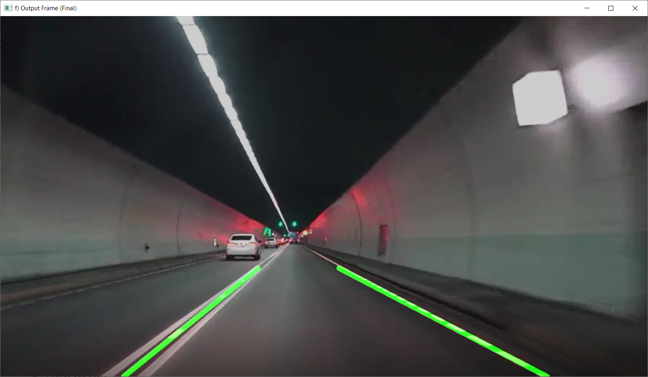
6. Output Frame (Final)

Slide 8
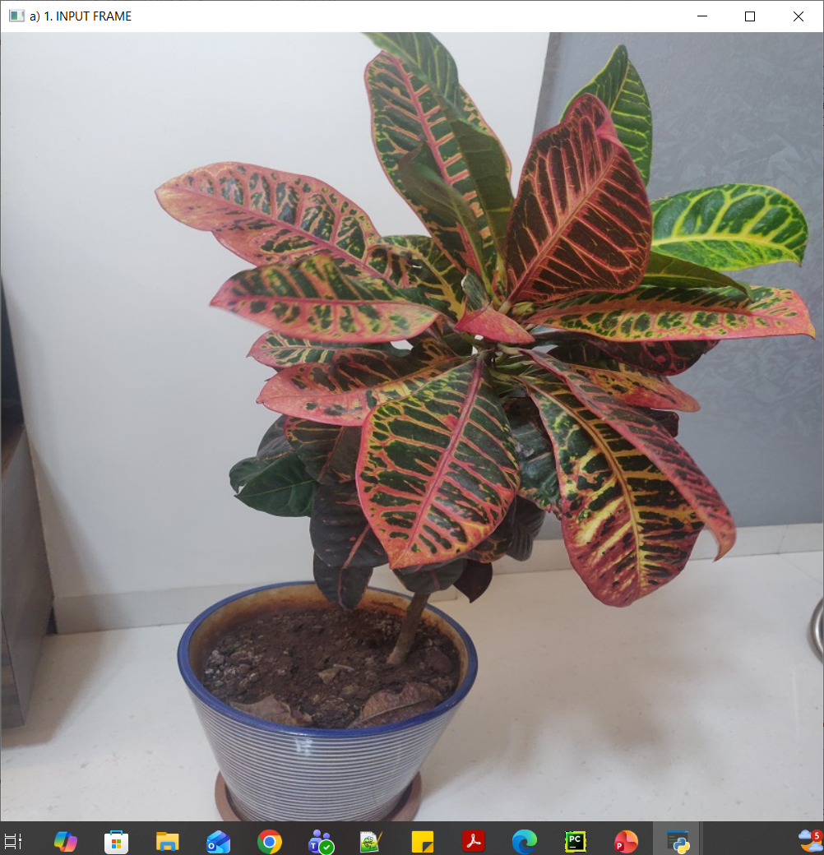
1. Input frame

Slide 9
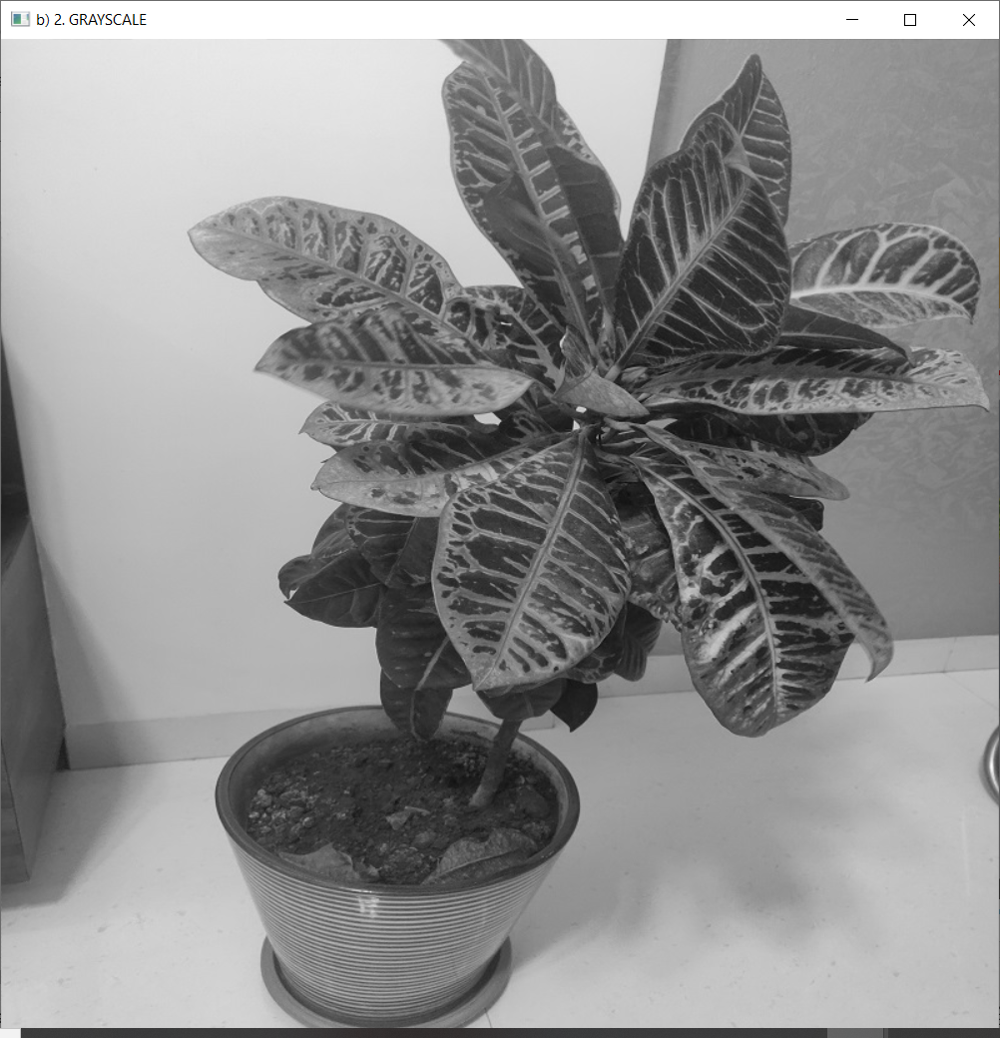
2. Grayscale

Slide 10

3. Gaussian Blur

Slide 11
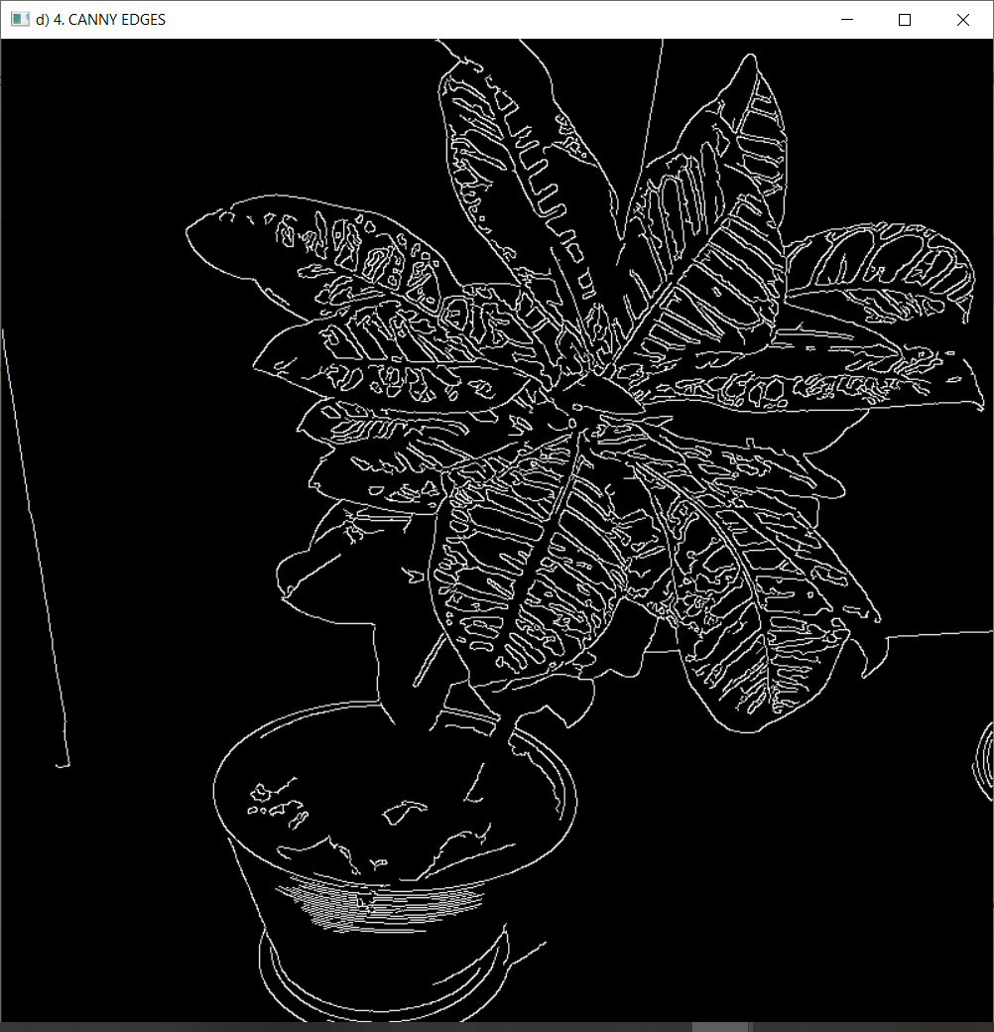
4. Canny

