Slide 1
GROUP – 15
PREDICTION OF INDICATORS OF CERVICAL CANCER USING BIOPSY TEST
Team Members : Mentor : Mr. JATINDER BEDI
NAVEEN RAM A
RUBINI S
SANTANU DATTA
SANTO K THOMAS
VYSAKH CHITHRAN A.P

Slide 2
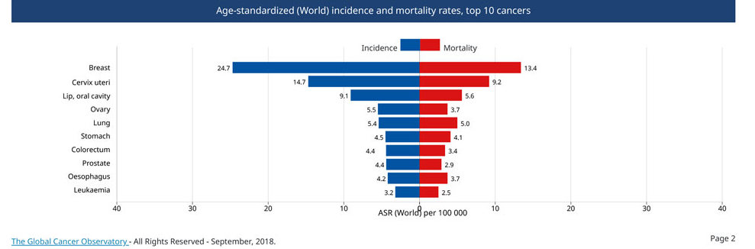
Problem Definition
Healthcare Business Problem
Cervical cancer is the leading gynecological malignancy worldwide.
This project presents diverse classification techniques and best approaches in predicting of cervical cancer disease.
To build an ML model that predicts the indicators of cervical cancer using biopsy test .

Slide 3
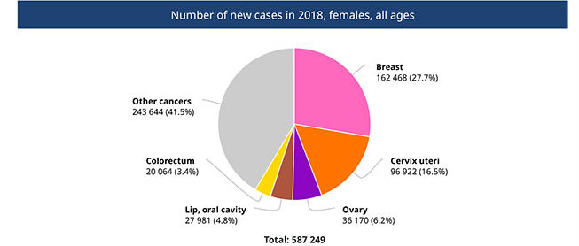
Why it is important problem
It is possible to prevent , detect and treat early cervical cancer since it is slow-growing.
What are the value additions you planned
In this project, a classification of patients due to their answers to a survey has been done to determine someone who has highly cervical cancer risk.

Slide 4
Data Description
The dataset has been obtained from the dataset archive that belongs to the University of California, Irvine (UCI).
Cervical cancer data involves 858 samples and 32 features as well as four classes (Hinselmann, Schiller, Cytology and Biopsy).
Our target here is ‘Biopsy’ as recommended by the literature review.
Attribute name Type Attribute name Type
Age int STDs: pelvic inflammatory disease Bool
Number of sexual partners int STDs: genital herpes Bool
First sexual intercourse (age) int STDs: molluscum contagiosum Bool
Number of pregnancies int STDs: AIDS Bool
Smokes bool STDs: HIV Bool
Smokes (years) int STDs: Hepatitis B Bool
Smokes (packs/year) int STDs: HPV Bool
Hormonal Contraceptives bool STDs: Number of diagnosis int
Hormonal Contraceptives (years) int STDs: Time since first diagnosis int
IUD bool STDs: Time since last diagnosis int
IUD (years) int Dx: Cancer Bool
STDs bool Dx: CIN Bool
STDs (number) int Dx: HPV Bool
STDs: condylomatosis bool Dx Bool
STDs: cervical condylomatosis bool Hinselmann: target variable Bool
STDs: vaginal condylomatosis bool Schiller: target variable Bool
STDs: vulvo-perineal condylomatosis bool Cytology: target variable Bool
STDs: syphilis bool Biopsy: target variable Bool

Slide 5
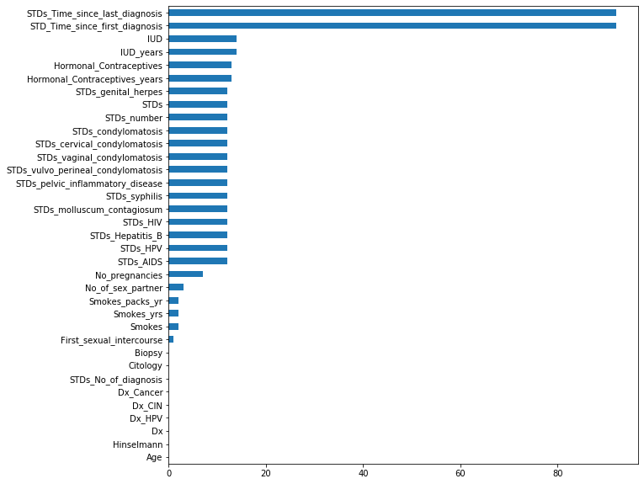
Data Preprocessing
Missing Values Imputation :
Used ML models to predict null values of a particular column (target) by considering all other non null columns as independent variables.
DecisionTreeRegressor for continuous columns and DecisionTreeClassifier for categorical columns.

Slide 6
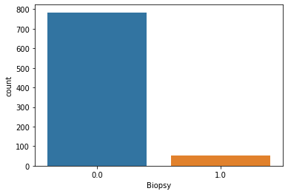
Exploratory Data Analysis
 | Missing Value Number | Missing Value Percentage
Negative | 784 | 93.56
Positive | 54 | 6.44
Dataset is highly imbalanced, so we need to take care of the imbalance of dataset.

Slide 7
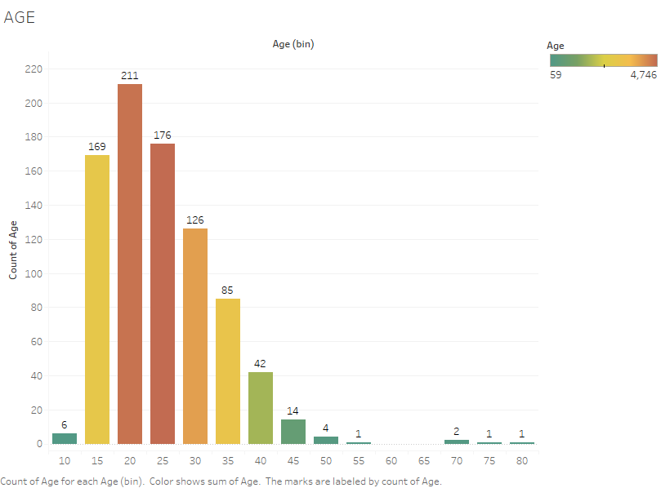
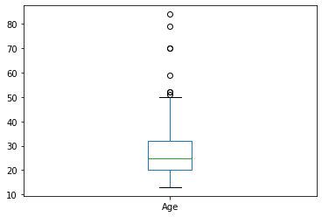
AGE
Inference
These 72 records are positive Biopsy records and the mean and median values of age are 29.5 and 28 respectively.
The age distribution of cervical cancer shows that the Venezuela cervical cancer standardized age is between 15-30.
Summary : Age
Summary : Age (w.r.t positive biopsy test)
count | 838
mean | 26.8126
std | 8.52921
min | 13
25% | 20
50% | 25
75% | 32
max | 84
count | 72
mean | 29.5139
std | 11.1051
min | 16
25% | 21
50% | 28
75% | 35
max | 84

Slide 8
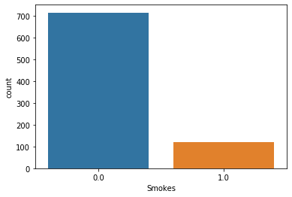
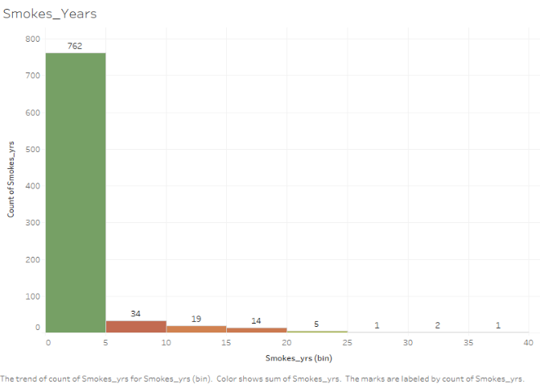
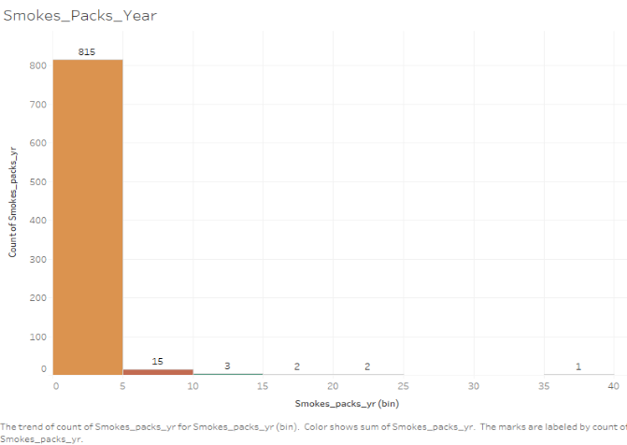
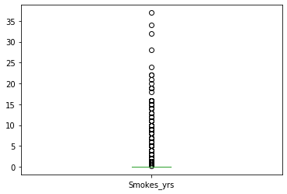
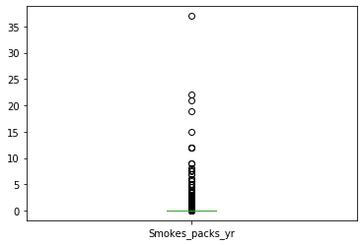
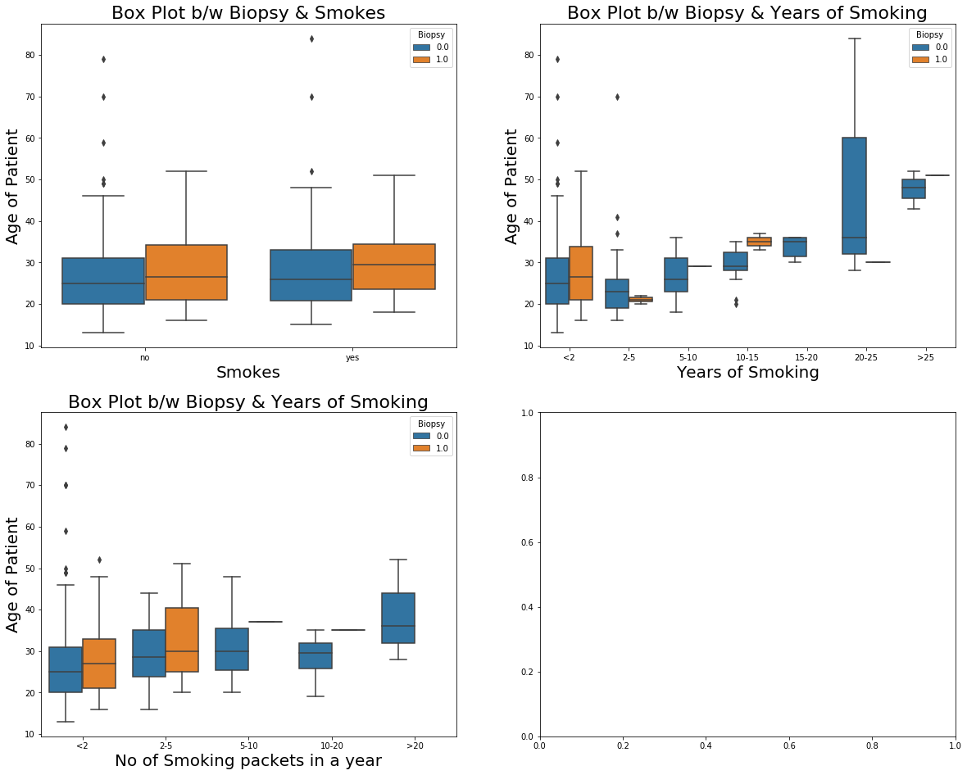
SMOKING HABIT ATTRIBUTES
Smoking_years
Smoking_packs_year
 | Smokes_yrs | Smokes_pac ks_yr
count | 838 | 838
mean | 1.216784 | 0.450366
std | 4.090836 | 2.228754
min | 0 | 0
25% | 0 | 0
50% | 0 | 0
75% | 0 | 0
max | 37 | 37

Slide 9
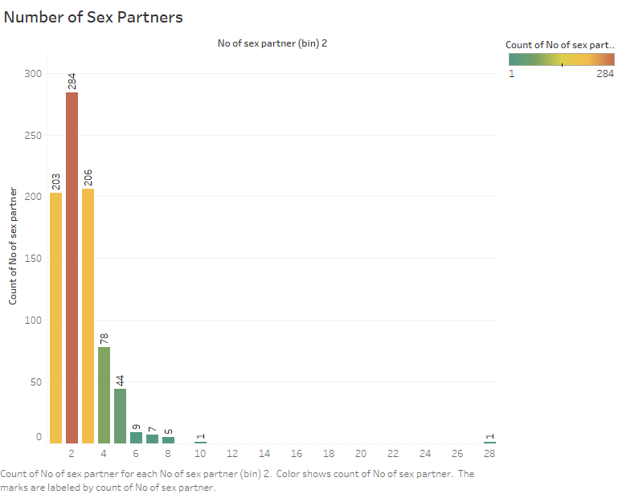
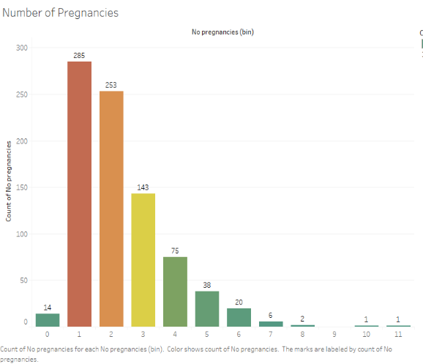
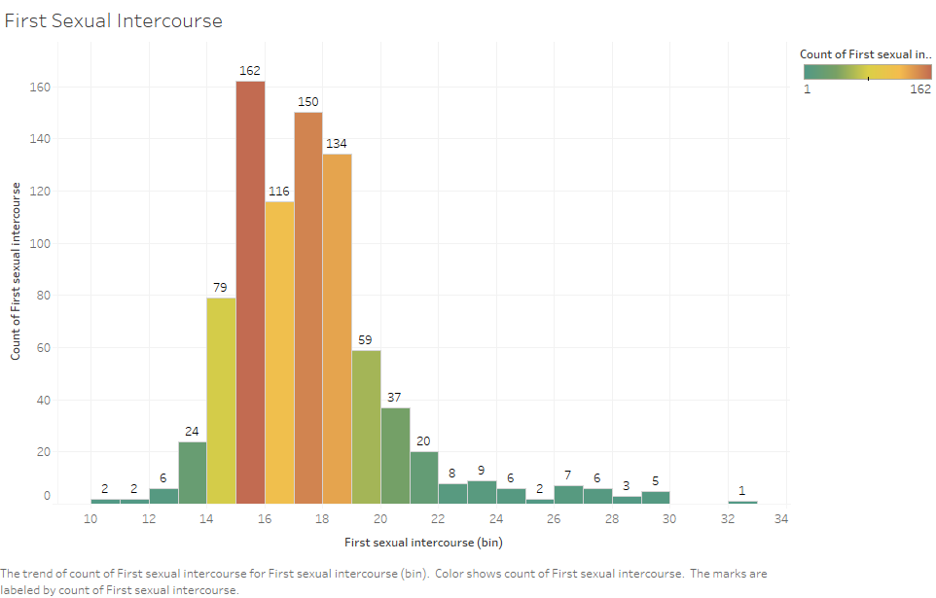
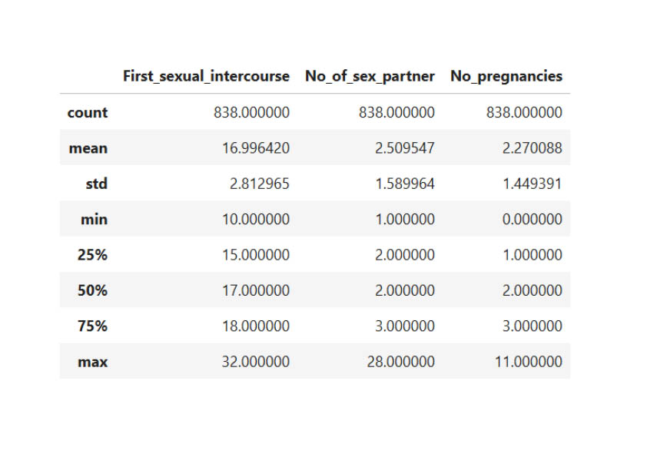
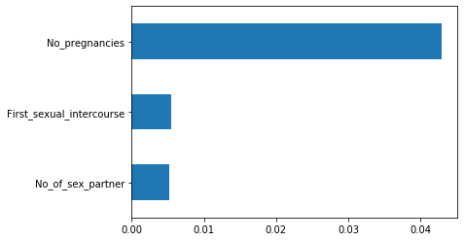
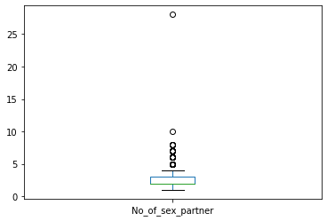
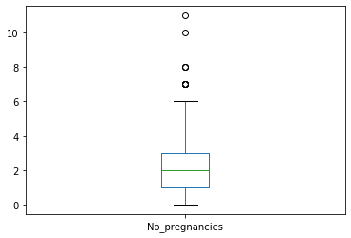
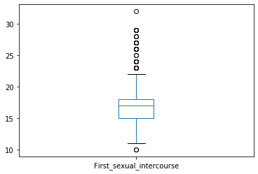
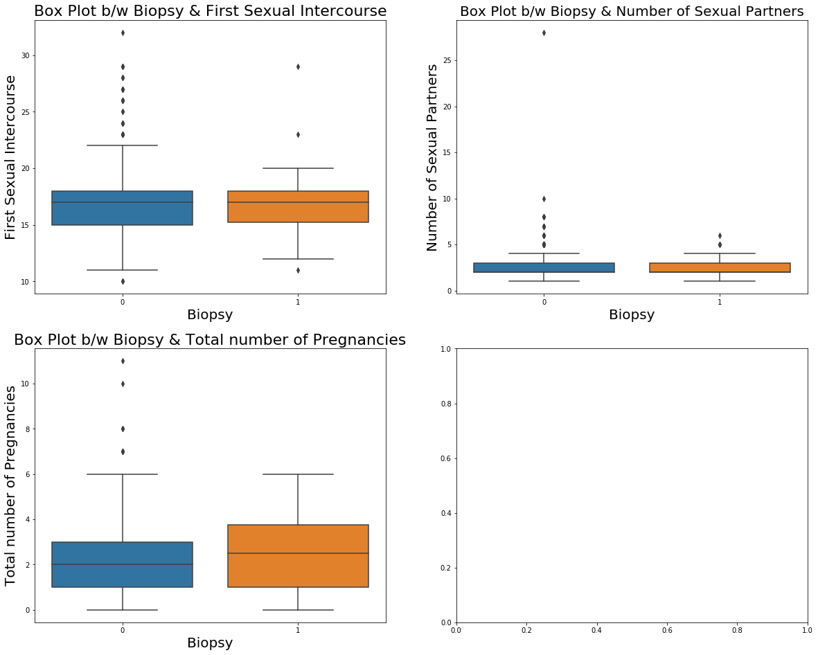
SEXUAL HABIT ATTRIBUTES
RELATION B/W BIOPSY AND SEXUAL ATTRIBUTES

Slide 10
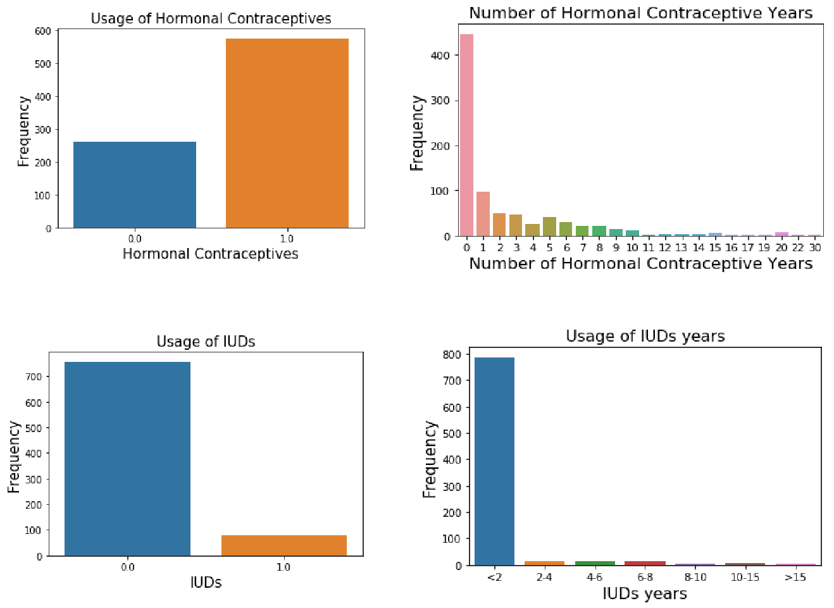
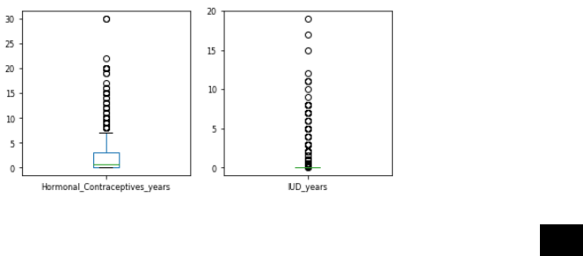
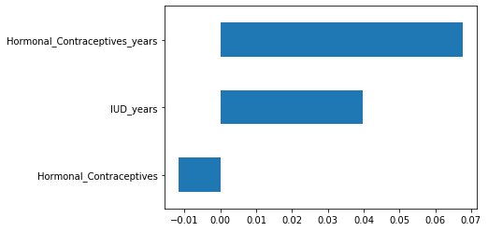
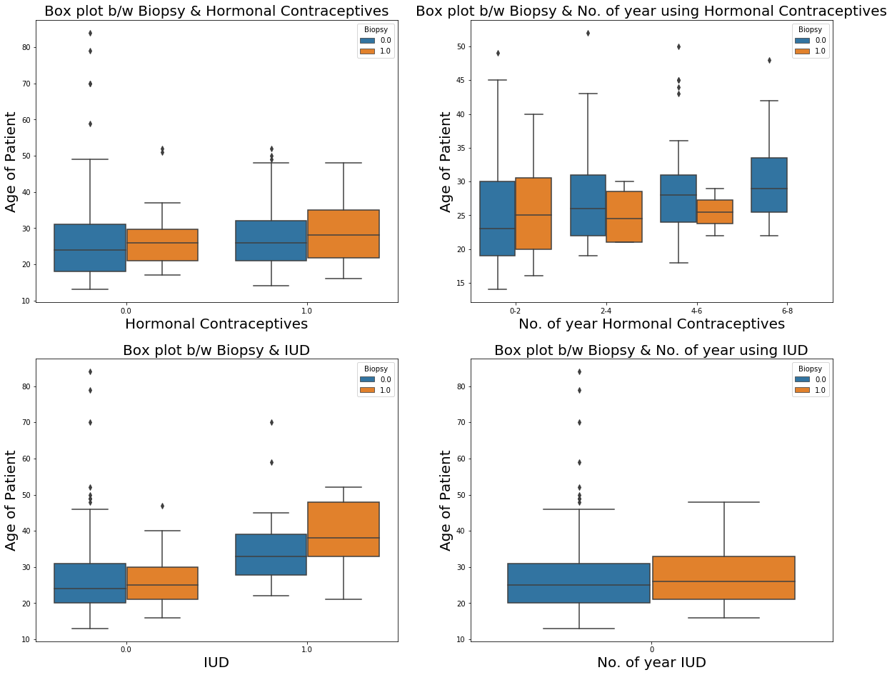
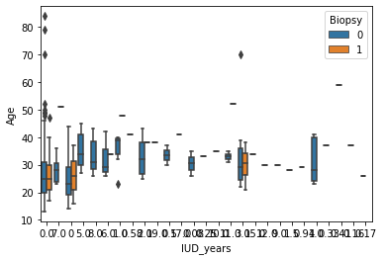
BIRTH CONTROL ATTRIBUTES
RELATION B/W BIOPSY AND BIRTH CONTROL ATTRIBUTES

Slide 11
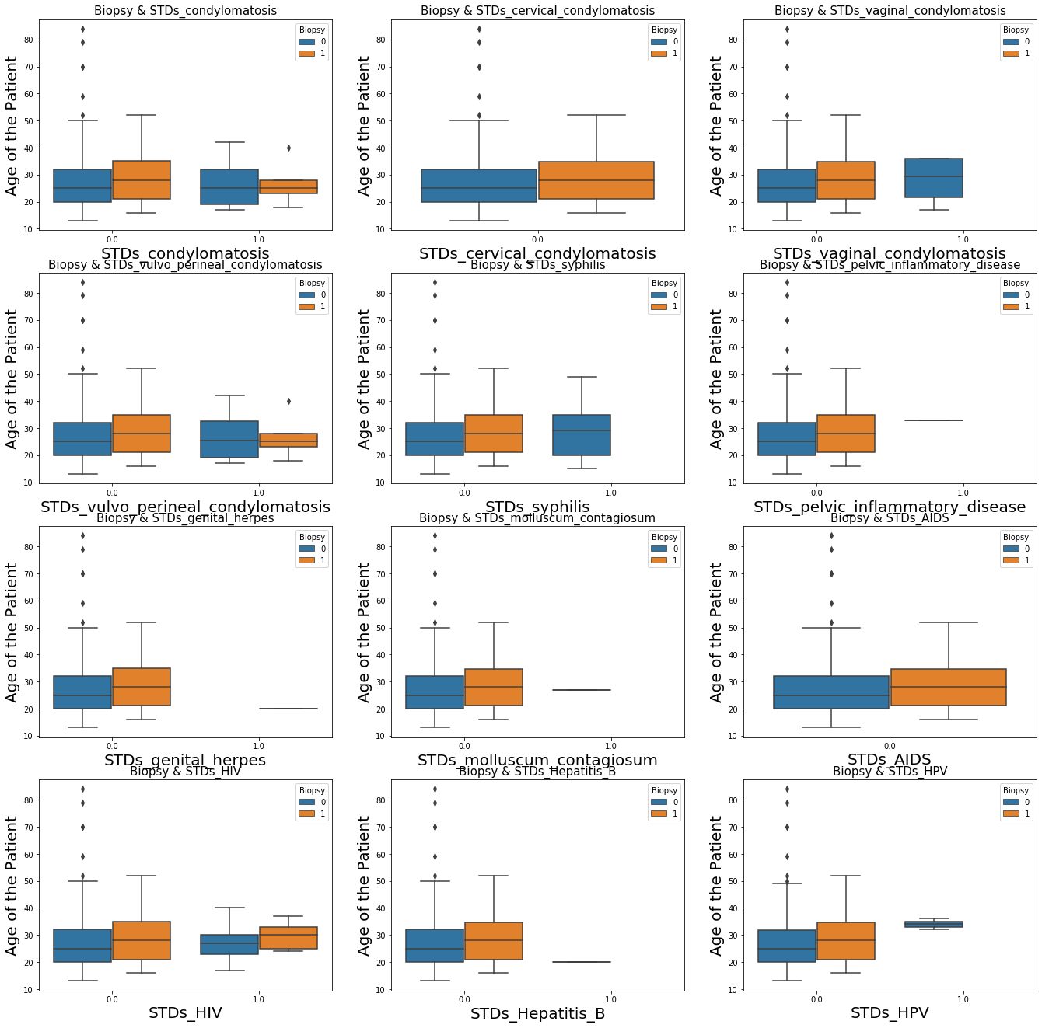
STDs ATTRIBUTES
Attribute | 0 (%) | 1(%)
STDs_condylomatosis | 0.95 | 0.05
STDs_cervical_condylomatosis | 1 | 0
STDs_vaginal_condylomatosis | 0.995 | 0.005
STDs_vulvo_perineal_condylomatosis | 0.951 | 0.049
STDs_syphilis | 0.98 | 0.02
STDs_pelvic_inflammatory_disease | 0.999 | 0.001
STDs_genital_herpes | 0.999 | 0.001
STDs_molluscum_contagiosum | 0.999 | 0.001
STDs_AIDS | 1 | 0
STDs_HIV | 0.98 | 0.02
STDs_Hepatitis_B | 0.999 | 0.001
STDs_HPV | 0.998 | 0.002

Slide 12
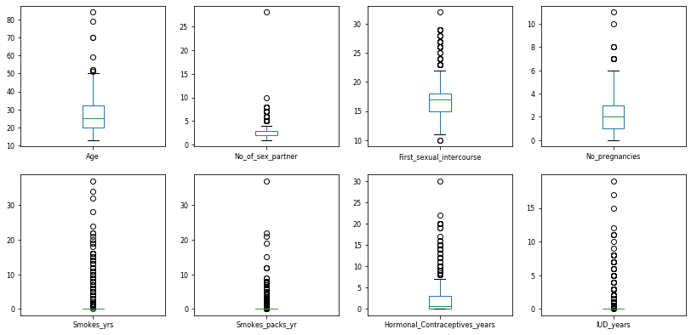
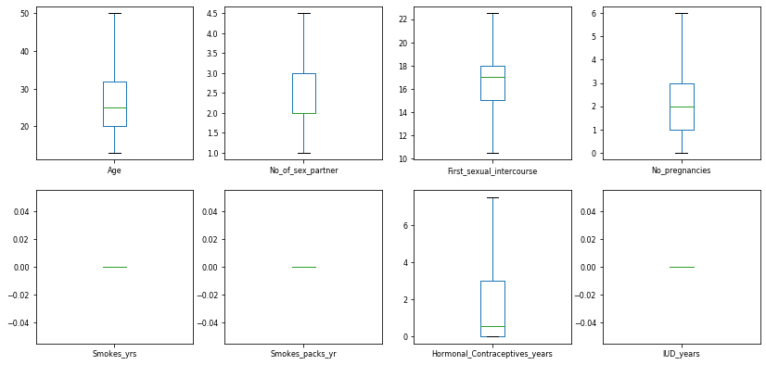
Outlier Treatment
Before Treatment
After Treatment
IQR = 75% quartile – 25% quartile.
Range = (25% quartile -1.5*IQR) to (75% quartile +1.5*IQR)

Slide 13
Base Model
 | Model | accuracy | f1score | recall | precision
0 | LogisticRegression | 0.944444 | 0.416667 | 0.333333 | 0.555556
1 | DecisionTree | 0.916667 | 0.461538 | 0.600000 | 0.375000
2 | RandomForest | 0.932540 | 0.370370 | 0.333333 | 0.416667
3 | GaussianNB | 0.071429 | 0.113636 | 1.000000 | 0.060241
4 | KNN | 0.940476 | 0.0000000 | .0000000 | 0.000000
A confusion matrix is a table that is often used to describe the performance of a classification model (or "classifier") on a set of test data for which the true values are known.
The matrix is generated after making predictions on the test data and then obtaining the values of True Positives, True Negatives, False Positives and False Negatives.
The F1 score can be interpreted as a weighted average of the precision and recall.
Logistic Regression gives the model accuracy and recall score of 0.94 and 0.33 respectively but we the Decision Tree gives a model accuracy and recall score of 0.91 and 0.60 respectively.
Since β – error is minimum in Decision Tree model we will consider it as good base model.

Slide 14
Thanks!

