Slide 2


Slide 4


Slide 5
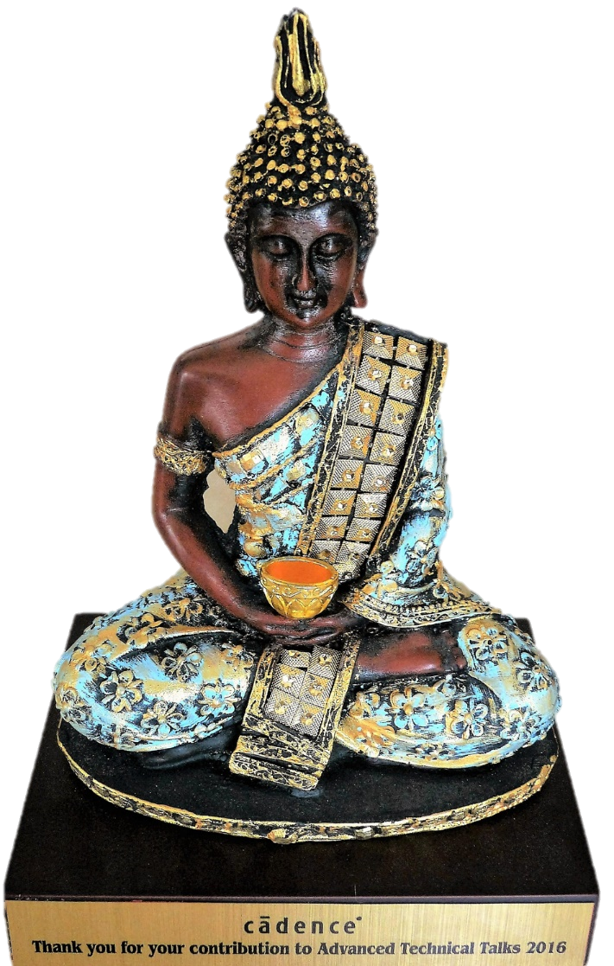

Slide 6


Slide 7

flavidoscope

