Slide 1
Credit Card Fraud Detection
Presentation by Sravani Neelapala,
Praneeth Sai Rachuri

Slide 2
Table of contents
01
02
03
04
05
06
Dataset and Problem Statement
Introduction
Feature
Engineering
Future Work
Conclusions
Analytical Techniques and Evaluation

Slide 3
Introduction
➔Payment cards give simple and convenient method for making purchases.
➔Increased use of payment cards, especially for online transactions, has led to a rise in fraud cases.
➔Transaction records used for building effective predictive models for fraud detection.
➔Accessing transaction data is challenging due to privacy concerns related to personal customer information.
➔The datasets available are often imbalanced, requiring a focus on minority cases (fraudulent transactions).
➔Keywords: Fraud detection, Unsupervised learning (Isolation Forest), Supervised learning (Random Forest).

Slide 4
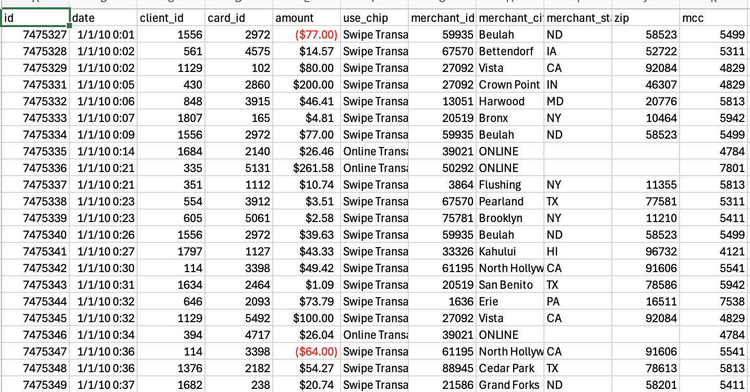
Dataset
Link : https://www.kaggle.com/datasets/computingvictor/transactions-fraud-datasets/data.
It is an Imbalanced dataset.
We took a dataset from Kaggle which includes 5 files of both json and csv.
We extracted 2 files i.e., transactions_data.csv – includes transaction history of users like amounts, merchant information, time stamp( cover from 2010 to 2020).
Number of rows: 13305915,Number of columns: 12
train_fraud_labels.json – includes id and label whether fraud or non – fraud.
Number of rows: 8914963, Number of columns: 2

Slide 5
Problem Statement
The project aim is on analyzing transactional data to understand spending behaviors and detect irregularities that may indicate fraudulent cases.
Develop a robust fraud detection system using time-series data to identify and classify fraudulent transactions effectively.
Implement unsupervised learning methods for anomaly detection and supervised learning techniques to classify fraud transactions based on labeled data.
Extend the system capabilities by forecasting future fraud detection using time-based approach and can prevent fraud activities.

Slide 6
Feature Engineering
Data loading and formatting were performed to prepare the dataset for analysis.
Missing values were checked, and imputations were applied instead of removing or dropping values to avoid introducing bias.
Useful time-based features, such as day, hour, and month, were extracted, and the time attribute was converted into a proper data frame format.
Features were converted to numeric formats (e.g., amounts with special characters like '$' were cleaned and standardized).
Duplicate values were identified and dropped to maintain data integrity.
One-hot encoding was applied to convert categorical data into numerical format, using a label encoder for features like use chip and merchant details, ensuring compatibility with machine learning algorithms.

Slide 7
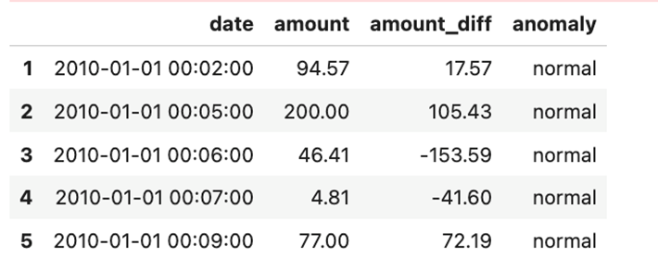
Unsupervised Learning
Implemented unsupervised learning as it does not require labeled training data.
Used an unsupervised decision-tree-based algorithm for outlier detection in the dataset, focusing on anomaly detection using a binary tree structure.
Applied the Isolation Forest algorithm, tuning parameters like contamination, and incorporated the amount feature for time-series analysis.
Detected anomalies by identifying sudden positive or negative changes in transaction amounts, as drastic fluctuations often indicate fraudulent activities.

Slide 8
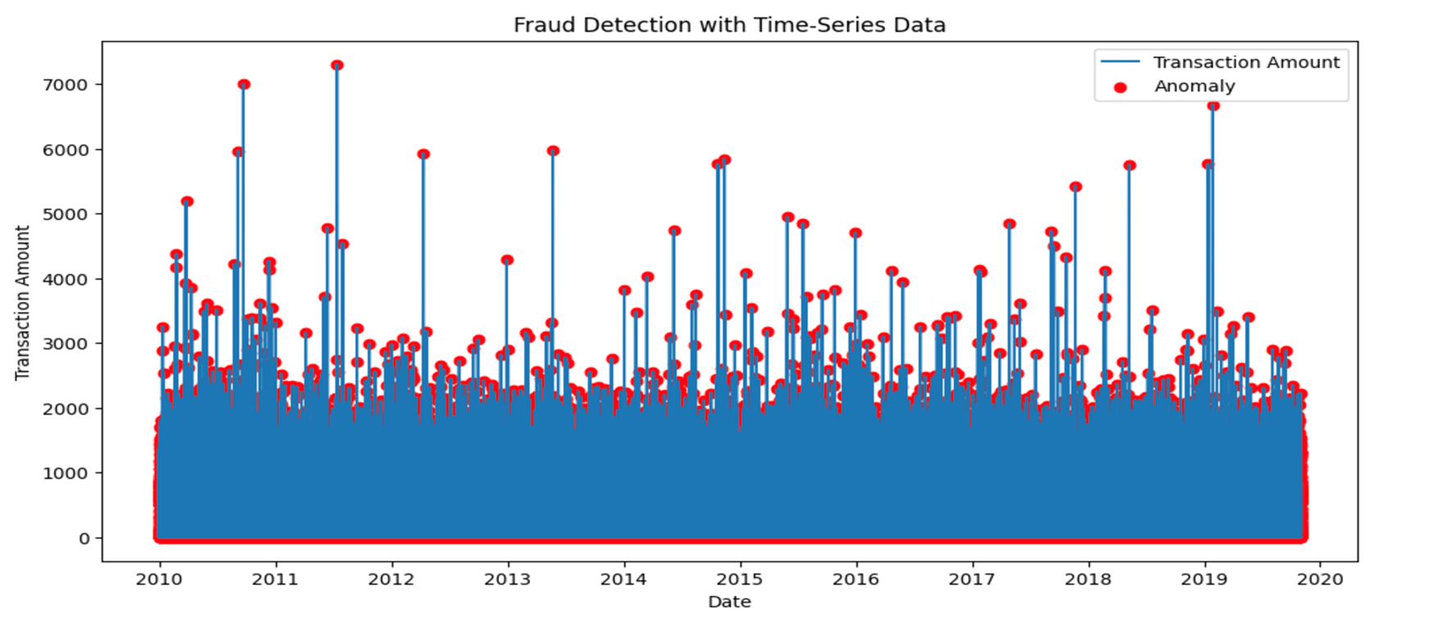
Visualization based on time series

Slide 9
Supervised Learning
Implemented supervised learning to verify the relevance of discovered patterns.
Trained the model using well-labeled data, incorporating additional features to enhance performance.
Selected Random Forest classifier, a classification algorithm that uses multiple decision trees for predictions, effectively handling complex patterns and avoiding overfitting, particularly suitable for imbalanced datasets.
Split the data into training and testing sets (80-20%).
Performed hyperparameter tuning by adjusting weights to optimize model performance.
Limitation: Requires significant computation time for the training process

Slide 10
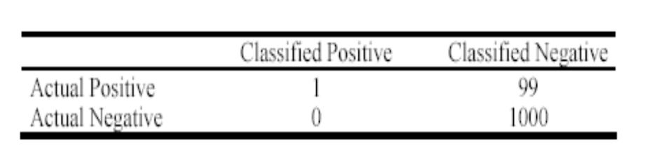
Evaluation metrics(Problems with accuracy)
Accuracy is not suitable in some applications.
Not well-suited for imbalanced datasets.
E.g. intrusion detection, bank fraud, we are interested in minority classes.
Not well-suited when we want to focus on the “positive” class
The class of interest is commonly called the positive class, and the rest are negative class.

Slide 11
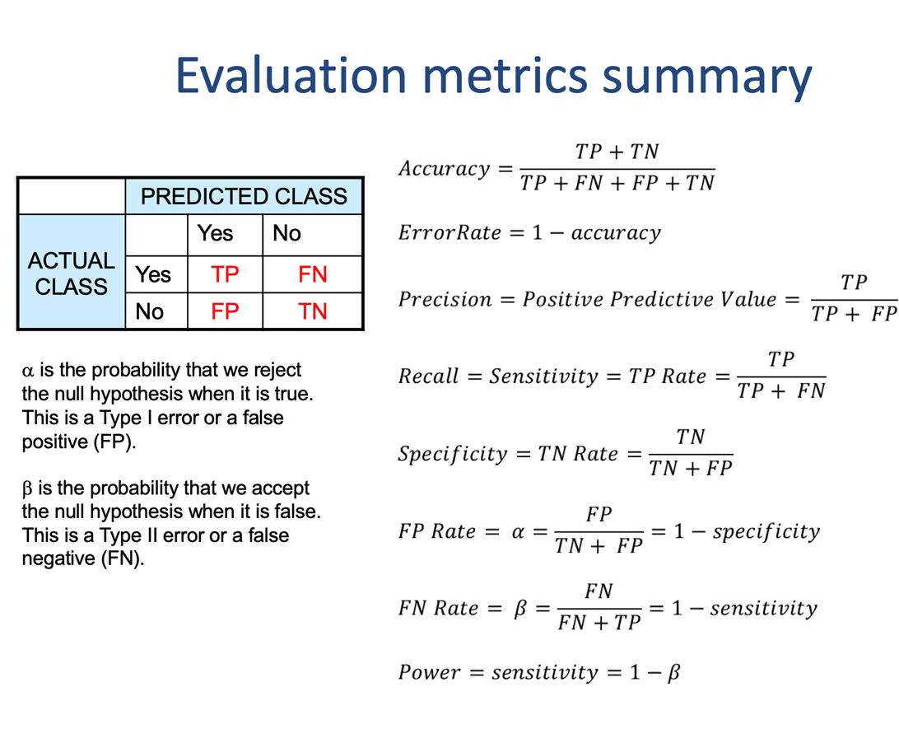
Evaluation Metrics
Accuracy
Precision
Recall
F1 score = 2*p * r / (p + r)
Where, p = precision
r = recall.
Confusion matrix
Correlation matrix
AUC – ROC curve
Detection based on Time series

Slide 12
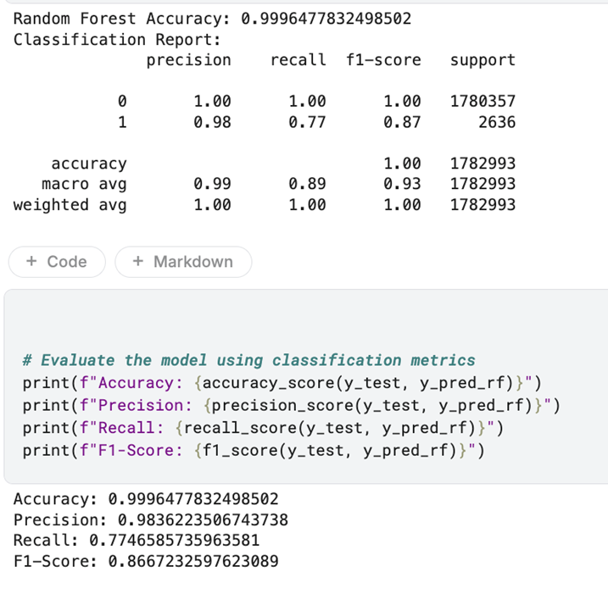
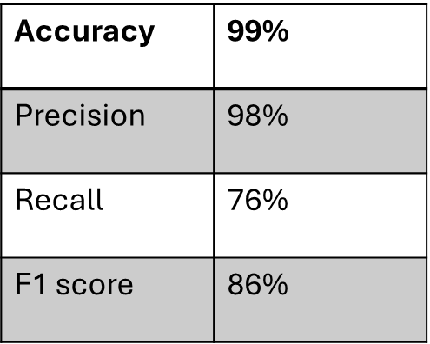
Evaluation metrics

Slide 13
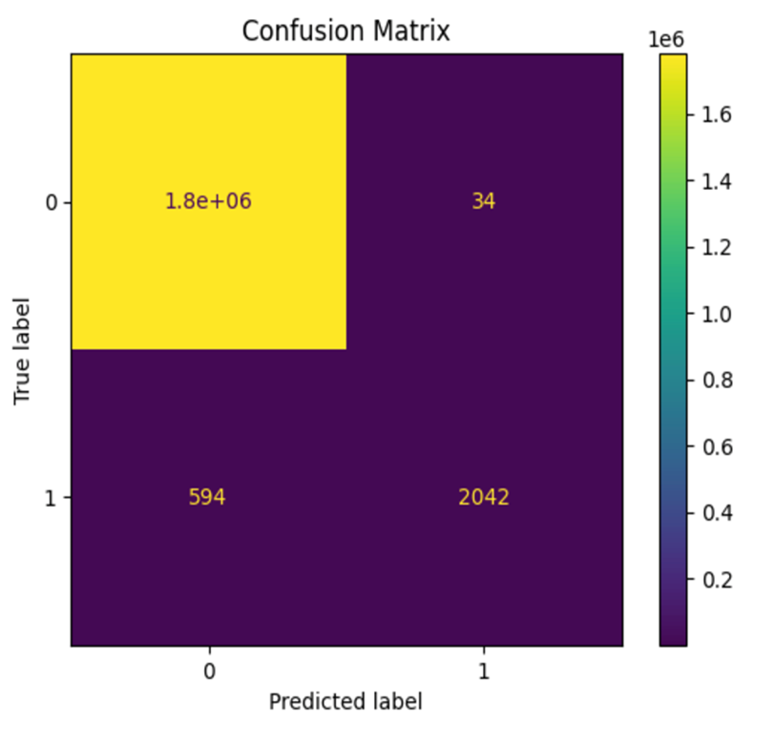
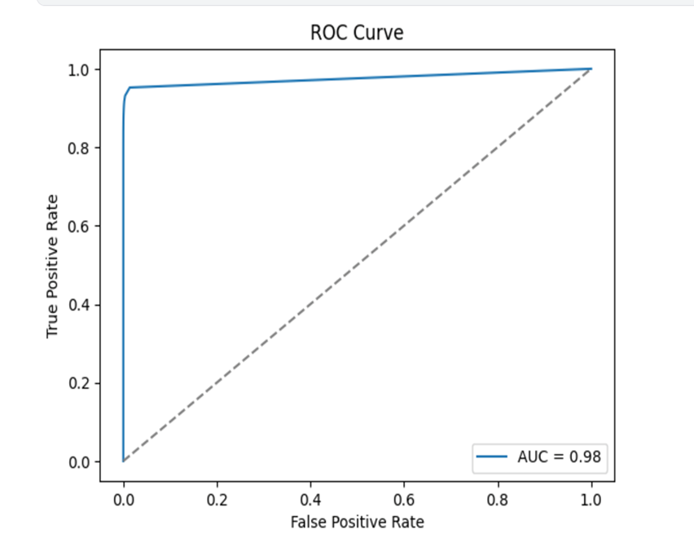
Visualization
The bigger area under ROC-AUC, the better is the classifier

Slide 14
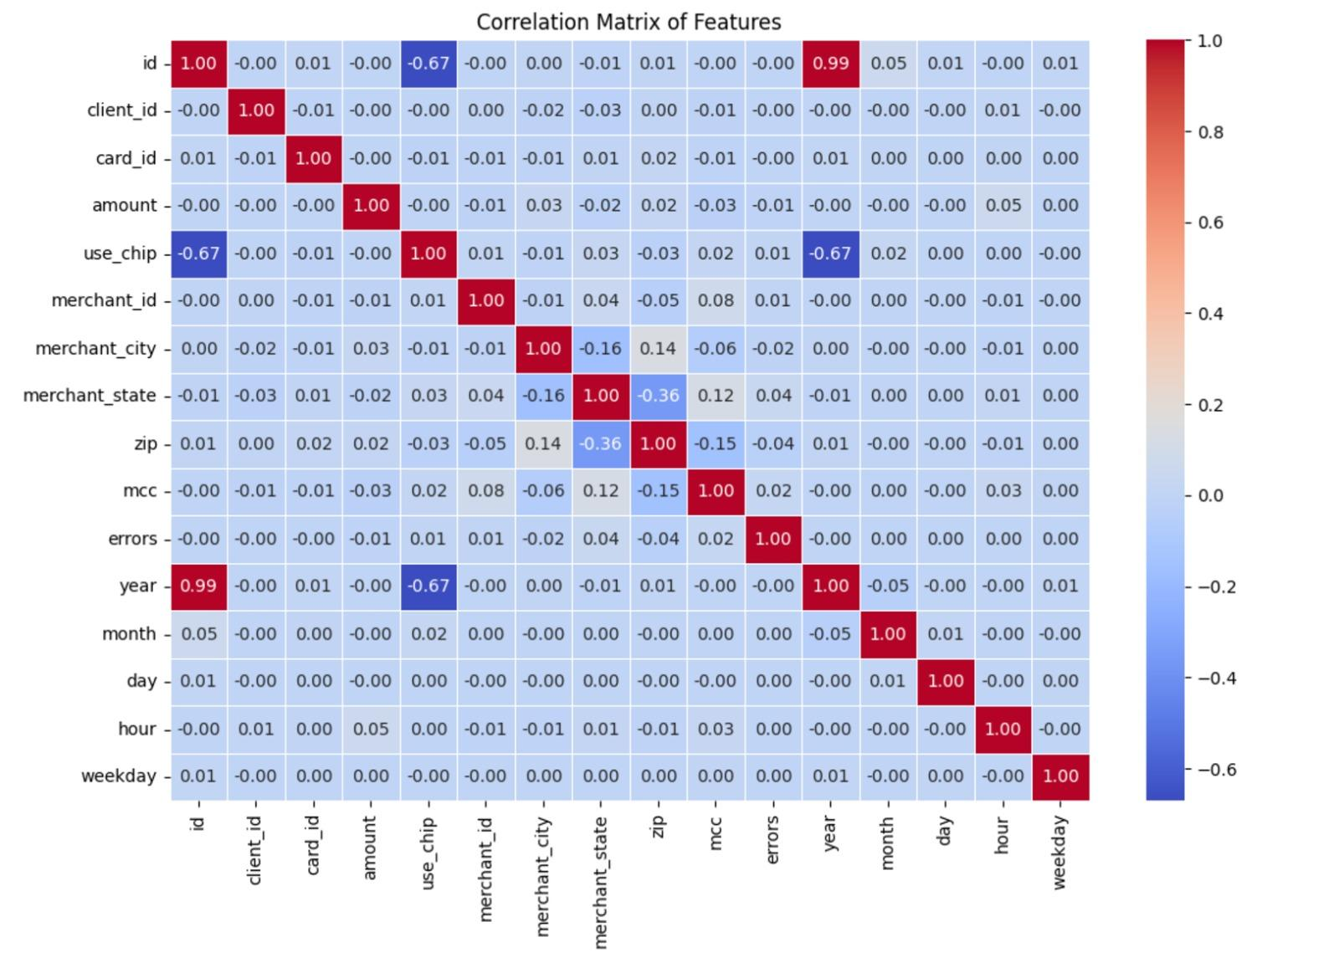
Correlation Matrix

Slide 15
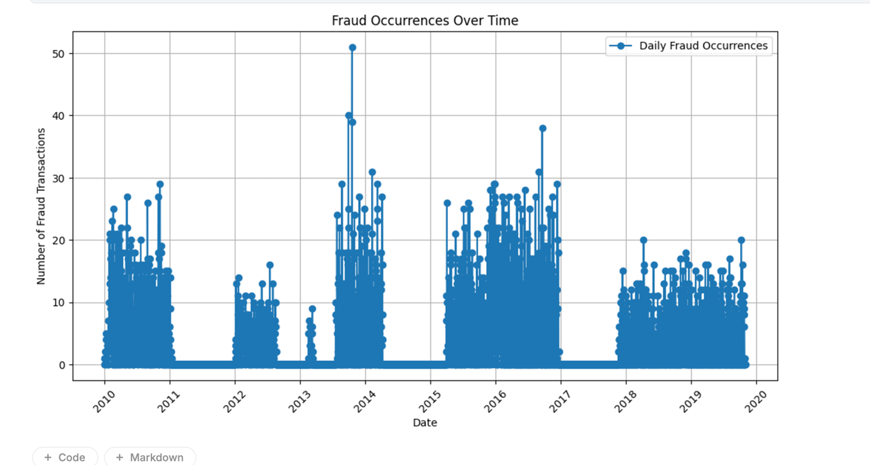
Time Series Analysis

Slide 16
Future Work
Forecast fraud detection based on time-series data using deep learning techniques(LSTM model).
Long Short-Term Memory (LSTM), a type of Recurrent Neural Network (RNN), is specifically designed for sequential data like time series. It is capable of learning long-term dependencies in sequential data, making it ideal for time-series forecasting.
Data preprocessing involved scaling and creating sequences from the dataset for time-series forecasting.
Train-test split followed the 80-20% rule for model evaluation.
LSTM model: suitable for sequential data, using the Adam optimizer , epoch = 50, dropout (30%) and performing hyperparameter tuning to optimize performance.
Limitation: Lot of computational time because more parameters need to be tested to achieve accuracy.

Slide 17
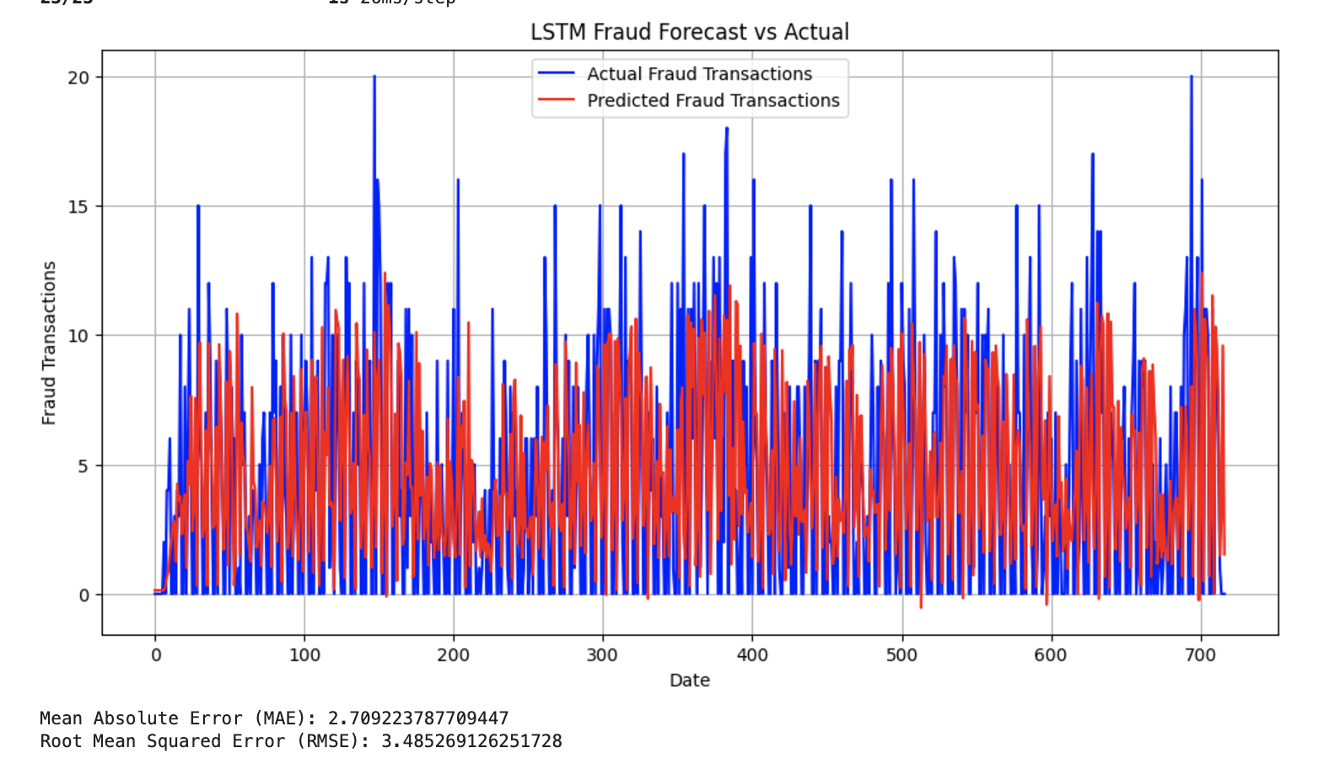
LSTM future forecast based on time-series

Slide 18
Conclusion
Effective Results: The implementation of unsupervised (Isolation Forest) and supervised (Random Forest) learning effectively detected anomalies and fraudulent transactions.
Role of Feature Engineering: Enhanced feature engineering, such as time-based features and label encoding, significantly improved model performance.
Challenges and Limitations: Addressed challenges like imbalanced datasets, feature engineering and computational constraints, highlighting the need for GPU resources for deep learning models.
Future Scope: Future work includes leveraging deep learning techniques like LSTM for better fraud forecasting and improving system scalability and accuracy.

Slide 19
Resources
https://www.sciencedirect.com/science/article/abs/pii/S0952197618301520?fr=RR-2&ref=pdf_download&rr=8eb9987ca8682379
https://link.springer.com/article/10.1007/s10479-021-04149-2
https://www.kaggle.com/datasets/computingvictor/transactions-fraud-datasets
https://www.geeksforgeeks.org/supervised-unsupervised-learning/
https://chat.openai.com

Slide 20
THANK YOU
Questions or Comments?

