Slide 1
Modeling Plant Distributions in the SF Bay Wetlands
By Neelay Junnarkar
December 8, 2015

Slide 2
Objective
Model effects of changing sea levels on plant distributions in marshlands
Simulate and predict effects of restriction by human development on shifting of ecosystem
Notes:
It is suspected that with water level change, the ecosystem would simply shift with the water level
However, the ecosystem is now restricted by human development such as highways

Slide 3
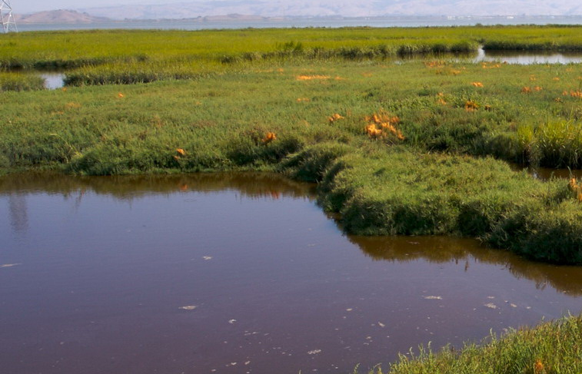
Wetlands Background
The San Francisco Bay wetlands ecosystem is unique
Brackish water -> diverse and unique species
Many endemic species
Important stopover on The Pacific Flyway
The wetlands provide many important functions:
Cleaning/Filtering air and water
Flood and Storm barrier

Slide 4
Plants
Chosen because they occupy different areas on marshland
Different tolerances for water salinity
Different tolerances for continuous submersion
The wetlands have large tides of 7+ feet

Slide 5
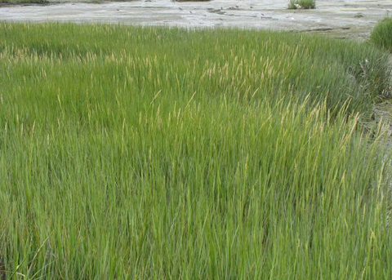
Plants::Cordgrass (Spartina foliosa)
Lowest elevation
High tolerance for submersion
Hollow stems to prevent rot during submersion
Salt glands to excrete excess salt

Slide 6
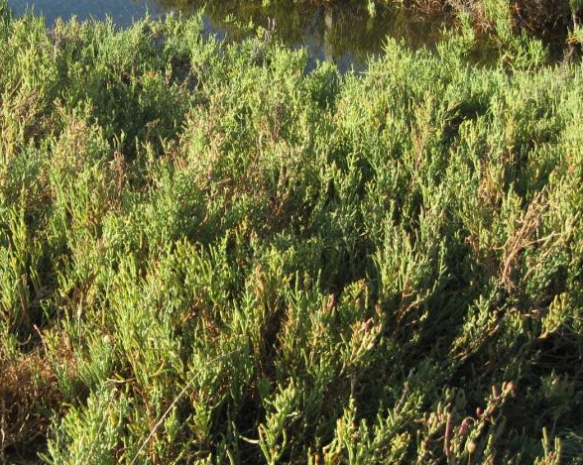
Plants::Pickleweed (Sarconia pacifica)
Middle elevation
Concentrates salt into tip leaves and allows those to die and drop off

Slide 7
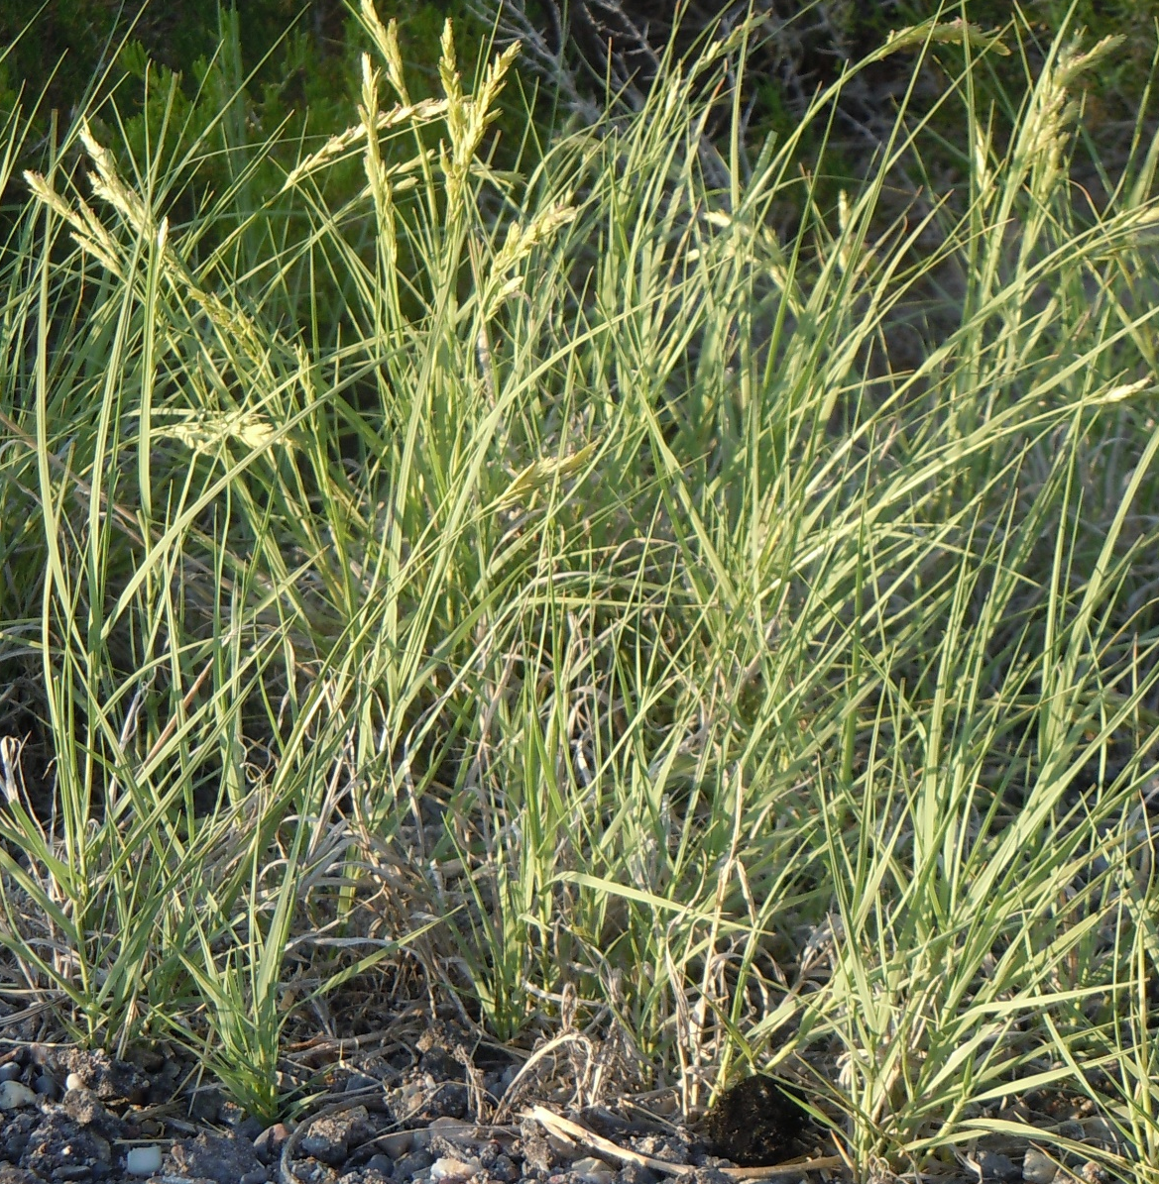
Plants::Salt Grass (Distichlis spicata)
Highest elevation
Excretes salt through leaves
Low tolerance for submersion

Slide 8
Process
Use data on:
Lifecycle of plant species
Wetlands tides
Sea level changes
Terrain (possibly)
Develop model from data on lifecycle of plants
Write computer program of model to take inputs of
Tides
Sea level changes
Terrain

Slide 9
Program
Language: C++ and R
R Plotting Libraries
Algebra Library Options (C++):
Armadillo
Boost::uBLAS
Elemental
Algebra Library Options (R):
RcppArmadillo
Notes:
Need the algebra libraries primarily for matrices, which I can use to represent the spatial terrain grid. Matrices are useful for calculations for discrete population dynamics such as mine. They are also useful for calculating migration (seed dispersal).

Slide 10
Current Progress
Am researching more into plants and their reproductive and life cycles
Have made a basic test non-spatial seed bank model that calculates population over time

Slide 11
Model: Current
Plant Death
Population
Seed Production
Seed Growth
Seed Bank

Slide 12
Model: Entire
Plant Death
Population
Seed Production
Seed Growth
Environmental Effects
Seed Bank
Environment

