Slide 1
Login Page

Slide 2
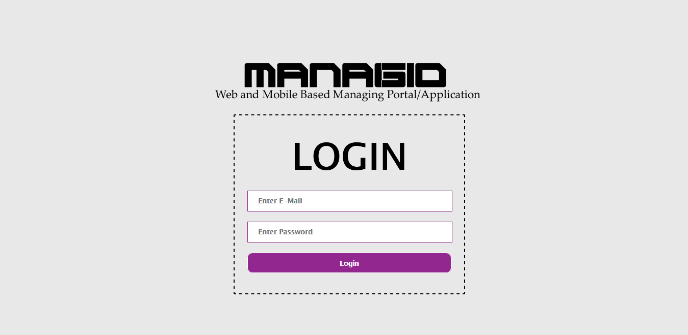
Users i.e. Admin, Faculties, Employees, Students, etc. can login from here

Slide 3
Dashboard

Slide 4
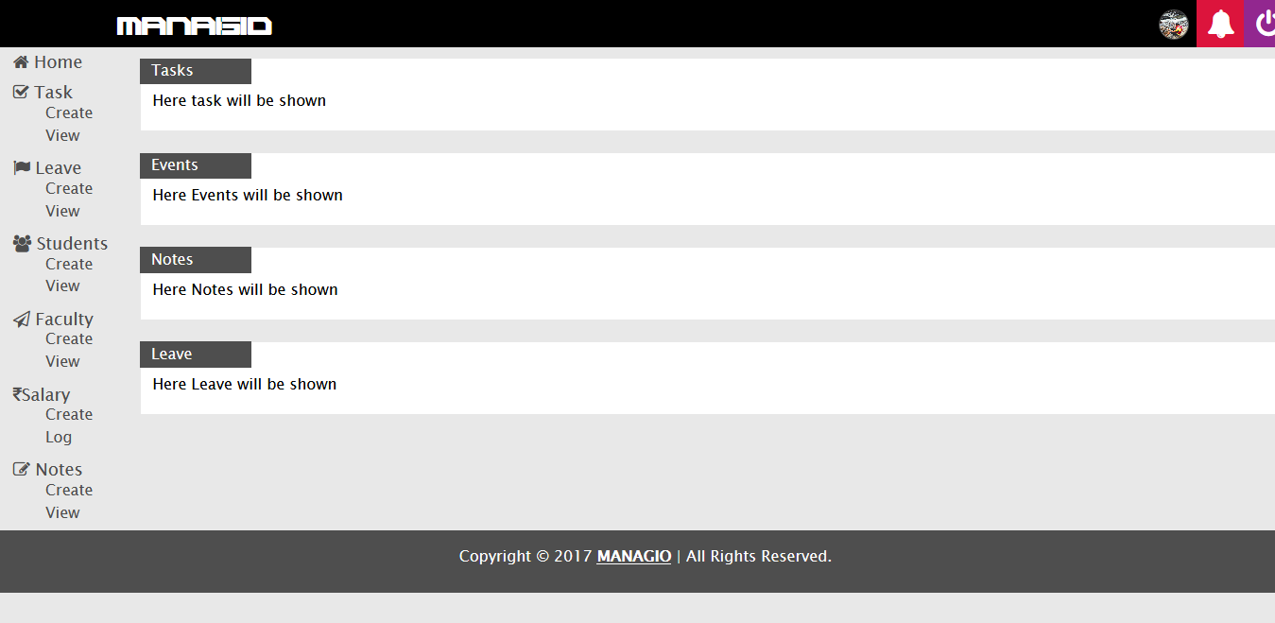
Redirects to Home of Dashboard.

Slide 5
Tasks can be created or Viewed from this option.

Slide 6
Leave can be created or Viewed from this option.
Students/Employee can apply for leave.
Admin or Faculty can allow or deny it.

Slide 7
Students can be created or Viewed from this option by Admin.

Slide 8
Faculties can be created or Viewed from this option by Admin.

Slide 9
Salary logs for Employees/Faculties i.e. depending on Organisation.

Slide 10
Notes i.e. Notifications, Assignments can be created.

Slide 11
Here assigned tasks will be shown.
Here new events will be shown.
Here Notes will be shown.
Here applied leaves will be shown.

Slide 12
Profile : You can change your Photo, Password, etc. from here.

Slide 13
Notifications: You can view recent notifications sent to you.

Slide 14
Logout: You can logout from here.

