Slide 1




Life Expectancy
Project Team
Neel Shah
Xi Lin(Linsey)
Suneeth Sreedharan
Ruchee Shorey
Sindhu Preethi Gokarakonda Venkata Naga Sai

Slide 2





Table of Contents
Overview
Objective & EDA
Modeling
Conclusion

Slide 3
OVERVIEW

Slide 4
Introduction
Life expectancy is a statistical measure of a typical period a human being is expected to live.
There have been numerous studies commenced on factors affecting life expectancy depending on various factors.
The project relies on accuracy of data and will emphasize immunization factors, mortality factors, economic factors, social factors, and other health related factors.

Slide 5
Data
Data Size: 684 KB
Attributes: 32 columns to select from
Countries: 183
Data from Years represented: 2000-2016
Data originated from: The World Health Organization & United Nations website

Slide 6
Objective & EDA

Slide 7
Objective
Our primary goal: understanding how other immunizations, health, social and economic variables could affect this number.
This type of information should allow governments to establish policies, regulations, and laws that could potentially enhance communities’ well-being.

Slide 8
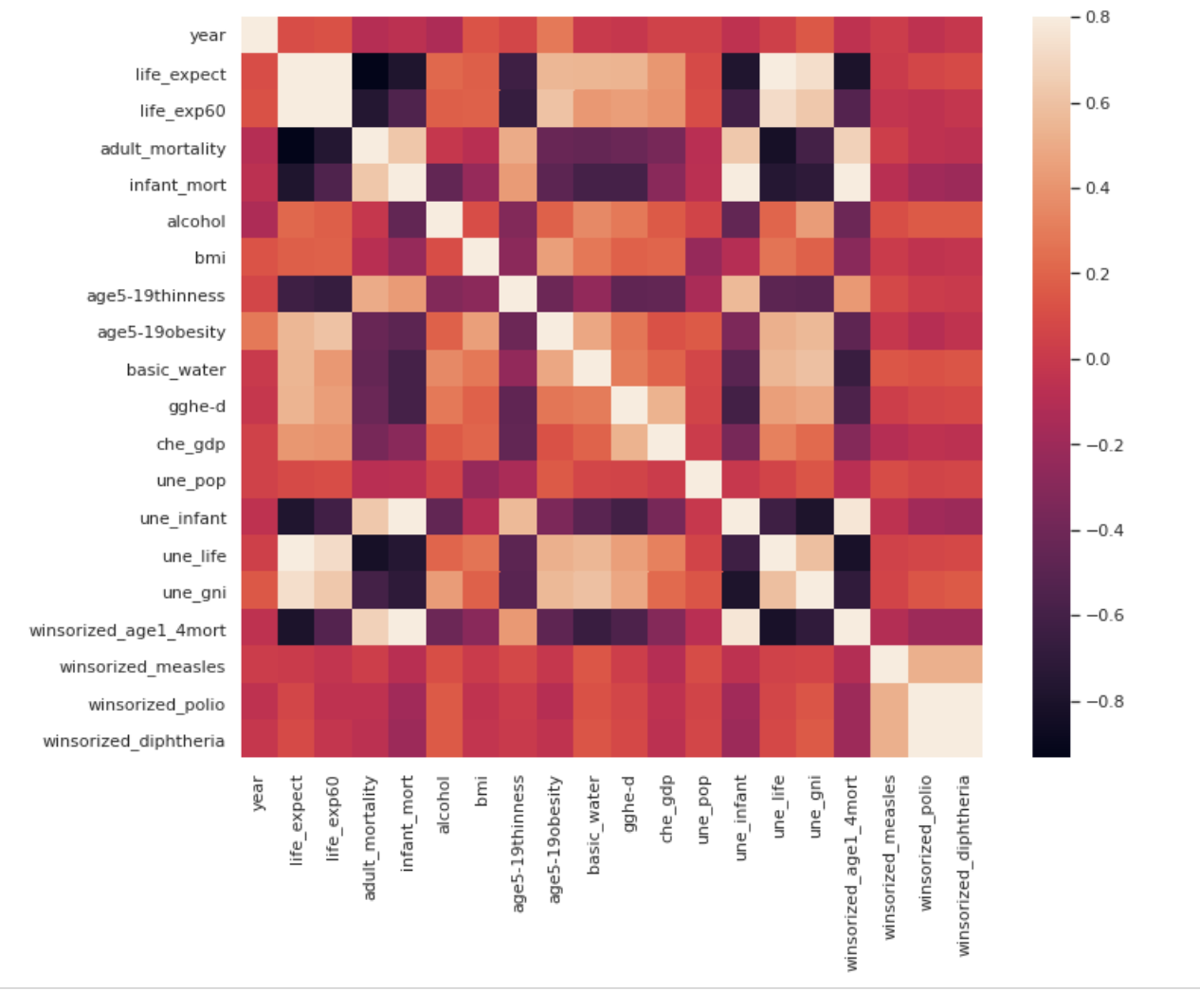
Heatmap
EDA

Slide 9
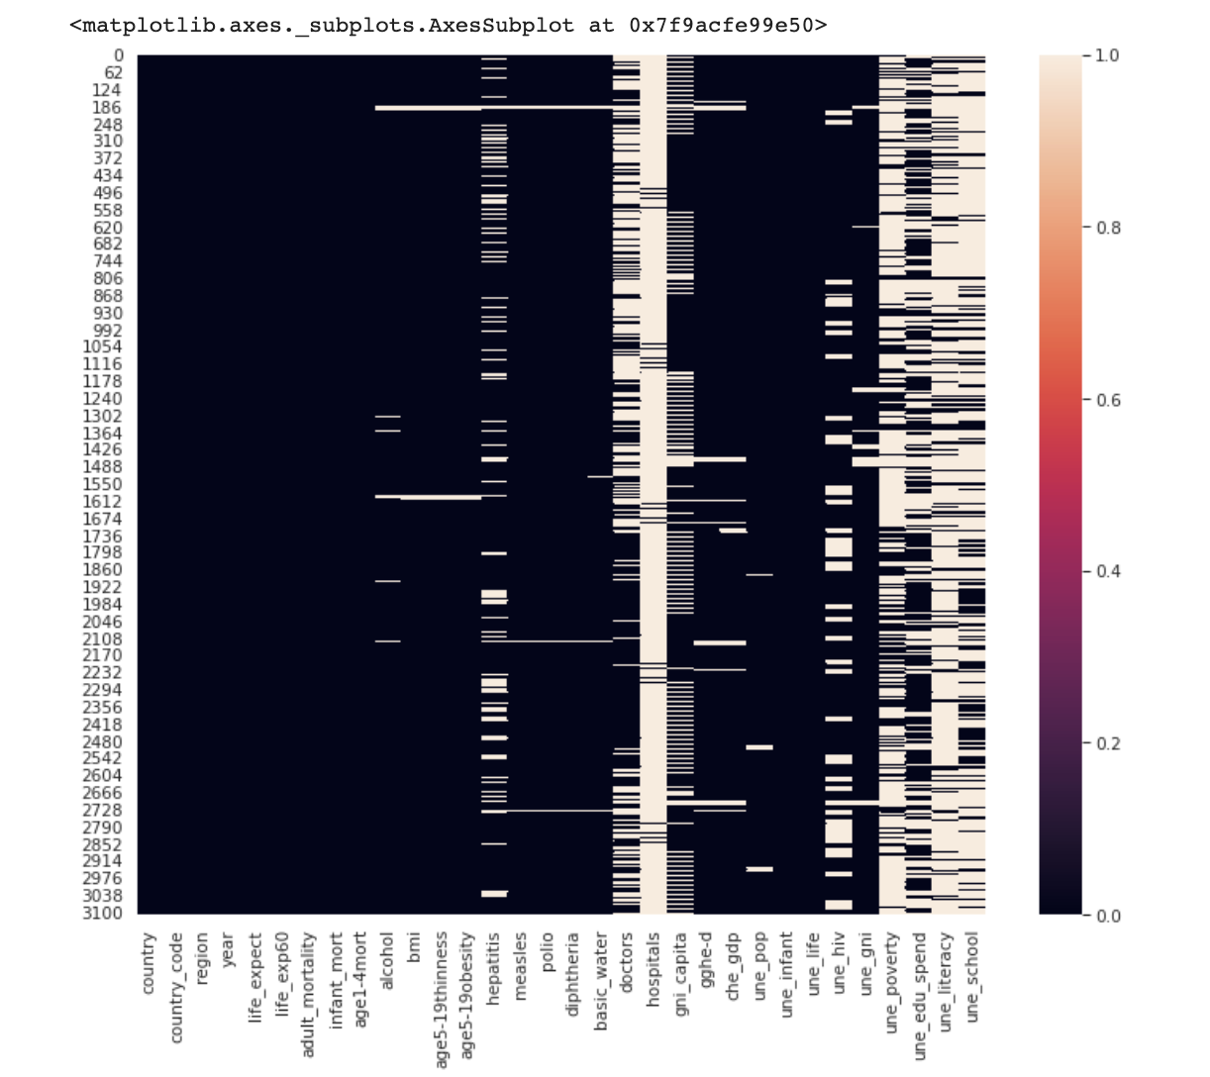
Visualization of Nulls/NAs

Slide 10
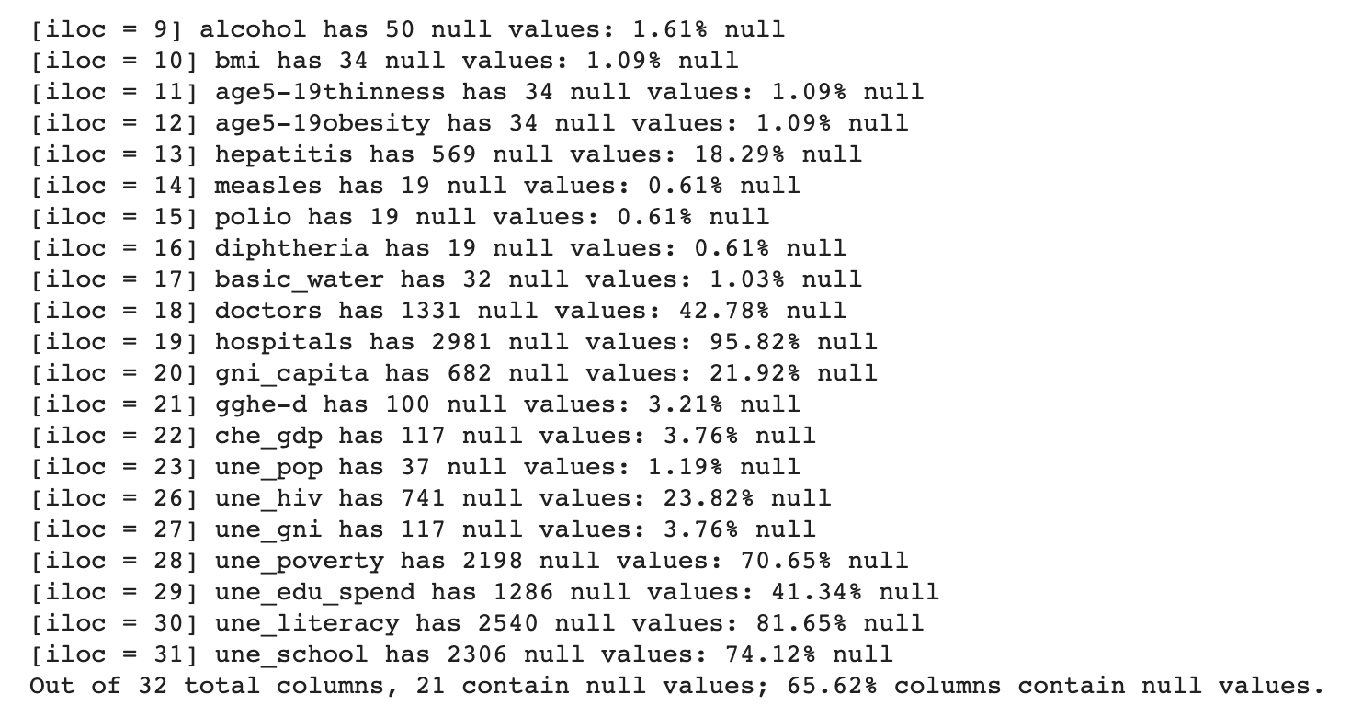

Slide 11
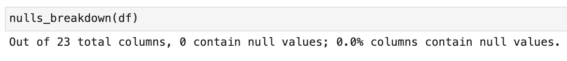
After retraining, there are no null values

Slide 12
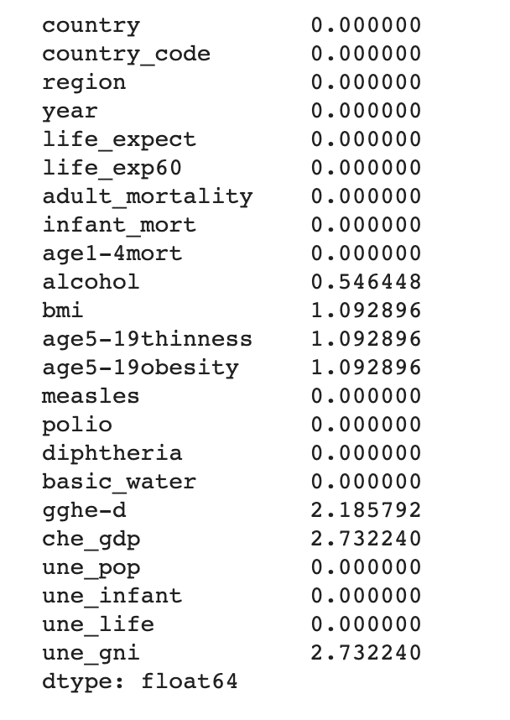
After Handling and Imputation
Replace Missing Values Associated with Country Feature Mean.
The remaining nulls are low in %, and hence will be retained.

Slide 13
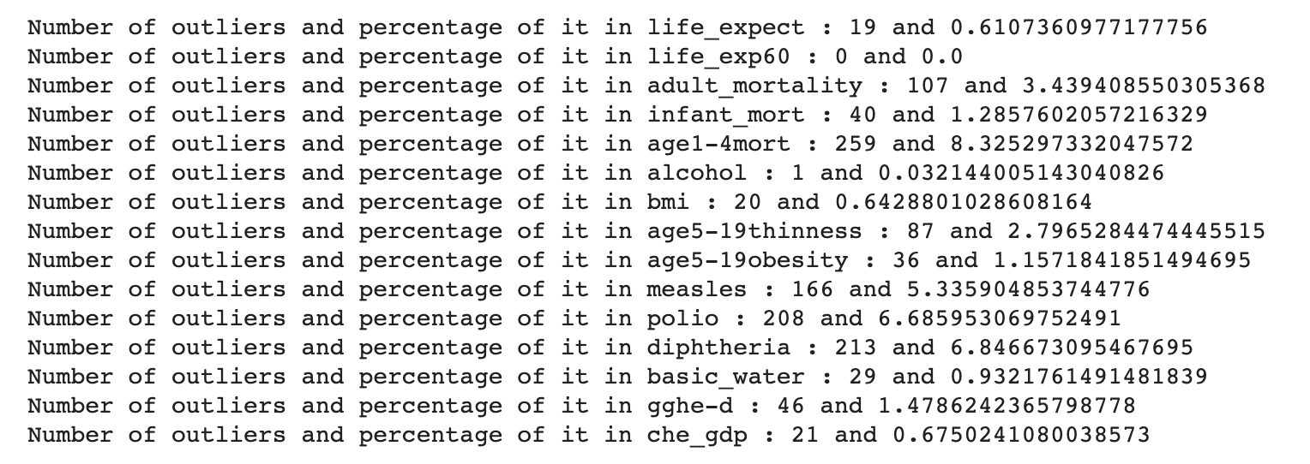
Outliers

Slide 14
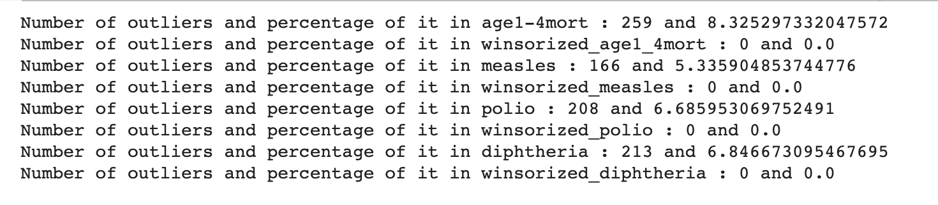
After Handling Outliers

Slide 15
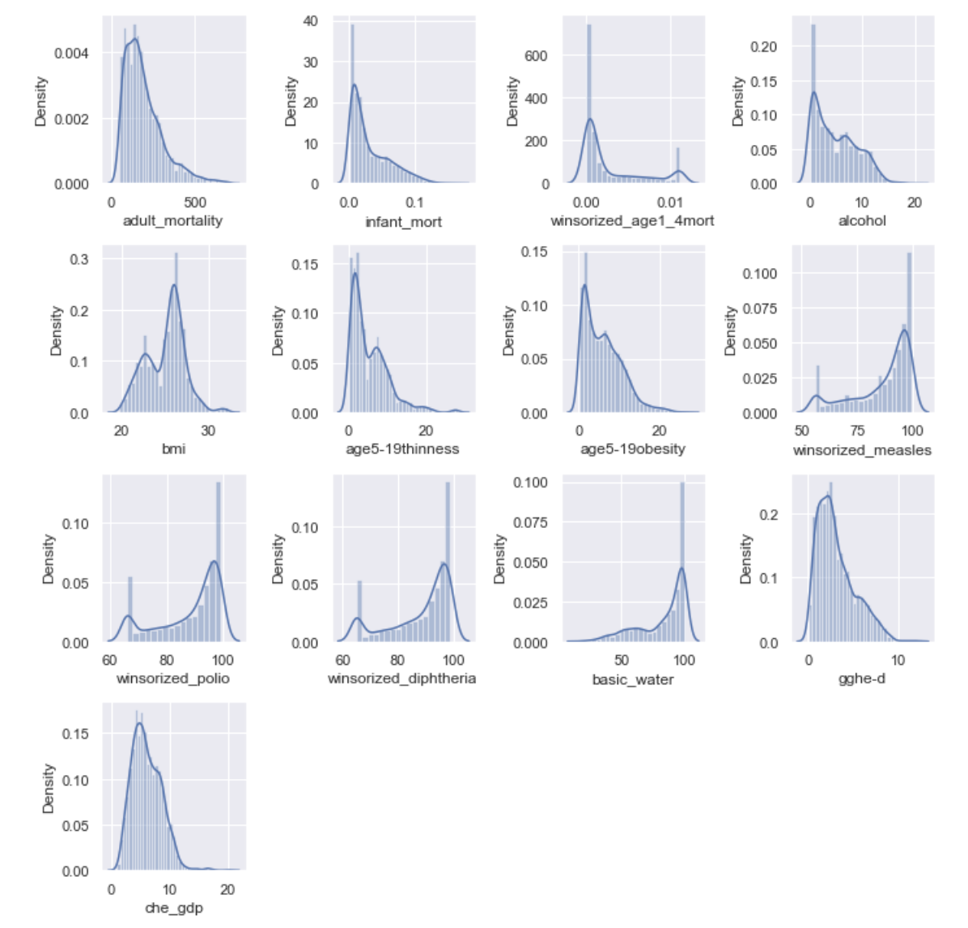
Visualizing Skewness

Slide 16
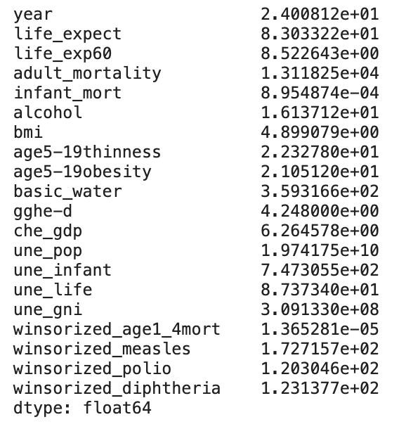
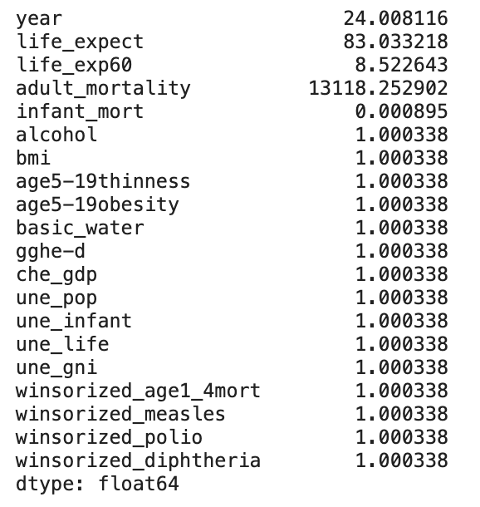
Notes:
Skewness before fixing & after fixing

Slide 17
Modeling

Slide 18
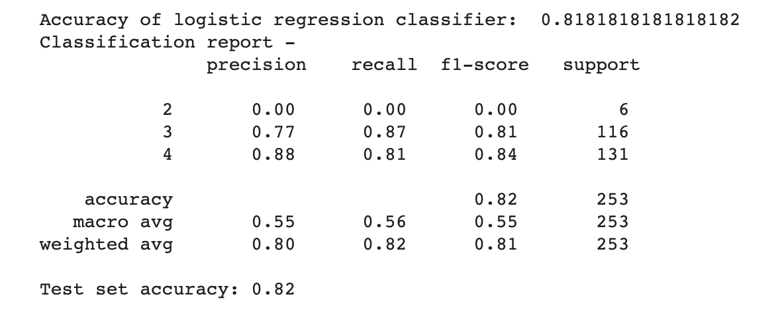
Logistic Regression

Slide 19
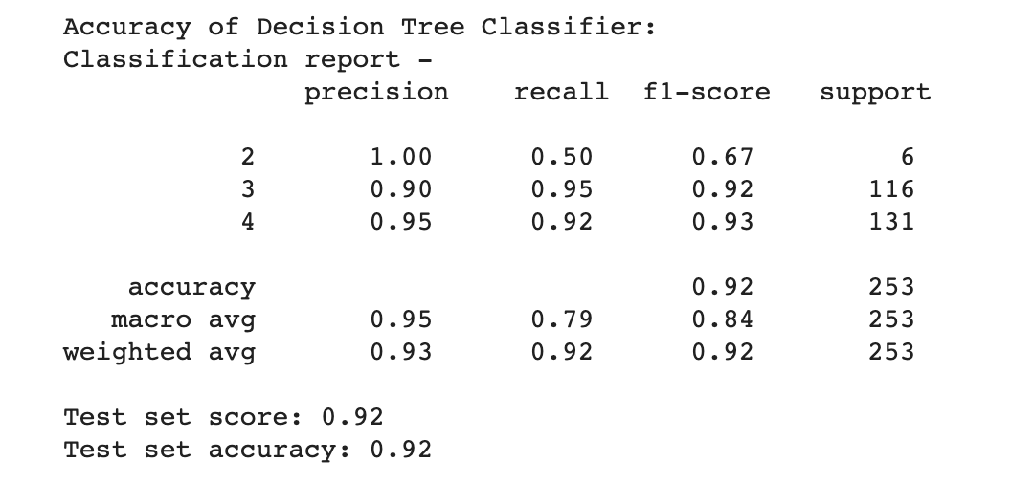
Decision Tree

Slide 20
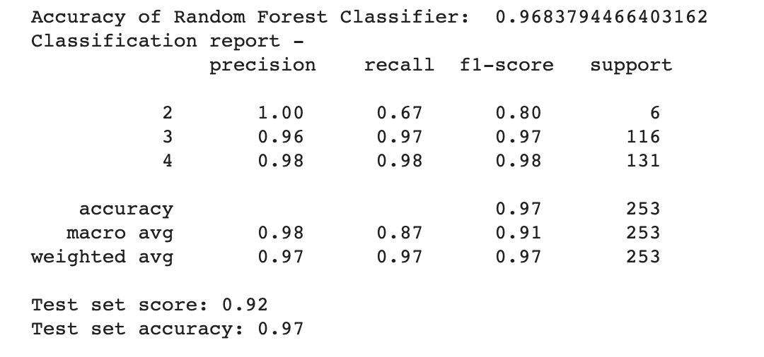
Random Forest

Slide 21
Conclusion

Slide 22
Insights
Unique about data : Time series
Imbalances : Nulls, Outliers, Skewness
Problems Faced: Messy data (outliers, null values, skewness) and continuous nature of features.
Resolving the issues : Non-normalized data handling, using substituting Country-group mean, imputing the null values, winsoring, scalar and log transformation.

Slide 23
Creating additional features/variables: Modified the predictor feature-life expectancy which is continuous in nature & Created Life-expectancy class/groups to fit the classier model.
Models: Logistic Regression, Decision Tree, Random Forest
Evaluation : RSME, test set scores & model accuracy, classification report recall, precision & accuracy.
Best Results: Random Forest with 0.97 accuracy.

Slide 24
Future Work
Applying Dimension Reduction Techniques like PCA.
Work on getting more clean data and extrapolating the data collection till 2021.
Suggestions:
Better the data, better the model building and accuracy, and focus on cleaning the data.
Enrich with further attributes like Countries Status; this will give a better understanding on developed and developing countries[4].
Implementing the Dimension Reduction Techniques like PCA.

Slide 25
References
Dataset : https://www.kaggle.com/mmattson/who-national-life-expectancy?select=who_life_exp.csv
[1] https://ourworldindata.org/life-expectancy
[2] https://population.un.org/wpp/Download/Standard/Mortality/
[3] https://unctadstat.unctad.org/EN/Classifications.html
[4] https://unctadstat.unctad.org/EN/Classifications.html

Slide 26
Thank You

