Slide 1
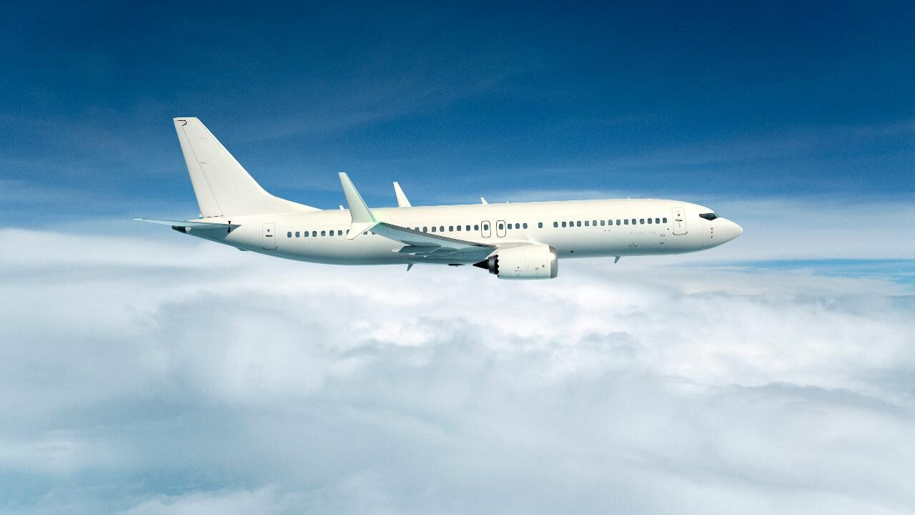



Capstone Project
Predicting Airline Customer satisfaction
Neel Deorukhkar
Thanks to Springboard Mentors
Ryan Knuffman, StateFarm
Bernard Chan,
Kabam

Slide 2

The Problem
Identify Key variables that drive Customer Satisfaction
Improve Customer Experience
Optimize Marketing Campaign
Target Consumer Segments based on Demographics

Slide 3
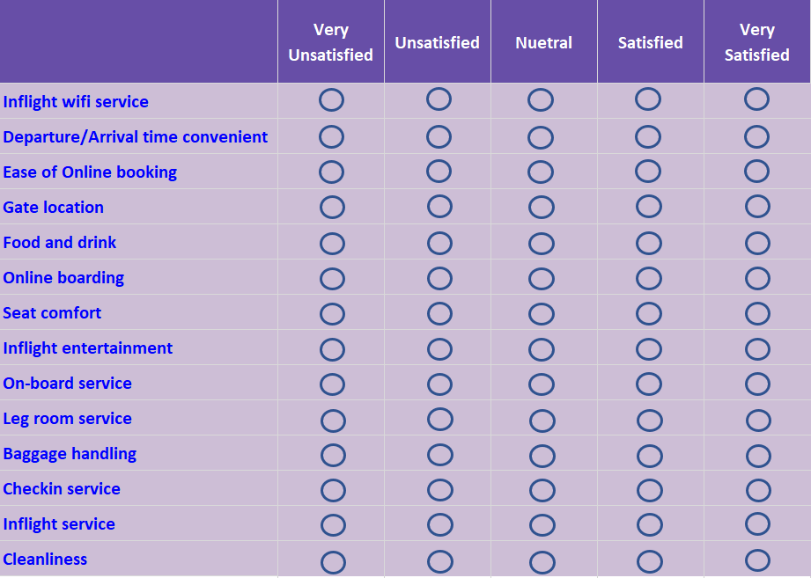
The Data
Categorical Variables
Ordinal Variables
Variable Name | Notes
Gender | Female | Male
Customer Type | Loyal | Disloyal
Type of Travel | Business Travel | Personal Travel
Class | Business | Eco | Eco Plus
Continuous Variables
Variable Name | Notes
Age | Ranges from 7 years old to 85 years old
Flight Distance | Median Flight Distance is 414 miles
Departure Delay | 75th Percentile Delay is 12 minutes
Arrival Delay | 75th Percentile Delay is 13 minutes

Slide 4

Success
The CEO wants to target actionable variables that impact satisfaction the most.
While airline delays do impact customer satisfaction, in some cases it’s inevitable to avoid delays due to poor weather.
The Criteria of success would be to classify the respondents’ satisfaction with the highest Accuracy scores by building machine learning models and then predicting the out of sample dataset.

Slide 5

Constraints
Weather Data unavailable
Operating/Installation costs not available
No competitor questions asked in the survey
The most impactful variable may not be the most efficient

Slide 6
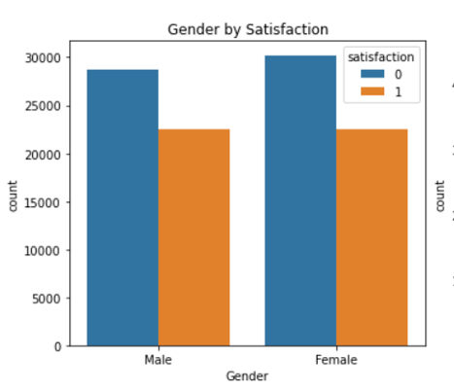
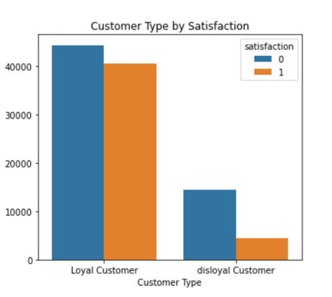
Exploratory Data Analysis
Gender
Customer Type
Satisfaction is not impacted by Gender. The data are equally distributed among the two groups
Loyal Customers are much more satisfied than disloyal customers

Slide 7
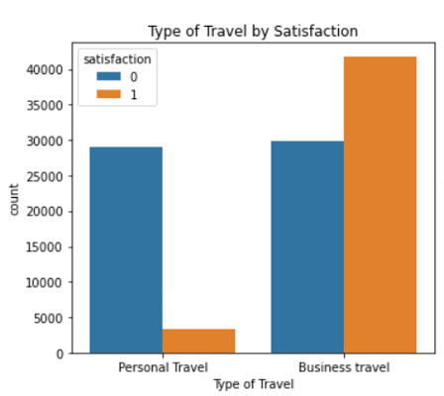
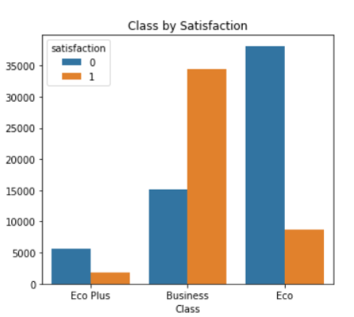
Exploratory Data Analysis
Travel Type
Class
Satisfaction is not impacted by Gender. The data are equally distributed among the two groups
Loyal Customers are much more satisfied than disloyal customers

Slide 8
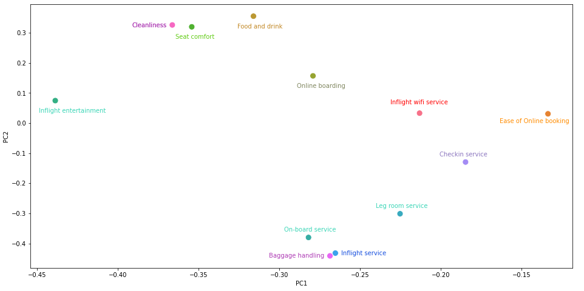
Customer Experience Analysis
Features can be reduced by using Principal component analysis based on this graph to avoid the curse of dimensionality. Algorithms such as random forests too can be used to select good features.
Inflight experience seems to standout on its own in the chart.
Seat Comfort, Cleanliness and Food and Drink seem to be highly correlated
Baggage experience and onboarding service seem to be highly correlated.

Slide 9
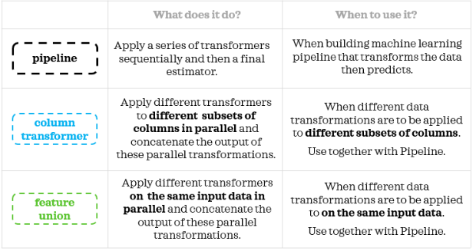
Data Engineering
Building a Data Engineering Pipeline is important to apply transformations on the test data.
Scikit-Learn’s “Pipeline” and “Feature Union” help standardize the code well

Slide 10
Sklearn Pipeline
Sklearn’s Pipeline and FeatureUnion can be used to create solid data engineering pipelines
X_train
Categorical
Ordinal
Continuous
ColumnSelector
ColumnSelector
ColumnSelector
ModeImputer
SimpleImputer
MeanImputer
OneHotEncoder
MinMaxScaler
PowerTransformer
Concatenates the output of pipelines
Model
Transformer
Estimator
Pipeline
FeatureUnion

Slide 11
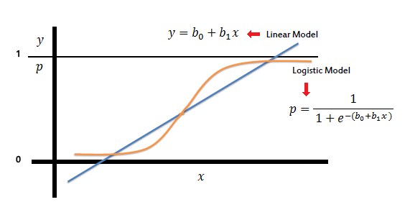
Modeling
Simple Logistic Regression
Logistic Regressions are easy to implement
Outputs results between 0 and 1
Accuracy : 87.76%
Tuned Hyper parameter Accuracy: 92.75%

Slide 12
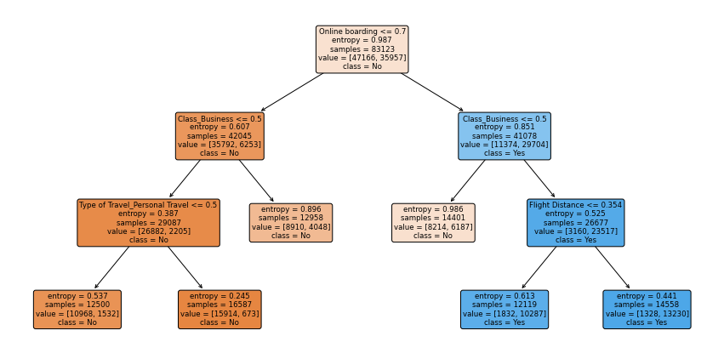
Modeling
Decision Trees
Onboarding experience is the most determining feature for Customer satisfaction
CEOs can potentially implement facial recognition scanners for faster boarding

Slide 13
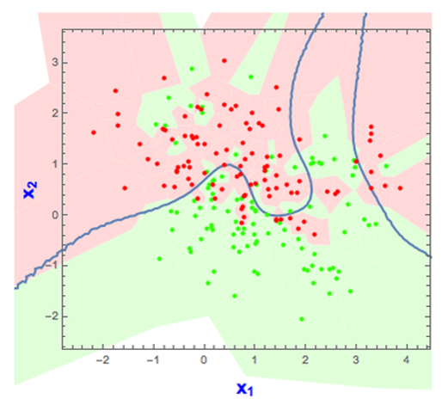
Modeling
K-Nearest Neighbors
KNN classifiers are sensitive to outliers
Computationally expensive
Accuracy : 89.71%

Slide 14
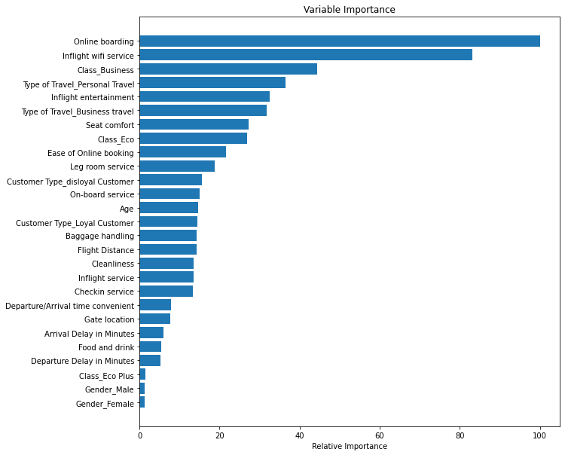
Modeling
Random Forests
Random Forests are one the best algorithms that are currently used.
Weak Decision Tree classifiers are built using random features over several bootstraps.
Gives a nice Feature Importance chart
Accuracy: 96.07%

Slide 15
Modeling Summary
Comparison of Machine Learning Algorithms
Model | Accuracy
Logistic Regression | 92.77%
KNN Classifier | 89.71%
Random Forest | 96.07%

Slide 16
Conclusion and Next Steps
Improve Onboarding Experience
Improve Wi-Fi Service
Gather cost data to gauge whether improving customer experience justifies the cost
Gather competitor data to position the brand on a Correspondence Map

Slide 17
Thank you!

