Slide 1
MINI PROJECT PRESENTATION
Attendance Management System
A Web-Based Application for Digital Student Attendance Tracking
Name: Neel Dube
Enrollment No.: 240503020016
Subject: Python
Stream / Class: BCA Cybersecurity — A1

Slide 2
Introduction & Problem Statement
The Problem
The Solution
Paper registers and spreadsheets make attendance slow to record and even slower to summarize — teachers manually tally presence and recompute totals by hand, and errors creep in as class sizes grow.
A lightweight PHP + MySQL web application that lets a teacher register students, mark daily attendance in seconds, and instantly see accurate, always-up-to-date attendance percentages — no manual tallying required.

Slide 3
Core Features
1
2
3
4
Add Student
Mark Attendance
Generate Report
Calculate Percentage
Register students with roll number, name, class, and email.
Mark every student Present or Absent for any chosen date.
View a class-wise summary of days marked and days present.
Auto-compute attendance %, flagging students below 75%.

Slide 4
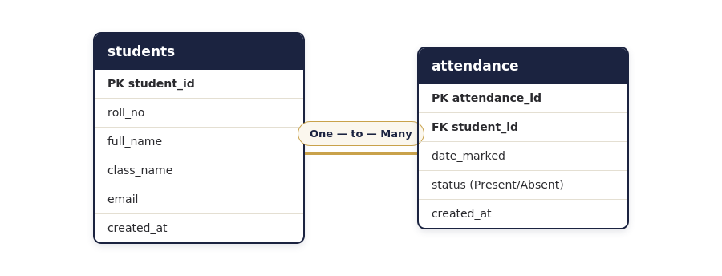
System Design — Database Schema
Two tables — students and attendance — linked in a one-to-many relationship.
Key design choice: A UNIQUE(student_id, date_marked) constraint with ON DUPLICATE KEY UPDATE ensures a student can never be marked twice for the same date.

Slide 5
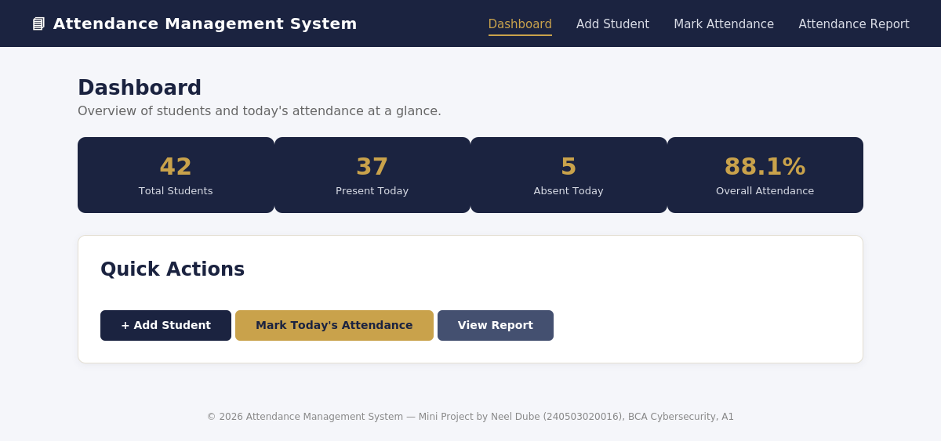
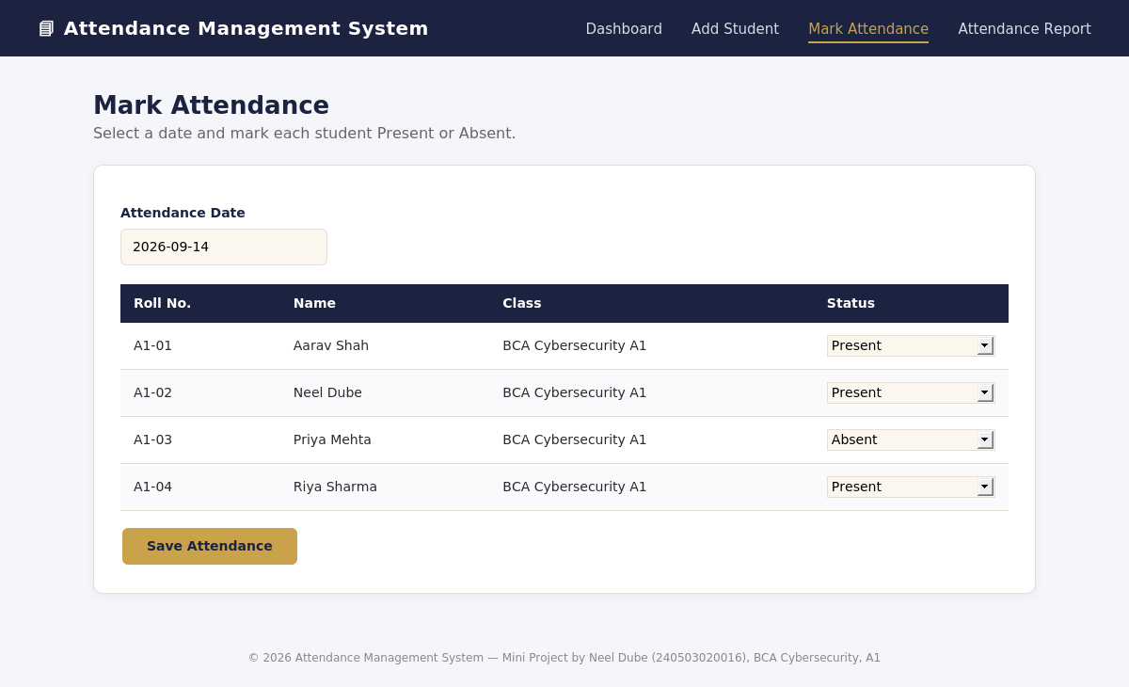
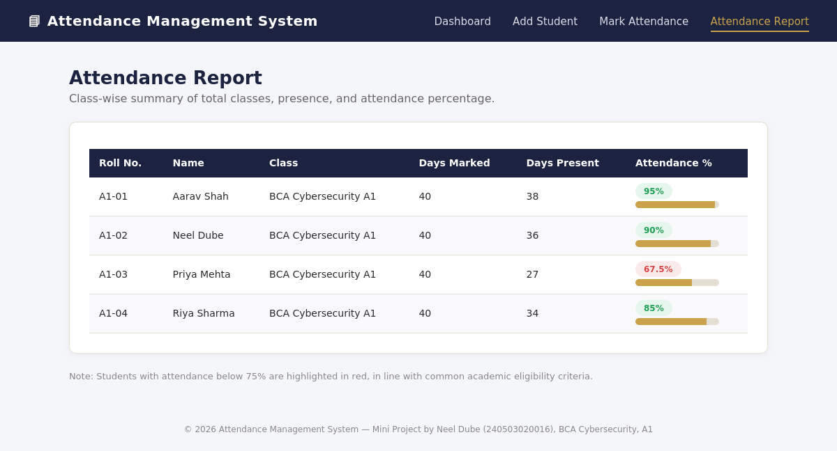
Application Walkthrough
Dashboard — live summary stats
Mark Attendance — date-wise Present/Absent
Attendance Report — computed percentages

Slide 6
Technology Stack & Testing
PHP 8
MySQL 8
HTML5 / CSS3
XAMPP (Apache)
Sample Test Cases
Test Case | Expected Result | Status
Add student with duplicate roll no. | Rejected by UNIQUE constraint | Pass
Re-mark attendance for same date | Existing row updated, no duplicate | Pass
Report for student with 0 records | Shows 0%, no division error | Pass
Attendance below 75% | Row flagged in red | Pass
Test Case
Expected Result
Status

Slide 7
Conclusion & Future Scope
Conclusion
Future Scope
This mini project replaces error-prone manual registers with a reliable PHP + MySQL web app covering the full attendance workflow — from registration to automatic percentage calculation — built on sound database design and secure, prepared-statement queries.
Role-based login for teachers, students, and admins
Automated alerts when attendance drops below 75%
Export reports to PDF / Excel
Subject/period-wise attendance tracking

