Slide 1

Indian Institute of Technology, Guwahati
Brief Presentation
Evaluation of Information Retrieval
using Precision@10
(TF-IDF and BM25)
Presented By:
The Crawlers
Dated: 10th September 2016
CS 570

Slide 2
Introduction
It is the process of assessing how well the search results satisfied the user’s query intent.
It corresponds to the number of relevant result on the first search result page.
If ‘K’ is the number of relevant result in the result-set, then Precision@10 will output K/10.
Page 1
Introduction

Slide 3


FrontPage
Page 2

Slide 4
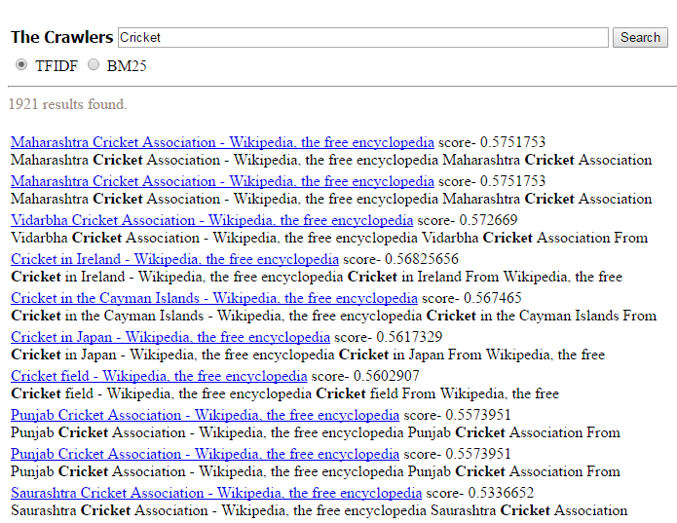
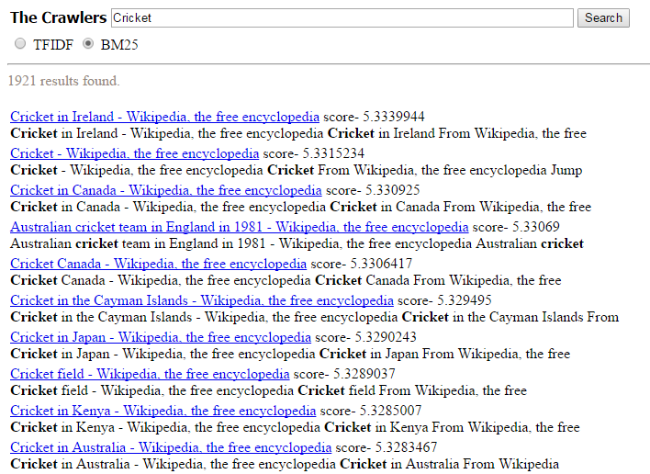
Query 1 : Cricket
TF-IDF Result BM25 Result
TF-IDF P@10:
3/10
BM25 P@10:
7/10
Page 2

Slide 5
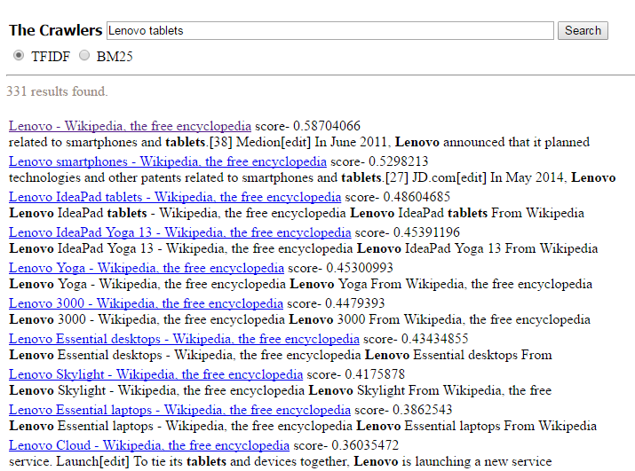
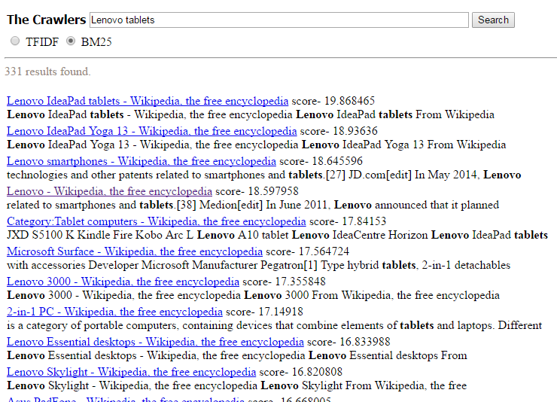
Query 2 : Lenovo Tablets
TF-IDF Result BM25 Result
TF-IDF P@10
5/10
BM25 P@10:
5/10
Page 3

Slide 6
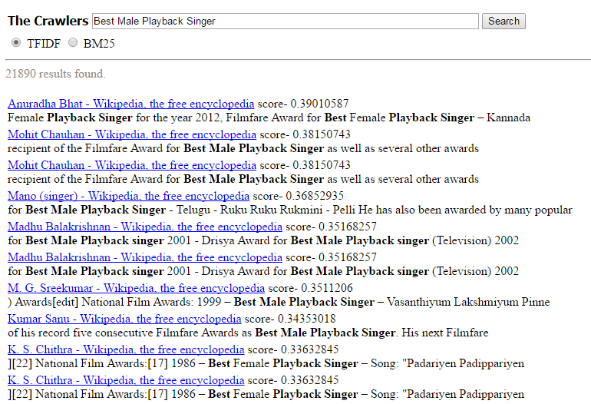
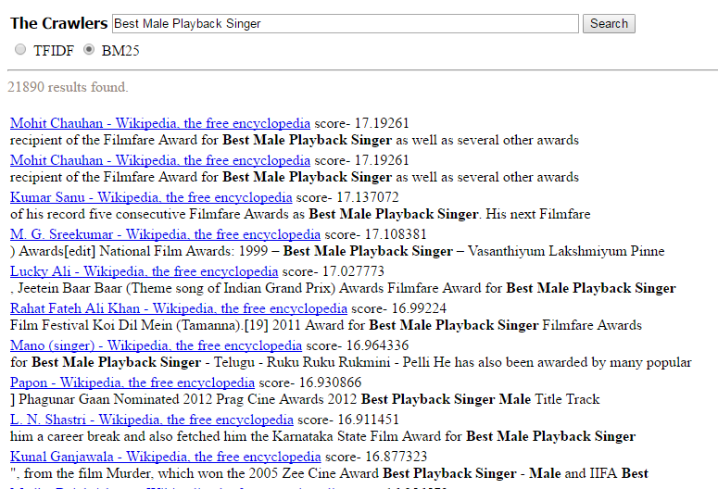
Query 3 : Best Male Playback Singer
TF-IDF Result BM25 Result
TF-IDF P@10:
6/10
BM25 P@10:
9/10
Page 4

Slide 7
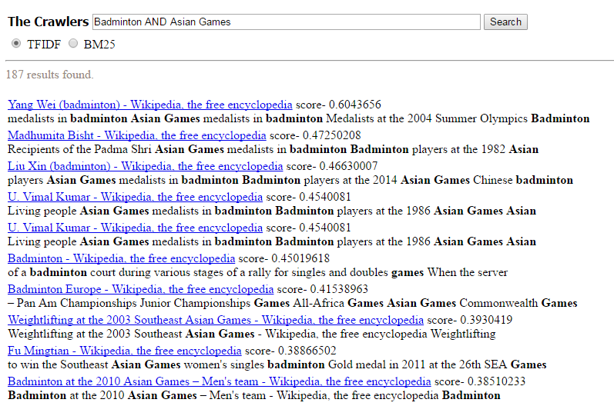
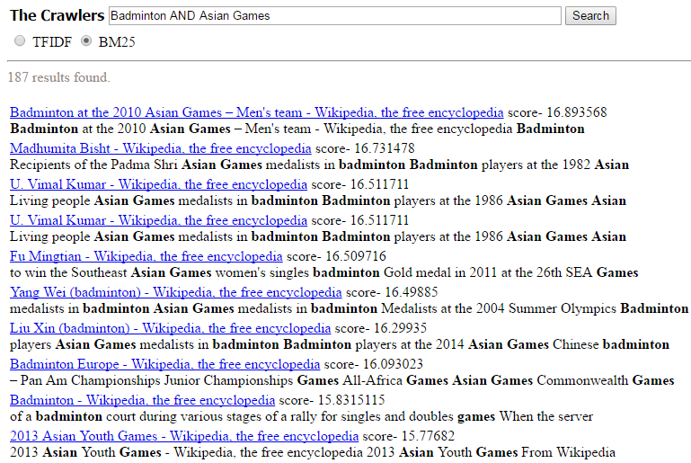
Query 4 : Badminton AND Asian Games
TF-IDF Result BM25 Result
TF-IDF P@10:
6/10
BM25 P@10:
7/10
Page 5

Slide 8
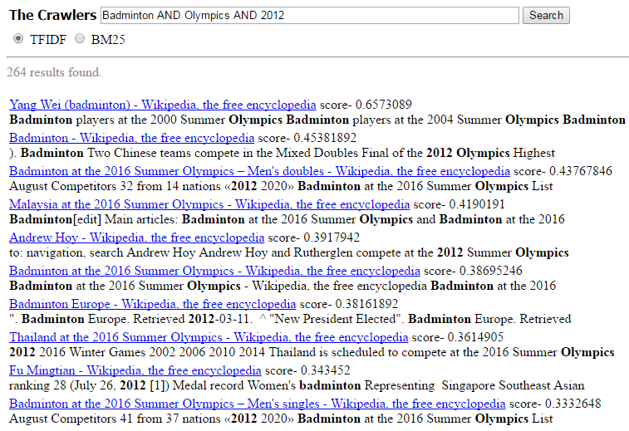
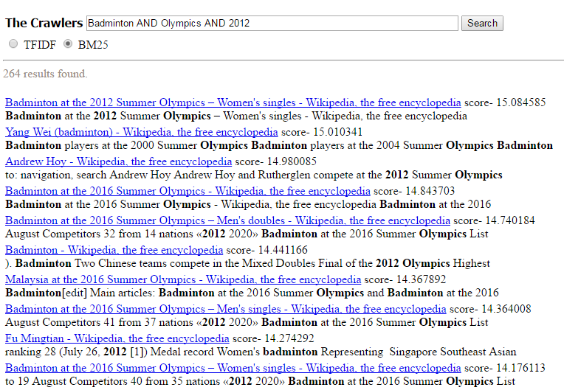
Query 5 : Badminton AND Olympics and 2012
TF-IDF Result BM25 Result
TF-IDF P@10:
5/10
BM25 P@10:
6/10
Page 6

Slide 9
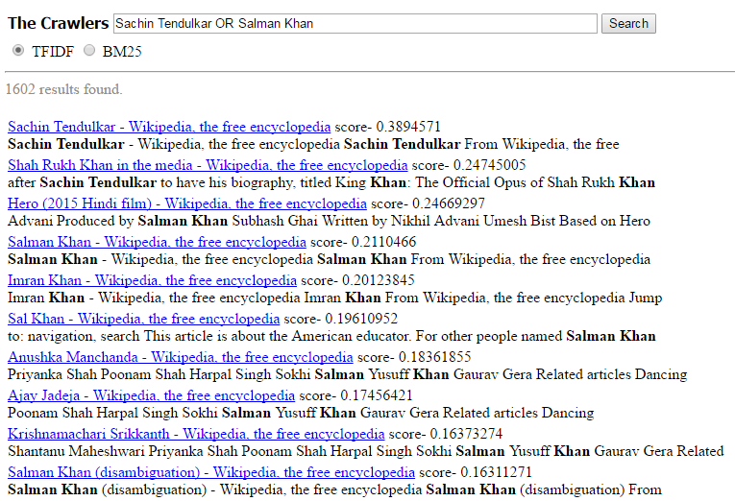
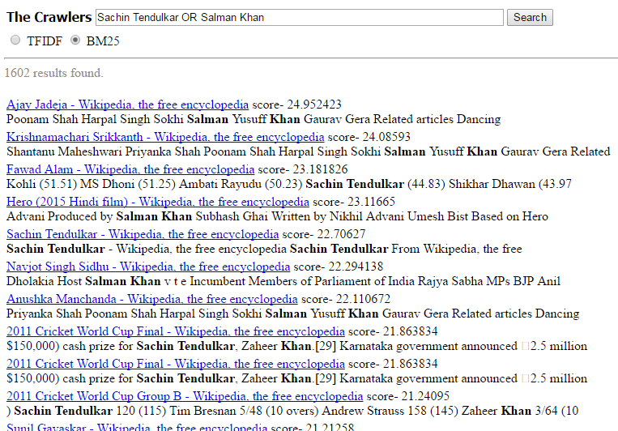
Query 6 : Sachin Tendulkar OR Salman Khan
TF-IDF Result BM25 Result
TF-IDF P@10 :
5/10
BM25 P@10:
4/10
Page 7

Slide 10
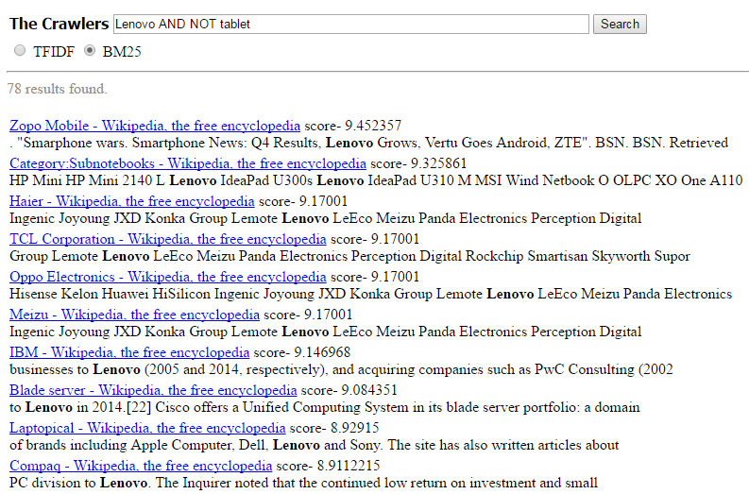
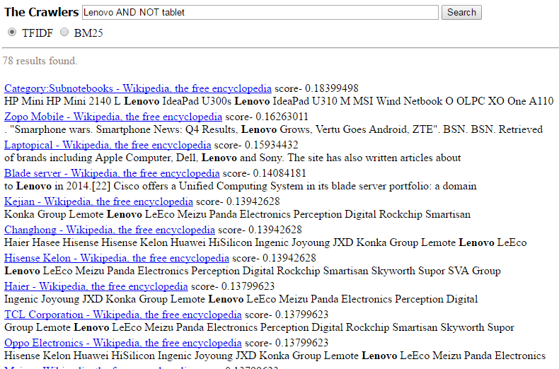
Query 7 : Lenovo AND NOT tablet
TF-IDF Result BM25 Result
TF-IDF P@10:
5/10
BM25 P@10:
5/10
Page 8

Slide 11

Analysis : Mean Average Precision
Mean average precision for a set of queries is the mean of the average precision scores for each query.
where Q is the number of queries.
Page 9

Slide 12
Analysis : Mean Average Precision
MAP(TF-IDF) = (0.3 + 0.5 + 0.6 + 0.6 + 0.5 + 0.5 + 0.5)/7
= 0.50
MAP(BM25) = (0.7 + 0.5 + 0.9 + 0.7 + 0.6 + 0.4 + 0.5)/7
= 0.61
Page 10

Slide 13
Conclusion
Since Mean Average Precision for BM25 is greater than TF-IDF. So It can be concluded that BM25 performs better than TF-IDF.
Page 11

Slide 14
Thank You

