Slide 1

Hotel Booking Demand Prediction
Neelesh Gangrade
Lavu Sri Jushatha
Mohammad Zubair Shaik
Battula Venkata Bala Krishna

Slide 2
Hotel Industry and Analysis Goals:
In the last two years, the pandemic has had a significant impact on the hotel industry. Every company had a low number of hotel reservations. We will recommend measures to improve bookings so that the hotel can make a profit. There are two categories of hotels owned by our client: resort hotels and city hotels. There are both quantitative and qualitative variables in the dataset.
With the help of this data set we will be analyzing the booking demand. We will be predicting the possibility of bookings with respect to different factors such as Type of Hotel, Arrival Date, Customer Type. The aim of this project is to predict the demand and help our client in improving their business.

Slide 3
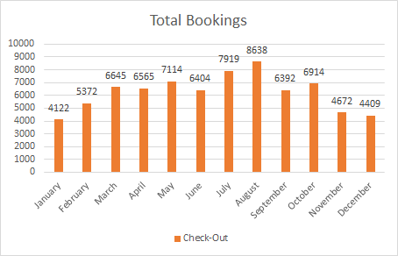
Graphical Presentation of Data
This graph represents the total number of booking made in one fiscal year.
The month of August has the most bookings, with 8638 total bookings, followed by the month of July, with 7919 total bookings.
We may deduce that these two months provide most of the income because they have the highest number of bookings compared to the others.

Slide 4
Total Reservations
/

Slide 5
Booking Status by Type of Hotel
The graph depicts bookings made depending on the type of hotel (Resort hotel or City hotel).
The cancelled bookings for city hotels are double than the cancelled bookings for resort hotels when compared to the total bookings made.
The demand for city hotels is clearly higher than the demand for resort hotels, as city hotel bookings are higher. However, for city hotels, cancellations account for more than half of all reservations.
It would be advised a decision should be taken to decrease the cancellations by taking reviews from customers and comparing the costs with the competitors.

Slide 6
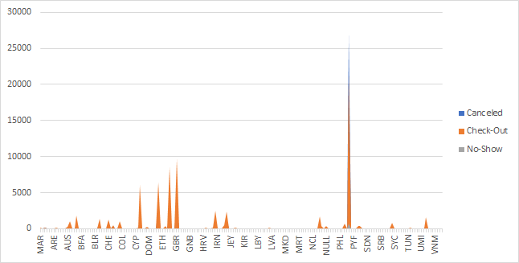
Country wise Reservations Status
This graph shows booking made for different countries.
Bookings in France are significantly higher than in other nations yet cancelled bookings in France outnumber reservations made by 26765 to 21071.

Slide 7
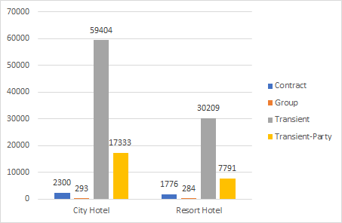
Total Bookings on customer type
The graphs show the different types of customers who stay in different types of hotels.
Transient guests in city hotels is higher than the transient guets in resort hotels, which is good sign, as the hotel gets a resonable profit margin through transient customers.
Adjusting room pricing, experimenting with promotional discounts (such as offering a complementary breakfast for last-minute bookings), and putting your hotel on multiple online travel agencies will all help to enhance your visibility.

Slide 8
Design Analysis:
First, we classify data using 3 methods. These 3 methods will help in knowing the performance and making the decision.
i) Logistic Regression: Using this method we are predicting the chances of a reservation not being canceled in a particular month.

Slide 9
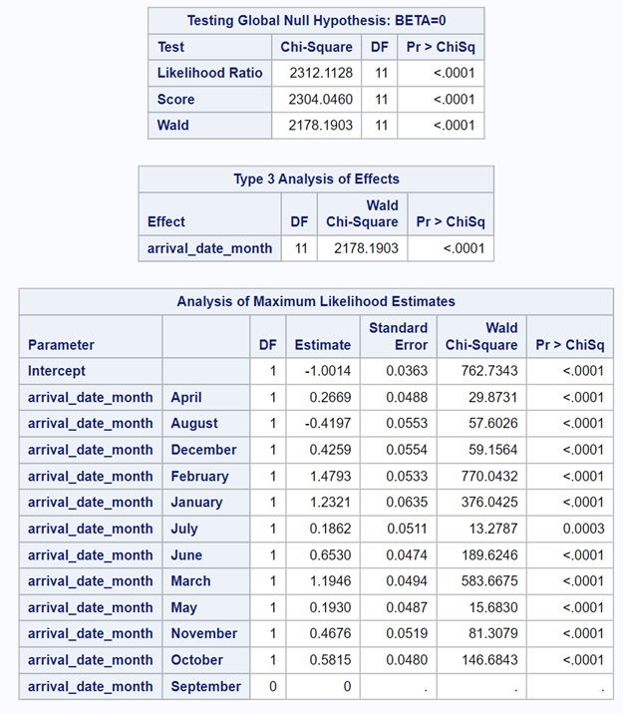
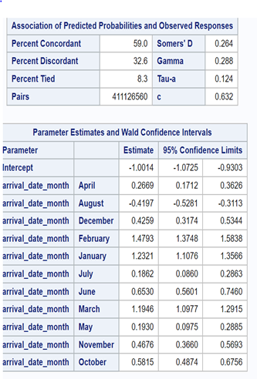
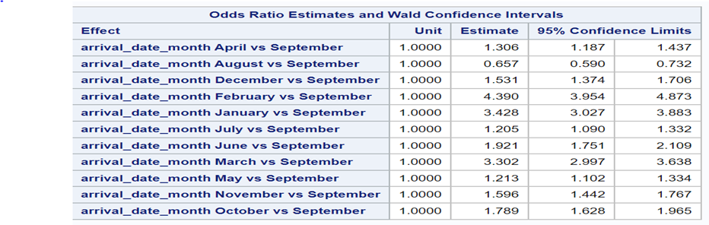
R-Square | 0.5370 | Max-rescaled R-Square | 0.7320

Slide 10
Result:
Here the Maximum Likelihood Estimates and P value is significant. Hence, we can conclude that there is a statistically significant association between the response variable and the term.
In these results, the arrival date of January is statistically significant at the significance level of <0.0001. We can conclude that changes in the reservation(booking) are associated with changes in the probability that the event(cancelation) will occur.
The estimates for arrival_date_January is 1.2321, which suggests that higher booking in January month is associated with higher probabilities that the event will occur (reservation cancelation will not happen).
Considering the odds ratio for arrival date January: Since 1 is not in the interval (3.027, 3.883) we are 95% confident that an increase of 1 booking in the January month increase the odds of booking not being canceled by 200% to 288%.
For these data, the Max re-scaled R2 value indicates the model provides a good fit to the data.

Slide 11
ii) Linear Multiple Regression:
To predict the booking cancellation based on bookings made through agents, we are using Linear Multiple regression:

Slide 12
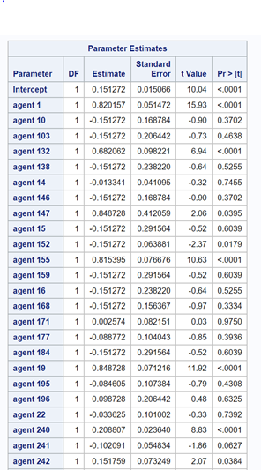
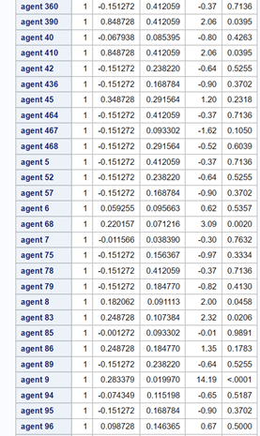
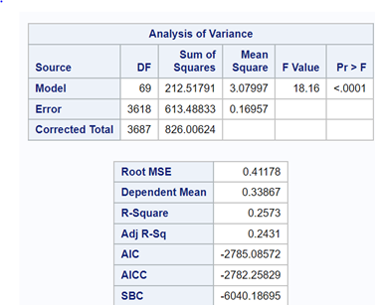

Slide 13
The model is statistically significant since the p value is less than 0.0001.
R-square value is 0.2573. That means independent variable agent explains about 26% of variation in the dependent variable.
Predicting the cancelation of booking made through agent-9 since they have the highest number of bookings canceled in past. So, if we get 100 booking through agent 9, then around 29 bookings can be canceled (Y = 0.1512+0.2833(100))

Slide 14
iii) Clustering:
Through the clustering problem based on K-Means we are analyzing the results of each cluster to identify the most profitable clients in our data set based on lead time and ADR.

Slide 15
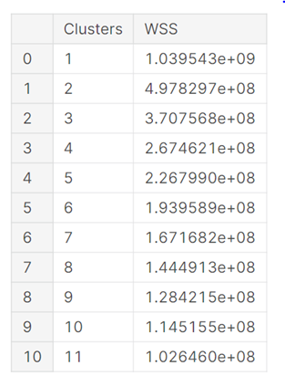
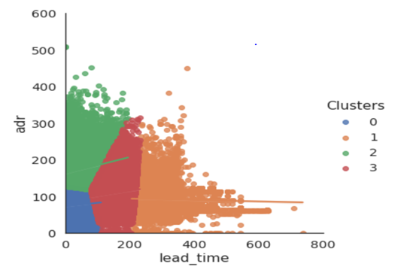

Slide 16
Through this analysis, we can say that the clients with the lowest lead time and the highest ADR i.e., the clients that appear in the green cluster are the most profitable.
While the red category shows the lowest ADR and the highest (least profitable) delivery time

Slide 17
Hotel demand forecasting is one such method that helps hotels make informed decisions, based on implementation of various analysis from regression methods and graphs, we can conclude:
We forecast hotel sector trends by evaluating the graphs, and we conclude that summer and fall season bookings are strong. Staff, inventory, and supplies should all be arranged ahead of time to keep these bookings under control.
To increase the number of transient type of customers (since, transient kind of customers generate most of the income), adjusting room pricing, experimenting with promotional discounts (such as offering a complimentary breakfast for last-minute bookings, and putting your hotel on multiple online travel agencies will all help to enhance your visibility.
Based on the implementation of multiple linear regression method we can conclude that chances of bookings getting canceled, which are done through agent are very less. We know that these days online travel agents are the best market for reservations. So, we may offer some credits to attract agents.
From the K-means we could visualize the most profitable customers and the least profitable customers, based on the two variables lead_time (Number of days elapsed between the date of entry of the reservation in the PMS and the client arrival date) and ADR (Average daily rate as defined by dividing the sum of all accommodation transactions by the total number of nights). This needs to be taken care of to get more customers and make more profit.
We have also used of logistic regression method to predict the odds of booking cancelation in the January month, because January is the season of travel. And we could predict with the high level of confidence level that on every increase in booking, the chances of reservation not being canceled is increased by 200% to 288%, which is a positive point.
Hiring Revenue Managers would be the best option to a hotel, as they know in and out of demand forecasting in the industry and can forecast fast and precisely.

