Slide 1
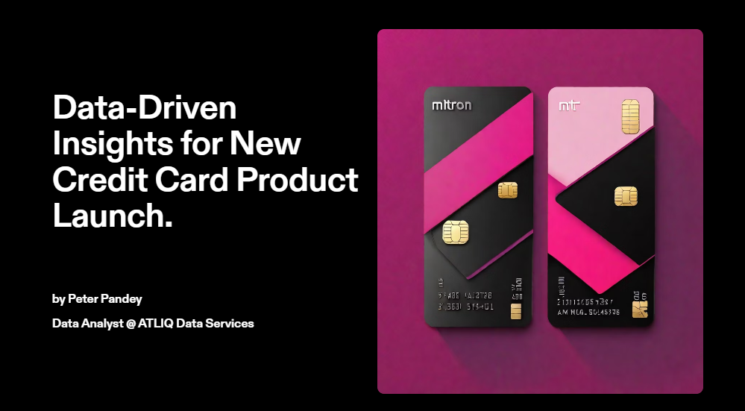
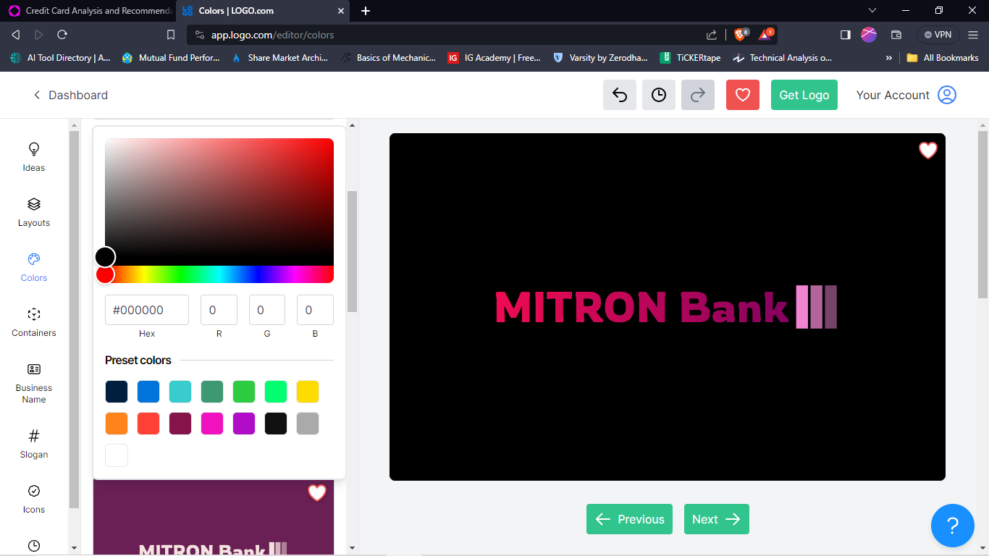

Slide 2
Problem Statement
Mitron Bank is a legacy financial institution headquartered in Hyderabad. They want to introduce a new line of credit cards, aiming to broaden its product offerings and reach in the financial market.
ATLIQ Data Services came to know about this through an internal link and approached Mitron Bank with a proposal to implement this project. However, strategy director of Mitron Bank, Mr.Bashnir Rover is skeptical and asked them to do a pilot project with the sample data before handing them the full project. They provided a sample dataset of 4000 customers across five cities on their online spend and other details.
Approach
Overall Data analysis in Demographic and Spending analysis, visualization using Power BI for providing insights and Recommendations according to Data.
Usage of credit card spending derived from the analysis by occupation, city and gender and categorized by age group.
Recommendations of credit card type based on use category and age group category.

Slide 3
Overall Analysis
Card Segmentation
Insights & Recommendations
Final Note

Slide 4
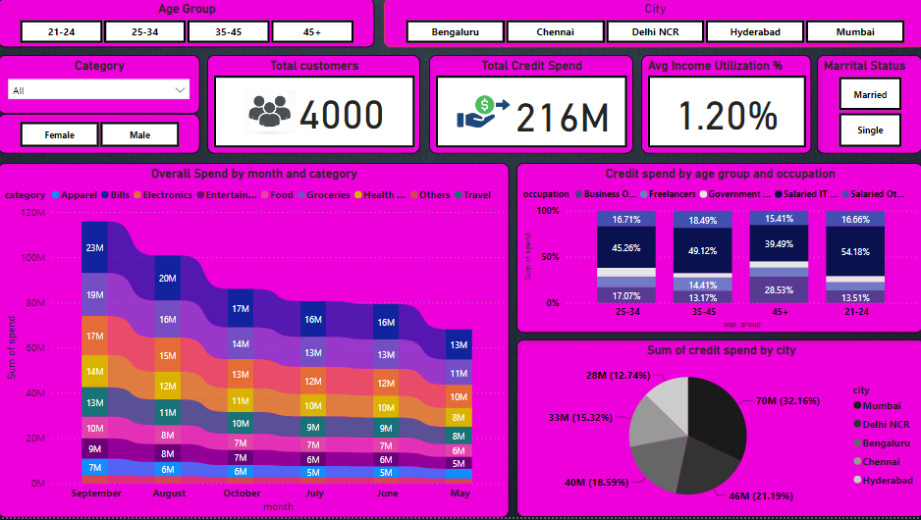

Slide 5
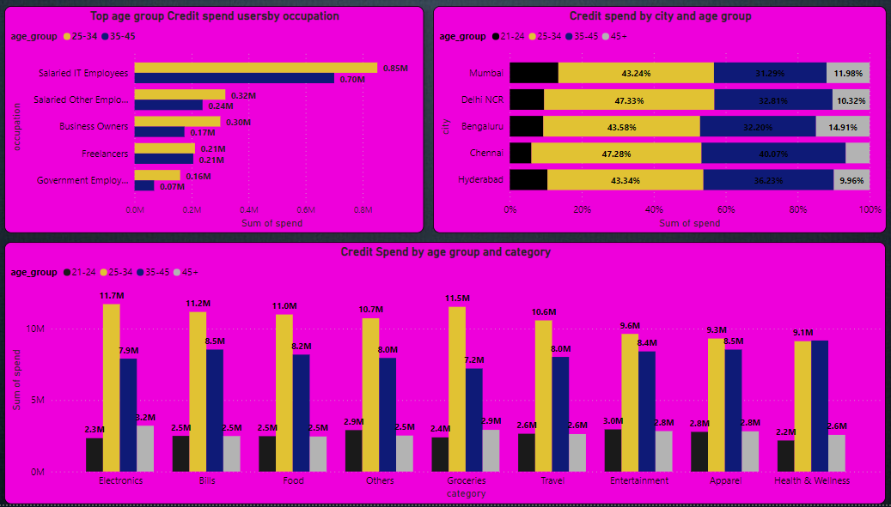

Slide 6
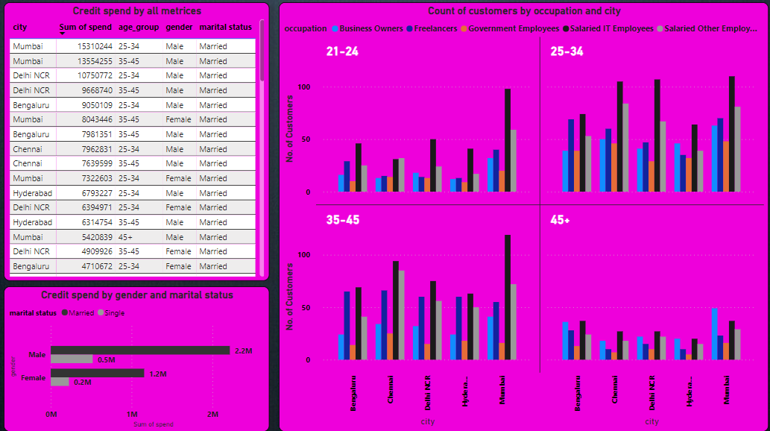

Slide 7
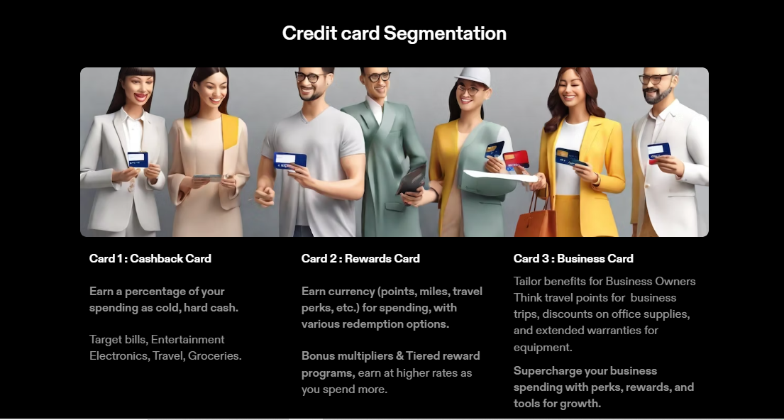

Slide 8
Insights
Age Group (21-24)
Target Cities : Mumbai, Delhi, Bengaluru
Top Occupations : IT, Other Salaried, Business Owners, Freelancers
Singles : Support the party guys with Cashback on Entertainment, Travel, Apparel, Food, and "Others".
Couples : Bills and Apparel take priority. Offer Cashback on Electronics and Health for tech-savvy and health-conscious duos.
Age Group (25-34) who has more Average Utilization %
Target Cities : Mumbai, Delhi, Bengaluru
Top Occupations : IT, Other Salaried, Business Owners, Freelancers
Married Men : Electronics, Groceries, Bills, Apparel, Entertainment, and Travel top their list. Cashback's their best option.
Married Women : Bills, Groceries, Electronics, Entertainment, and Travel are their strengths. Reward them with points on these spends.
Singles (Both) : Entertainment, Food, Electronics, and Apparel are their jam. Cashback or Rewards, they'll be game!

Slide 9
Age Group: (35-45) who has more Average Utilization %
Target Cities : Mumbai, Delhi, Bengaluru
Top Occupations : IT, Other Salaried, Business Owners, Freelancers
Couples : Bills, Health, Entertainment, Apparel, Electronics, and Travel are their shared passions. Cashback and Rewards, both work!
Single Men : Apparel, Food, Travel, and Groceries fuel their adventures. Cashback keeps their wallets happy.
Age Group: (45+)
Target Cities : Mumbai, Bengaluru, Delhi
Top Occupations : Business Owners, IT, Other Salaried
Couples : Groceries, Travel, Electronics, Entertainment, and Apparel are their spending staples. Cashback and Rewards, let them choose!
Married Women : Health joins their spending list. Reward them for taking care of themselves.
Single Men : Health joins their spending list. Cashback helps them stay healthy and wealthy.

Slide 10
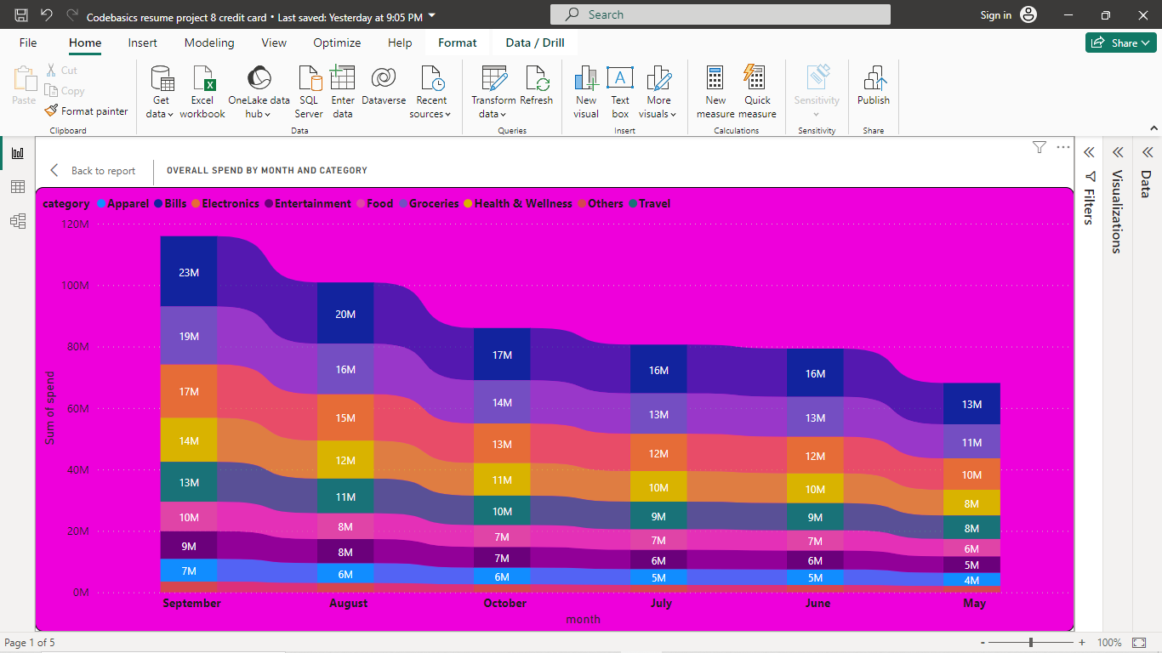
From the above RIBBON Chart analysis It’s understood that more transactions happen in September followed by August, October, July, June and May.
August and September months are usually the festival season in South India of September more, with many celebrations such as Ganesh Chaturthi, Onam, Navratri, and Dussehra. These festivals may increase spending on groceries, apparel, entertainment, food, and travel, as you may buy more items for rituals, gifts, decorations, and celebrations. Also spend more on electronics, as this month may have some attractive offers and discounts on gadgets and appliances.
From October there will be Amazon and Flipkart Big billion days happen due to its festival season in upcoming months.

Slide 11
Card Recommendations
Cashback Card - Think "Big Spenders, Big Rewards."
Age 25-34 & 35-45 : Married couples in Mumbai, Delhi, and Bengaluru who love electronics, entertainment, bills, travel, and groceries. Bonus for IT and other salaried employees.
All Ages : Single Mumbaikars, Delhiites, and Bangaloreans with a taste for the finer things – apparel, entertainment, food, and electronics. Perfect for freelancers and business owners!
Reward Card - Think "Smart Savers, Savvy Rewards."
Age 25-34 & 35-45 : Health-conscious married couples in Mumbai, Delhi, and Bengaluru who juggle bills, electronics, travel, and food. IT and salaried employees love these perks.
All Ages : Single men and women who prioritize entertainment, food, electronics, and apparel. Business owners and freelancers enjoy flexible rewards.
Business Card - Think "Hustle Harder, Earn Smarter."
All Ages : Business owners in Mumbai, Bengaluru, and Delhi who crave travel, electronics, bills, and entertainment

Slide 12
Other Insights & Recommendations
Additionally with the Top 3 spending cities mentioned earlier Chennai will also be a great market place because of more IT salaried and Salaried other employees presence there.
There’s a huge spending difference between married and single category where Married one’s use Credit card more.
We can also observe Freelancers contribution is next among occupations. So, We can suggest a type for them and also for students which help them improve their CIBIL score which is like ONE METAL CARD which is collaborated with other banks.
Travel card which is part of Reward card can that gives benefits on travel expenses such as air miles, hotel stays, airport lounge access, travel insurance, and more collaborated with MAKEMYTRIP, OYO, GOIBIBO and with companies like SPICEJET, VISTHARA and AIR INDIA we can use this card to explore new destinations and cultures around the world.
Fuel card which is part of Reward card that gives you savings on fuel expenses such as cashback, discounts, or surcharge waivers at select petrol pumps. You can use this card to reduce your travel costs and enjoy more road trips.
Cashback card gives you cashback on every purchase you make, either as a fixed percentage or as a variable rate depending on the category. You can use this card to save money on your bills, electronics, Groceries and apparels from popular marketplaces and brands like AMAZON, MYNTRA, AJIO, RELIANCE DIGITAL, CROMA, GROFERS, ZEPTO, BIGBASKET, WESTSIDE, TRENDS, and more.

Slide 13
Finally,
Singles Crave Fun : Entertainment, food, and travel are top priorities for single cardholders across all ages.
Married Means Bills : Bills and groceries become top spending categories for married couples across age groups.
Health Matters : Health spending increases with age, especially for women above 45.
City Slickers Spend : Mumbai, Delhi, and Bengaluru lead the spending spree across all age groups and card types.
MITRON Bank's new credit cards are designed to fit your lifestyle, not just your wallet. Choose yours and unlock a world of rewards in every swipe !

Slide 14

Dashboard
Codebasics resume project 8 credit card.pbix
Thanks to for the Project
Thank you.

