Slide 1

Be-Fit
Team Members
Neelesh Saladi
Ravichander Reddy Goli
Rohitha Reddy Meda
Sai Rohith Gorla

Slide 2
Introduction to the Problem
In the current time of pandemic it is very difficult for people to go to gym and also take precautions of COVID19 Pandemic. To overcome this problem we are proposing this application Be Fit.
By using this application people can book their slots as per their requirement.
Rohitha

Slide 3
Proposed Solution
Be Fit is a Android application which helps us in pre-booking the dates for different exercise routines that are offered in the gym, In the current times of covid19 kind of situations people are more worried about their health and safety, So if they have option to pre book the slot in gym in which there will be limited number of people and also Users can also get to choose various kind of “Exercise Routines” schedule them with appropriate times it helps in assuring the safety of the users.
Rohitha

Slide 4
Features
User can book the slots and he will be displayed with the amount will be charged per session. He can view the total amount in rate card activity and can pay by the end of the month at store.
Rohitha

Slide 5
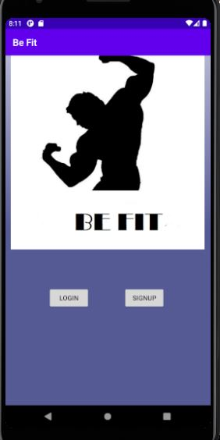
Main Activity
The application Be-Fit starts with the Main Activity, In this we can see the Login Option for already existing Users and a Signup Option.

Slide 6
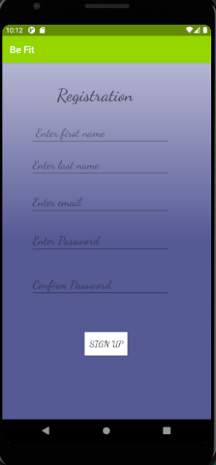
Signup Activity
In this activity user need to signup by giving all required fields.
In Sign Up, User has to provide his/her basic information such as Username, E-Mail, Phone number, Password. By signing user can have easy and unlimited access to the application.

Slide 7
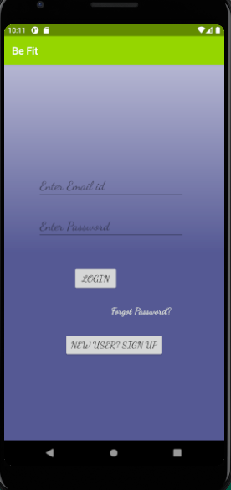
Login Activity
In this activity user needs to login by giving mail id and password.
User can login by entering his/her credentials to their registered account. If the user was not able to login into the account by forgetting password, then they can reset their password by clicking on forgot password option and they will able to reset their password.

Slide 8
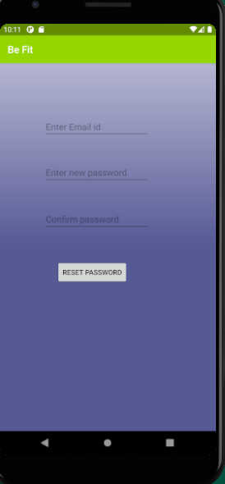
Forgot password Activity
In the Forgot password activity user can enter their credentials in hanging their password.

Slide 9
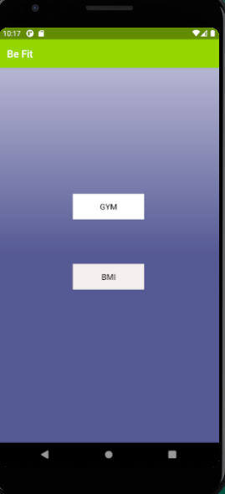
Home Activity
In Home activity, we have added a BMI calculator and the Exercise routine menu starts from the Gym.

