Slide 1
Healthify-NWMSU

Slide 2



Vineetha Yenugula Shiva Rama Krishna Vodnala Naga Anshitha Velagapudi
Swaroopa Thirumalareddy
Soumya Thogiti

Slide 3
Requirements
Choose your app name
Select a color scheme
Customize your app design
Choose the right test device
Install the app on your device
Add the features you want (Key Section)
Test, test, and test before the launch
Publish your app
Promote your app
Ask your users for feedback

Slide 4
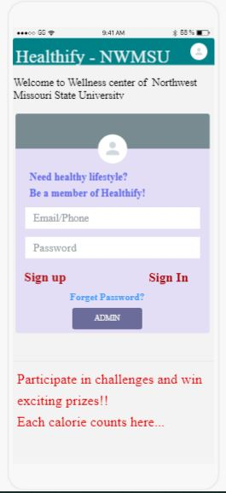
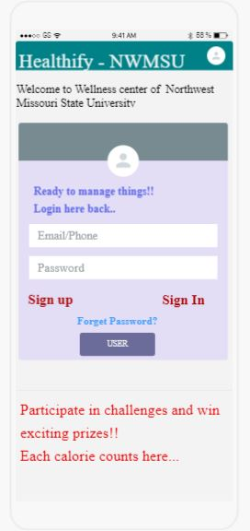
Screens of UI Sketches Login page of user and admin

Slide 5
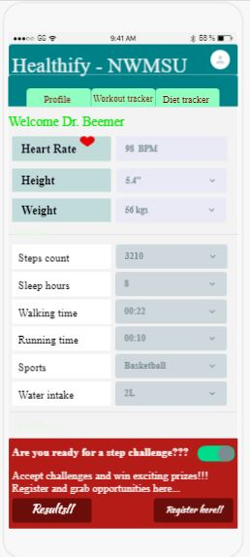
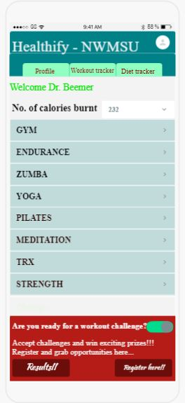
Screens of UI Sketches

Slide 6
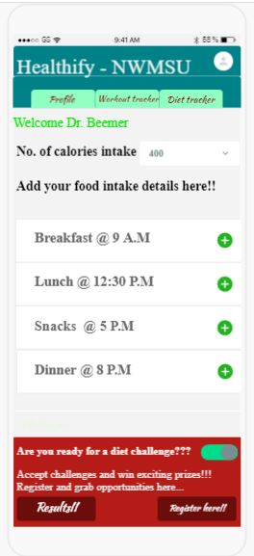
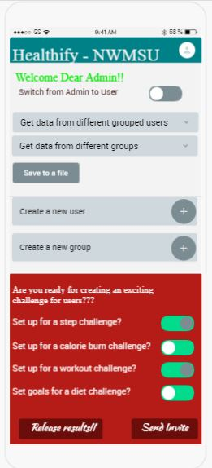
Screens of UI Sketches

Slide 7
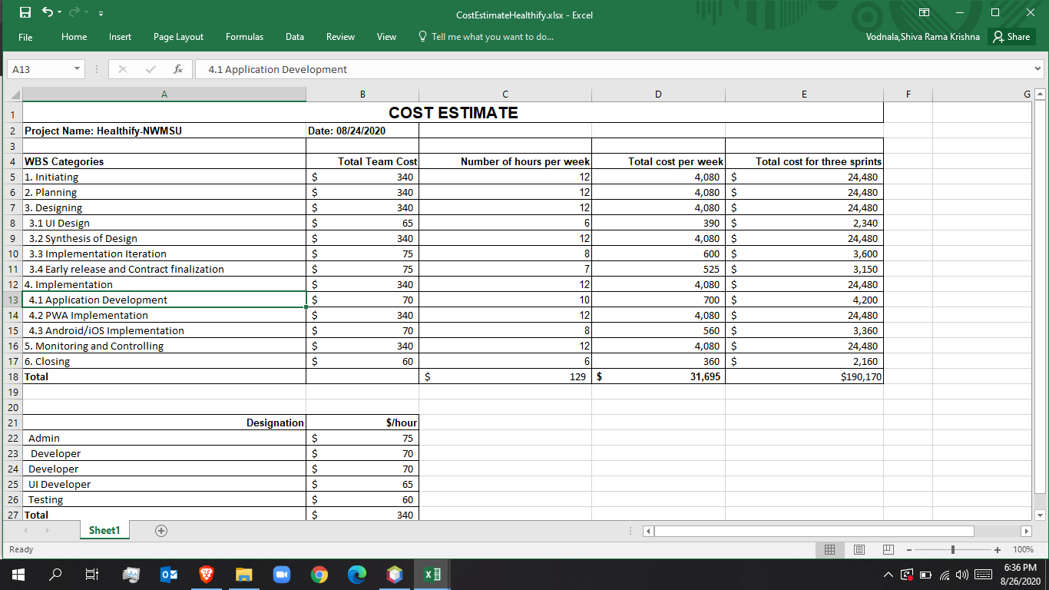
Cost Management

Slide 8
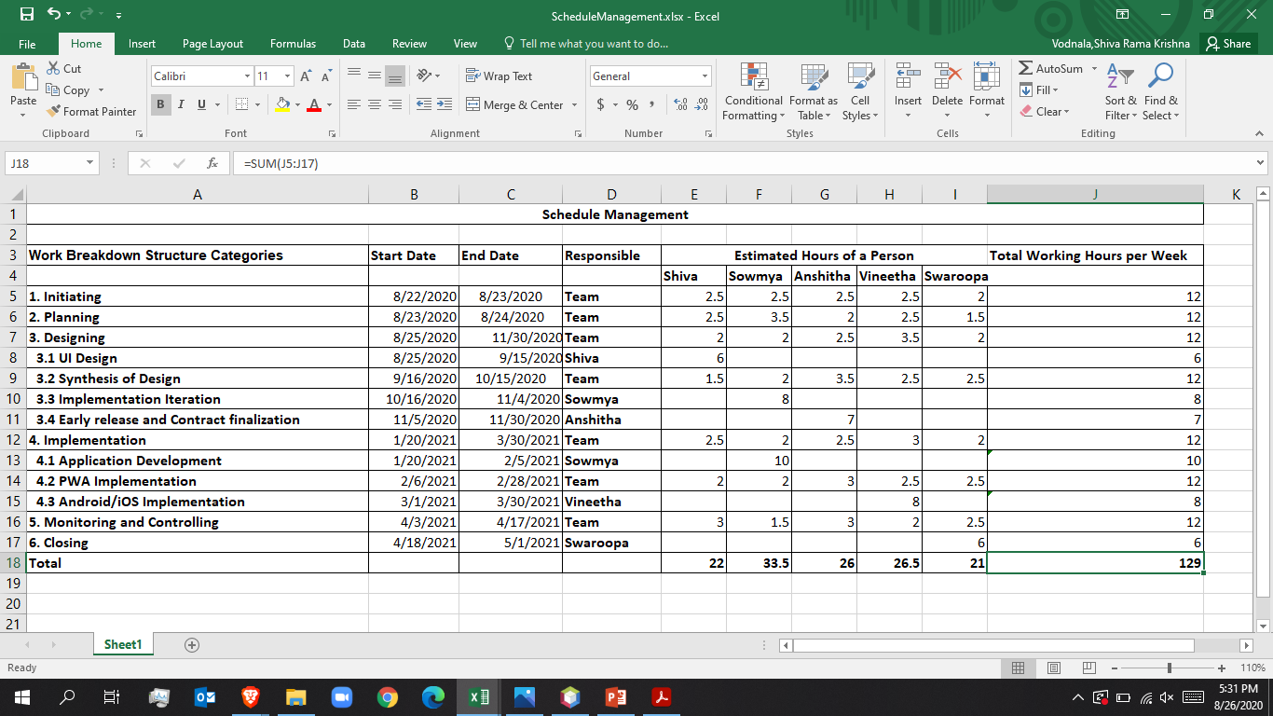
Schedule Management

Slide 9
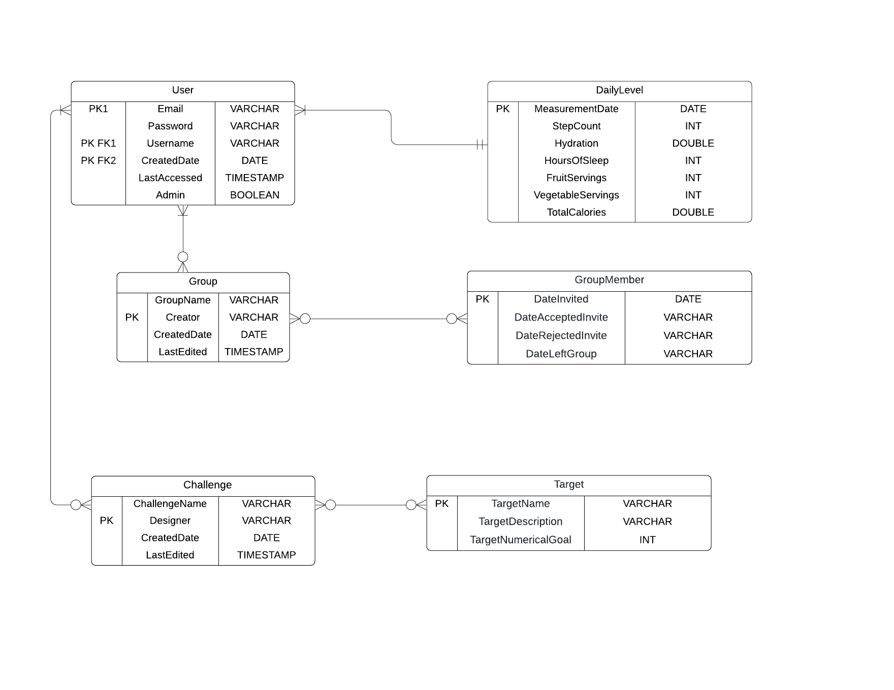
ER Diagram

Slide 10
Thank You

