Slide 1
Healthify-NWMSU

Slide 2


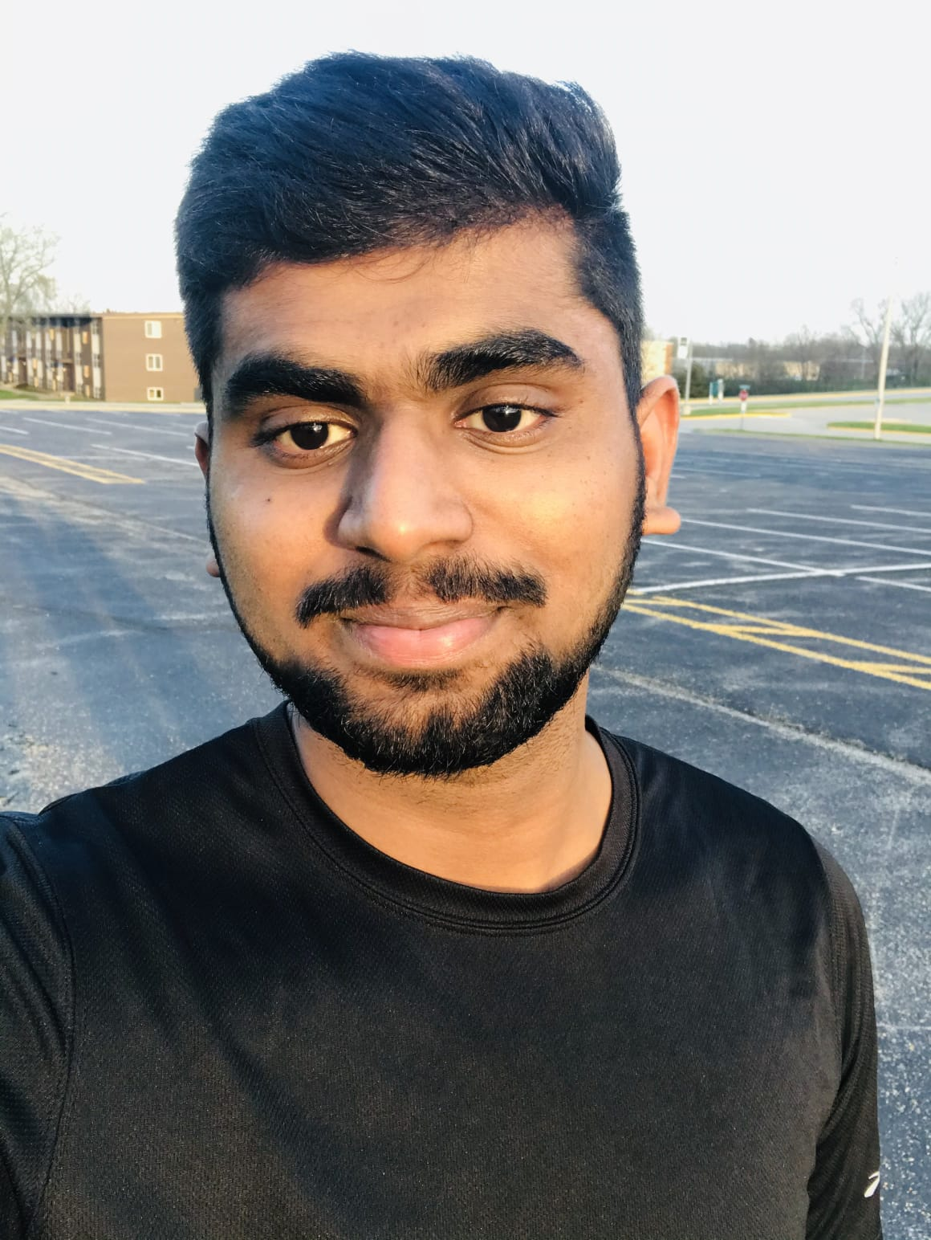
Vineetha Yenugula Naga Anshitha Velagapudi Swaroopa Thirumalareddy
Shiva Rama Krishna Vodnala Soumya Thogiti

Slide 3
Requirements
Choose your app name
Select a color scheme
Customize your app design
Choose the right test device
Install the app on your device
Add the features you want (Key Section)
Test, test, and test before the launch
Publish your app
Promote your app
Ask your users for feedback

Slide 4
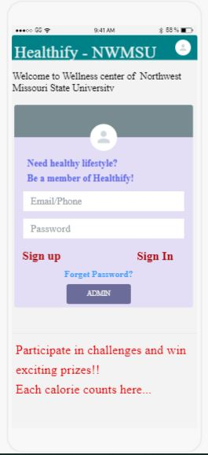
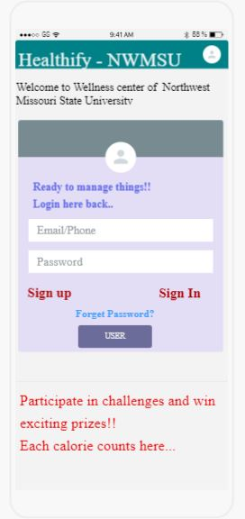
Screens of UI Sketches Login page of user and admin

Slide 5
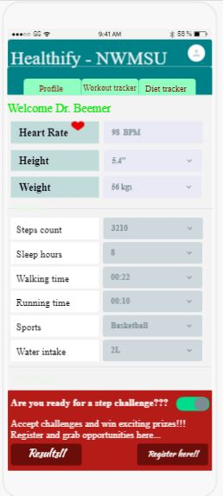
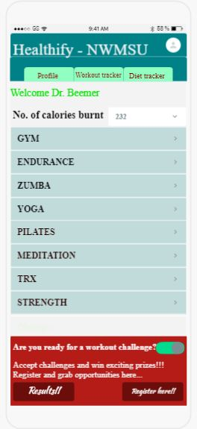
Screens of UI Sketches

Slide 6
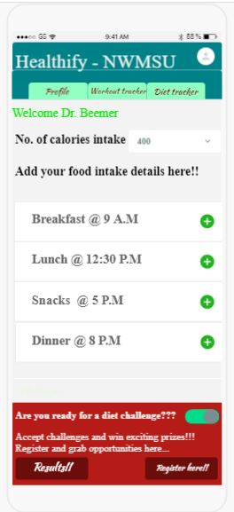
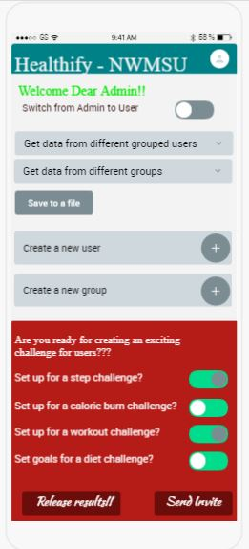
Screens of UI Sketches

Slide 7
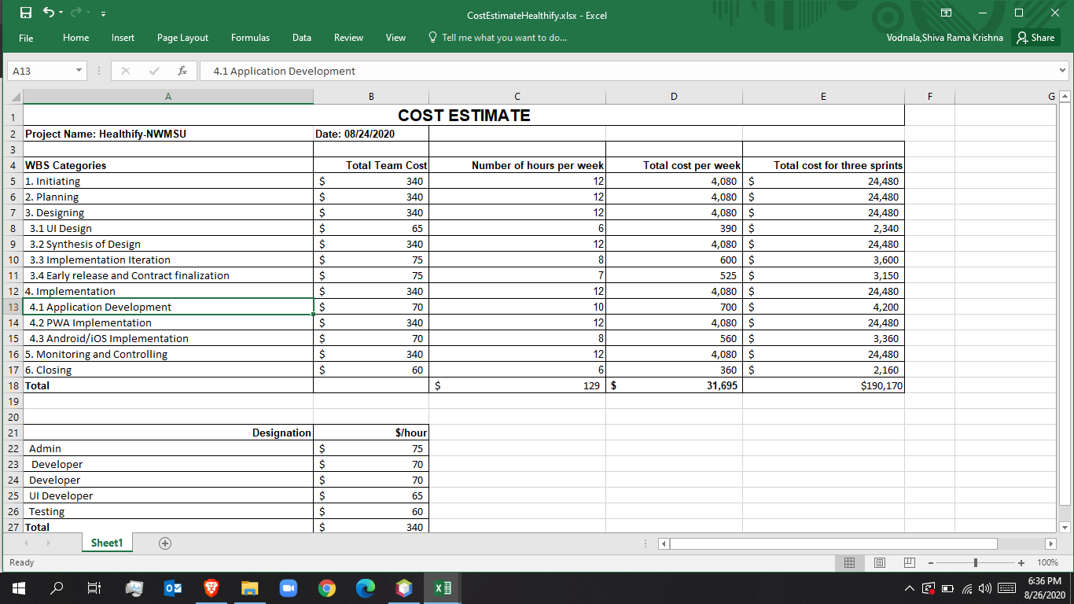
Cost Management

Slide 8
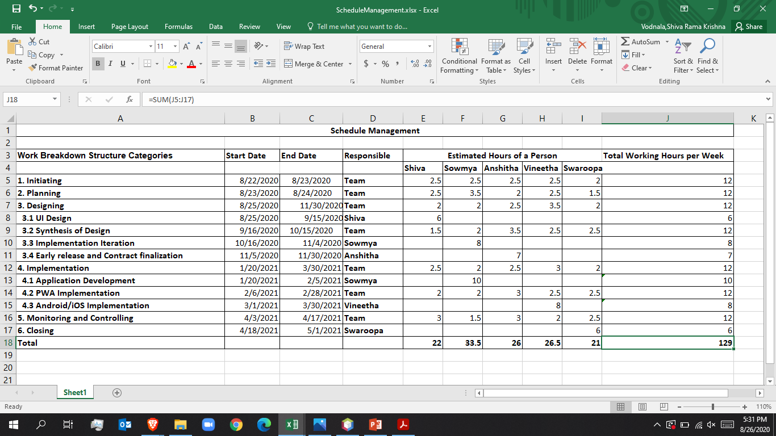
Schedule Management

Slide 9
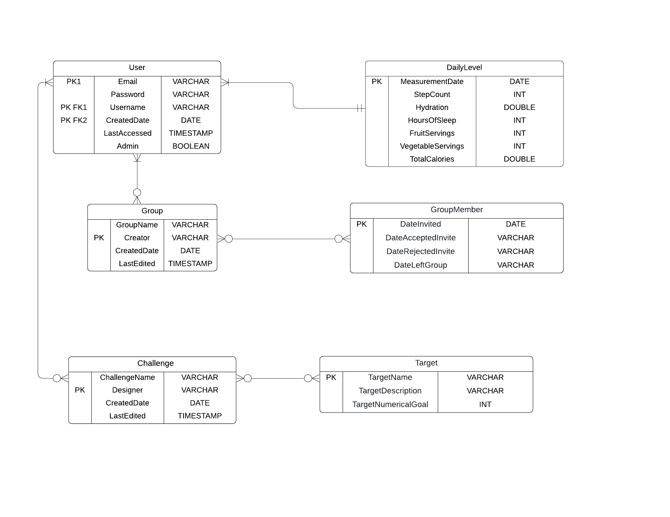
ER Diagram

Slide 10
Acceptance Criteria
The Healthify-NWMSU app will work on all devices like in all android devices ,an iphone SE , an iPad and in all laptops.
Admin is able to view and download all data entered by the user by just selecting the get data intoa file button.
Admin is able to create and manage the user groups by selecting add symbol.
Admin is able to share challenge results with group members by clicking release results button.
Users are able to create and edit data of personal details upon signup.
Users are able to participate in new challenges just by clicking register buttons on each page of challenges.
Users are able to accept or reject group assignents upon receiving mails from the admin invites.
Users are able to view data from past challenges by clicking on the results.
User can access the application only by submitting required details.
Enabling responsive Mobile menu for Tablets and Mobiles.
User can Easily Navigate across different screens.
User can have a clear Clarity and Readability of application buttons.
User can have Responsiveness of drop-down lists.
User can Distinguish the inactive buttons from active buttons.

Slide 11
Benefits
Monitor your diet everyday
Track your footsteps
Track your water intake
Helps in calorie count
Set goals that you can achieve
Create your yoga studio
Easily keep track of your progress
Get free workout ideas
Heartrate tracking
Weight loss progression
Pedometer
Give free health and fitness tips
Keeps you Motivated

Slide 12
Thank You

