Slide 1
Healthify-NWMSU

Slide 2





Sowmya Thogiti Vineetha Yenugula Swaroopa Thirumalareddy
(Admin) (Developer) (Developer)
Naga Anshitha Velagapudi Shiva Rama Krishna Vodnala (Tester) (UI Designer)

Slide 3
Purpose Overview
The Healthify-NWMSU app can incorporate data from thousands of third-party apps that are designed to promote healthier habits from nutrition to fitness.
This app lets you keep all your health and fitness information under your control and in one place on your device.
Healthify-NWMSU is a fitness app that helps users track their diet and weight and set fitness goals.
It is free to download app which allows user to track their calories, steps, manage, view and participate in group challenges.
It helps users to track their food intake and measure calories accurately.

Slide 4
Acceptance Criteria
The Healthify-NWMSU app will work on all devices like in all android devices ,an iphone SE , an iPad and in all laptops.
Admin is able to view and download all data entered by the user by just selecting the get data into a file button.
Admin is able to create and manage the user groups by selecting add symbol.
Admin is able to share challenge results with group members by clicking release results button.
Users are able to create and edit data of personal details upon signup.
Users are able to participate in new challenges just by clicking register buttons on each page of challenges.
Users are able to accept or reject group assignments upon receiving mails from the admin invites.
Users are able to view data from past challenges by clicking on the results.
User can access the application only by submitting required details.
Enabling responsive Mobile menu for Tablets and Mobiles.
User can Easily Navigate across different screens.
User can have Responsiveness of drop-down lists.

Slide 5
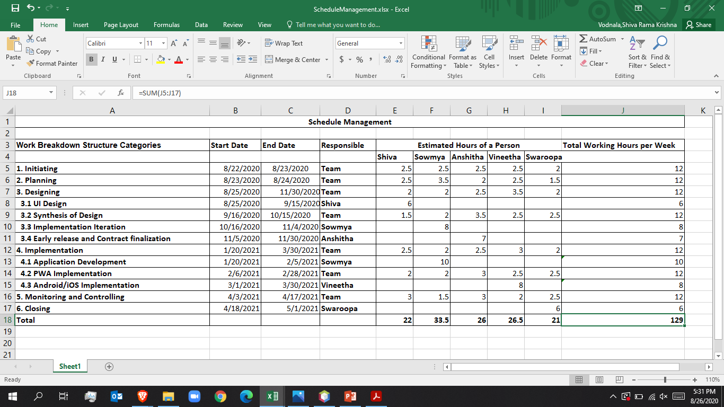
Schedule Management

Slide 6
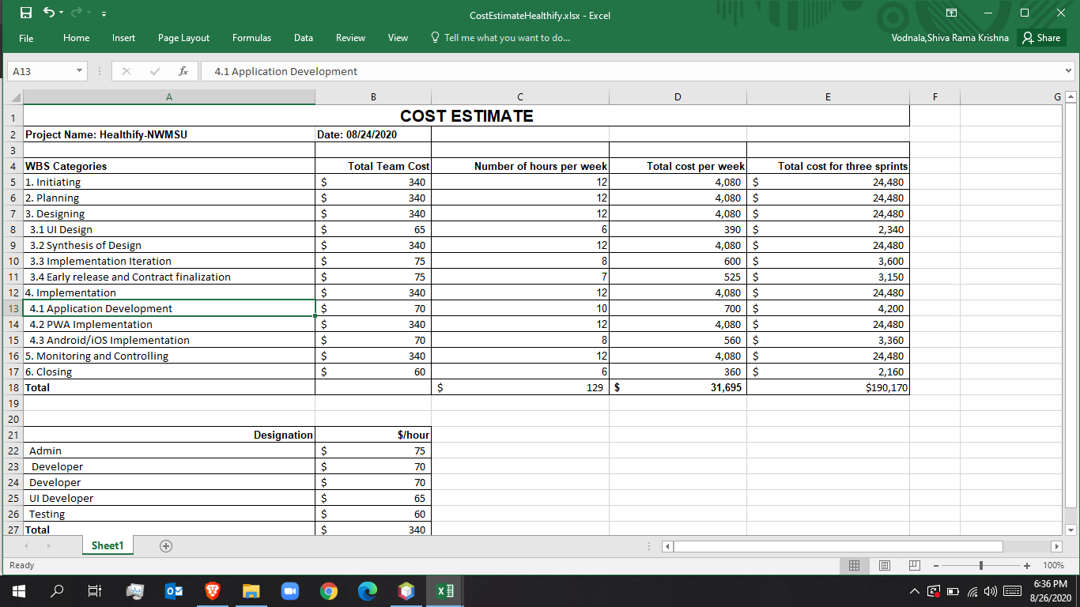
Cost Management

Slide 7
Requirements
Choose your app name
Select a color scheme
Customize your app design
Choose the right test device
Install the app on your device
Add the features you want (Key Section)
Test, test, and test before the launch
Publish your app
Promote your app
Ask your users for feedback

Slide 8
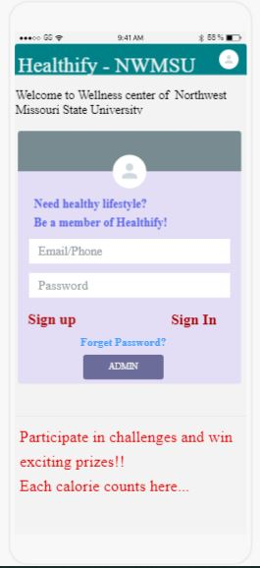
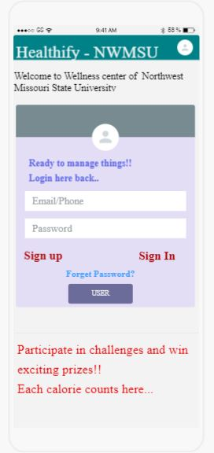
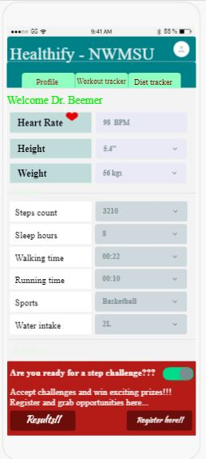
Screens of UI Sketches

Slide 9
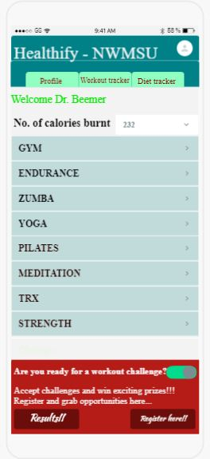
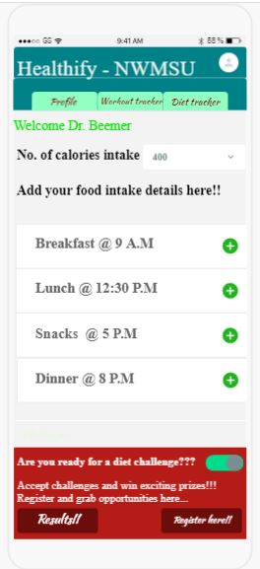
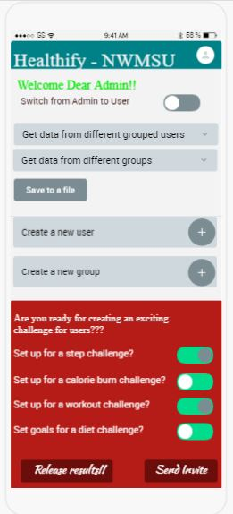
Screens of UI Sketches

Slide 10
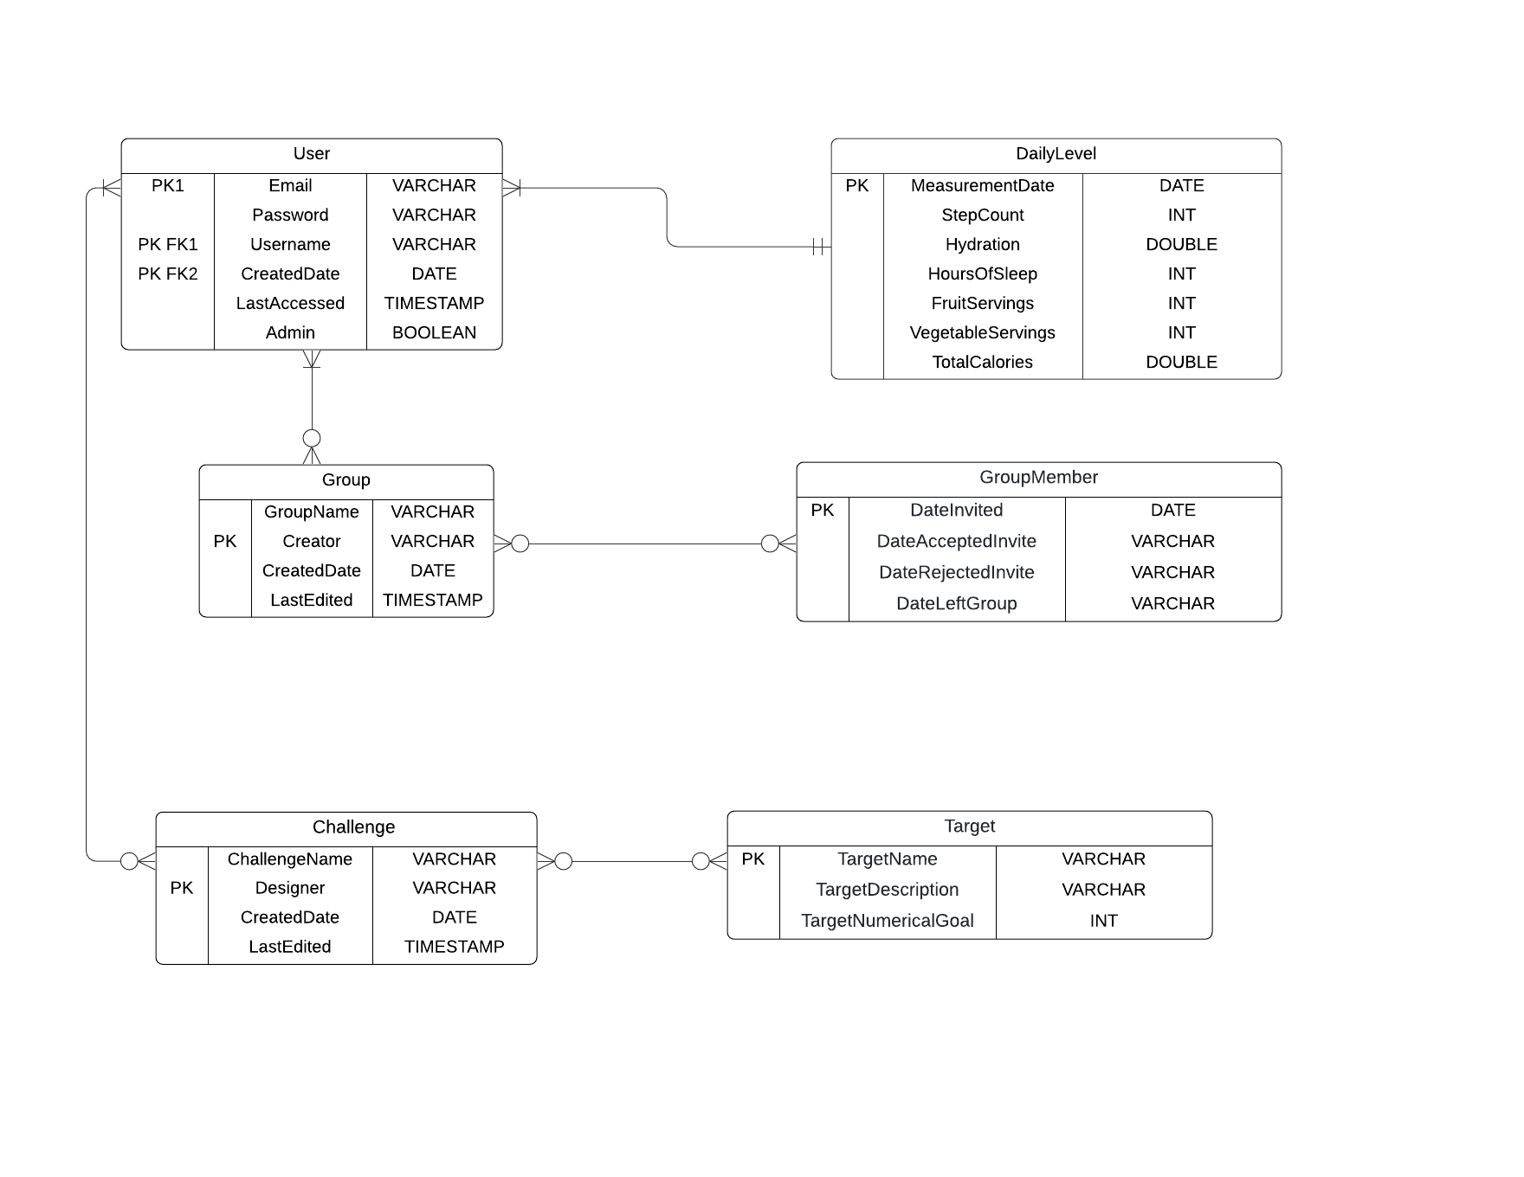
ER Diagram

Slide 11
Benefits
Monitor your diet everyday
Track your footsteps
Track your water intake
Helps in calorie count
Set goals that you can achieve
Create your yoga studio
Easily keep track of your progress
Get free workout ideas
Heartrate tracking
Weight loss progression
Pedometer
Give free health and fitness tips
Keeps you Motivated

Slide 12
References
Jira link: https://sowmyathogiti27.atlassian.net/jira/software/projects/HN/boards/2
FluidUI Link: https://www.fluidui.com/editor/live/
Github Link: https://github.com/sowmyathogiti/Healthify-NWMSU

Slide 13
Thank You

