Slide 1

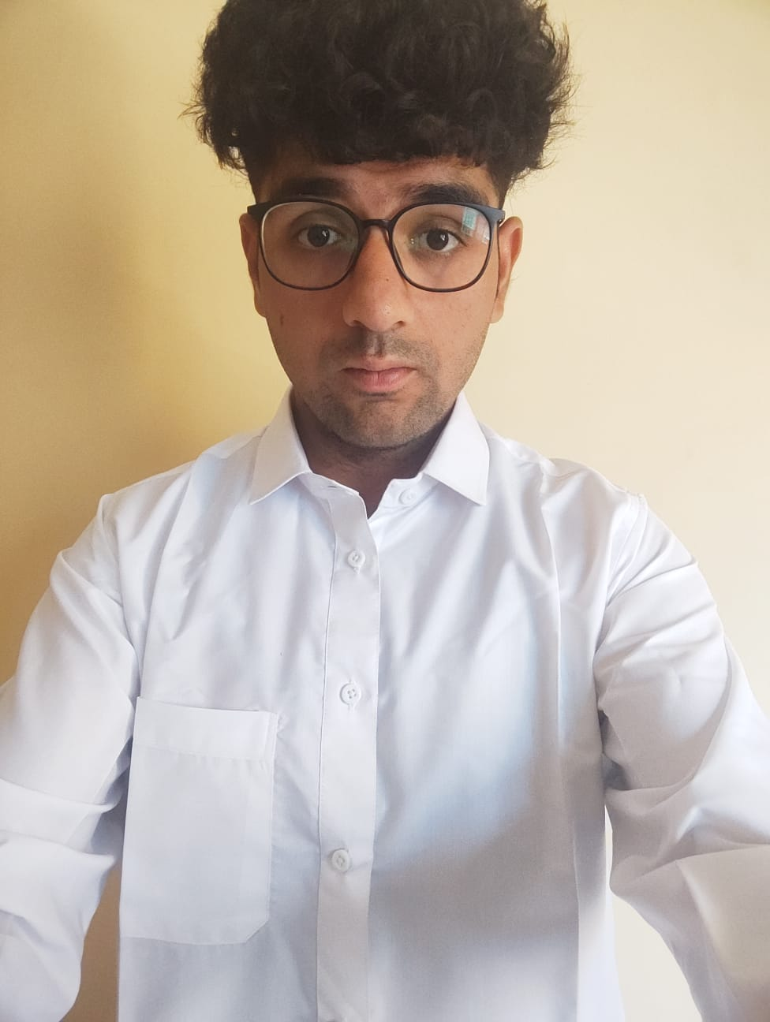
Digital
Portofolio
Neelesh Shukla
20BCE10236

Slide 2
Digital Portfolio
20BCE10060
Introducing
Hey there , I am Neelesh Shukla!
VIT Bhopal University
Page 02 0f 13

Slide 3

About Me
Digital Portfolio
I'm currently in my fourth year at VIT Bhopal University, majoring in Computer Science and Engineering. My academic journey is marked by a keen focus on Java programming ,Python and working on Data Anlaysis where I explore the intersection of code and creativity. Beyond this, my interests in art, as drawing has become a hobby. Additionally, I find solace in the great outdoors, with hiking and camping being a favorite pastime.
Java
Python
MYSQL
Page 03 of 13

Slide 4

Academic History
2017
2019
2024
High School ( Xth ) CBSE
Blue Bells Public School
Percentage: 79.83
Intermediate ( XIIth ) ICSE
Blue Bells Public School
Percentage: 76.2
Under - Graduation Bachelor’s
VIT Bhopal University CGPA : 7.31
Page 04 0f 13

Slide 5


Technical
20BCE10060
Java MySQL HTML CSS
Python
Tableau
Power BI
Page 05 of 13

Slide 6

Courses across B.Tech
20BCE10060
These are the Core Subjects
DSA: Data Structures and Algorithms OS: Operating System
DBMS: Database Management System CN: Computer Networks
Java Advanced Java
Software Testing
DAA : Design and Analysis of Algorithms Python
Page 06 of 13

Slide 7
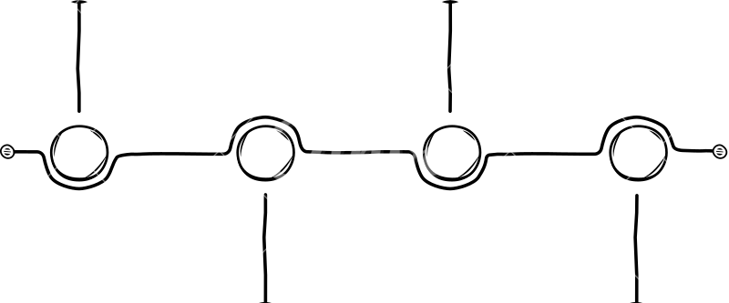
Academic Projects in UG
20BCE10060
Project Exibition 1: Cricket Data Analysis
EPICS :
ASPEN AI
2020
2024
Project Exibition 2: Game Develpement
Capstone :
Early recognition of Parkinson’s Disease
Page 07 0f 13

Slide 8

Project : CRICKET DATA ANALYSIS
Description :
Have used cricket T20 world cup (2022) data to build insights on a best 11 players team that can be used to pick the Best X1.
Technology:
Python , MYSQL, Tableau, PowerBI
Team Project:
3 members
Role:
Data Cleaning and Dashboard Building Using BI Power
Page 08 0f 13

Slide 9
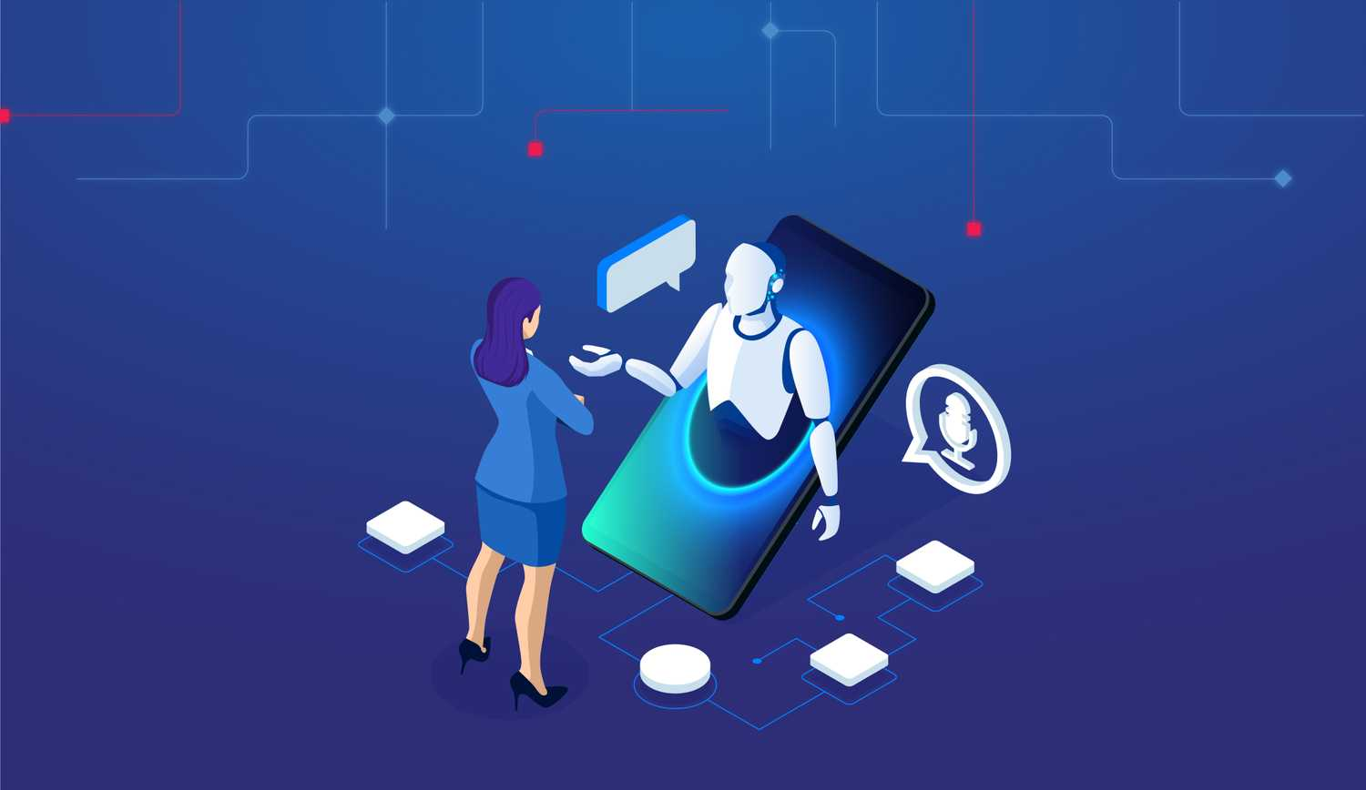
Project : GAME DEVELOPEMENT
Description :
Created Multiple games using Unity with the implementation of C#. The Games were 2D games working in any PC/Laptop some example were Fruit Ninja,Speed Racing , Type Master
Technology:
C# , Unity
Team Project:
5 members
Role:
Fruit Ninja.
Page 9 of 13

Slide 10

Epics : ASPEN AI
Description :
Created an Voice Assistant AI Similar to Alexa Using JavaScript and uploaded it on a website of our own Using Html,Css.
Technology:
HTML, CSS, MySQL, JavaScript
Team Project:
8 members
Role:
Front End Developer
Page 10 0f 13

Slide 11

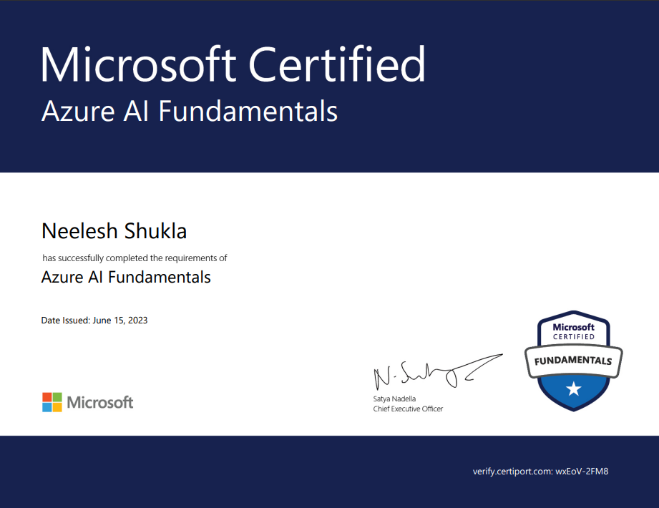

Certificates
Microsoft Certified AI-900:Azure AI Fundamentals
Microsoft Certified AI900 : Azure Funamentals
Page 11 of 13

Slide 12
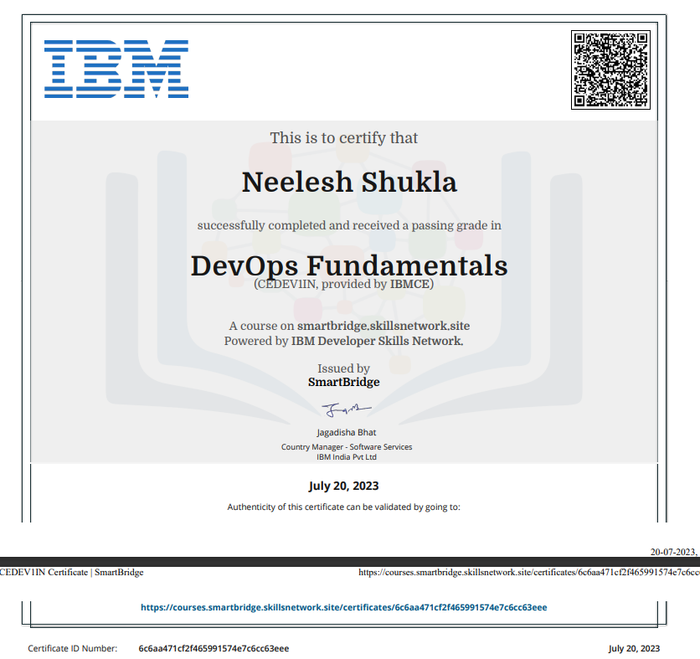
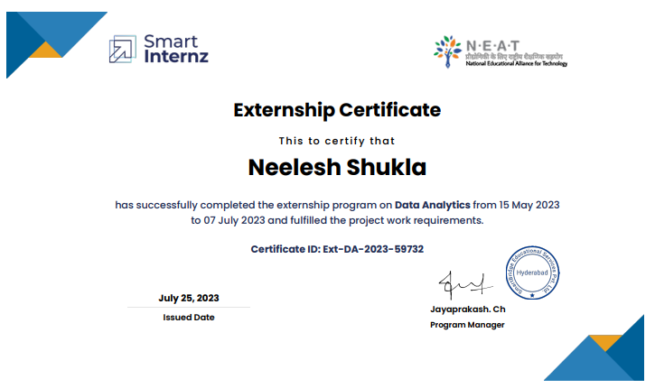
Certificates
Smart-Bridge Data Analysis
IBM DevOps Fundamentals
Page 12 of 13

Slide 13
https://www.linkedin.com/in/neelesh-shukla-6a3758247/
Digital Porfolio
shuklaneelesh26@gmail.com
@neele_sh_ukla
https://github.com/neeleshshukla
https://leetcode.com/user1947Le/https://
https://drive.google.com/file/d/1YHxHreuLc6Hrz4gg2G2Qv3y94yuUMdwX/view?usp=drive_link
Connect With ME

