Slide 1
Enterprise Self-Healing Automation
Architecture, Concurrency & CI/CD Stability Report
Playwright for Java 1.61 · Java 21 · TestNG 7.11 · Jenkins CI · OrangeHRM
Target System: OrangeHRM Enterprise Portal | Hardware: AMD Ryzen 5 7530U (6C/12T), 16GB RAM | Status: 100% Green (6/6 Passed)

Slide 2
PLAYWRIGHT-JAVA AUTOMATION
Executive Problem & Strategic Solution
Challenges in Traditional Automation
• Brittle Locators: Minor DOM changes (class, ID, tag) break scripts with TimeoutError.
• CI/CD False Positives: Builds fail on harmless UI updates, halting deployment pipelines.
• Single-Thread Bottleneck: Sequential suite execution took ~3m 03s, underutilizing multi-core CPUs.
• SPA Race Conditions: Double-clicks on OrangeHRM client-side router aborted route changes.
Engineered Architecture
• Self-Healing Engine: Thread-safe singleton evaluating sequential candidate fallbacks.
• Persistent Cache: Verifies and saves healed selectors to healed_locators.json for instant reuse.
• ThreadLocal Parallelism: Independent Playwright/BrowserContext lifecycles per worker thread.
• Deterministic Synchronization: Replaced brittle exact-text waits with resilient SPA route transitions.

Slide 3
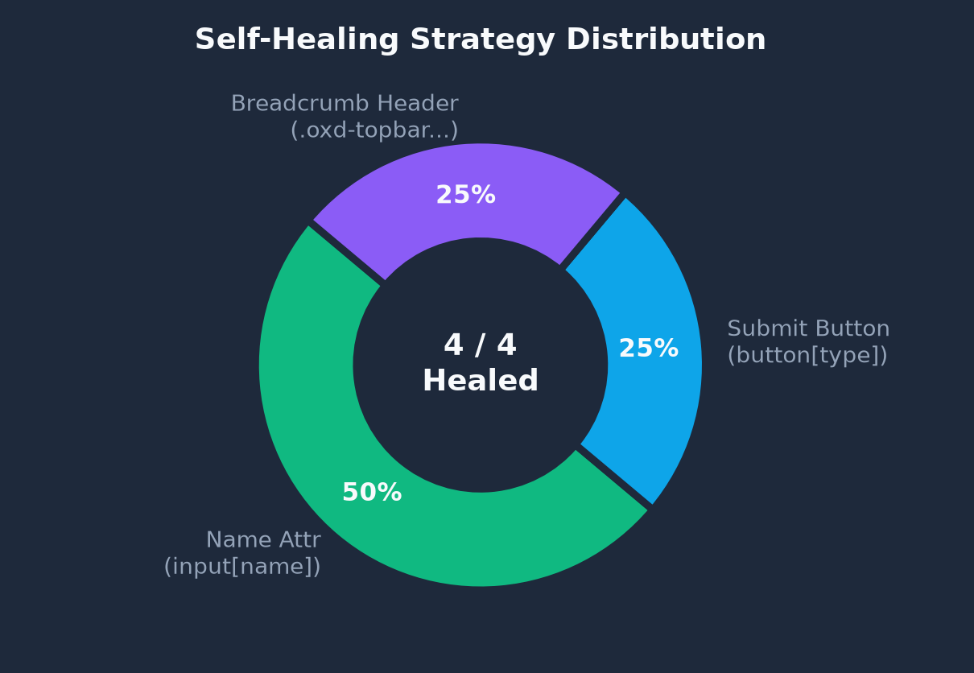
PLAYWRIGHT-JAVA AUTOMATION
Self-Healing Engine: Heuristic Resolution & Recovery Graph
4-Tier Selector Recovery Waterfall
✓ Tier 1 - Cache Inspection:
Queries memory and healed_locators.json for proven selectors.
✓ Tier 2 - Primary Attempt:
Attempts default locator with non-crashing timeout interception.
✓ Tier 3 - Fallback Waterfall:
Sequentially tests alternative attributes (name, type, role, relative CSS).
✓ Tier 4 - Verification & Commit:
Executes user action, writes healed locator to JSON, logs telemetry.
100% Recovery Rate (4 / 4 Elements Healed)
Zero test crashes. All broken locators healed within SLA and persisted.

Slide 4
PLAYWRIGHT-JAVA AUTOMATION
Jenkins Pipeline Stability & Health (Build #255 - #257)
Build #255
FAILED (2 Failures / 5 Tests)
Logout timeout & PIM routing collision
Build #256
SUCCESS (6/6 Passed)
Integrated Self-Healing Engine + BasePage
Build #257
SUCCESS (6/6 Passed in 161s)
Fully stabilized, cached locators, 100% green
Test Class | Test Method | Status | Resolution Highlights
LoginTest | verifyOrangeHRMLogin | PASSED | Standard credentials authentication
LogoutTest | verifyOrangeHRMLogout | PASSED | Targeted .oxd-userdropdown-tab with fallback retry
SelfHealingTest | testSelfHealingEngineWorkflow | PASSED | 4 broken selectors dynamically healed & saved
CreateBuzzPostTest | verifyCreateBuzzPost | PASSED | Timestamped post submission & feed sync
DeleteBuzzPostTest | verifyDeleteBuzzPost | PASSED | Targeted post deletion with confirmation modal
PIMEmployeeTest | createVerifyAndDeleteEmployee | PASSED | E2E Employee creation, photo upload & cleanup

Slide 5
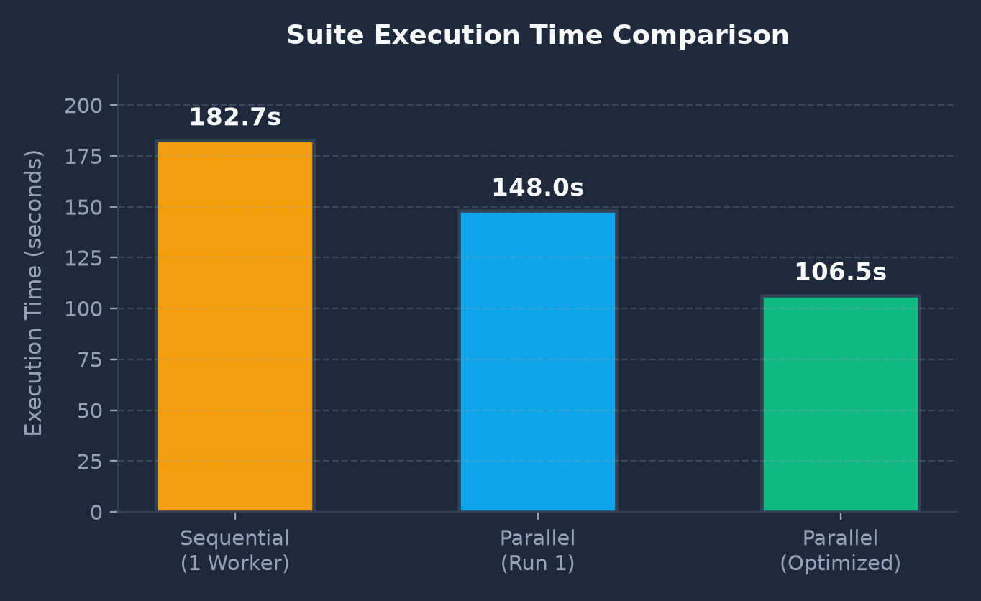
PLAYWRIGHT-JAVA AUTOMATION
ThreadLocal Parallel Execution & Benchmark Graph
Sequential Duration
182.7s (3m 03s)
Parallel Duration
106.5s (1m 46s)
Thread-Safe Concurrency Key Highlights
• ThreadLocal Isolation: tlPlaywright, tlBrowser, tlContext, and tlPage guarantee zero state bleed.
• Automatic Teardown: BaseTest.tearDown() invokes .remove() on all ThreadLocal variables.
• Significant Speedup: Up to 76.2 seconds saved (-42% overall duration reduction).
• Deterministic Thread Pool: Fixed thread-count=3 prevents CPU thread thrashing.

Slide 6
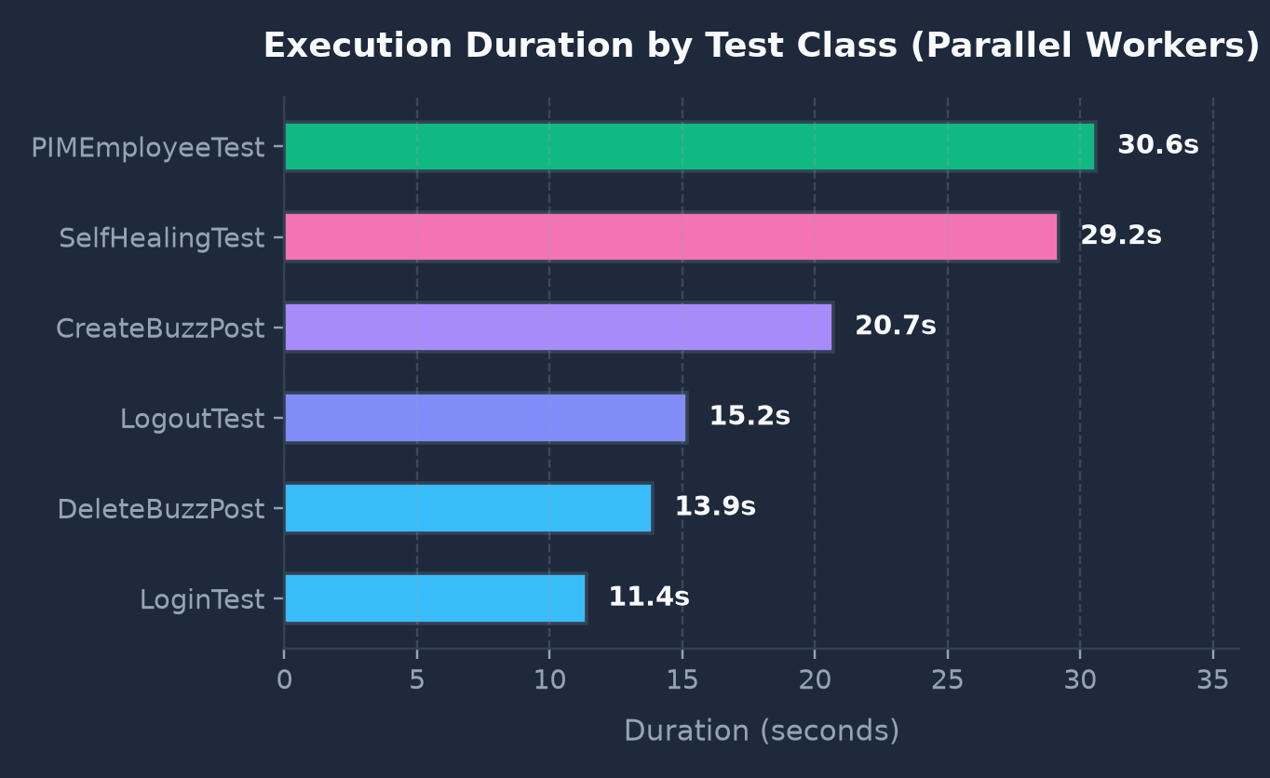
PLAYWRIGHT-JAVA AUTOMATION
Test Execution Duration Breakdown & Critical Path Analysis
Critical Path Insights
• PIMEmployeeTest is the Critical Path (30.6s):
Because PIM tests perform 14 sequential steps (add, personal details, photo, verify, delete), the parallel suite cannot finish faster than this single test.
• Balanced Execution Distribution:
Login (11.4s) and DeleteBuzz (13.9s) finish rapidly on Workers 1 & 2, freeing threads to pick up Buzz Post creation and Logout.
• Zero Network Bottleneck Contention:
Independent BrowserContexts ensure zero HTTP cookie collision during simultaneous OrangeHRM logins.

Slide 7
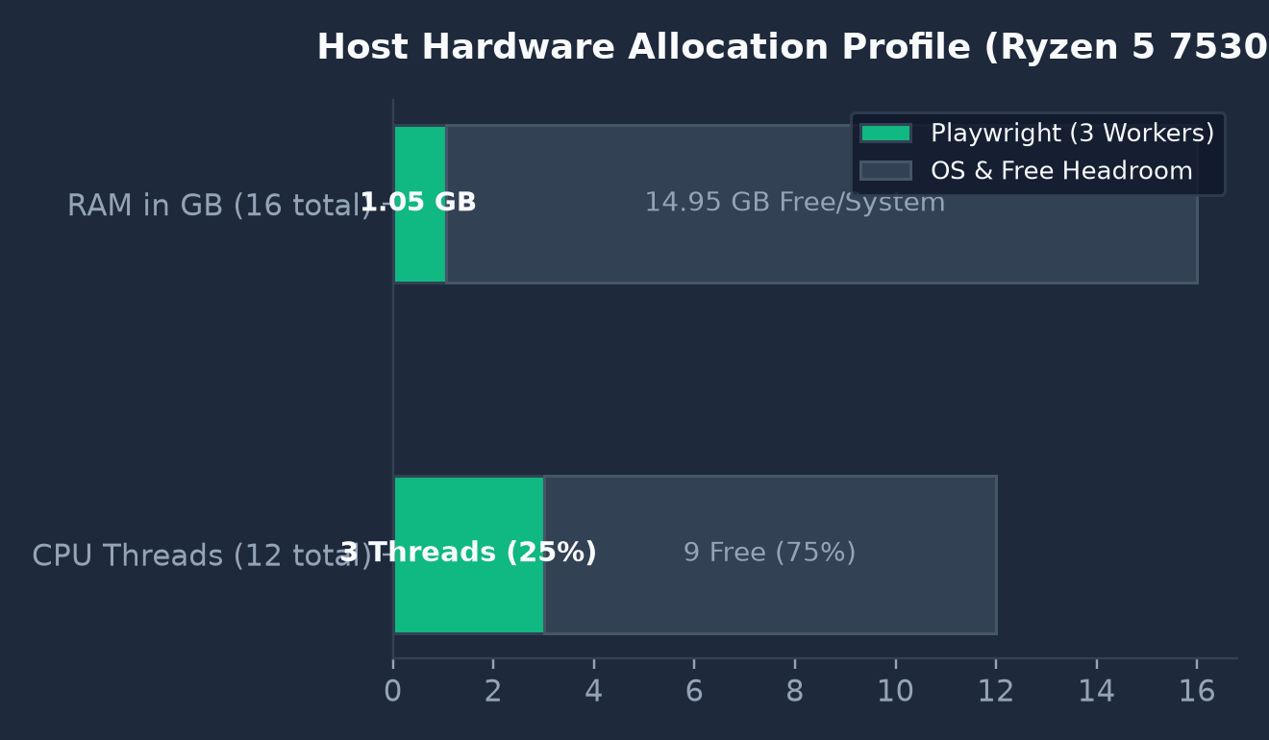
PLAYWRIGHT-JAVA AUTOMATION
Hardware & Computational Resource Profiling
AMD Ryzen 5 7530U (6C / 12T)
25% Thread Utilization: 3 worker threads active. 9 threads remain completely free for OS scheduler and browser rendering processes.
16 GB DDR4 Physical RAM
Lightweight Footprint: 3 headless Chromium instances consume ~1.05 GB total. Over 4.7 GB RAM remains free, eliminating disk swap paging.
Process Architecture
13-15 child OS processes spawned cleanly across Playwright Node.js driver, Blink renderers, and GPU compositors.

Slide 8
PLAYWRIGHT-JAVA AUTOMATION
Strategic Recommendations & Maintenance Roadmap
1. Centralized Configuration
Extract URLs, admin credentials, and default timeouts into src/test/resources/config.properties for multi-environment switching.
2. Production Logging Framework
Add Logback (ch.qos.logback:logback-classic) to replace SLF4J warnings and stream structured timestamped logs to files.
3. Instant Failure Screenshots
Capture full-page .png screenshots at the exact instant of test failure in BaseTest.tearDown() for instant visual triage in Jenkins.
4. Allure Reporting Integration
Add allure-testng to generate interactive dashboards, historical flakiness trends, and embedded failure artifacts.

