Slide 1
Content
Business Case
(3198 counties across the U.S. were analyzed for poverty rate)
Data Acquisition
(Data was obtained in CSV format)
Data Preparation
(Data Cleaning through Python)
Data Visualization
(Descriptive Statistics through Python)
Exploratory Data Analysis
(Independent features selected for further analysis)
Feature Significance Testing
(Performed Feature Importance for Gradient Boosting)
Evaluation
(Applied Correlation for Numeric Variable)
Conclusion
(Predictive Analysis)
Operationalisation
(Prescriptive Analysis)
Notes:
Business case- data acquisition- data preparation- data visualization- exploratory data analysis- hypothesis modeling- evaluation- conclusion- operationalization

Slide 2



Data Preparation
Total of 3198 records
No Duplicate values found in dataset
14 variables with > 0% and < 5% missing values
5 variables with > 5% and < 20% missing values
2 variables with > 20% missing values

Slide 3
Exploratory Data Analysis
Predictor (Y) Variable
NOISE FEATURES
FEEDER/
CHEATER
INDEPENDENT
Redundant
Missing values
Poverty Rate
Row ID
None
Area rucc
Urban influence
Economic typology
% Civilian labor
Unemployment rate
% Uninsured adults
% Uninsured children
% Female
% below 18
% over 65
% Hispanic
% non-Hispanic African American
% Non-Hispanic white
% Native American
% Asian
% without H/S diploma
% with some college
% with bachelors or higher
Birth rate per 1k
Death rate per 1k
% adult obesity
% adult smoking
% diabetes
% low birthweight
% physical inactivity
Air pollution particulate matter
Motor vehicle crash death rate per 100k
Pop per dentist
Pop per pcp
yr
None
% Female
% below 18
% over 65
% Hispanic
% non-Hispanic African American
% Non-Hispanic white
% Native American
% Asian
% adult obesity
% adult smoking
% diabetes
% low birthweight
% physical inactivity
Air pollution particulate matter
Motor vehicle crash death rate per 100k
Pop per dentist
Pop per pcp

Slide 4
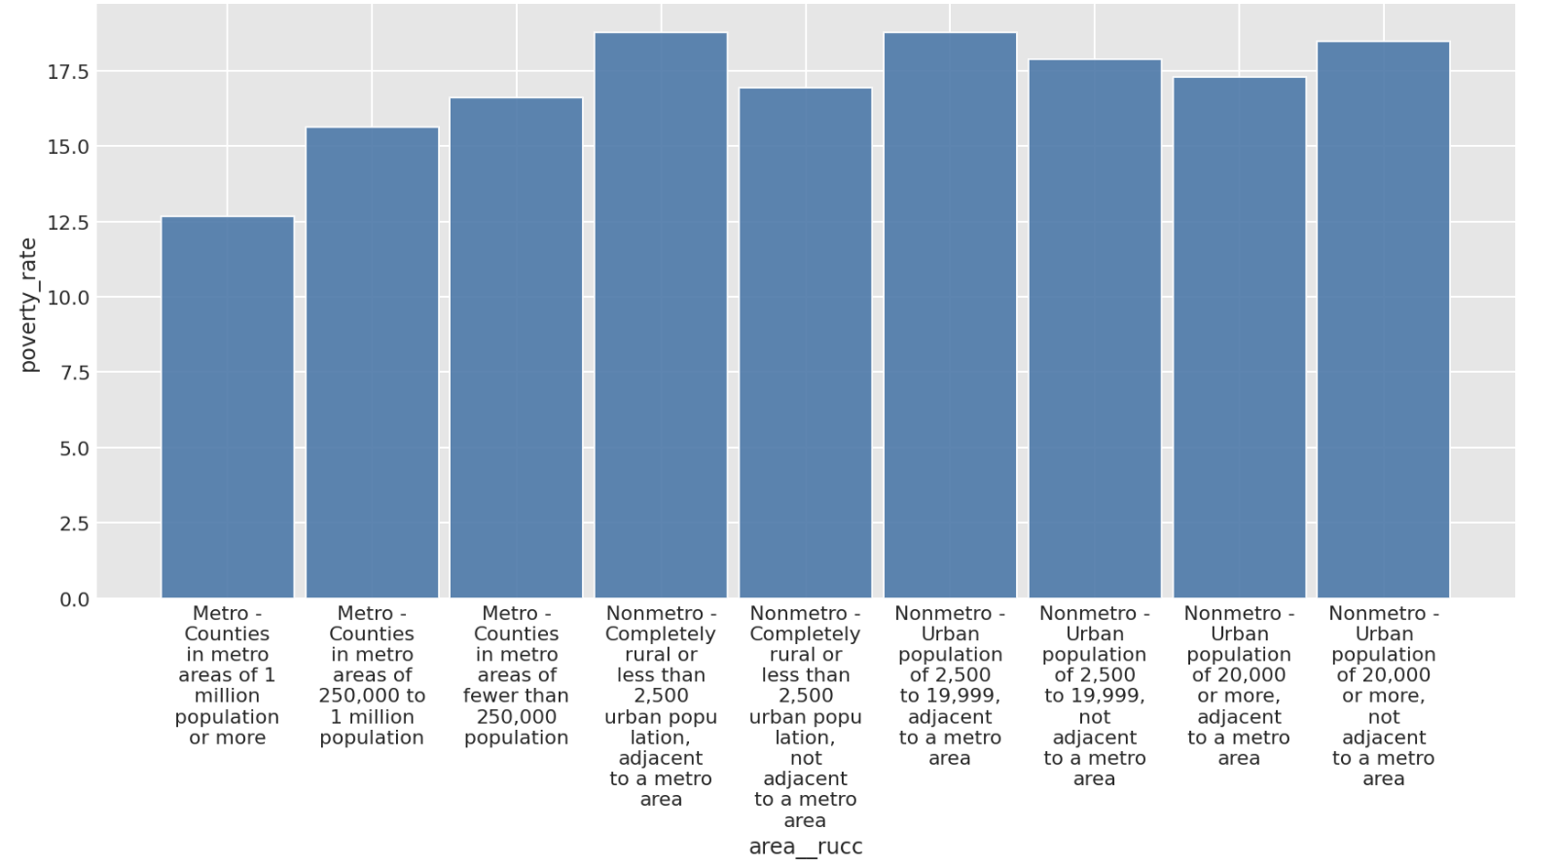
Poverty Rates by Rural-Urban Continuum Codes
Poverty rates for different counties based on the population size of their metro area is roughly the same (~17.5%), except for Large metro area with at least 1 million residence or more (12.5% poverty rate)

Slide 5
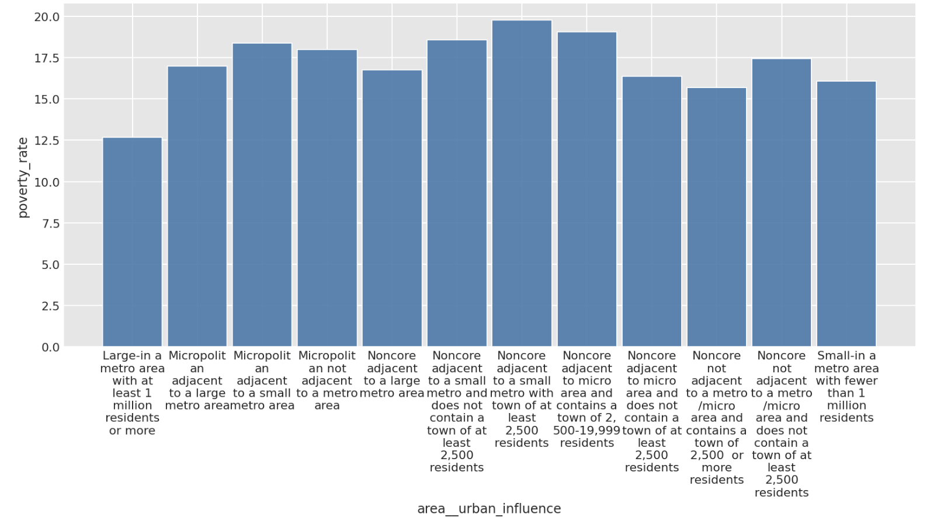
Poverty Rates by Urban Influence
Poverty rate based on urban influence is roughly the same (~17.5%), except for metro area with at least 1 million residents (~12.5%)

Slide 6
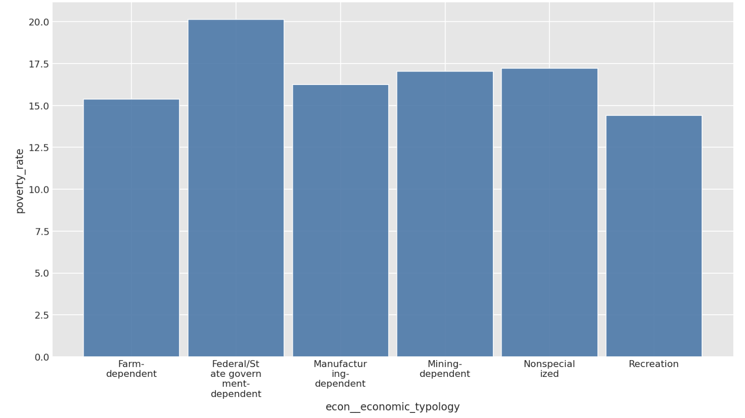
Poverty Rates by Economic Typology
Poverty rate for different economic typology is roughly the same (from 15 to 17.5%), except for Federal/State government dependent (20%)

Slide 7
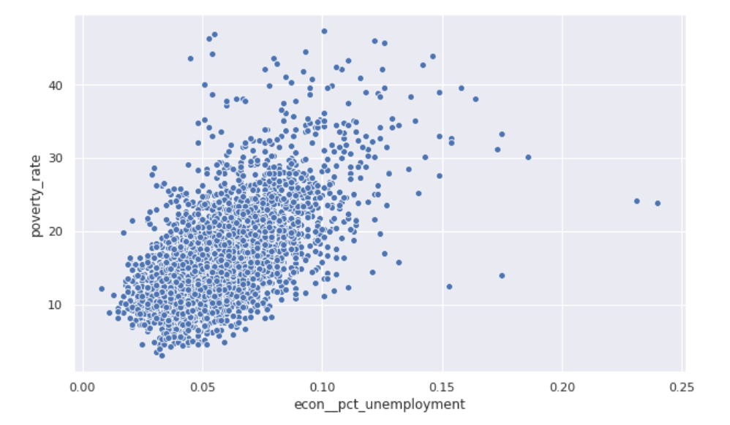
Poverty Rate based on Unemployment Rate
Counties that have higher unemployment rate tend to have higher poverty rate

Slide 8
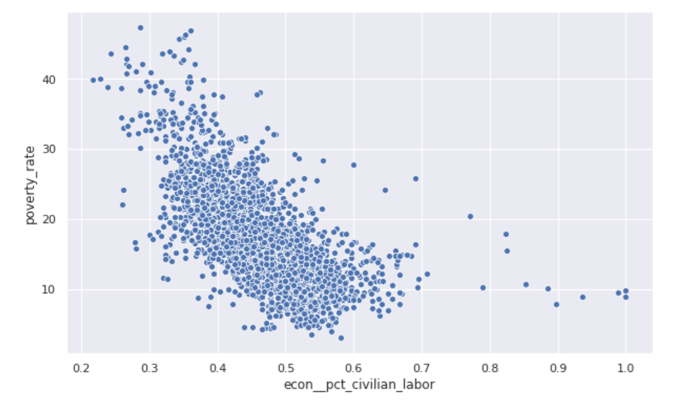
Poverty Rates based on Percent of Civilian Labor
Counties that have higher percentage of people in the civilian labor force tend to have lower poverty rates

Slide 9
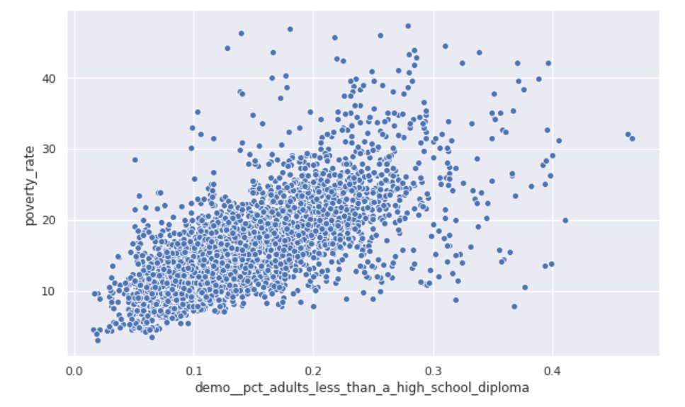
Poverty Rate based on Percent without a High School Diploma
Counties with a higher percentage of people without a high school diploma tend to have higher poverty rate

Slide 10
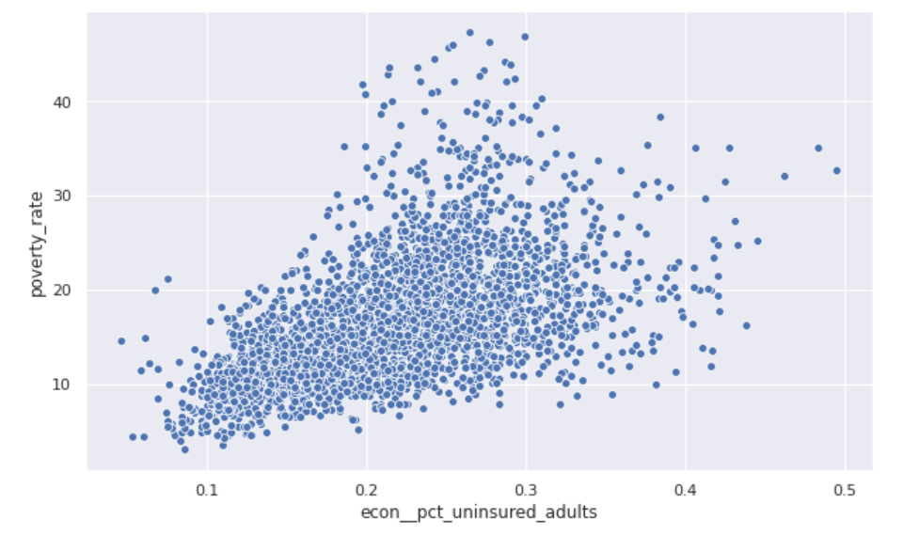
Poverty Rate based on Percent of Uninsured Adults
Counties that have a higher percentage of people without insurance tend to have higher poverty rate

Slide 11
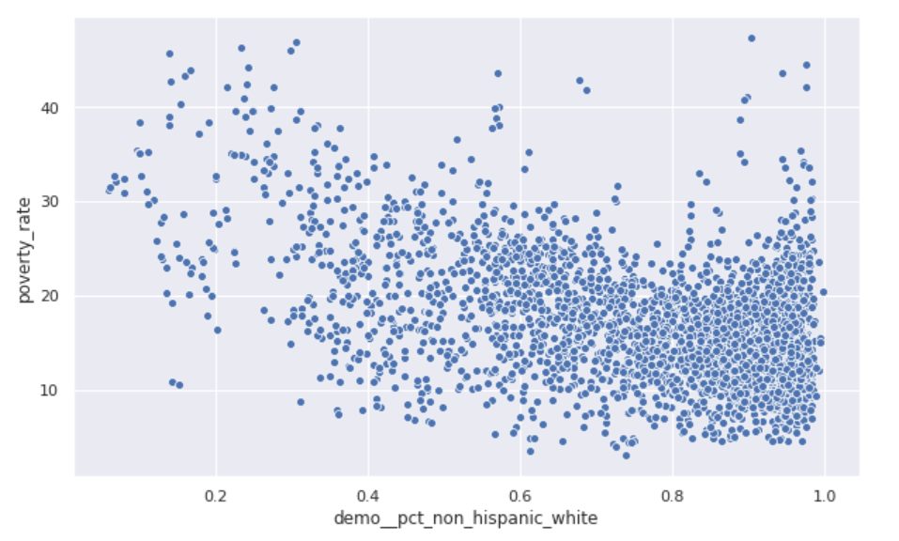
Poverty Rate based on Percent of Non-Hispanic White population
Counties that have higher percentage of people who are non-Hispanic whites have lower poverty rates

Slide 12
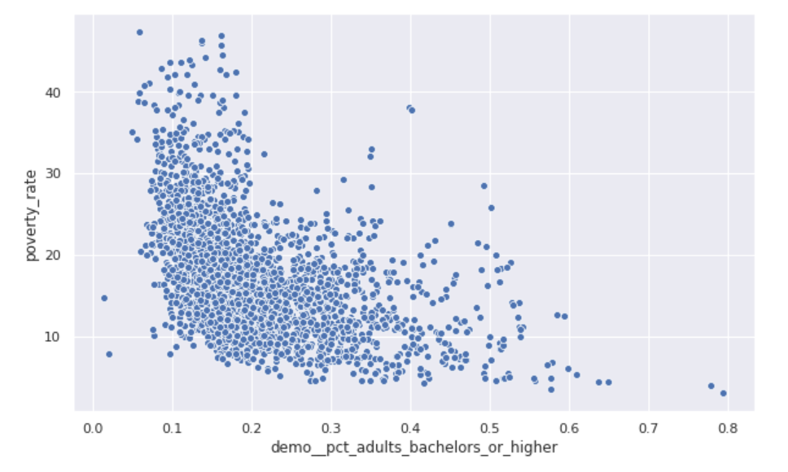
Poverty Rates based on Percent with at least a Bachelors Degree
Counties that have a higher percentage of college graduates tend to have lower poverty rates

Slide 13
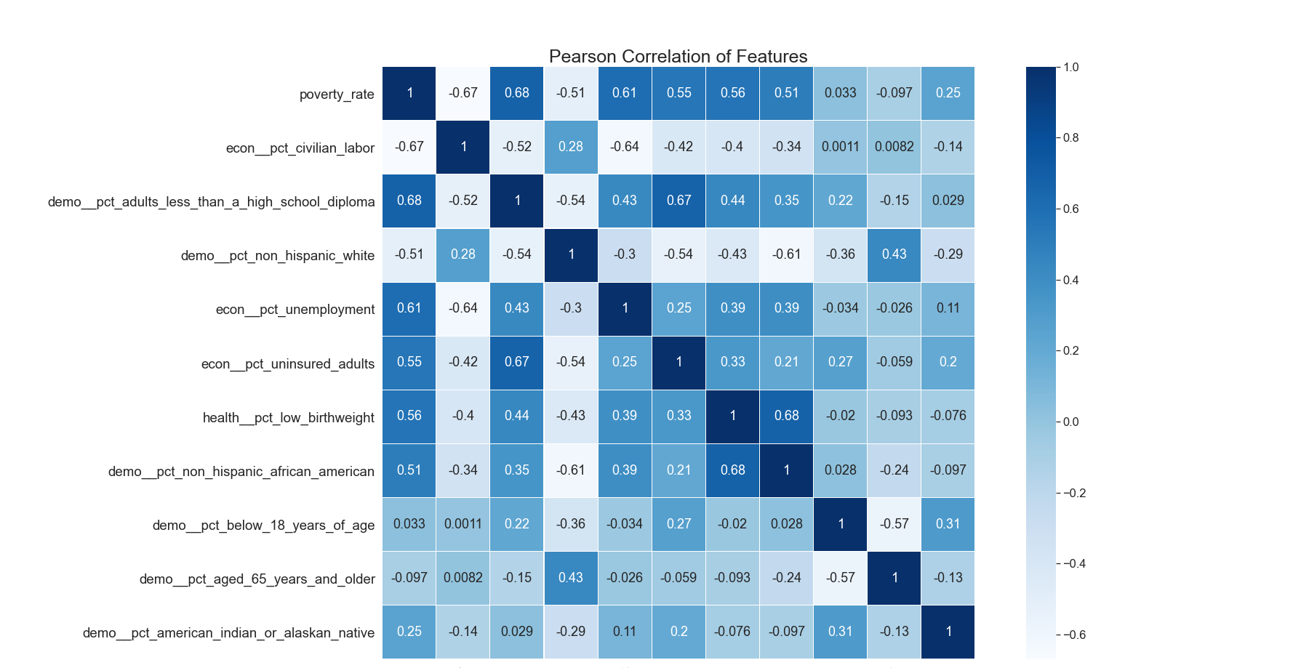

Slide 14
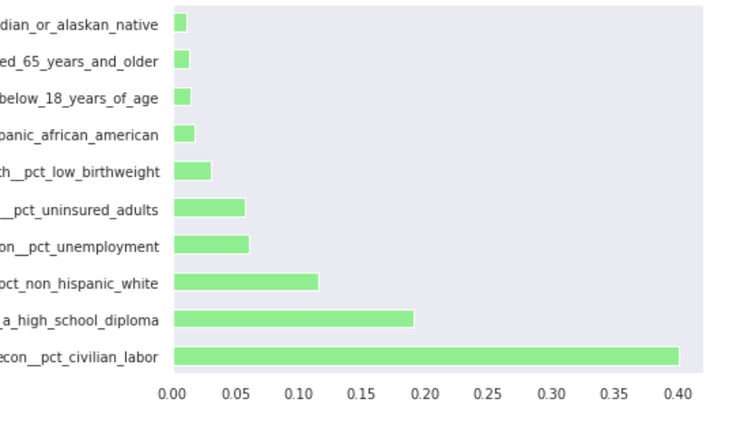
Feature Importance
5 most important features:
Percent of citizens in the Civilian Labor Force
Percent of citizens without a high school diploma
Percent of citizens who are non-Hispanic white
Percent of citizens who are unemployed
Percent of adults who are uninsured

